Slide 1
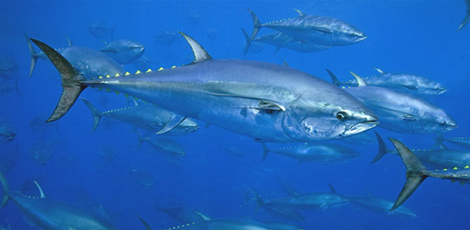
BFT Management Strategy Evaluation (MSE)
Panel 2
ICCAT Commission Meeting November 2022
References
Splash Page: https://iccat.github.io/abft-mse/ with Shiny Apps and quilt plots
Decision Guide (PA2_BFT_MSE_OCT_02_ENG) Atlantic Bluefin Tuna MSE – Final Results & Decision Guide Package

Slide 2
Decision Points before Panel 2
Minimum TAC change: Do or do not require a minimum threshold for a TAC change before one occurs, of up to 100 t for the West management area and up to 1000 t for the East management area.
Operational management objective for Stock Status: 60%, 65% or 70% probability of occurring in the green quadrant (SSB≥SSB_{MSY} & U < U_{MSY}) of the Kobe plot in year 30 of the projection period (PGK).
Management cycle length: 2- or 3-yr TAC setting intervals.
Management procedure type: BR or FO.

Slide 3
Decision point 1: Do or do not adopt a minimum TAC change threshold from one management cycle to the next. If adopted, specify a minimum TAC change of up to 100 t for the western management area and up to 1000 t for the eastern management area.
Strategic considerations:
- Specifying minimum change in TAC could help to ease administrative burden because MP-determined TAC increases and
decreases of less than the minimum level would be disregarded
- 100t-west and 1000t-east minimum TAC thresholds had very minor impacts to the performance statistics.
- Because of this minor impact, the remaining results for Decision points #2-4 incorporate a minimum TAC change threshold
- Any lower values (e.g., within the ranges 0-99 t and 0-999 t) would be similar and are thus viable options.
Table 3. Averaged over all CMPs, PGK targets and 2 and 3-year variants, the percentage difference in all primary performance statistics is quite low, except for VarC, which is higher with the minimum threshold. This is not unexpected given that, when a change in TAC is made, such change needs to be greater with the 100/1000 t thresholds.

Slide 4
Decision point 2: Operational management objective for Stock Status: 60%, 65% or 70% probability of occurring in the green quadrant (SSB ≥ SSB_{MSY} & U < U_{MSY}) of the Kobe plot in year 30 of the projection period (PGK).
Strategic considerations:
PGK of 60% has heavier fishing pressure and entails a higher probability of overfishing and/or being overfished, relative to PGK 70%, which has lower fishing pressure.
 | West |  |  |  | East
 | AvC10 (50%) | AvC30 (50%) | VarC (50%) | LD (15%) | AvC10 (50%) | AvC30 (50%) | VarC (50%) | LD (15%)
PGK 60% | 2.75 | 2.50 | 13.18 | 0.41 | 48.59 | 39.39 | 17.88 | 0.43
PGK 65% | 2.66 | 2.38 | 12.99 | 0.42 | 46.41 | 37.73 | 17.30 | 0.45
PGK 70% | 2.56 | 2.26 | 13.01 | 0.43 | 43.88 | 35.82 | 16.99 | 0.48
%difference from PGK60 to 70 | -7% | -9% | -1% | 4% | -10% | -9% | -5% | 13%
*Results are averaged across 2 and 3 year management cycles for FO and BR CMPs

Slide 5
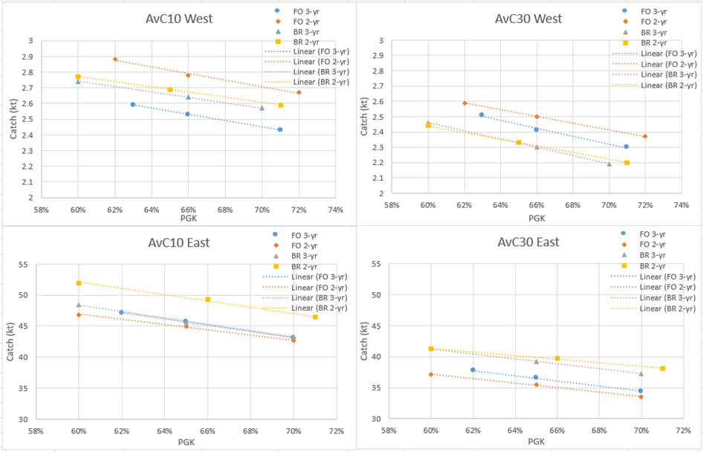
Decision point 2: PGK60, PGK65 or PGK70
Figure 1. Performance results of the BR and FO CMPs, with 2- or 3-year management cycles, showing the nearly linear relationship between PGK values and catch. Short-term catch (AvC10) is on the left, and long-term catch (AvC30) is on the right. The West management area is on the top, and the East management area is on the bottom. All CMPs use the 100 t (West) and 1000 t (East) minimum thresholds for TAC change.

Slide 6
Decision point 3: Management cycle length, 2- or 3-year TAC setting intervals.
Strategic considerations:
The 3-yr cycle CMPs are slightly slower to react to signals to change the TAC. As a result, the changes in TAC need to be larger in the 3-yr cycle variants, and this is seen in larger VarC statistics.
Managers will need to decide whether biomass and yield differences, which differ by CMP type, as shown below, are large enough to outweigh other considerations, such as administrative needs.
 | West |  |  |  | East
Mgmt cycle (yrs) | AvC10 (50%) | AvC30 (50%) | VarC (50%) | LD (15%) | AvC10 (50%) | AvC30 (50%) | VarC (50%) | LD (15%)
2-year | 2.73 | 2.41 | 11.85 | 0.42 | 47.43 | 37.92 | 16.01 | 0.48
3-year | 2.58 | 2.36 | 14.01 | 0.42 | 45.55 | 37.74 | 18.73 | 0.43
% difference | -6% | -2% | 18% | -1% | -4% | 0% | 17% | -12%

Slide 7
Decision point 3: Management cycle length, 2- or 3-year TAC setting intervals
within tuning level PGK60% for a given CMP
*
*
*Results include the 100(w)/1000(e) min TAC threshold

Slide 8
Decision point 3: Management cycle length, 2- or 3-year TAC setting intervals
within tuning level PGK65% for a given CMP
*
*
*Results include the 100(w)/1000(e) min TAC threshold

Slide 9
Decision point 3: Management cycle length, 2- or 3-year TAC setting intervals
within tuning level PGK70% for a given CMP
*
*
*Results include the 100(w)/1000(e) min TAC threshold

Slide 10
Decision point 4: Management procedure: FO or BR
24 remaining variants, with combinations of
2 CMP types (i.e., BR, FO)
2 options for minimum TAC change (i.e., with and without)
3 PGK values (i.e., 60%, 65%, 70%)
2 management cycle lengths (i.e., 2-year, 3-year)
2x2x3x2=24 variants
All remaining variants meet minimum operational management objectives for Stock Status and Safety but with varying performance on the Yield and Stability tradeoffs.

Slide 11
Decision point 4: Management procedure: FO or BR
*See Annex 1 of PA2-613 for full mathematical specifications of BR and FO.

Slide 12
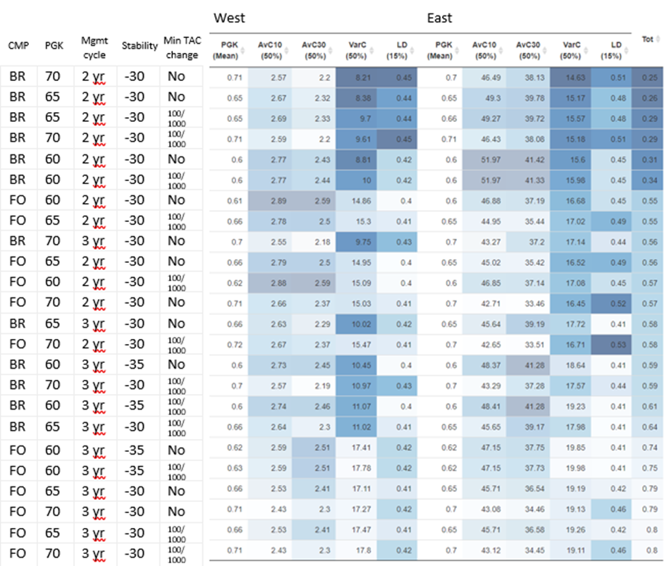
Decision point 4: Management procedure: FO or BR
Primary Quilt Plot of remaining 24 CMP variants

Slide 14
Displaying Results: Quilt Plot #2
Includes 10 additional performance statistics:
Safety:
LD* (5%): 5%tile of lowest depletion over years 11-30
LD* (10%) 10%tile of lowest depletion over years 11-30,
Status:
Br20: Depletion (SSB relative to dynamic SSB_{MSY}) in projection year 20 (50%)
AvgBr: SSB relative to dynamic SSB_{MSY} over projection years 11-30 (50%)
Br30: Depletion (SSB relative to dynamic SSB_{MSY}) in projection year 30 (5%)
POF: Probability of Overfishing (U > U_{MSY}) after 30 projected years (mean)
PNRK: Probability of not Red Kobe (SSB ≥ SSB_{MSY} or U < U_{MSY}) after 30 projected years (mean)
OFT: Overfished trend, SSB trend over projection years 31 - 35 when Br30 < 1
Stability: None
Yield:
C1: catch in the first year of CMP application (actual value in kt)
AvC20: average catch (kt) over years 1-20 (50%tile)
CMPs are ordered the same as in Quilt Plot #1

Slide 15
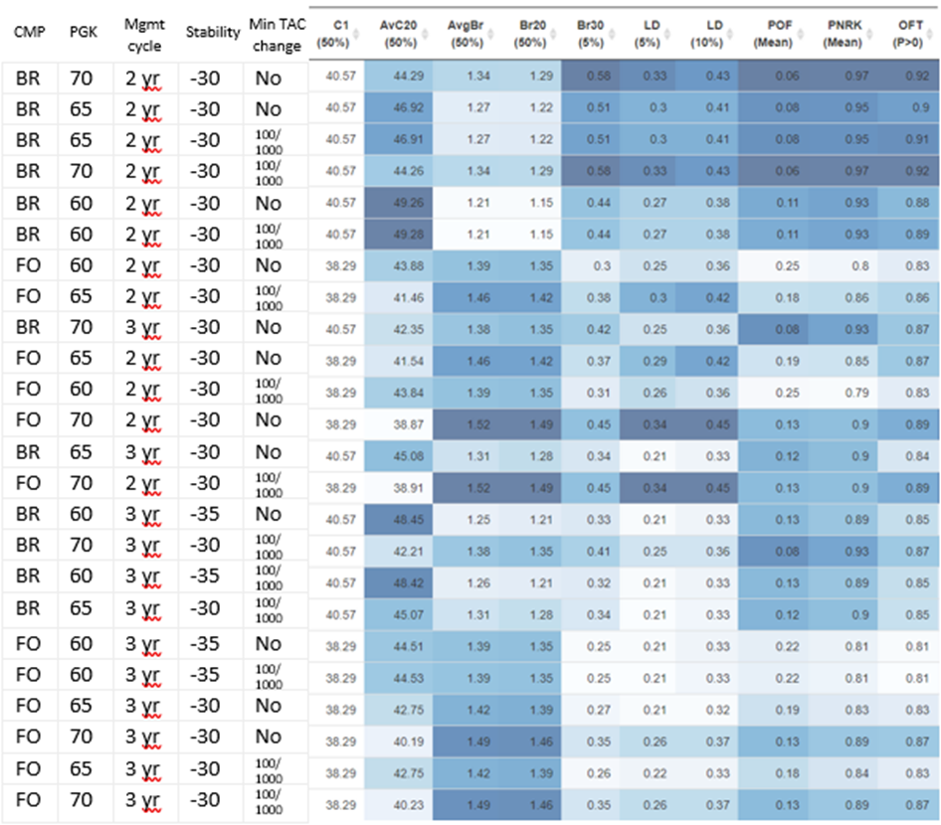
Decision point 4: Management procedure: FO or BR
Quilt Plot #2 - East
CMPs are ordered based on Primary Quilt Tot column
Notes:
Quilt plot 2. C1 is the catch in kt that would correspond to each CMP

Slide 16
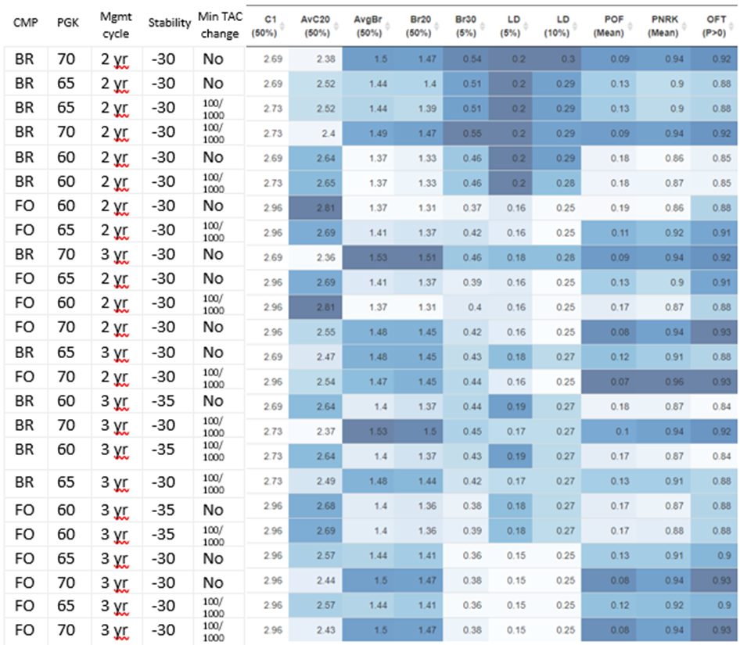
Decision point 4: Management procedure: FO or BR
Quilt Plot #2 - West
CMPs are ordered based on Primary Quilt Tot column
Notes:
Quilt plot 2. C1 is the catch in kt that would correspond to each CMP

Slide 17
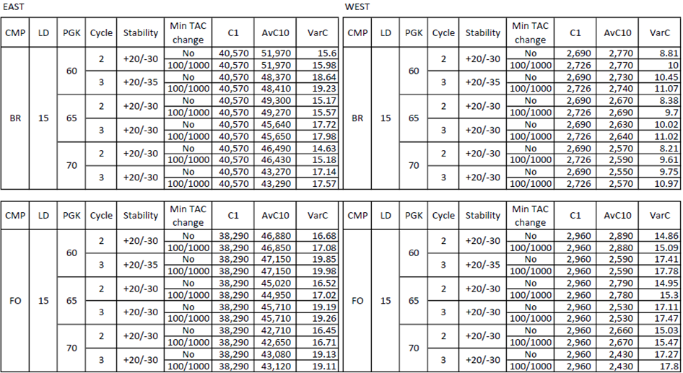
CMPs and their variants and their short (C1) and medium (AvC10) yields and variability in yield (VarC).

Slide 18
Decisions, revisited
Minimum TAC change [With or without; if with, up to 100 t for the West and up to 1000 t for the East]
Operational management objective for Stock Status: 60%, 65% or 70% PGK. [This is the most influential decision on the yield vs. status tradeoff.]
Management cycle length: 2- or 3-yr TAC setting. [Any interval can meet PA2 objectives.]
Management procedure: BR or FO. [Any of the CMPs meet PA2 objectives and represent robust management procedures.]

Slide 19
Acknowledgements
ICCAT Secretariat for continual assistance
GBYP https://www.iccat.int/gbyp/en/
https://www.bluematterscience.com/ (Tom Carruthers)
CMP developers (9 original teams)
BFT Working Group, MSE Technical and Communications Teams
BFT MSE Ambassadors
Panel 2 for taking SCRS requests for multiple meetings and being strong partners in this MSE

Slide 20
Additional material
(trajectory plots)

Slide 21
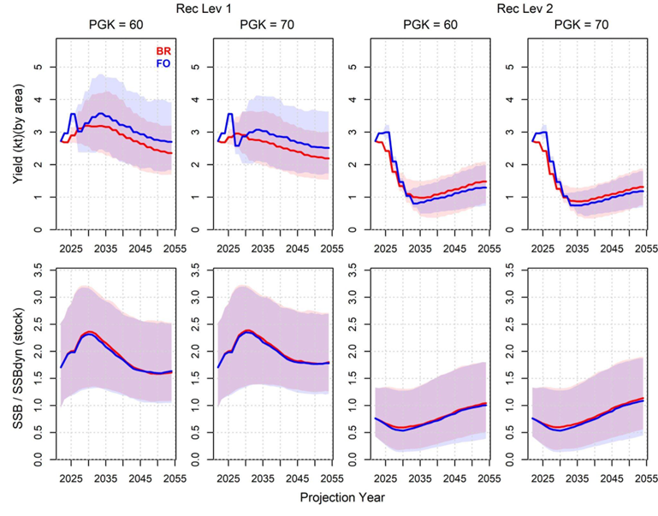
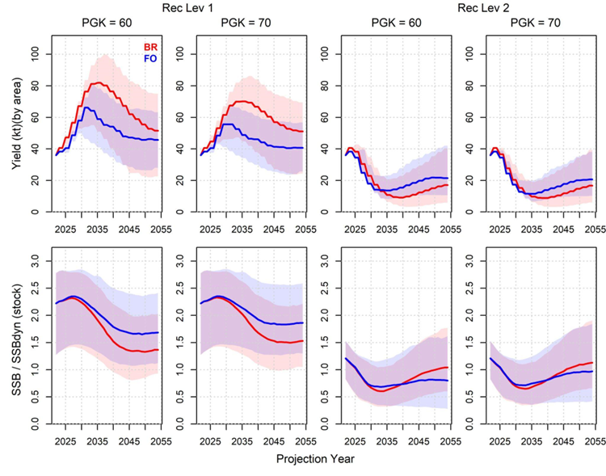
Trajectory Plot: Yield & biomass trend by recruitment level, 2 yr mgmt cycle
West
East
Notes:
Projected yields and SSB/dynamic SSB_{MSY} for recruitment scenarios 1 and 2. The lines are the medians integrated over all operating models and simulations of the reference grid for each recruitment scenario. The shaded areas are the 80% inter-quantile range. For each plot, the starting points are the 2022 TACs and SSB-related statistic for both East and West.

Slide 22
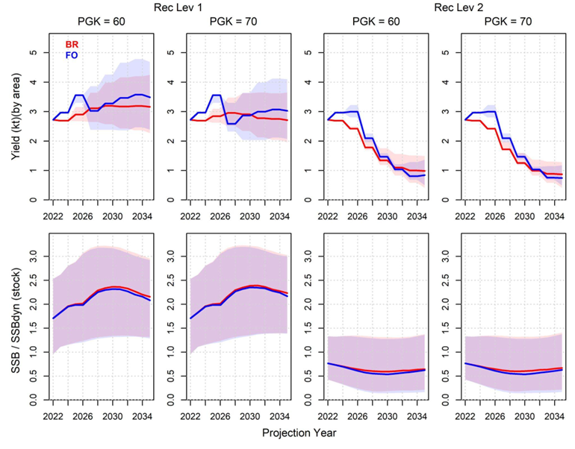
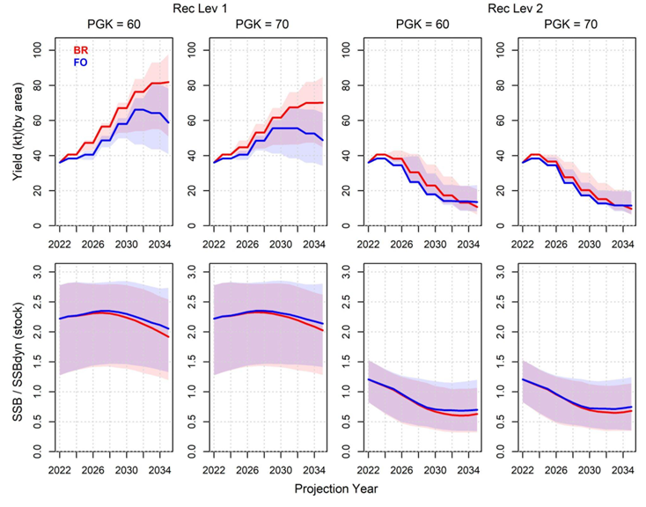
Truncated Trajectory Plot: Yield & biomass trend by recruitment level, 2 yr mgmt cycle
West
East
Notes:
Same as prior slide but truncated to 2035.
Projected yields and SSB/dynamic SSB_{MSY} for recruitment scenarios 1 and 2. The lines are the medians integrated over all operating models and simulations of the reference grid for each recruitment scenario. The shaded areas are the 80% inter-quantile range. For each plot, the starting points are the 2022 TACs and SSB-related statistic for both East and West.

Slide 23
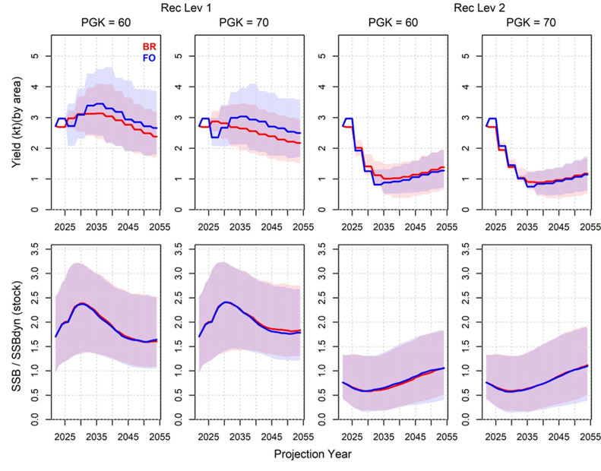
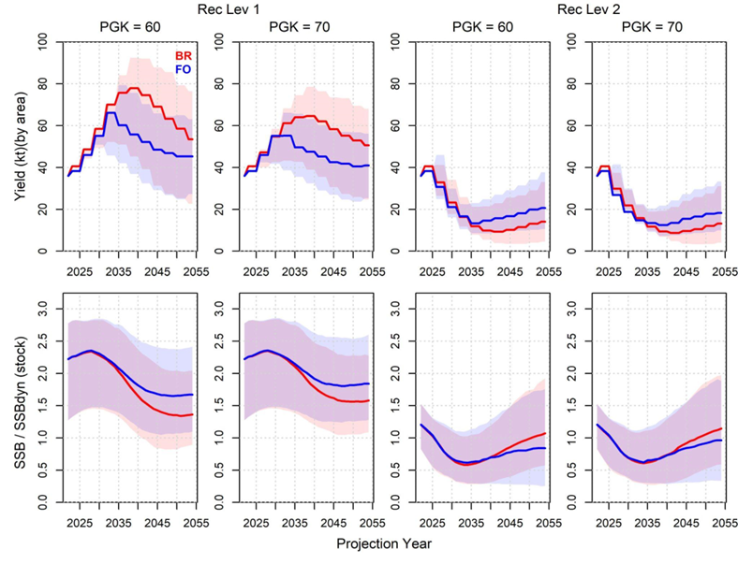
Trajectory Plot: Yield & biomass trend by recruitment level, 3 yr mgmt cycle
West
East
Notes:
Projected yields and SSB/dynamic SSB_{MSY} for recruitment scenarios 1 and 2. The lines are the medians integrated over all operating models and simulations of the reference grid for each recruitment scenario. The shaded areas are the 80% inter-quantile range. For each plot, the starting points are the 2022 TACs and SSB-related statistic for both East and West.

Slide 24
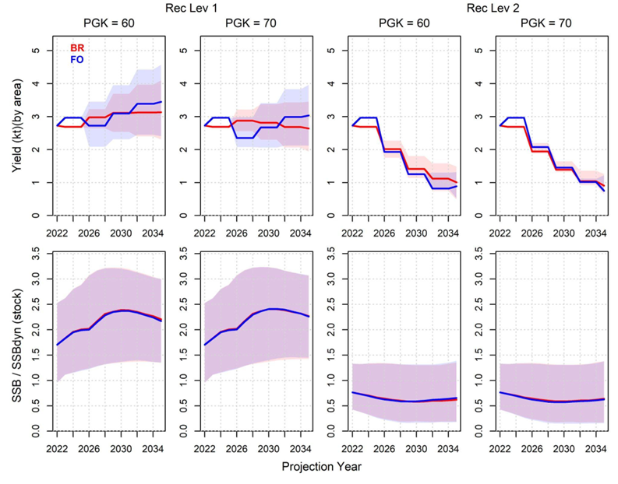
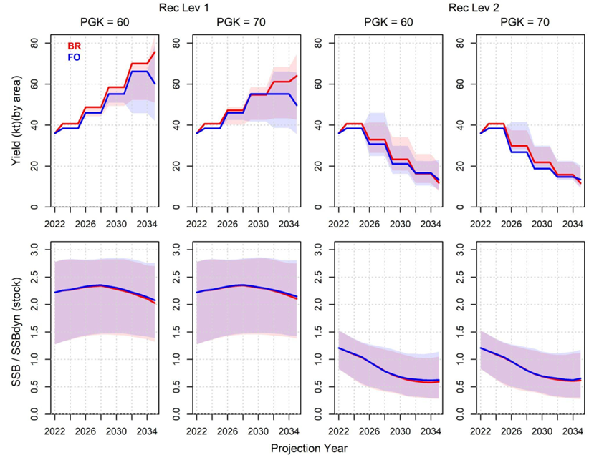
Truncated Trajectory Plot: Yield & biomass trend by recruitment level, 3 yr mgmt cycle
West
East
Notes:
Same as prior slide but truncated to 2035.
Projected yields and SSB/dynamic SSB_{MSY} for recruitment scenarios 1 and 2. The lines are the medians integrated over all operating models and simulations of the reference grid for each recruitment scenario. The shaded areas are the 80% inter-quantile range. For each plot, the starting points are the 2022 TACs and SSB-related statistic for both East and West.

