Slide 1
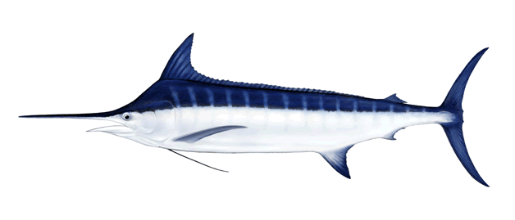
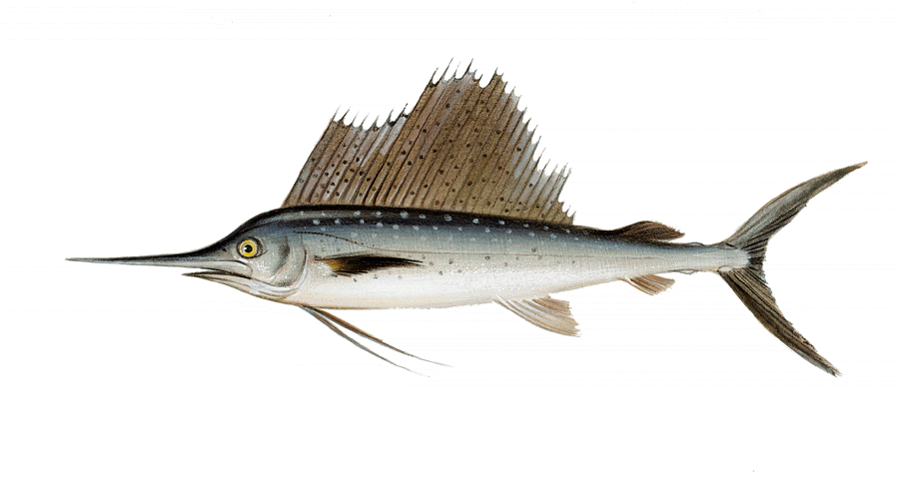
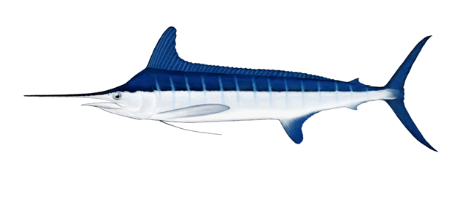
SCRS Report 2022 – PANEL 4
Swordfish
Billfishes
Sharks
Small tunas

Slide 2
Presentation Summary
Main contents of this presentation
Billfishes
  Not assessed in 2022.
  Summaries from previous assessments and fishery statistics (BUM, WHM, SAI)
Swordfish
  North and South stock assessment assessed in 2022.
  Status from previous Med assessments and fishery statistics.
  Summary update on N-ATL Swordfish MSE
Small tunas
  Updates on the progress of work
Sharks:
  Porbeagle shark assessed in 2022
  Summaries from previous assessments and statistics
Responses to the Commission
Recommendations with financial implications

Slide 3
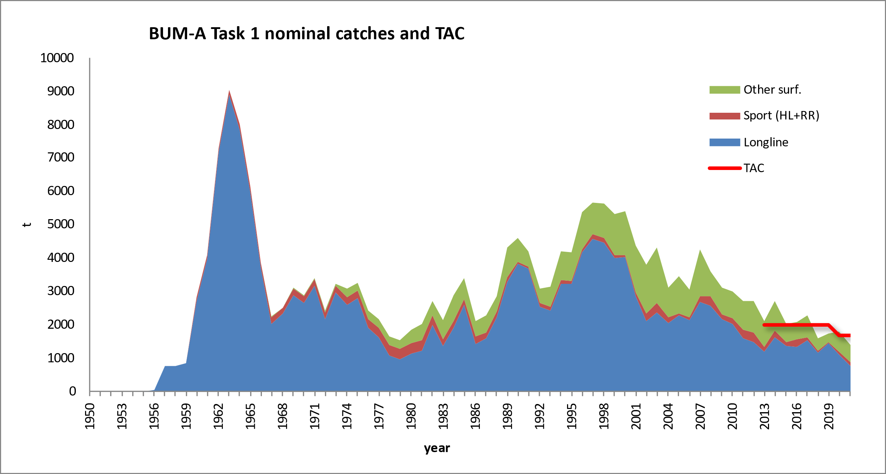
BUM Fishery Indicators
Blue marlin annual catch by gear
Catch (2020): 1,888 t
TAC (2020): 1,670 t
Catch (2021): 1,711 t
TAC (2021): 1,670 t
Catches 2020-2021

Slide 4
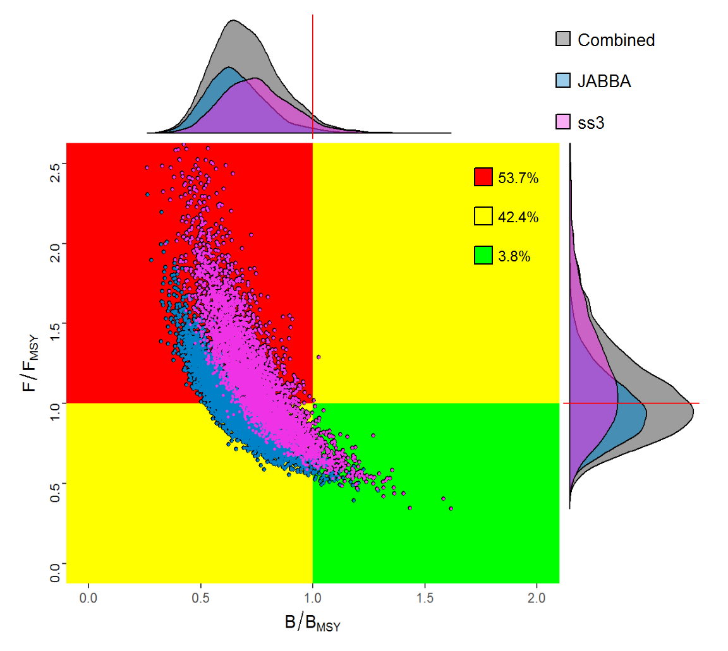
BUM State of the Stocks
Blue marlin status
Last assessment in 2018 (estimates of stock status for 2016)
Results showed that the stock was overfished, and
    undergoing overfishing.
Stock status in 2016
Combined Kobe plot from production and integrated models
Notes:
The results of the 2018 assessment indicated that the current stock status is overfished and undergoing overfishing.
The estimated MSY was determined to be 3,001 t with 10% and 90% confident limits of 2,399 to 3,537 t
However, the Committee recognizes the high uncertainty with regard to data and the productivity of the stock.

Slide 5
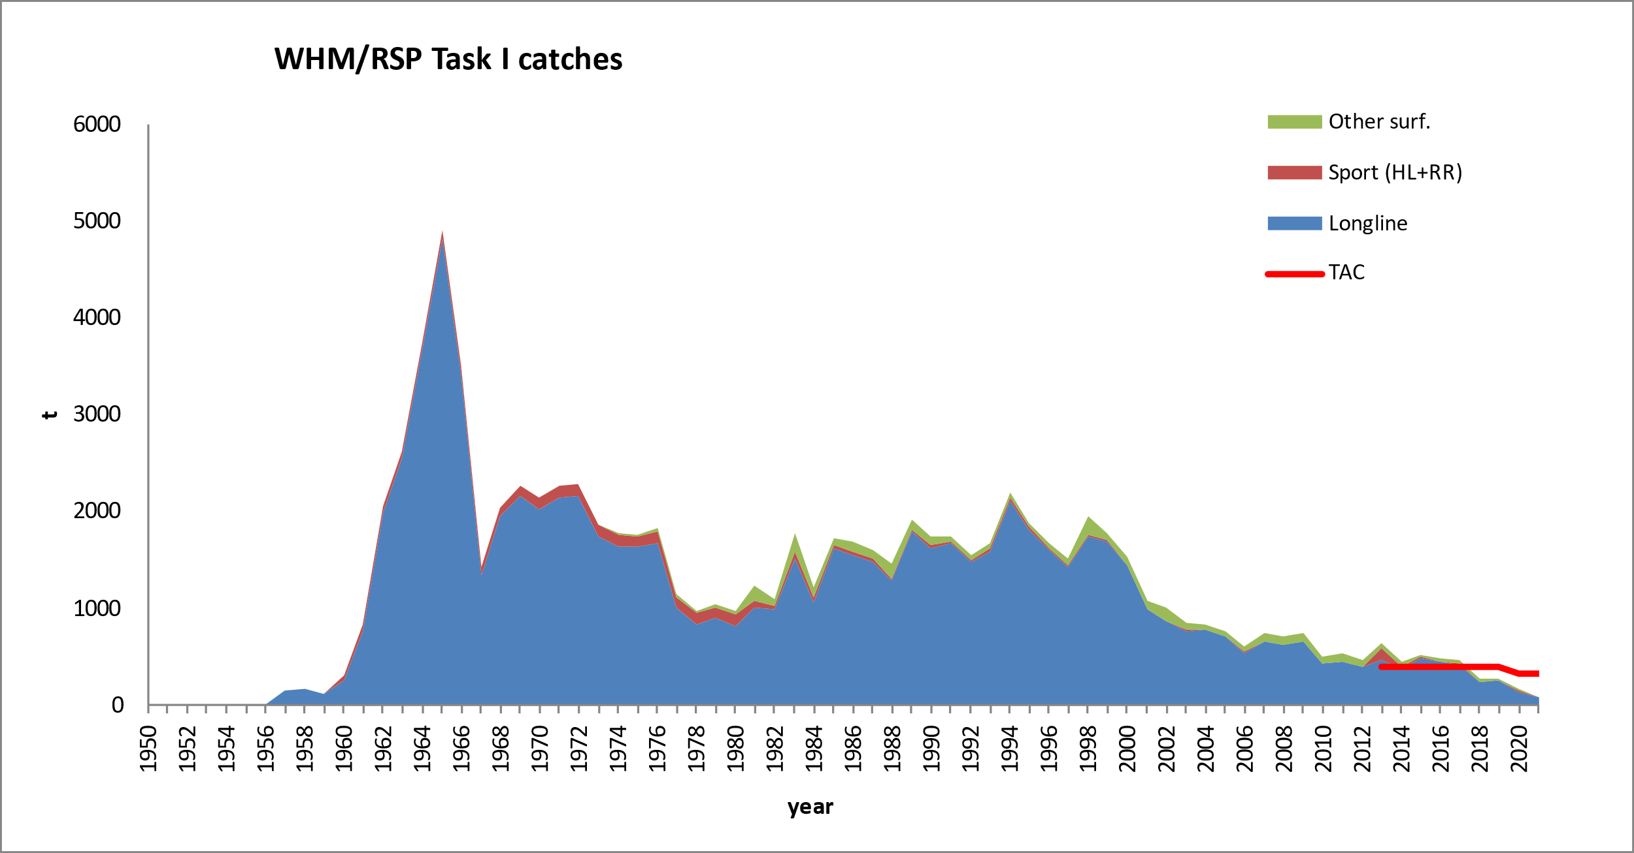
WHM Fishery Indicators
White marlin annual catch by gear
Catch (2020): 179 t
TAC (2020): 335 t
Catch (2021): 120 t
TAC (2021): 335 t
Catches 2020-2021

Slide 6
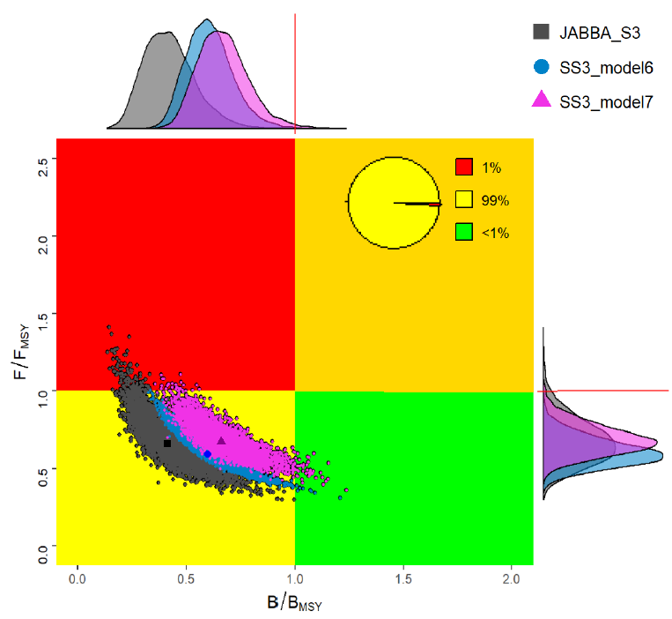
WHM State of the Stocks
White marlin status
Last assessment in 2019 (estimates of stock status for 2017)
Results showed that the stock was:
  overfished, but
  overfishing not occurring.
stock status (last data: 2017)

Slide 7
SAI Fishery Indicators
Sailfish annual catch by gear –Catches updated to 2021
East Stock
Catch 2020: 1,186 t; 2021: 1,523 t)
TAC (2017-2021): 1,271 t
West stock:
Catch (2019: 1,368 t; 2020: 1,714 t; 2021; 821 t)
TAC (2017-2021): 1,030 t

Slide 8
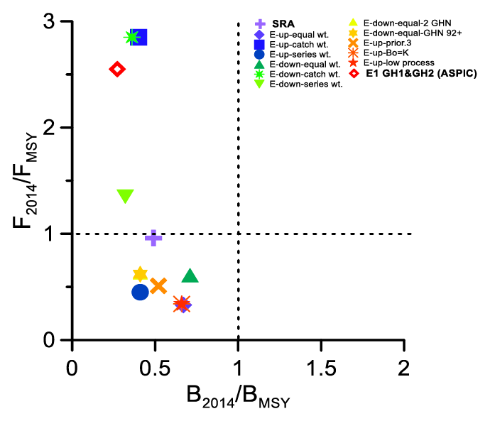
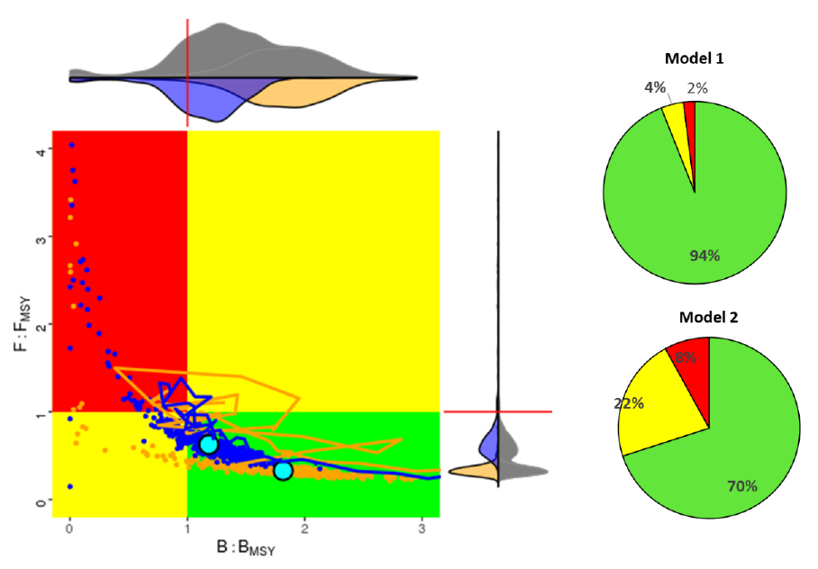
SAI State of the Stocks
Sailfish stock status
Stock status in 2014
EAST
WEST
Last assessment in 2016 (estimates of stock status for 2014)
EAST: all scenarios considered the stock is overfished, but overfishing status is uncertain
WEST: both models indicated that the stock is neither overfished nor experiencing overfishing
Notes:
Models used:
EAST - Combined Kobe plot from a set production models and Stock Reduction Analysis
WEST - Combined Kobe plot two integrated SS3 models
Last assessment 2016 with estimates of stock status for 2014.
For the East all the scenarios considered for advice using the surplus production models indicated that the stock is overfished (0.27-0.71 BMSY), but overfishing status is uncertain (0.33-2.85 FMSY)
For the West both Stock Synthesis models indicated that the stock is neither overfished nor experiencing overfishing

Slide 9
SAI Effect of current regulations
ICCAT [Rec. 16-11] establishes that if the total catch harvested any year exceeds 67% of the estimated MSY (1,271 t in the EAST and 1,030 t in the WEST),the Commission shall review the recommendation and effectiveness of this.
  EAST Atl.: Catches exceeded total catch level in 2017, 2019 and 2021, but not in 2018 and 2020.
  WEST Atl.: Catches exceeded total catch level in 2017, 2018, 2019 and 2020, but not in 2021.
  This limit of 67% MSY was not exceeded in recent years.

Slide 10

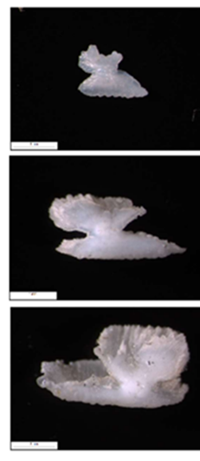
Enhanced Billfish Research Programme (EBRP)
Objectives: To obtain detailed catch and effort statistics for billfishes, to implement a tagging program, and to undertake studies on age and growth. Program further expanded in 2021 to evaluate adult habitat use, study spawning patterns, and billfish population genetics.
2022 Activities:
Otoliths sent to the FAS for age reading and a workshop (Oct 25-28) for standardizing protocols among laboratories and creating a reference set of main billfish species.
New contract issued to continue and enhance the collection of samples onboard industrial vessels
Analysis undertaken of length and age data for estimating the growth parameters based on spines of the main billfish species that occur in the eastern Atlantic at the workshop.
September 2022, the Secretariat received a draft proposal for development of a Reproductive biology study on Atlantic blue marlin in the Gulf of Mexico
Funds were made available sampling of artisanal and small-scale fisheries (catch and effort) in the eastern Atlantic (Côte d’Ivoire, and Senegal).
WHM
146 cm
194cm
193 cm

Slide 11
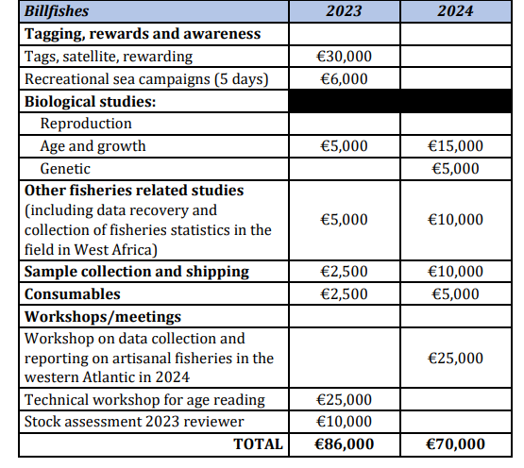
BIL Workplan and Recommendations with financial implications
The highest priorities for 2023 are to support the objectives established by the billfish work plan and those of the EPBR:
  Continue the growth study of the three priority billfish species in the eastern Atlantic;
  Initiate/continue reproduction study of blue marlin in the Gulf of Mexico;
  Fund a Workshop on small-scale fisheries (artisanal) in the West Africa region, with the objective of collecting detailed information describing their fishery(ies) and sampling programmes, aiming to improve the collection and submission of billfish fisheries data in these regions (funding already available from 2022 science budget);
  Fund a technical workshop on age reading in 2023 to standardize protocols, start the aging reference set and reading guidelines, and a second workshop in 2024 that should focus on building a reference set for both spines and otoliths.
  Conduct electronic tagging of marlins (BUM/WHM) in the north-east Atlantic area.
(

Slide 12
BIL Responses to the Commission
17.1 Explore potential technical changes to the terminal gear and fishing practices that could reduce bycatch and bycatch mortality (at-vessel and post-release). Design and implement a study(ies) to compare the effects of hook shape and size on catch rates. Rec. 19-05, para 21.
A Subgroup within the Billfishes SG was created in 2021 to explore potential technical changes to the terminal gear, continued its work in 2022 with significant progress in the following:
Compiling a preliminary list of operational longline fleet characteristics preliminary review of available scientific literature regarding catch rates and retention rates, at-haulback mortality and post-release mortality in ICCAT longline fisheries.
Conducting a power analysis for some ICCAT longline fleets to establish the required fishing effort to be able to detect the effects of the technical gear changes.
While the Committee acknowledges that important work has been conducted to address the Commission’s request, it also indicated that more work is required in order to provide advice to the Commission.
Work will continue intersessionaly in 2023 with a report provided to the Subcommittee on Ecosystems and Bycatch.

Slide 13
BIL Responses to the Commission
17.2 Develop recommendations for Electronic Monitoring Systems, Rec. 19-05, para 20
A Subgroup within the Billfishes Species Group was created in 2021 to address this issue.
The Sub-group noted that there were already minimum standards recommended by the SCRS for EMS on purse seine fisheries (Ruiz et al., 2017) then focused most of its work on pelagic longline fisheries, noting that other fisheries (e.g., gillnets) also need to be addressed in the future.
The Sub-group worked intersessionally during 2021 and 2022, focusing on the following items:
  review of previous literature comparing human observers with EMS,
  comparison of what data can be collected by human observers versus EMS specifically for ICCAT pelagic longline fisheries (using ICCAT observer data form ST-09), and
  creating a draft proposal for ICCAT EMS minimum standards for pelagic longlines.
The main work and conclusions from this Sub-group were presented to SC-STATS in 2022 under document “Report of the Sub-group on Electronic Monitoring Systems: Proposal of draft ICCAT minimum technical standards for EMS in pelagic longliners” (SCRS/2022/165). (Appendix 17).

Slide 14
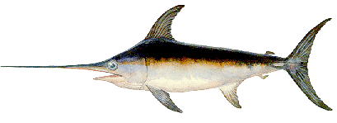
Swordfish Species Group
SWO - SWORDFISH
3 stocks
(North Atlantic, South Atlantic, Mediterranean)

Slide 15
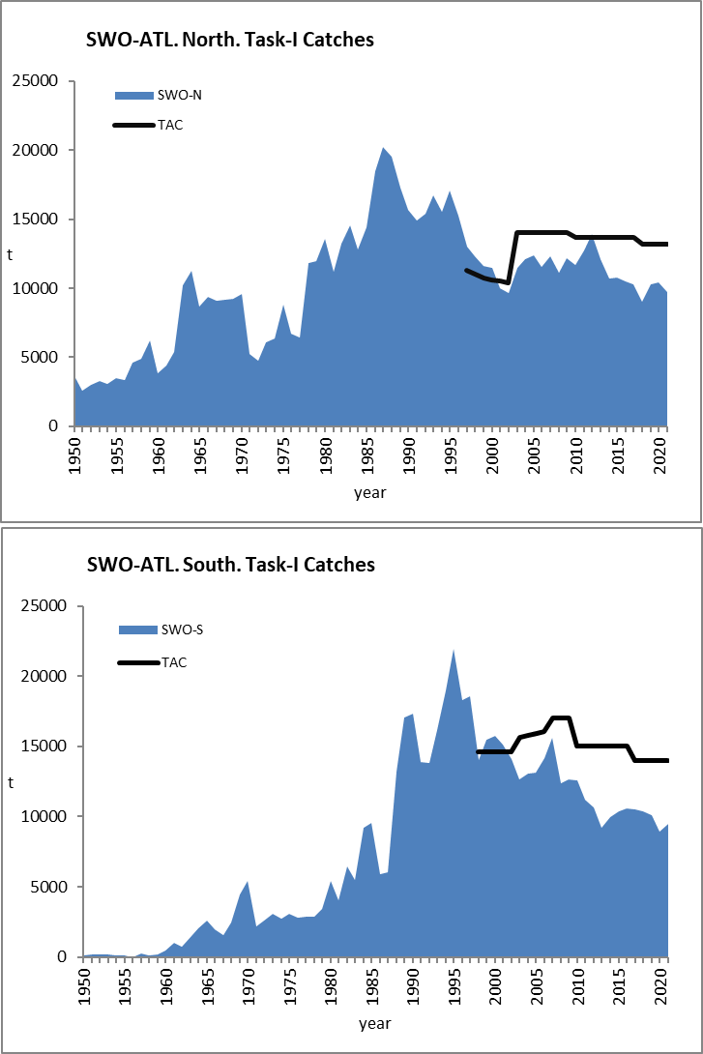
SWO Atlantic - Fishery Indicators
Atlantic Swordfish
North Atlantic:
2020 2021
Catch 10,451 t 9,729 t
TAC 13,200 t 13,200 t
South Atlantic:
2020 2021
Catch 8,964 t 9,486 t
TAC 14,000 t 14,000 t
The Committee continued to express concerns due to the low percentage of fleets that have reported annual dead discards (in t) and that what has been reported is not necessarily scaled to the entire fishery.

Slide 16
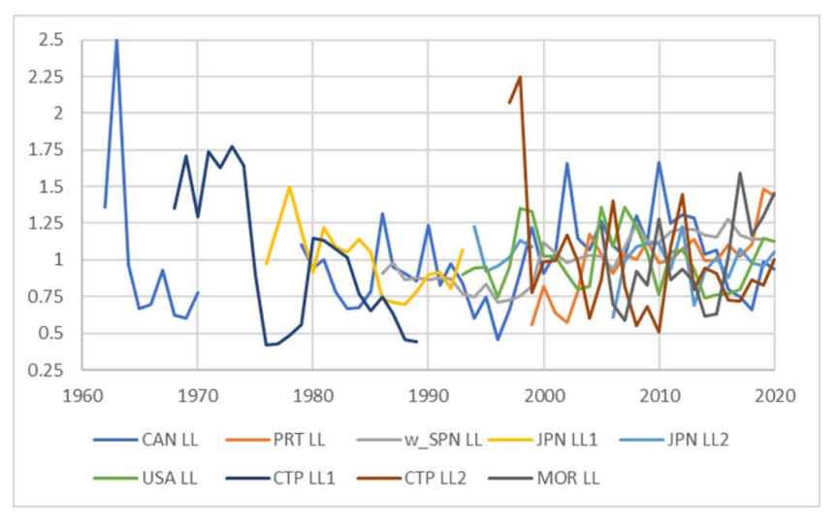
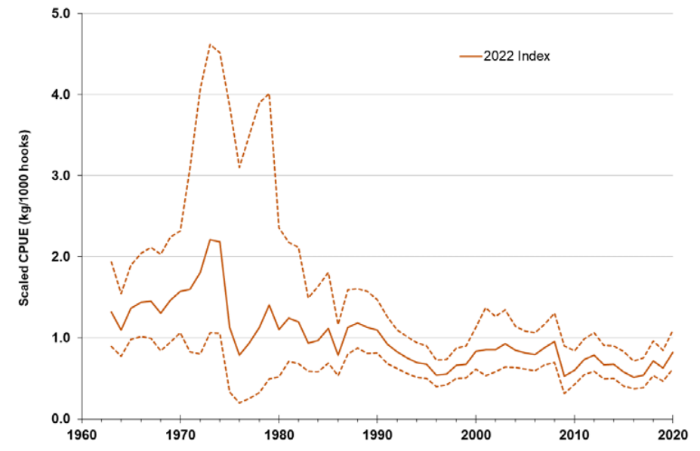
North SWO Fishery Indicators
Fleet specific relative abundance indices updated up to 2020, and combined index calculated in 2022.
Most of the series have an increasing trend since the late 1990s but show a decrease or plateau in the more recent years.

Slide 17
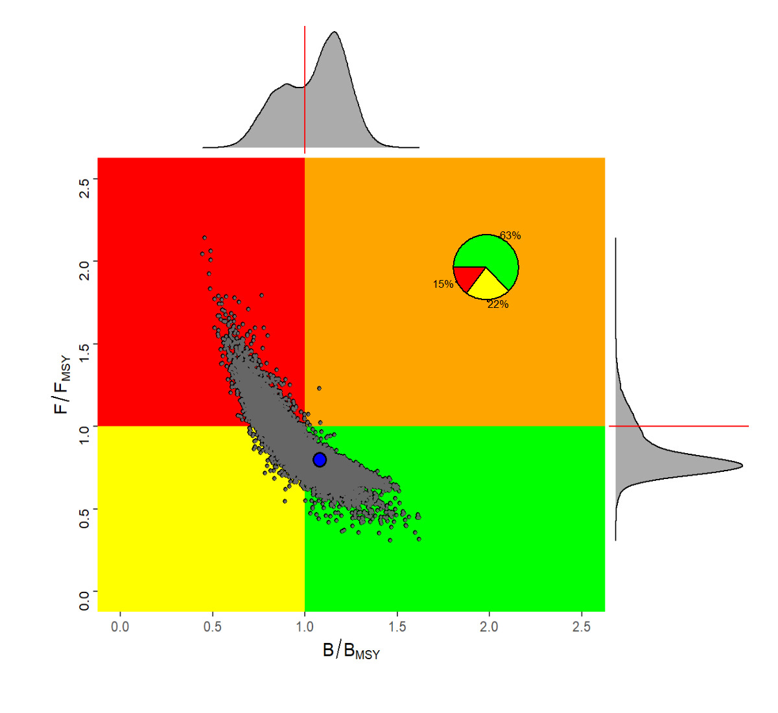
North SWO State of the stock
- Advice based on two models
- The SS model provided estimates of full number of dead discards (ie. reported and unreported) due to size limit
- Stock status (in 2020) is very similar to one estimated in the last assessment
Notes:
No overfishing/overfished
Pgreen 63%
MSY

Slide 18
North SWO Outlook
Under current TAC level (13,200 t), there is a 60% probability of being in the green quadrant in 2033.
However, given that the estimated MSY is 12, 819 t, catches above MSY will result in biomass declines over the projection period.

Slide 19
SWO Effect of current regulations
Minimum size limits (Rec 17-02)
The proportion of swordfish less than 125 cm LJFL reported in the landings (in numbers) has been generally decreasing in the North Atlantic and stable in the South.
The estimated proportion of undersized fish in the catch that are discarded in the North Atlantic is decreasing.
The Committee also noted high values of hooking mortality (ranging between 78-88%) on small swordfish (<125 cm LJFL) by surface longline fisheries targeting swordfish
The post-release mortality of specimens discarded alive from commercial fishing gear is unknown. Evaluating other strategies to reduce fishing mortality on juvenile swordfish will need complete datasets on fishing effort and size data over the entire Atlantic.
Notes:
For both North and South

Slide 20
North SWO Management Recommendations
A 13,200 t constant catch, which is the current TAC level (Rec. 21-02), will result in a 60% probability of being in the green quadrant in 2033. However, given that the estimated MSY (that is inclusive of dead discards) is 12,819 t, catches above MSY will results in biomass declines over the projection period.
The Committee also recognizes that the above advice does not fully account for removals associated with the actual mortality of unreported dead and live discards, quota carryovers (15% in the North Atlantic), quota transfers across the North, and South stock management boundaries nor the total cumulative quota, which includes catch allocated to "other CPCs" and would fall above the TAC if achieved. The Committee emphasizes that the importance of this uncertainty be taken into consideration by the Commission when adopting a TAC.

Slide 21
South SWO Fishery Indicators
Fleet specific relative abundance indices were updated up to 2020

Slide 22
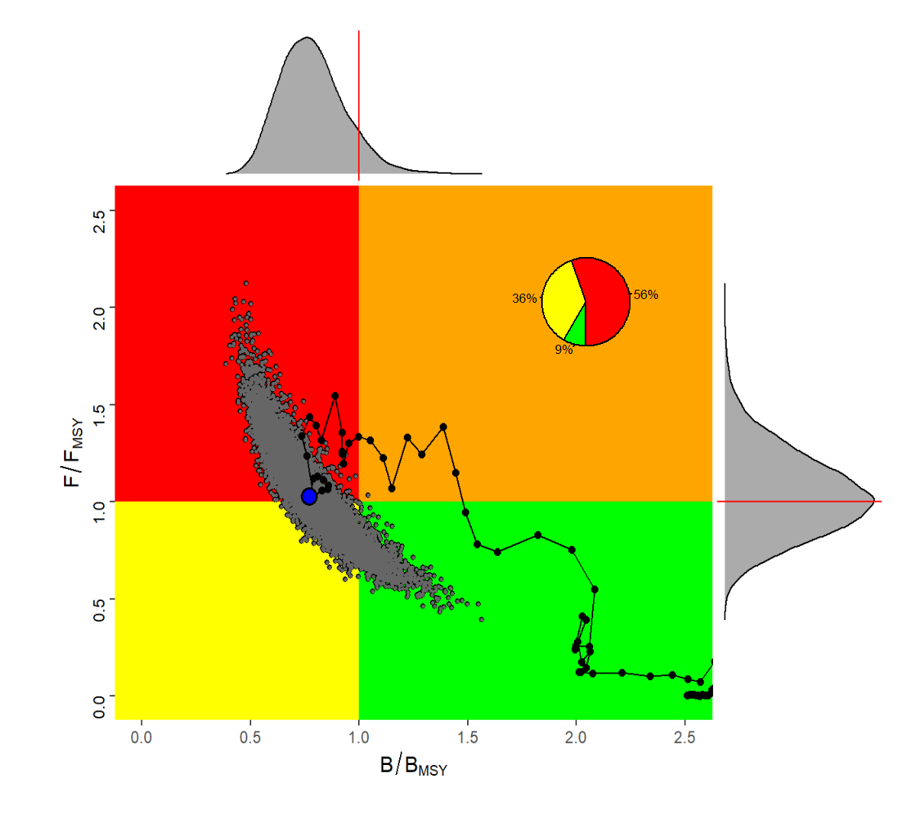
South SWO State of the stock
Overall consistency among two models (JABBA and SS)
Advice based on one model (JABBA)
56% probability that the stock is within the red quadrant
Notes:
overfishing/overfished
Pred 56%
MSY

Slide 23
South SWO Outlook
Less productive stock compared to last assessment (MSY₂₀₂₀ = 11,481 t; MSY₂₀₁₅ = 14,570 t).
Projections from the 2017 assessment indicated that if catches remained below 11,000 t, there was a 60% chance of the stock falling within the green quadrant by 2020. The average catch for the period 2016-2020 was 10,125 t, yet the assessment still indicates a 56% probability that the stock is within the red quadrant in 2020.
Under current catch levels (9,826 t), the South Atlantic swordfish stock has a 55% probability of being in the green quadrant of the Kobe plot by 2033.

Slide 24
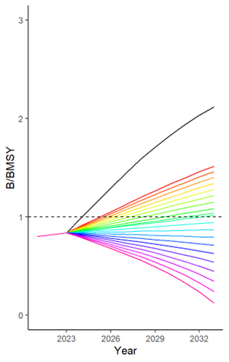
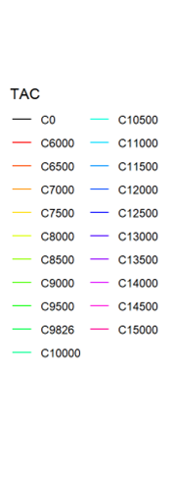
South SWO Management Recommendations
The current TAC of 14,000 t (Rec. 21-03) is unlikely (3% probability) to result in the stock being in the green quadrant of the Kobe plot by 2033.
Catch levels less than 10,000 t will accelerate rebuilding.
The Committee also recognizes that as was the case for the northern stock, the above advice does not fully account for removals associated with the actual mortality of unreported dead and live discards, quota carryovers (30% in the South Atlantic) nor quota transfers across the North and South stock management boundaries. The Committee emphasizes the importance of these uncertainties and recommends that the stock be closely monitored in the upcoming years to confirm rebuilding.

Slide 25
Mediterranean SWO summary
MED SWO Fishery indicators
Catch (2021): 7,493 t
TAC (2021): 9,296 t

Slide 26
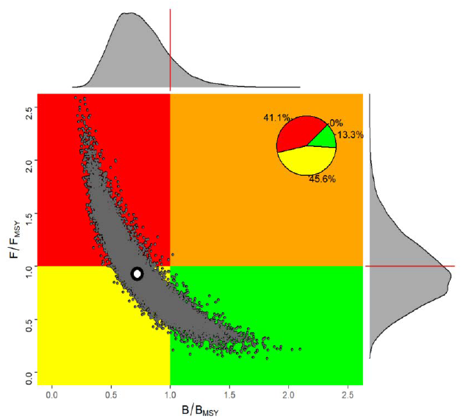
Mediterranean SWO summary
MED SWO State of the stock
Stock status from the 2020 assessment (data until 2018).
The assessment indicated that the stock was most likely overfished and current fishing mortality just below Fmsy levels

Slide 27

N-SWO Atlantic - MSE
Progress on N-SWO MSE
Year | Key events
2018 | Process initiated; initial OM uncertainty grid generated
2019 | OM development; technical expert develops initial MSE framework; conceptual management objectives adopted (Res 19-14)
2020 | OM development; early cMP development
2021 | OM grid revisions (reduce grid redundancy; account for discard mortality); cMP development; candidate performance indicators; MSE code review from external expert; candidate advice intervals
2022 | Stock assessment; OM reconditioning; cMP development, development of performance metrics, relative importance of uncertainty axes to focus CMP evaluation on key OMs.
2023 | Continue CMP development, engage with Panel 4 and stakeholders to refine performance metrics and develop and select an MP at the Annual Meeting. Develop exceptional circumstances protocol and communications material
2024+ | MP to be run on predetermined timescale.
(Details of the MSE roadmap in PLE-XXX)

Slide 28
SWO
Workplan for 2023
Intersessional Species Group meeting (6 days):
  Update information related to the Mediterranean assessment
    Review fisheries and biological data
    Update standardized CPUE indices
    Estimates of discard misreporting
  Improve North and South CPUEs

Slide 29
SWO
Workplan 2023 cont.
Two 1-day MSE meetings
  Finalize OM grid and robustness Oms
  Review CMPs
Two 1-day meetings with Panel 4 to:
  Develop operational management objectives, performance metrics, advice intervals and CMPs
  Review small set of CMPs and their performance.
  Undertake a closed Loop simulation study for South Atlantic swordfish
Continue research on Life history project, Size/sex distribution study, PSAT tag joint analysis, Environmental effects on the assessment and Sex specific relationships between straight and curved lower/upper Jaw Fork Length.
Host a Technical workshop (5 days) for age, growth and reproduction

Slide 30
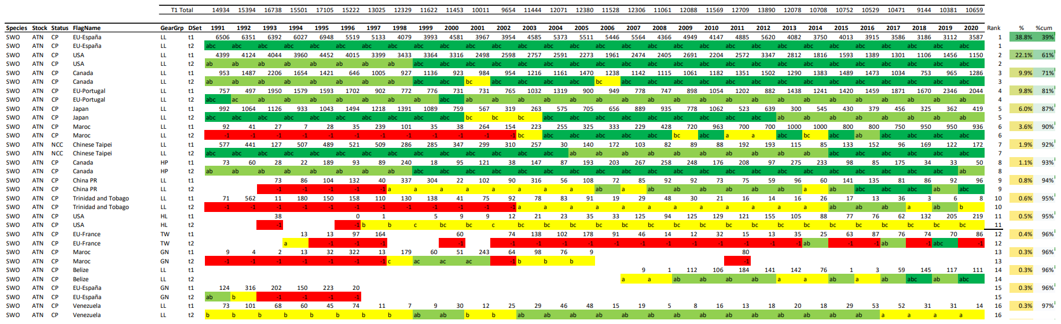
SWO Responses to the Comm
17.32 The SCRS shall review these data (catch, catch at size, location and month of capture) annually. Rec. 17-02, para 8
Background: All CPCs catching swordfish in the North Atlantic shall endeavor to provide annually the best
available data to the SCRS, including catch, catch at size, location and month of capture on the smallest scale possible, as determined by the SCRS. The data submitted shall be for broadest range of age classes possible, consistent with minimum size restrictions, and by sex when possible. The data shall also include discards (both dead and alive) and effort statistics, even when no analytical stock assessment is scheduled. The SCRS shall review these data annually.
(…) Overall, the available catch, size, and effort data for the main fleets (the fleets that catch approximately 95% of the total catch) are quite complete, while the data for the minor fleets continue to be sparse. With respect to the reporting of dead and live discards, the Committee observed that only a few CPCs have been providing these data and only one CPC extrapolates observations to the total effort.

Slide 31
SWO Responses to the Comm
17.33 The SCRS should continue to monitor and analyze the effects of this measure (minimum size) on the mortality of immature swordfish. Rec. 17-02, para 10
Background: Notwithstanding the provisions of paragraph 9, any CPC may choose, as an alternative to the minimum size of 25 kg/ 125 cm LJFL, to take the necessary measures to prohibit the taking by its vessels in the Atlantic Ocean, as well as the landing and sale in its jurisdiction, of swordfish (and swordfish parts), less than 119 cm LJFL, or in the alternative 15 kg, provided that, if this alternative is chosen, no tolerance of swordfish smaller than 119 LJFL, or in the alternative 15 kg, shall be allowed. For swordfish that have been dressed, a cleithrum to keel (CK) measurement of 63 cm can also be applied. A Party that chooses this alternative minimum size shall require appropriate record keeping of discards. The SCRS should continue to monitor and analyze the effects of this measure on the mortality of immature swordfish.
An answer to these requests was provided by the Committee in 2017. (…) the estimated mortality at-haulback for undersized swordfish differed between fleets and varied annually but is on average 78%. However, it is not clear how much the regulation may have reduced the encounter rate with small fish as a redistribution of fishing effort to avoid undersized swordfish could also have resulted in reduced total mortality. The Committee reiterates that reporting of dead discards and the corresponding lengths of the discarded fish are essential to address the efficacy of this recommendation. Currently, the Committee is reviewing new studies and conducting further analysis to determine population level impacts of this at-haulback mortality and intends to provide advice to the Commission tentatively in 2023. In addition, the ongoing N-SWO MSE work might provide further insight on this issue.

Slide 32
SWO Responses to the Comm
17.34 The SCRS to provide advice on conservation and management measures for North Atlantic swordfish, Rec. 21-02, para 5
Background: The Commission shall establish at its 2022 meeting conservation and management measures
for North Atlantic swordfish on the basis of the SCRS advice resulting from a stock assessment that will be
carried out by the SCRS in 2022 as well as the Resolution by ICCAT on Criteria for the Allocation of Fishing
Possibilities (Res. 15-13).
(…) Details of the stock assessment methods, results, and management advice related to TAC and minimum size limits are provided in SCRS/2022/012. Further details on the management advice can be found in Swordfish Executive Summary.

Slide 33
SWO Responses to the Comm
17.35 Interim limit reference (LRP) of 0.4*BMSY or any more robust LRP established through further analysis, Rec. 17-03, para 12 (Rec. 21-03)
Background: When assessing stock status and providing management recommendations to the Commission in 2021, the SCRS shall consider the interim limit reference (LRP) of 0.4*BMSY or any more robust LRP established through further analysis.
There was no analysis conducted for southern swordfish on this issue in 2022. Until such an analysis is
conducted, the Committee will consider the interim limit reference point of 0.4*BMSY.
17.36 The SCRS shall report to the Commission the results of the 2022 South Atlantic swordfish stock assessment, Rec. 21-03, para 2
Background: The SCRS will carry out a stock assessment of South Atlantic swordfish in 2022 and report the results to the Commission.
(…) Details of the stock assessment methods, results, and management advice is provided in SCRS/2022/012. Further details on the management advice can be found in Swordfish Executive Summary.

Slide 34
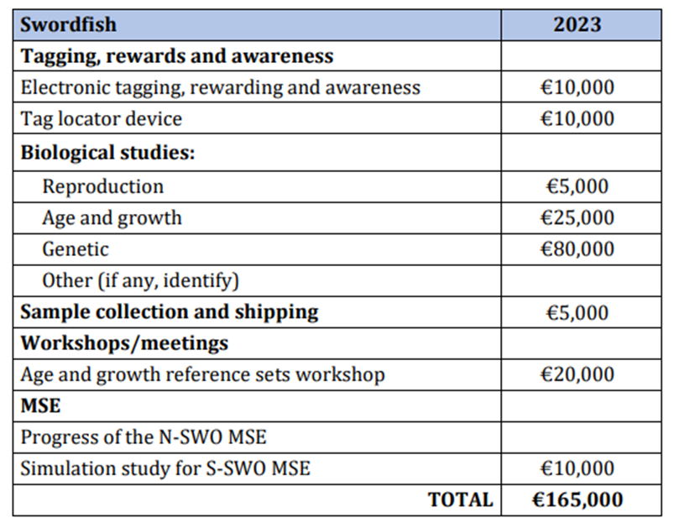
SWO Recommendations with financial implications
Applied to all stocks (Atlantic and Mediterranean)
Swordfish Year Programme (SWOYP): Biology and stock structure study . the Committee recommends as high priority to continue biological studies on swordfish (this recommendation applies to all 3 stocks).
  Satellite tagging: continue deployment of satellite tags. Purchase satellite tag receiver for use among ICCAT species groups.
  Reproduction: continue analysis gonads
  Age and growth: finish processing spines/otoliths, and start an
  age validation bomb-radiocarbon study
  Genetics: continue population analysis of tissue samples for stock
  differentiation, and a pilot study on epigenetic ageing and CKMR
  Workshops: Workshop on the reference set for age and growth
MSE:
  Continuing MSE for N-SWO: Work started in 2018, and the SCRS
  recommends funding for continuing the swordfish MSE work in 2023.
  Closed-loop simulation study for S-SWO: continue analyses and review simulation setup and code.
(Details of funding requests on Document STF-XXX)

Slide 35
Sharks
SHK - SHARKS
SMA
BSH
POR
…and 21 more species (sharks and rays)
Notes:
Blue shark, shortfin mako and porbeagle are large pelagic sharks that the SCRS has assessed those with more traditional fishery assessment models.
The SCRS has conducted an Ecological Risk Assessment for these and another 13 Atlantic shark species ( a total of 20 stocks).
New ICCAT convention amendment has a list of 24 species (sharks and rays) that are oceanic, pelagic and highly migratory.
But the 3 main ones (BSH, SMA and POR) constitute the majority of the catches in ICCAT

Slide 36
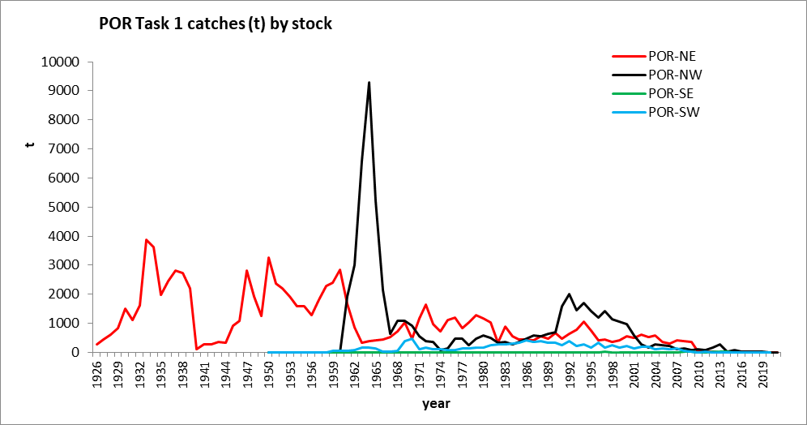
POR Atlantic - Fishery Indicators
Porbeagle shark catches
Catch (2021)
  NE Atl: 5 t
  NW Atl: 10 t
  SE Atl: 0 t
  SW Atl: 0 t
General notes on shark statistics:
Global statistics on sharks have improved; … but are still insufficient to provide quantitative advice on stock status for most stocks (except BSH, SMA and POR).

Slide 37
NE POR Assessment
2022 ICES – ICCAT Northeast Porbeagle Stock Assessment
ICES Working Group on Elasmobranchs (WKELASMO)
  Data Evaluation (29 November-03 December 2021).
  Stock ID meeting (03 February 2022).
  CPUE indices meeting (15 February 2022).
  Assessment Benchmark meeting (29 April 2022).
ICCAT SHK SG meeting (16 – 18 May 2022).
ICES Working Group on Elasmobranch fisheries (WGEF) (15 – 17 June 2022).

Slide 38
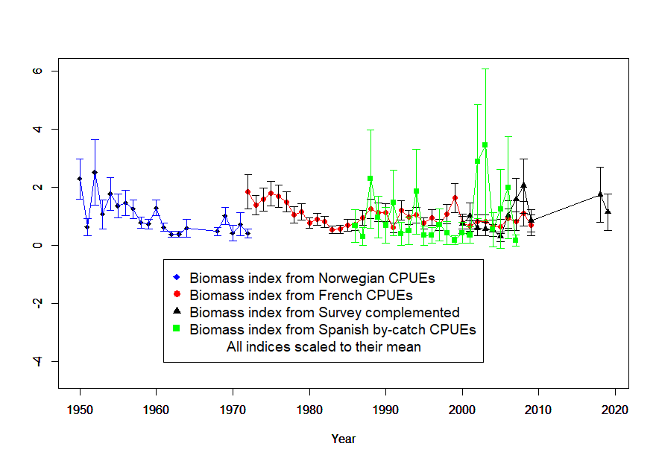
NE POR Assessment
2022 ICES – ICCAT Northeast Porbeagle Stock Assessment
Fishery indicators
      Discards are unquantified and assumed not to be large enough to distort the trend shown by the landings too much.
      4 biomass indices were considered for the assessment.

Slide 39
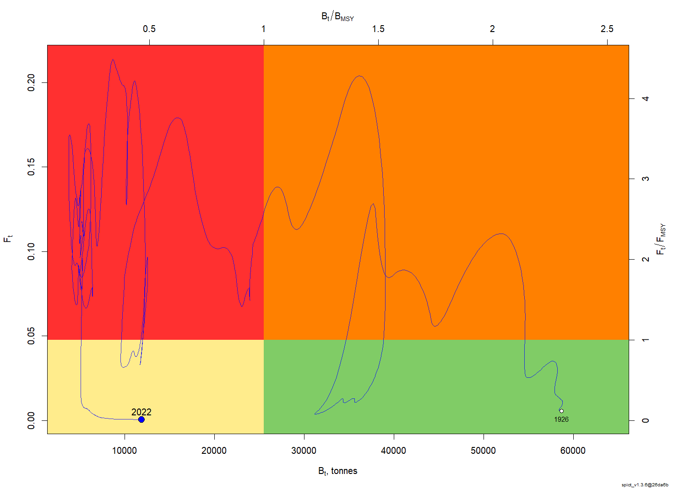
NE POR Assessment
2022 ICES – ICCAT Northeast Porbeagle Stock Assessment
Stock Status
      Results indicate that the status of the NE Atlantic porbeagle stock is still overfished, but with overfishing no longer occurring.
      Kobe matrix not created due to technical problems.

Slide 40
NE POR Assessment
2022 ICES – ICCAT Northeast Porbeagle Stock Assessment
Effect of current regulations
      Several CPCs banned landing porbeagle since the early 2000s
      Estimated catches (based primarily on landings data) for the NE stock have steadily decreased (…) to 7.1 t in 2022.
      The proportion of catches released alive has increased since 2015 following the implementation of Rec 15-06.
      Porbeagle is listed in CITES Appendix II and CMS Appendix II.
      Under current regulations, NW and NE stocks have increased in the last 10 years.
Notes:
CMS: Convention on Migratory Species

Slide 41
NE POR Assessment
2022 ICES – ICCAT Northeast Porbeagle Stock Assessment
Management recommendation.
      Considering the underreporting of removals, the current stock status of the NE Atlantic stock B2022/BMSY=0.464 (0.15-1.43), and the lack of reliable projections to build K2SM, the Committee recommends that total removals (i.e., the sum of landings and estimated dead discards) at the very least shall not exceed the average reported ICCAT catch since the implementation of the zero TAC recommendation (i.e., 2010-2021 which current estimates would be 9.3 tons) to allow for stock recovery. Lower levels of removals will accelerate such recovery.
Notes:
CMS: Convention on Migratory Species

Slide 42
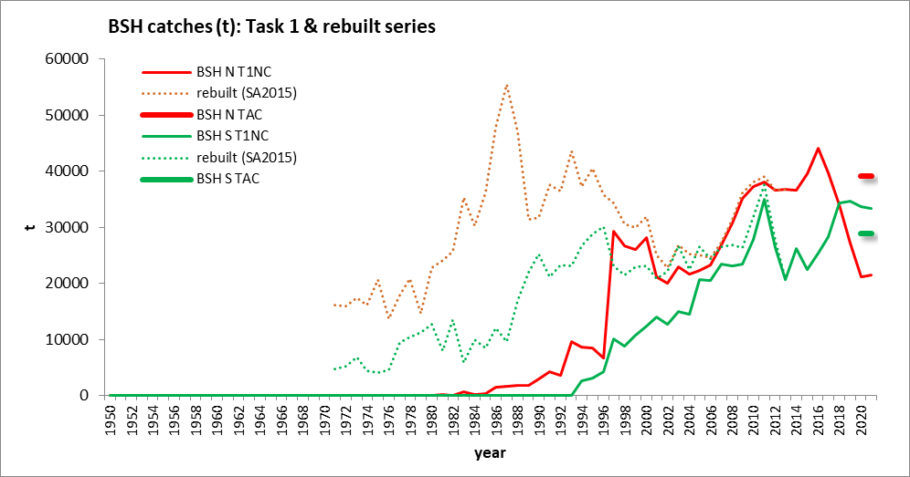
Sharks Fishery Indicators
Blue shark catch statistics
BSH - North
Catch (2021): 21,507 t
TAC (2021): 39,102 t
BSH – South
Catch (2021): 33,327 t
TAC (2021): 28,923 t
Notes:
North: recent decrease
South: recent increase

Slide 43
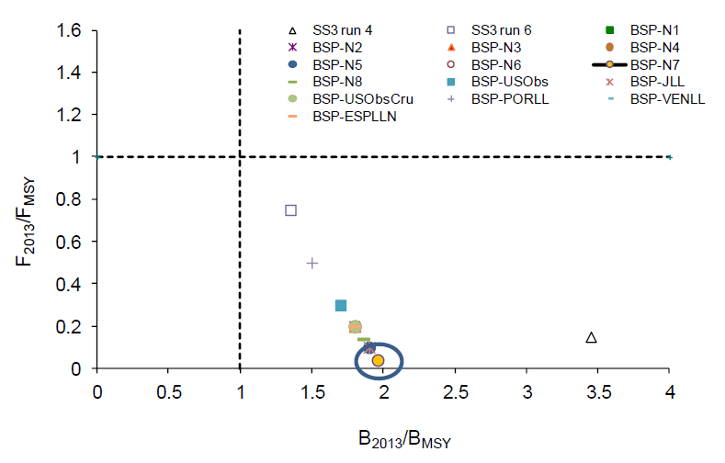
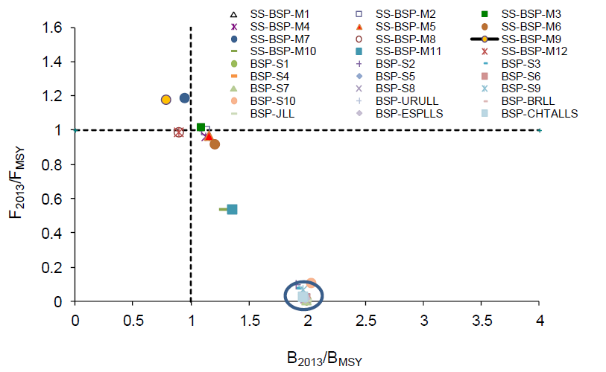
BSH Stock Status
Blue shark stock status (assessed in 2015, data until 2013)
North Atlantic
North: All scenarios indicated that the stock was not overfished and that overfishing was not occurring
South Atlantic
South: The stock could be overfished and overfishing could be occurring
Notes:
Results from production models (BSP) and SS3 models
The circles in the plots denotes common status for several BSP runs

Slide 44
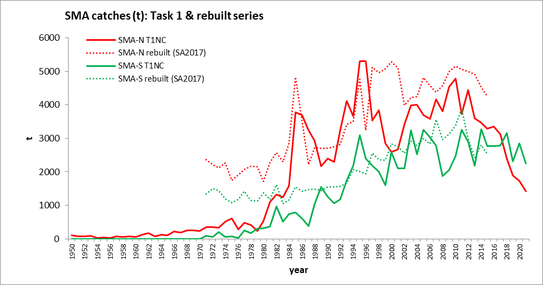
Sharks Fishery Indicators
Shortfin mako catch statistics
SMA - North
Catch (2020): 1,729 t
Catch (2021): 1,431 t
SMA – South
Catch (2020): 2857 t
Catch (2021): 2,249 t

Slide 45
SMA Stock Status
SMA 2017 stock status (data until 2015)
South Atlantic
North Atlantic
28%
10%
38%
90%
34%
F/Fmsy
F/Fmsy
B/Bmsy
B/Bmsy
Stock abundance was below Bmsy and fishing mortality above Fmsy (90% probability).
Combined probability of the stock being overfished was 32.5% and that of experiencing overfishing was 41.9%
Notes:
In 2019, projections for the North Atlantic were carried out with Stock Synthesis only. The Committee noted that because the fishery mainly focuses on juvenile animals, the production models (BSP2JAGS and others) are only tracking juvenile abundance and thus the projections are not informative about trends in the mature population, which would lag behind the trends in the exploitable population by the number of years it takes new recruits to reach maturity.

Slide 46
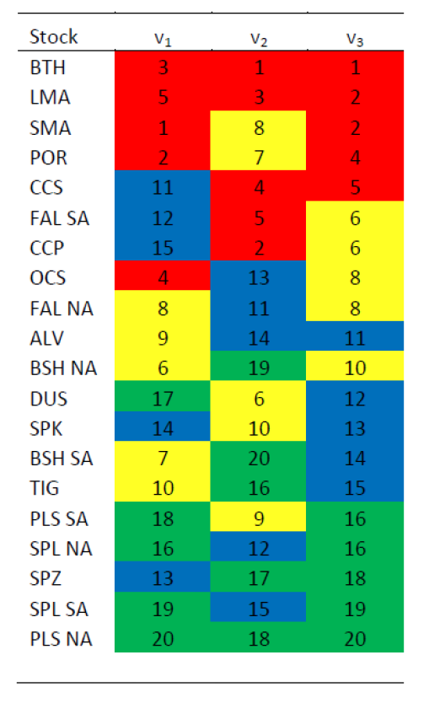
Other sharks Stock Status
Ecological Risk Assessment (last update in 2012)
Vulnerability rank for 20 stocks of pelagic sharks and rays: A lower rank indicates higher risk. Stocks listed in decreasing risk order according to the sum of the three indices. Red highlight indicates risks scores 1-5; yellow, 6-10; blue, 11-15; and green, 16-20.
Main results:
Most vulnerable stocks: bigeye thresher, longfin and shortfin makos and porbeagle (Lamniformes sharks).
Lowest vulnerabilities: scalloped hammerheads, smooth hammerhead and pelagic stingray

Slide 47
Responses to the Commission
Shortfin mako
17.4 SCRS and Panel 4 shall work together to test and confirm the appropriateness of the process to
determine possible retention. Rec. 21-09, para 5a
Background: During 2022 and 2023 the SCRS and Panel 4 shall work together to test and confirm the appropriateness of the approach in Annex 1, or alternative approaches, for determining the amount of permissible retention of North Atlantic shortfin mako in the future. Any alternative approaches shall take into consideration, among other factors, the relative contributions made by CPCs to conserve, manage, and rebuild the stock (including a CPC’s performance in reducing its mortality in line with the objectives of previous ICCAT Recommendations 17-08 and 19-06) and other criteria as set out in Resolution 15-13, as well as the need to continue to incentivize individual CPC accountability to achieve fishing mortality reductions in line with the objectives of this rebuilding program. To assist with this work, the SCRS shall, as appropriate, provide to the Commission estimates of post release mortality and, where needed, estimates of dead discards, taking into account data submitted by CPCs and other relevant information and analyses.
It is important that CPCs provide complete Task 1 data of shortfin mako retained catch, dead discards, and live releases. If a CPC’s reporting of retained catch, dead discards, and/or live releases is incomplete or estimates are not considered to be scientifically sound, then the default approach is used by the Committee for filling in the data gaps (see item 17.5 of this report). At this time reporting appears to be incomplete and hampers the evaluation of this approach.

Slide 48
Responses to the Commission
Shortfin mako
17.5 SCRS to calculate possible retention allowed in 2023 and provide the results to the Commission.
Rec. 21-09, para 5b
Background: Notwithstanding paragraph 3, in 2022, the SCRS will use Annex 1 to calculate possible retention allowed in 2023 and provide the results to the Commission, which shall then validate the amount of any permissible retention in 2023.
For CPCs that had not submitted information on landings for 2021, the Committee estimated the landings based on the average of the preceding two years with data.
- Retained catch (landings): 1,483 t
- Dead discards: 44 t
- Live Discards: 147 t
The dead bycatch retention allowance was calculated to be -1,311 t or
-1,327 t (depending on the post-release mortality rate used). Therefore, the possible retention allowance for 2023 (calculated with Annex 1) is 0 t.
Notes:
Postrelease mortality rates used: 23% (Miller et al 2020) and 34% (Bowlby et al 2021).
Note: some statistics changed after we adopted this Response (see App 6). Basically, Spain reported 0 t landed and 837 t discarded (while we “estimated” 867 t landed and 0 discarded). It does not affect the conclusions (possible retention is 0 t).

Slide 49
Responses to the Commission
Shortfin mako
17.6 The SCRS shall review and approve the methods and, if it determines that the methods are not
scientifically sound, the SCRS shall provide relevant feedback to the CPCs in question. Rec. 21-09,
para 13
Background: No later than 31 July 2022, CPCs that reported annual average catches (landings and dead discards) of North Atlantic shortfin mako over 1 t between 2018-2020 shall present to the SCRS the statistical methodology used to estimate dead discards and live releases. CPCs with artisanal and small-scale fisheries shall also provide information about their data collection programs. The SCRS shall review and approve the methods and, if it determines that the methods are not scientifically sound, the SCRS shall provide relevant feedback to the CPCs in question to improve them.
Few CPCs have submitted documents describing how they estimate their discards. In compliance with this paragraph of Rec. 21-09, CPCs that have submitted documents in 2022 were Canada, Japan, China (P.R.), Chinese Taipei.
The SCRS made comments and suggestions to improve the methodologies in the future.
Notes:
The United States had already submitted and published a document with the methodology for BFT (Brown, 2001). Even though this method was initially developed to update a time series of BFT dead discards, it has been used by the United States to estimate dead discards and live releases for a variety of species, including sharks.

Slide 50
Responses to the Commission
Shortfin mako
17.8 The SCRS shall continue to prioritize research, together with the benefits and disadvantages for the objectives of the rebuilding programme, and identify other areas deemed helpful both to improving stock assessments and reducing shortfin mako mortality. Rec. 21-09, para 19
Background: The SCRS shall continue to prioritize research into: identifying mating, pupping and nursery grounds, and other high concentration areas of North Atlantic shortfin mako; options for spatial-temporal measures; mitigation measures (inter alia, gear configuration and modification, deployment options), together with the benefits and disadvantages for the objectives of the rebuilding programme, aimed at further improving stock status; and other areas the SCRS deems helpful both to improving stock assessments and reducing shortfin mako mortality. In addition, CPCs are encouraged to investigate at-vessel and post-release mortality of shortfin mako including, but not exclusively through, the incorporation of hook-timers and of satellite tagging programs.
The Shark Research and Data Collection Programme (SRDCP) started in 2014 with its focus on different aspects of the life history, stock structure, and fisheries of the shortfin mako. Since then, a large amount of work has been undertaken, producing very valuable information regarding the age and growth of the species, stock structure, movements, habitat use, and post release mortality. The Committee has recommended a SRDCP workshop take place in early 2023 (…) in order to review the progress of the Programme and to identify the information gaps that need to be prioritized as mentioned in paragraph 19 of Rec. 21-09. Additionally, the Committee is working on Technical Gear Changes to tackle mitigation measures and mortality reductions.

Slide 51
Responses to the Commission
Shortfin mako
17.9 The SCRS shall launch a pilot project to explore the benefits of installing mini data loggers on the mainline and on the branchlines of longline fishing vessels targeting ICCAT species that have potential interactions with shortfin mako sharks, and shall provide guidance on the basic characteristics, minimum number, and positions to install the mini data loggers. Rec. 21-09, para 20
Background: Taking into account that hotspots of incidental catches may occur in areas and periods with specific oceanographic conditions, the SCRS shall launch a pilot project to explore the benefits of installing mini data loggers on the mainline and on the branchlines of longline fishing vessels which participate in the project on a voluntary basis targeting ICCAT species that have potential interactions with shortfin mako sharks. The SCRS shall provide guidance on the basic characteristics, minimum number and positions to install the mini data loggers with a view to have a better understanding of the effects of the soaking time, fishing depths and environmental characteristics underpinning higher incidental catches of shortfin mako.
No information was presented to the Committee on this issue during 2022. A study such as this will be longterm and take several years to complete (...) This issue could be explored and proposed to be included as a long-term line of research in the SRDCP (...) Importantly, this study will require a significant amount of funding that would need to be added to the ICCAT Shark Research and Data Collection Programme (SRDCP). Other methodologies could be explored to determine hotspots of incidental catches, such as those based on modelling the effect of environmental conditions on the shortfin mako CPUE.

Slide 52
Responses to the Commission
Shortfin mako
17.10 The SCRS shall review the reported landings and discards of longfin mako shark to identify any
unexpected inconsistencies that could be the result of misidentification between the two mako species.
Rec. 21-09, para 22
Background: The SCRS shall review the reported landings and discards of longfin mako shark to identify any
unexpected inconsistencies that could be the result of misidentification between the two mako species, for the
purpose of formulating management advice.
The Committee reviewed the reported nominal catches of longfin mako shark in the last years. Insofar as
the possible reporting of shortfin mako as longfin mako, no unexpected inconsistencies related to possible
misidentification of the species were found.

Slide 53
Workplan
Sharks Workplan for 2023 (SCI-58)
To conduct a stock assessment for blue shark in 2023:
- Hold a 5-day Data Preparatory meeting to collate and analyze all the existing information required for stock assessment, using data through 2021.
    Hold a 5-day Stock Assessment meeting, using data through 2021.
  Host a 3-day meeting to assess of the results achieved in SRDCP and to review its ongoing activities.
  Continue and/or expand participation in:
      SCRS Subgroup on Technical Gear Changes.
      SCRS Subgroup on Electronic Monitoring.

Slide 54
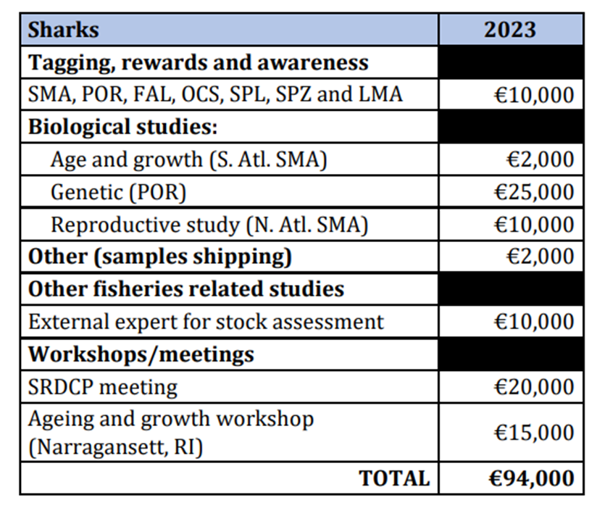
SHK Recommendations with financial implications
Provide funding for continuing the Shark Research and Data Collection Programme SRDCP:
  South Atlantic shortfin mako age and growth.
  Stock differentiation analysis for porbeagle.
  Movement, habitat characterization and post-release
  mortality for shortfin mako, porbeagle, silky, oceanic
  whitetip, longfin mako, and hammerhead sharks.
  Maturity and reproductive state of shortfin mako.
Workshop to update the BSH age and growth
information that will be used in the 2023 stock assessment.
Meeting to do a thorough assessment of the achieved
results of SRDCP and to review its ongoing activities.
(Details of funding requests on Document STF-XXX)

Slide 55
SMT - Small Tunas
SMT – SMALL TUNAS
BLF
SSM
LTA
BON
BLT
FRI
…and 7 more species
Notes:
They range in maximum size from more than 2 meters (wahoo) to just over half a meter (frigate tuna)

Slide 56
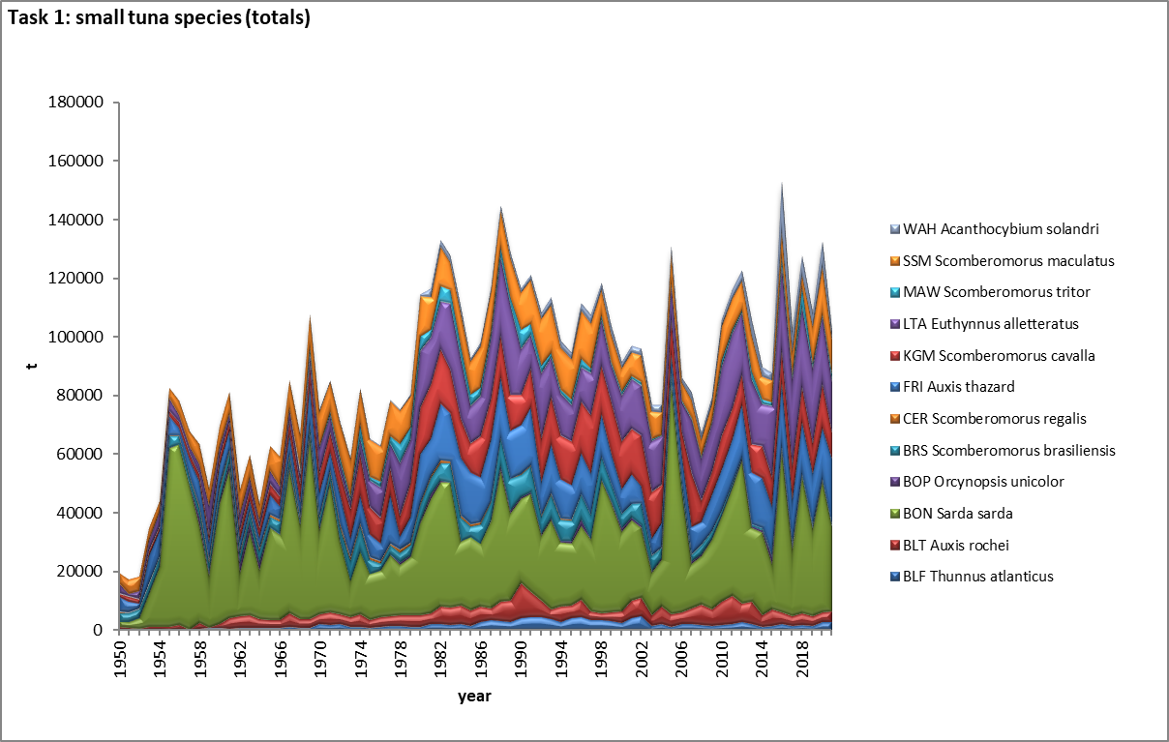
Small Tunas Fishery Indicators
Small tuna catches updated to 2021
- Reported catches are variable from one year to another.
- Important from a social and economic perspective.
- For many coastal communities it is a main source of food.
- Total landings likely underestimated, due to the difficulties in data collection.
Notes:
The 13 species of small tuna can reach high levels of catches and values in some years
Those species can have a very high relevance from a social and economic point of view, because they are important for many coastal communities in all areas and a main source of food.
Their social and economic value is often not evident because of the underestimation of the total landing figures, due to the difficulties in data collection…

Slide 57
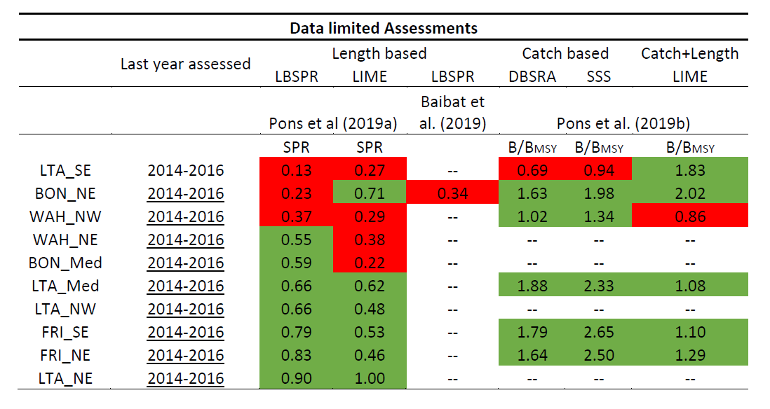
SMT State of the Stocks
Status estimated in 2019 using data-limited approaches
State of some stocks determined with a series of data-limited approaches.
In 2019 this was applied to 10 stocks: LTA_SE and WAH_NW show some signs of overfishing, deserving special attention in the future.
Notes:
How are the Small tunas being assessed (data limited approaches):
- 2016-2017: Productivity/Susceptibility analysis - Defined species with high vulnerability
- 2018: First attempts for length-based Data-Limit models; evaluation of data-limited approaches
- 2019: Pons et al (2019):
- Applied Length Based Spawning Potential Ratio – LBSPR
- Length-based Integrated Mixed Effects – LIME
Note that catch data is highly unreliable, so at this point more trust is put in the length-based models

Slide 58
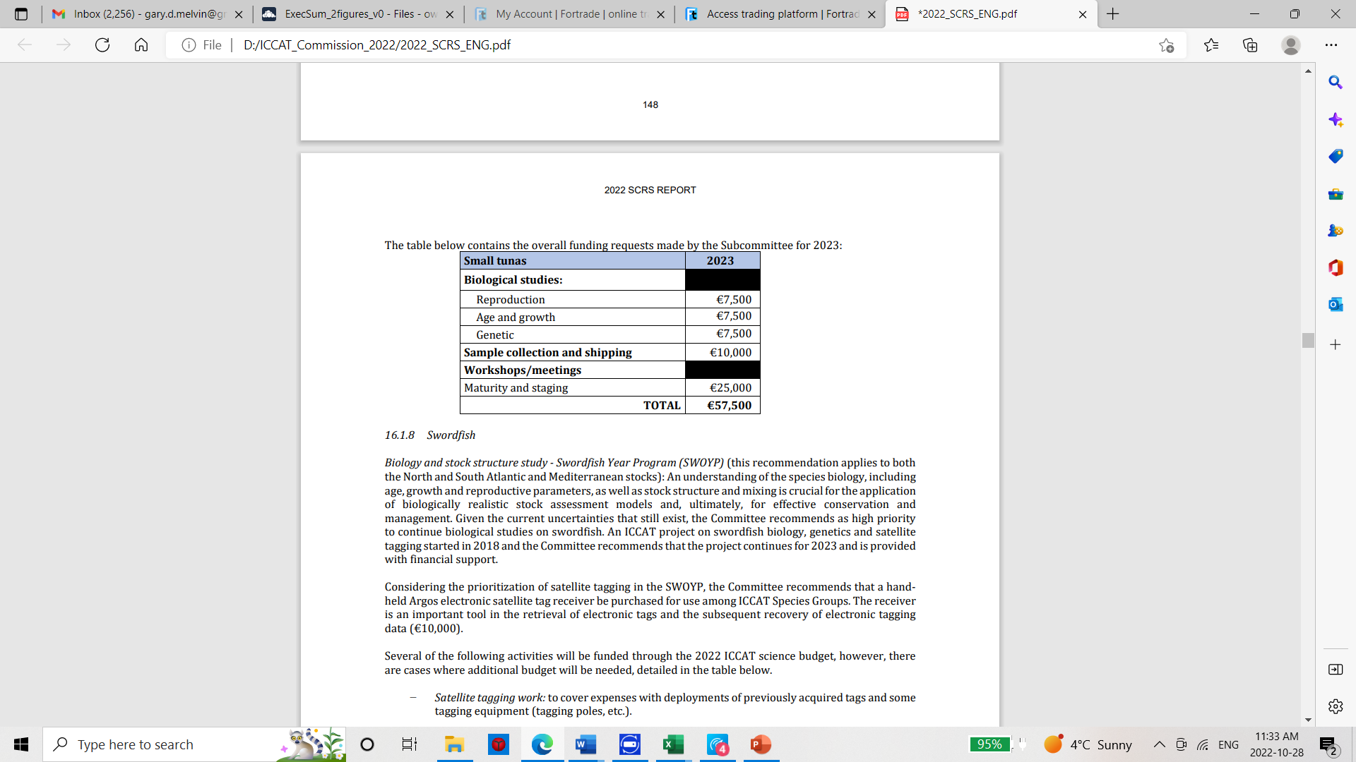
SMT Recommendations with financial implications
Continuing support to the SMTYP: The Committee recommended for 2023 to further improve the biological information on geographical coverage, growth, maturity and stock identification).
Fill remaining data gaps of the three species (WAH, LTA, BON) and continue the sampling for Auxis thazard (FRI) and A. rochei (BLT). Costs for 2023 are partly covered by the 2022 budget.
Conduct a regional workshop (in person, 4 days) on the application of data-limited methods to assess small tuna stocks. Data-limited models include integrated, length, and catch based models.
Hold a Workshop (in person, 4 days) on maturity staging (reproduction) in 2023 for small tuna stocks: This would allow for calibration and adopting internationally agreed macroscopic and microscopic maturity scales for the new studied small tuna species.

Slide 59
Thank You

