Slide 1

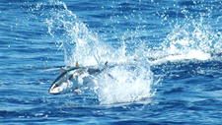
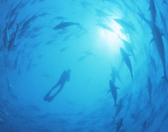
Southern Temperate Tunas
2022 ICCAT Panel 3
South Atlantic Albacore
and
Southern Bluefin Tuna

Slide 2

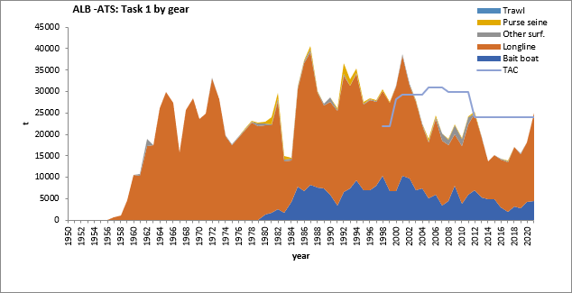
Fishery Indicators:
South Atlantic Albacore
South Atlantic Albacore
  Catch Updated to 2021
TAC 24,000t for 2017-2022.
Catches well below TAC since 2002 with the exception of 2011 and 2021 (25,006 t).
2021 catch increase attributed to longline.

Slide 3
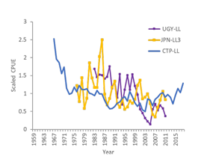
Fishery Indicators:
South Atlantic Albacore
South Atlantic
Last assessment 2020 with data up to 2018.
Fishery indicators:
  3 standardized CPUE indices updated to the most recent data available.

Slide 4
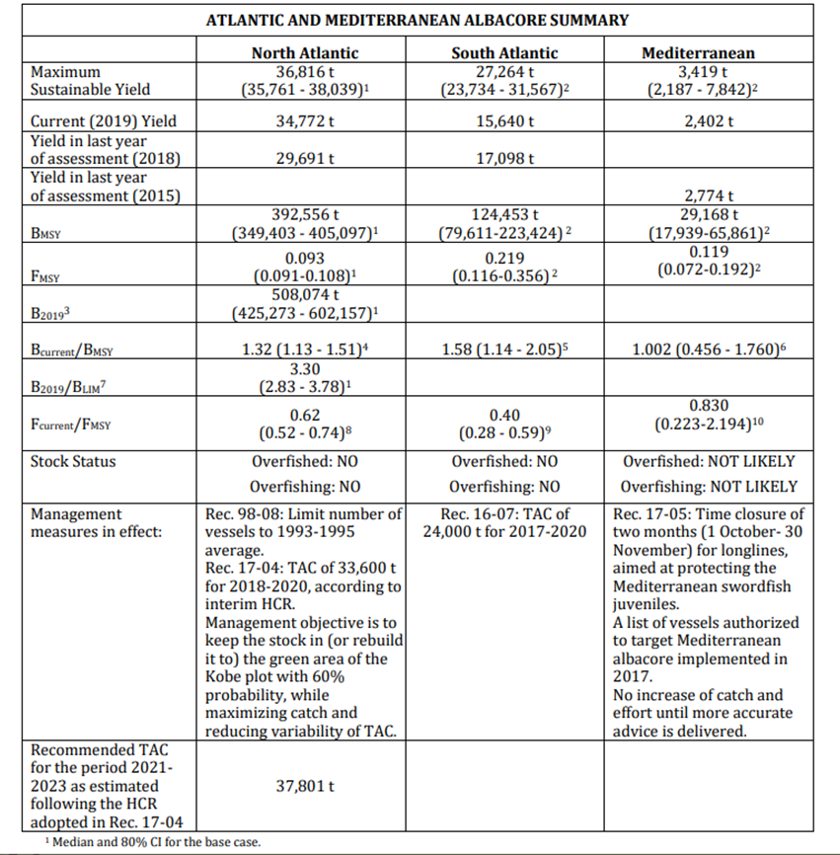
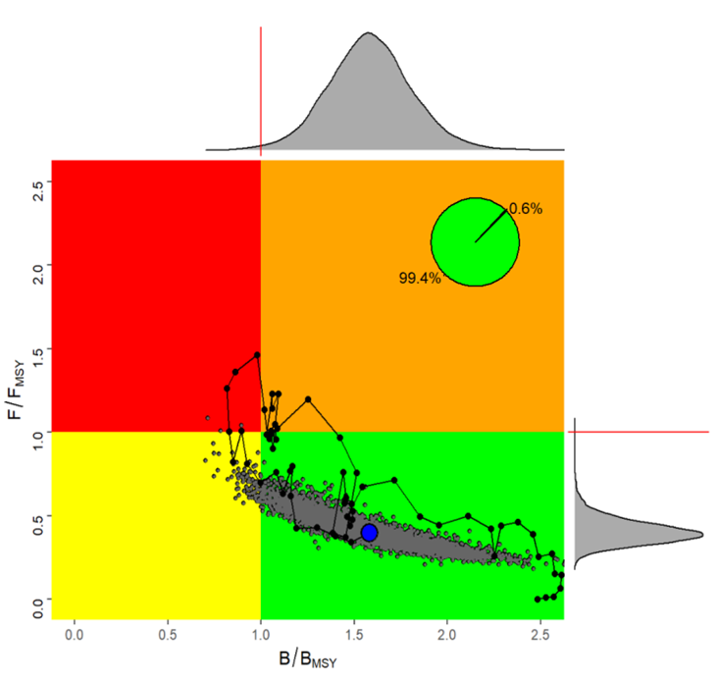
South Atlantic Albacore
Stock status:
South Atlantic albacore Kobe plot with Stock status trajectories of B/BMSY and F/FMSY over time (1956-2018).
The South Atlantic albacore stock is not overfished and overfishing is not occurring
31.0%
66.0%

Slide 5
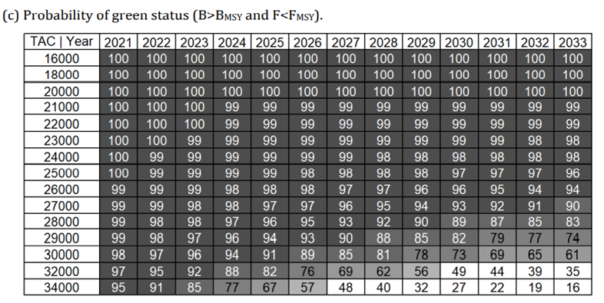
South Atlantic Albacore
Outlook and Management Recommendations
Catches consistent with current TAC (24,000 t) showed a 98% probability of being in the green quadrant of the Kobe plot by 2033.
Projections at a level consistent with MSY (27,264 t) showed that probabilities of being in the green quadrant of the Kobe plot would remain very high (90%) by 2033.

Slide 6
Work Plan
South Atlantic Stock Proposed Work Plan
Common Workplan for all ALB stocks:
To continue research activities for all the stocks within the Albacore Year program (ALBYP) with a focus on: biology and ecology, monitoring stock status, and management strategy evaluation.
Two albacore intersessional meetings are envisaged (5 days each).
South Atlantic Stock Workplan:
Continue activities on reproductive biology (including aging of analyzed individuals, using spines) and electronic tagging.

Slide 7
South Atlantic: (combined with North)
The Committee recommends continued funding of the Albacore Research Programme for North and South Atlantic stocks, as well as to start funding the research for the Mediterranean stock. Of high priority is the continuation of electronic tagging and reproductive biology studies (with associated aging of samples) in the North and South Atlantic, and to progress on the North Atlantic albacore MSE.
Recommendations with financial implications

Slide 8
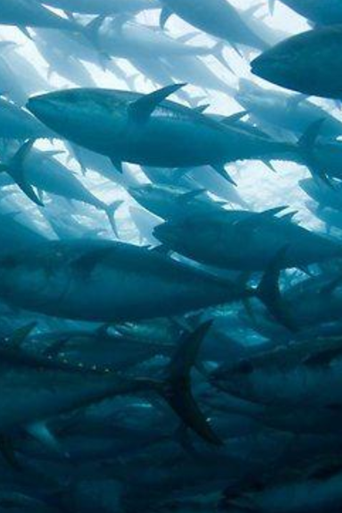
Southern Bluefin Tuna
The Commission for the Conservation of Southern Bluefin Tuna (CCSBT) is charged with assessing the status of southern bluefin tuna. Each year the SCRS reviews the CCSBT report in order to remain up to date on southern bluefin tuna research and the stock assessments carried out. The reports are available from the CCSBT.

Slide 9
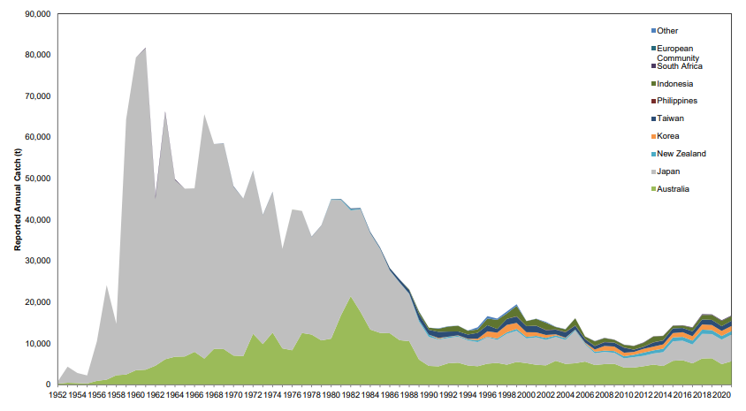
Southern Bluefin Tuna – Fishery Indicators
Annual reported catches by country for the period 1952-2021.
Catches decreased rapidly in the late 1980’s then continued to slowly decline until about 2010.
Catches have generally increased since 2010 to 16,824 in 2021.
Figure 3: Reported southern bluefin tuna catches by flag, 1952 to 2021. Note: a 2006 review of SBT data indicated that catches over the preceding 10 to 20 years may have been substantially under-reported.

Slide 10
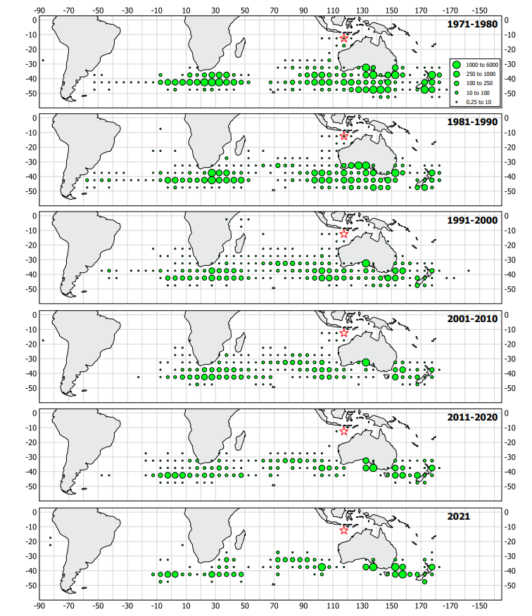
Southern Bluefin Tuna (SBFT)
Geographical distribution of average annual reported southern bluefin tuna catches (t) by CCSBT members and cooperating non-members over the periods 1971-1980, 1981-1990, 1991-2000, 2001-2010, 2011-2020, 2021 per 5° block.

Slide 11
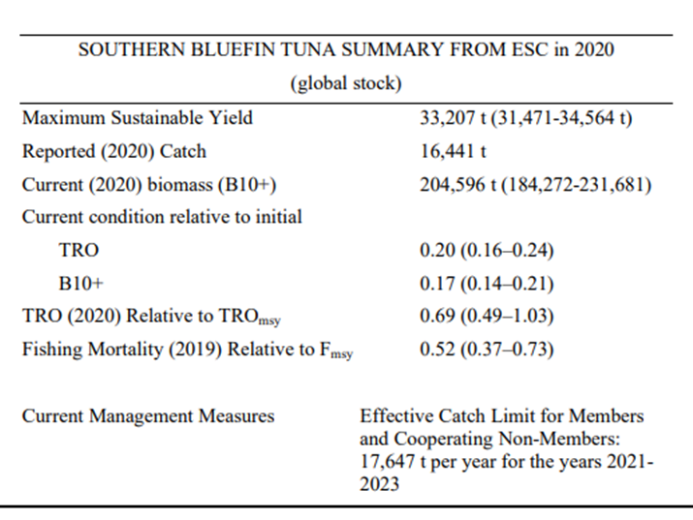
Southern Bluefin Tuna - Stock Status
No change since Last year’s (2021) report
Exploitation rate: Moderate (Below F_{MSY})
Exploitation state: Overexploited
Abundance level: Low abundance
Next stock assessment scheduled for 2023.
Stock Status:
  Overfishing: No
  Overfished: Yes
The stock remains below the level estimated to produce (MSY)

Slide 12
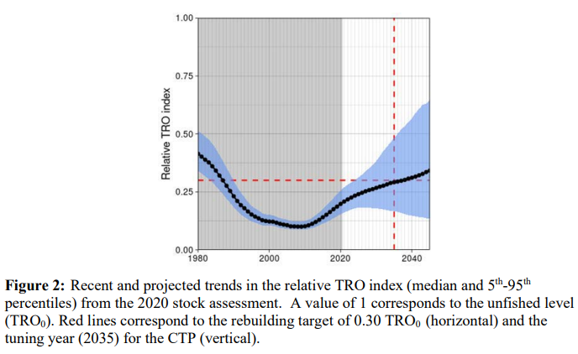
Southern Bluefin Tuna - Stock Status Summary
The stock has been rebuilding by approximately 5% per year since the low point in 2009.
The next full stock assessment is not until 2023, however, outcomes of updating in 2022, the OMs with new data and the new CPUE index undertaken provides indicates that the SBT stock is continuing to rebuild and is likely to be near or above the 20% TRO level (median result).
The ESC recommends that the global TAC in 2023 should remain at 17,647 t.
Operation of the CTP led to a recommended global TAC for 2024-2026 of 20,647 t.

