Slide 1

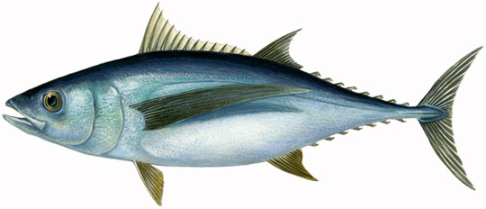
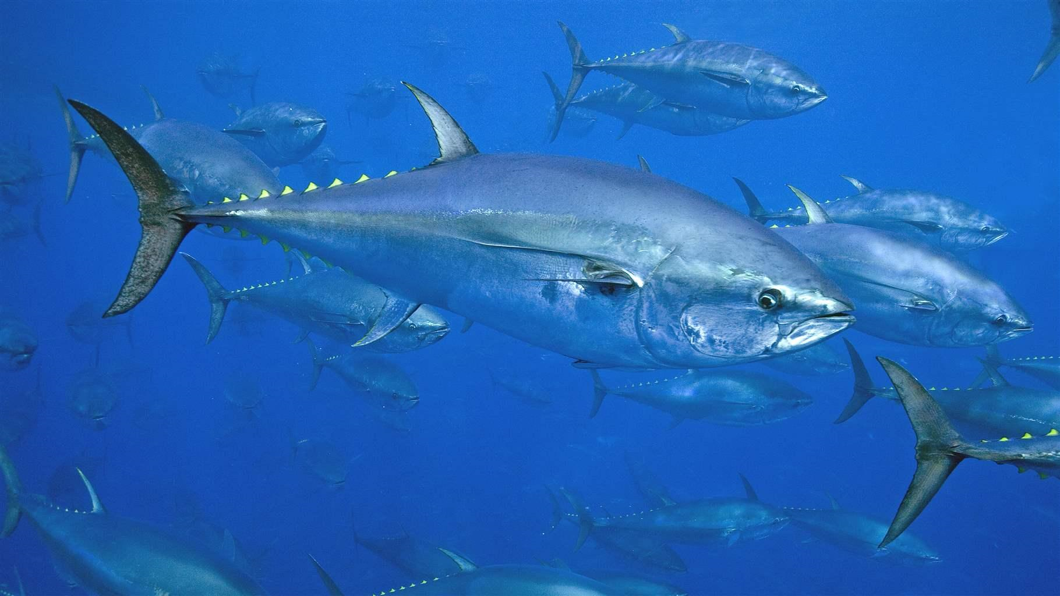
SCRS Report 2022
Panel 2 – Northern Temperate Tuna
Albacore Tuna
Bigeye
Yellowfin
Bluefin Tuna
Skipjack

Slide 2

Summary Northern Temperate Tunas
Presentation Summary
  Brief Overview of Northern Atlantic and Mediterranean Albacore stock Status
  State of Stocks and Outlook from eastern Bluefin tuna Executive Summary
  Effects of Current regulations (from Executive Summaries)
  Management recommendations(from Executive Summaries)
  BFT Workplan
  Recommendations with financial implications
  Responses to the Commission

Slide 3
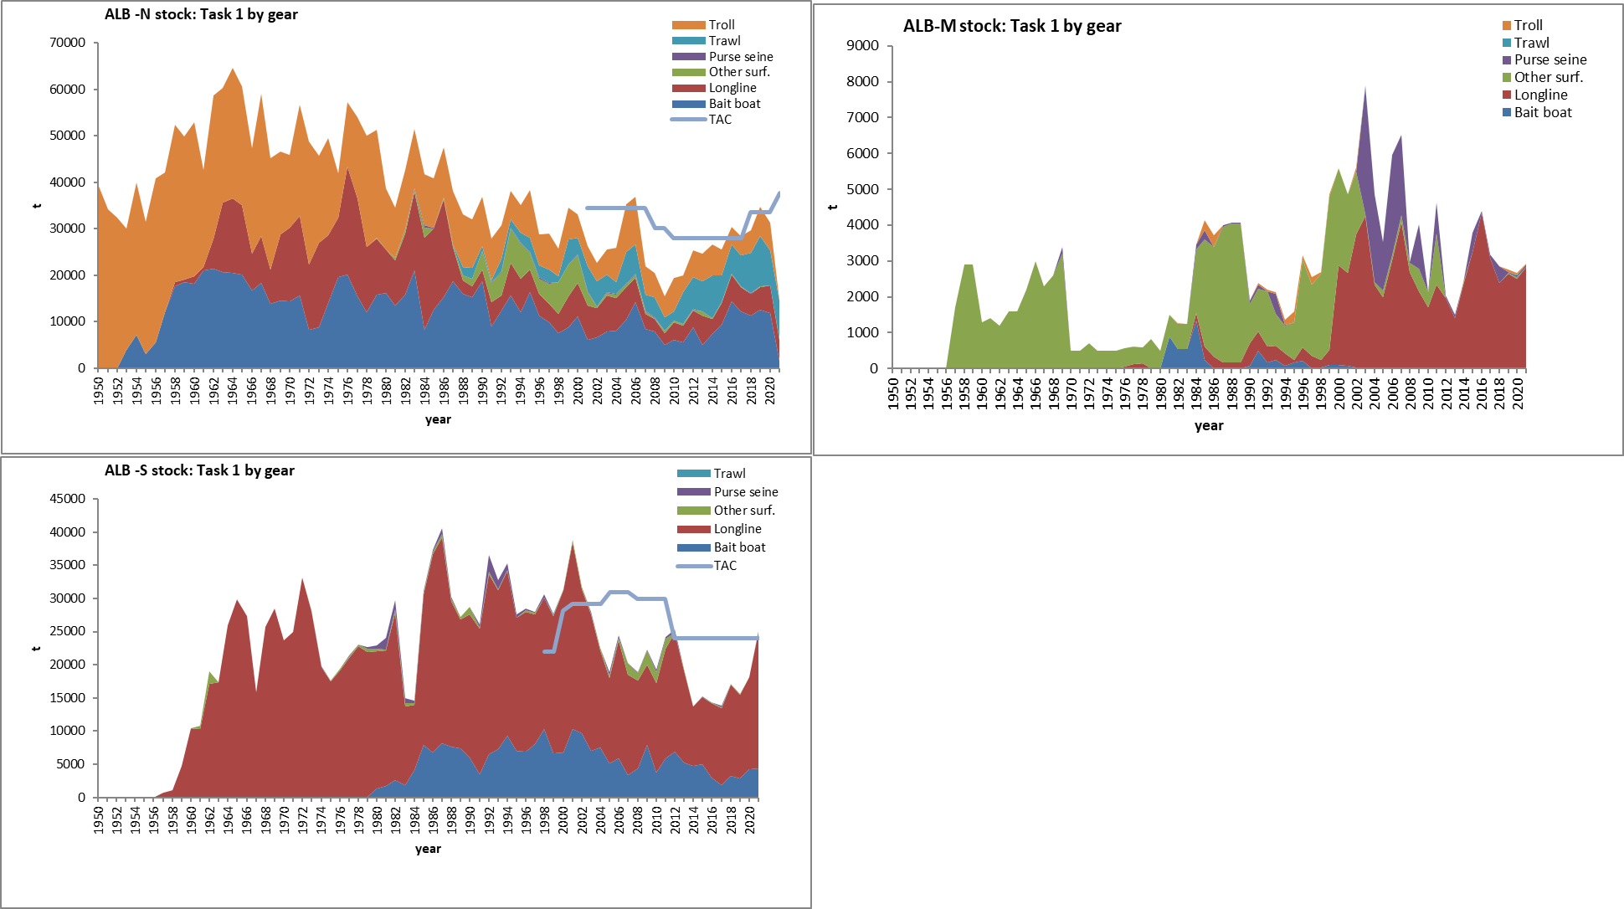
2021 State of the stock - Albacore
Total albacore catches in the North Atlantic, South Atlantic and the Med stocks to 2021.
North Atlantic Catches were less than both the TAC of 37,801t in 2021 (31,374) and < 2020 catches.
South Atlantic Albacore catches increased in 2021 from 18,171 in 2020 to 25,006t in 2021, above the TAC of 24,000.
Albacore Catches in MED increased in 2021 to 2901 from 2,675 in 2020.

Slide 4

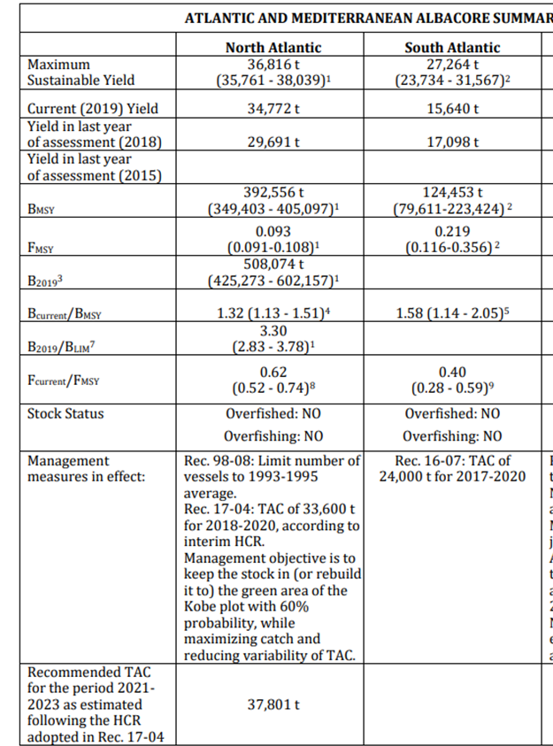
Atlantic Albacore
Stock status:
The North Atlantic albacore stock is not overfished and overfishing is not occurring
The South Atlantic albacore stock is not overfished and overfishing is not occurring
The Mediterranean albacore stock is overfished and overfishing is occurring

Slide 5
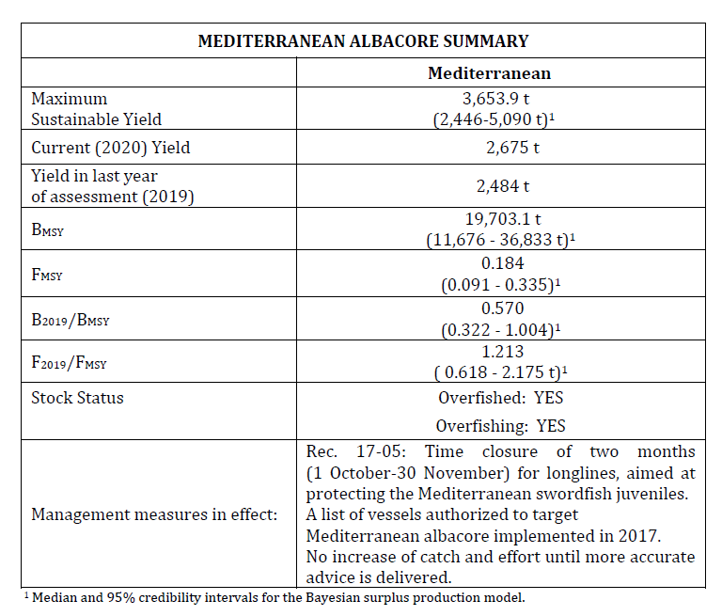
State of the Stock – MED Albacore
MED - There is considerable uncertainty about current stock status and the ability of the available CPUE series to monitor stock trends is limited.
Current fishing mortality levels (2019) are above FMSY (1.2), Median and the current biomass is below the BMSY level (0.57).

Slide 6
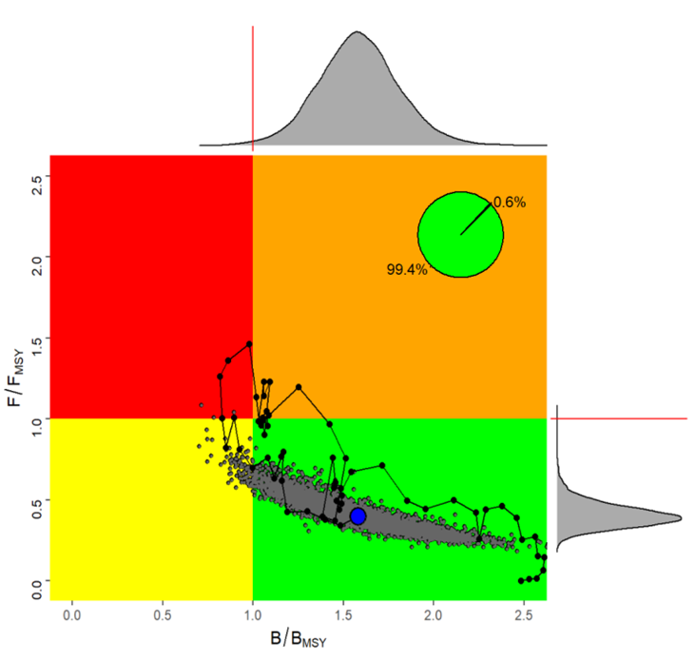
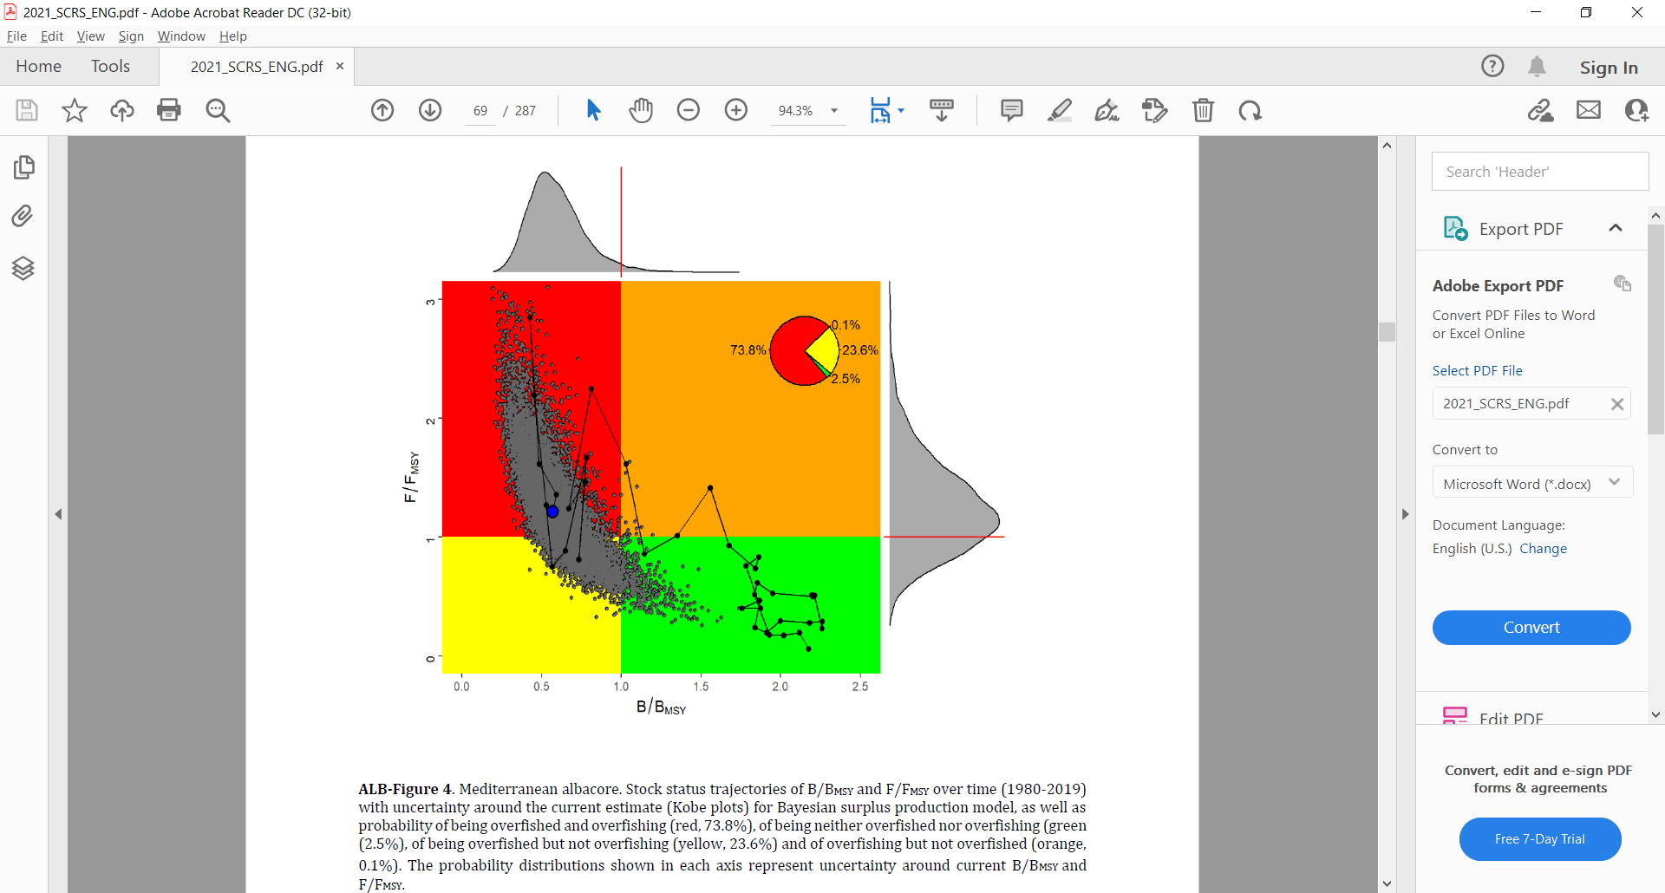
Albacore Kobe plots with Stock status trajectories of B/BMSY and F/FMSY over time (1956-2018)
Northern Atlantic Albacore.
South Atlantic Albacore.
Mediterrean Albacore.

Slide 7
North ALB Progress on MSE -2022
During 2022, the following technical tasks were conducted, in accordance with the multiyear Albacore MSE roadmap and the requirements under Rec. 21.04:
Application of the exceptional circumstances protocol and determination of whether exceptional circumstances were detected or not, using indicators defined in Rec. 21.04.
  -> See Response 17.22
Testing of alternative management procedures, as well as determining the number of CPUE series and the level of underreporting that would trigger the occurrence of exceptional circumstances.
  -> See Response 17.23
New Stock Synthesis model: initial trials for the 2023 assessment, which will serve as a basis to condition new operating models for the “second round” of the MSE.

Slide 8
Albacore Research and Workplan
Common Workplan: (North, South, Mediterranean)
Develop a comprehensive Albacore Research Programme with a focus on: biology and ecology, monitoring stock status, and management strategy evaluation. Two intersessional meetings are envisaged during 2023 (5 days each).
North Atlantic Stock Proposed Workplan:
Conduct stock assessment
Iterate the Management Procedure
Check existence of exceptional circumstances
Start developing a new MSE
Continue the reproductive biology and electronic tagging studies within the ALBYP.
Mediterranean Stock Proposed Workplan:
Conduct stock assessment (strict update with two additional years of data)
Research: set up an information network to promote collaboration among scientists working in the Mediterranean. The main objective will be the development of a detailed research plan.

Slide 9
Albacore Research Recommendations with financial implications
The Committee recommends continued funding of the Albacore Research Programme for North and South Atlantic stocks, as well as to start funding the research for the Mediterranean stock. Of high priority is the continuation of electronic tagging and reproductive biology studies (with associated aging of samples) in the North and South Atlantic, and to progress on the North Atlantic albacore MSE.
The Committee also supports further research on the use of larval indices in stock assessments, including development of larval habitat models, corrected abundance indices and their impact in the MED ALB stock assessment.

Slide 10
2022 ALBacore Responses to the Commission
17.22 Assess the occurrence of exceptional circumstances, Rec. 21-04, para 4
The SCRS shall assess the occurrence of exceptional circumstances (ECs) and the Commission shall act in accordance with the Exceptional Circumstances Protocol set out in Annex 2.
2 indicators assessed:

Slide 11
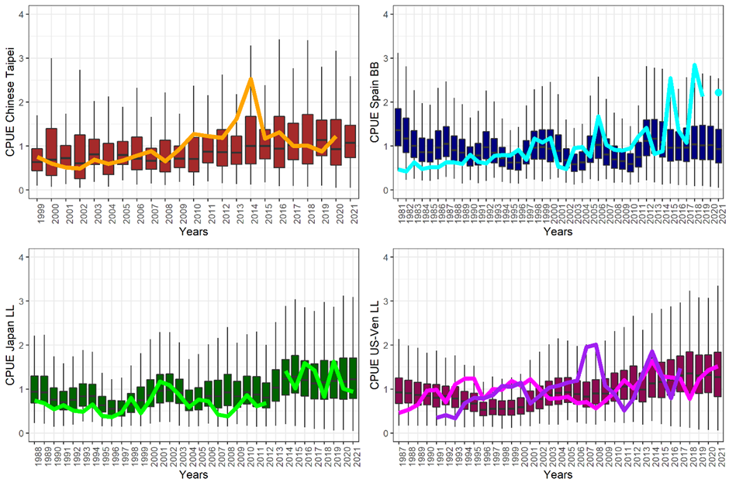
2022 ALBacore Responses to the Commission
17.22 Assess the occurrence of exceptional circumstances, Rec. 21-04, para 4
The SCRS shall assess the occurrence of exceptional circumstances (ECs) and the Commission shall act in accordance with the Exceptional Circumstances Protocol set out in Annex 2.
2 indicators assessed:
Catch (31,408t) below TAC ✓
Updated CPUEs within 2.5%-97.5% percentile range ✓
No exceptional circumstances detected

Slide 12
2022 ALBacore Responses to the Commission
17.23 The SCRS should undertake the following analyses, Rec. 21-04, para 14
(a) test further HCRs (…):
FTAR=(0.8; 0.9; 1.0) * FMSY
BTHRESH = (0.8; 0.9; 1.0; 1.1; 1.2) * BMSY
The management objective was met for any BTHRESH value as long as FTAR was kept at 0.8. When FTAR increased to 0.9, only BTHRESH values at or above 1 would meet the management objective. For FTAR equal to 1, none of the scenarios met the management objective.

Slide 13
2022 ALBacore Responses to the Commission
17.23 The SCRS should undertake the following analyses, Rec. 21-04, para 14
b) evaluate the number of CPUE series that need to be available and the percentage by which catch data are underreported, that would trigger an occurrence of exceptional circumstance
- Reduced number of CPUEs: The management objective would still be achieved in the absence of one or several series of catch per unit of effort, except when the Japanese longline index was used alone.
- Effects of underreporting: the Committee was unable to fully accomplish this task in 2022 and will provide a more complete response in 2023.
- Management objectives also met for the following scenarios:
  Carryover
  Systematic over/under catch (banking and borrowing scenario)
  25%up-20%down stability clause when B>BLIM

Slide 14

Bluefin Tuna

Slide 15
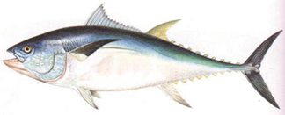
2021 Western Bluefin Tuna – Summary
Summary.
The 2021 assessment was a new and full stock assessment but restricted to two stock assessment models (VPA and Stock Synthesis) for management advice.
Significant changes to the model specifications and input data were made in 2021.
The 2021 stock assessment used 10 CPUE and two survey indices up to and including 2020 of which 5 underwent major revisions.
Management advice was based on MSY reference points with short-term advice based on an F0.1 reference point using recent recruitment.
The low recruitment observed in the 2020 assessment was estimated to have increased and returned to levels at or above the 2017 estimate.
Major differences in stock status was observed from 2020 wBFT stock assessment.
An external expert was recruited to review the assessment process and results.
TAC increased from 2,350 mt in 2021 to 2,726 mt in 2022.
Catches were 2269 and 2303 t in 2020 and 2021.

Slide 16
2022 Eastern and Mediterranean Bluefin Tuna – Summary
New stock assessment undertaken in 2022. Three assessment modelling platforms were used to conduct the assessment a virtual population analysis (VPA), Stock Synthesis (SS) and the age-structured assessment programme (ASAP) with catches updated to 2021.
Catches between 2019 and 2021 were 31,134 t, 35,038 t and 35,075 t for the East Atlantic of which 22,041 t, 24,164 t and 24,729 t were reported for the Mediterranean.
The updated eastern abundance indicators for ten abundance indices up to 2020 (seven CPUE series and three fisheries independent indices)were evaluated. It was noted that CPUE indices have been affected by regulatory measures thus, making it is difficult to distinguish regulatory effects from the effects of changes in abundance.
2022 TAC advice for EBFT was 36,000t. No 2023 TAC advice based on 2022 stock assessment is provided due to uncertainties.
2023 TAC Advice should be determined under an MSE framework with the MP to be selected by the Commission in 2022.

Slide 17
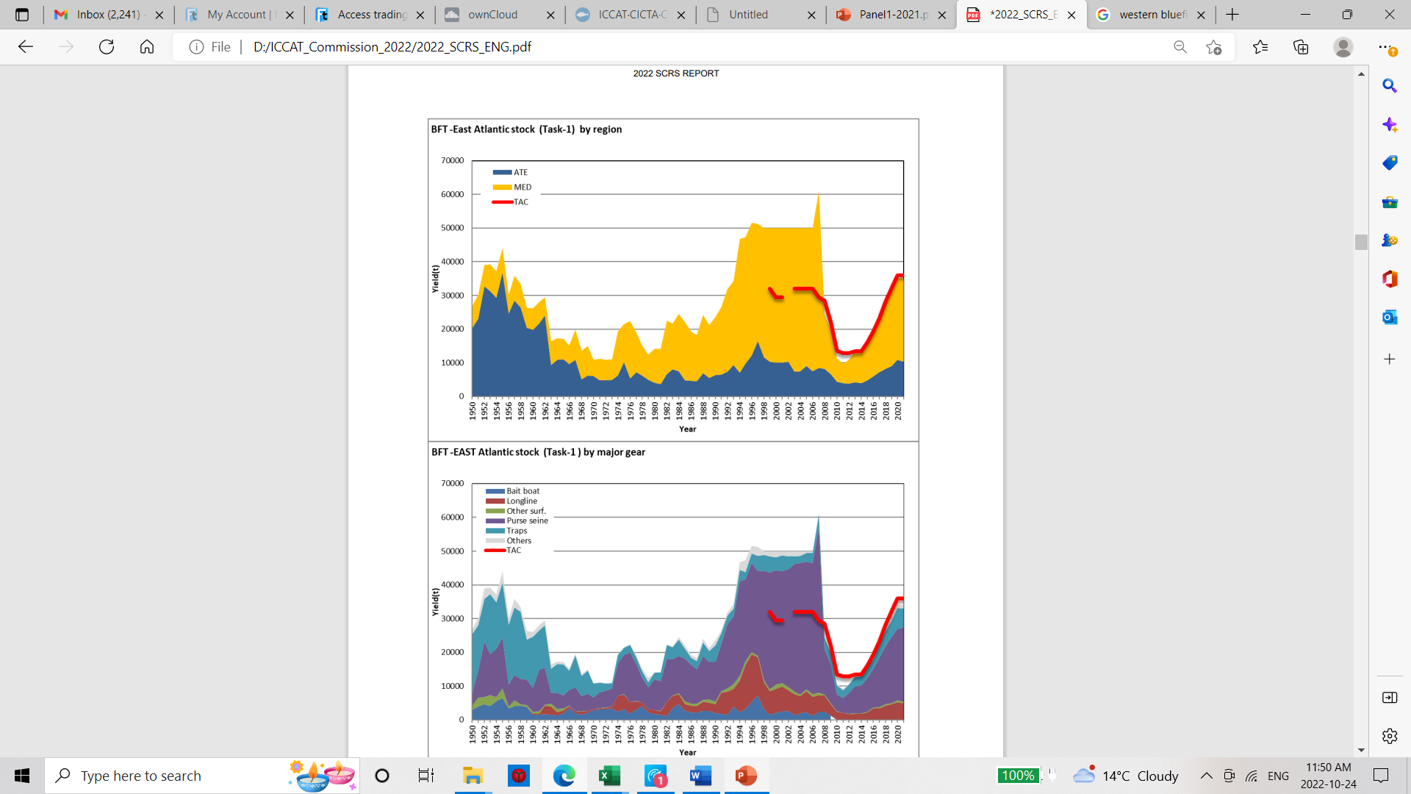
2022 Eastern Bluefin Tuna – Fishery Indicators

Slide 18
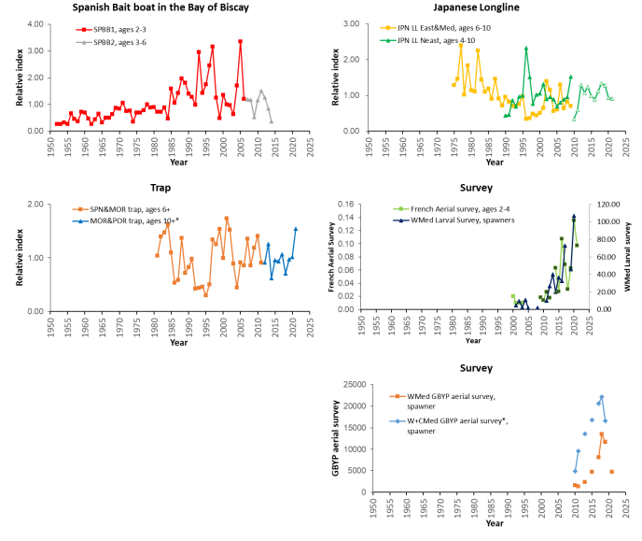
2022 Eastern Bluefin Tuna – Fishery Indicators
Indices of relative abundance for eastern bluefin tuna. Indices show mixed trends, but most remain high relatively compared to the past.
Note:
Indices denoted with “*” represent revised indices rather than strict updates of indices used in the 2020 stock assessment. Indices denoted with an “s” were used in Stock Synthesis and indices with a “v” were used in VPA.
U.S. Rod and Reel 66-114 and 115-144 indices are shown for illustrative purposes but were superseded by the combined 66-144 index.

Slide 19
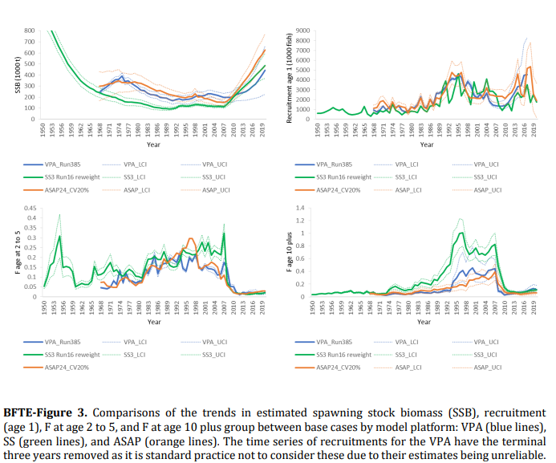
2022 eastern Bluefin Tuna – Biomass, Recruitment, Fishing mortality
Trends for all model formulations are similar for biomass, fishing mortality and recruitment since about 2010. However, the scale in SSB varies among models with ASPA showing the highest levels

Slide 20
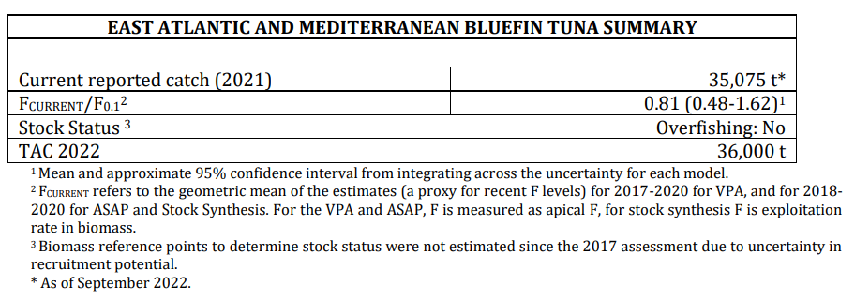
2022 Eastern Bluefin Tuna – State of the Stock
The SCRS given the uncertainties and shortcomings, supported by an independent peer review, only provides VPA short-term projections for informative purposes.
Factors contributing to uncertainties include mixing between the stocks, recruitment, age composition, age at maturity, the possibility of regime shifts, assumptions regarding selectivity, and indices of abundance.
Highly uncertain estimates of recent recruitment and absolute biomass, make short-term catch advice based on F0.1 not robust for evaluating a particular TAC and the
accuracy of absolute F0.1 estimate.
An independent review also recommended against projections for management advice.
Management advice is based on a F reference point to project short-term catches based on recent recruitments. F0.1 has been considered a reasonable proxy for FMSY since 2018.

Slide 21
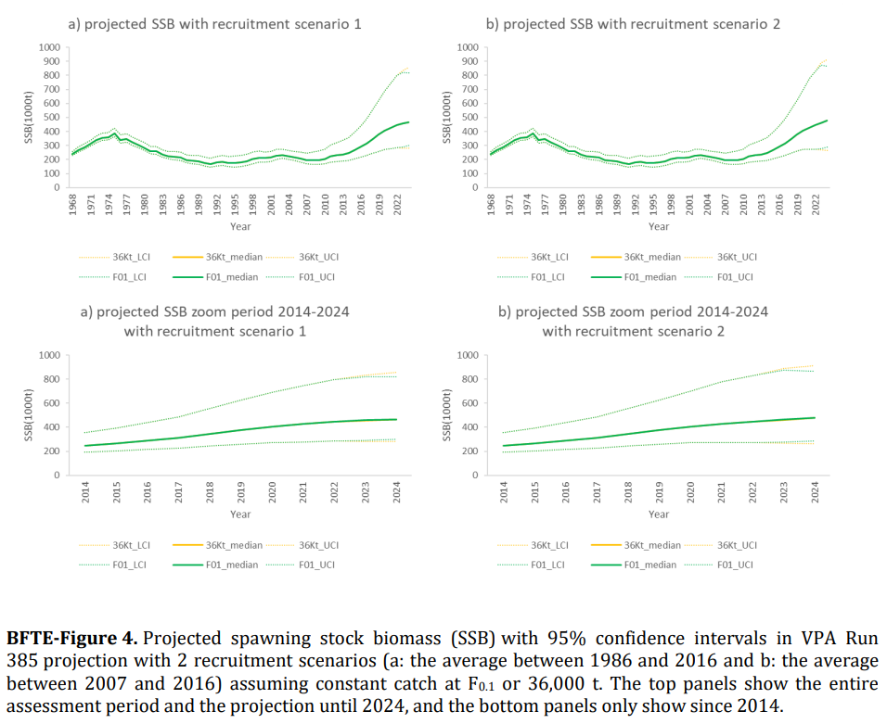
2022 Eastern Bluefin Tuna – Projections/Outlook
Outlook
Current catch advice based on F0.1 is not robust in terms of both the consequences of taking a particular TAC and the accuracy of absolute F0.1 estimate. Thus, the Committee only provided VPA short-term projections and only for informative purposes.
Regardless, indications are that the spawning biomass will increase for the next two years under both scenarios (35,000 t and 38,500 t for 2023 and 2024) and both recruitment assumptions.
.

Slide 22
2022 Eastern Bluefin Tuna – Recommendations
Current catch advice based on F0.1 is not robust in terms of both the consequences of taking a particular TAC and the accuracy of absolute F0.1 estimate. Thus, the Committee only provided VPA short-term projections and only for informative purposes.
The Committee recommends that the Commission adopts one of the MSE-tested management procedures and that the TAC be set based on that MP for 2023 and beyond.
However, should the Commission not adopt an MP, the Committee sees no undue risk to the stock for a rollover of the present TAC for 2023 (36,000 t). This is based a review of the stock indicators and the trends in the VPA projections that indicate increases in the stock under the current management.

Slide 23
ABFT Workplan for 2023
Intersessional Meetings:
a) MSE Technical team (January/February)
b) BFT intersessional meeting (5 days hybrid meeting, June/July):
c) Panel 2 March 2023 (initial discussions with Panel on Exceptional Circumstances Provisions)
d) Panel 2 October/November 2023 (Finalize Exceptional Circumstances provisions)
2. Work on Responses to the Commission
Continue analysis to estimate catch rates, defined as nominal CPUE,per vessel size and gear type.
Develop response to the Commission on observer coverage.
3. Hold 3 technical workshops:
CKMR/genomics for ABFT and BFT biological sampling coordination
BFT electronic tagging (not for SCRS official schedule)
BFT larval surveys (not for SCRS official schedule)
4. Technical Subgroup Activities: (focused research teams to address specific issues)
    BFT Technical Sub-group on Farm Operations to address methodological improvements in the monitoring of transfers and in the estimation of the size and biomass of the tuna fattened in the farms.
    CKMR for ABFT and BFT biological sampling coordination
    BFT electronic tagging and BFT larval surveys

Slide 24
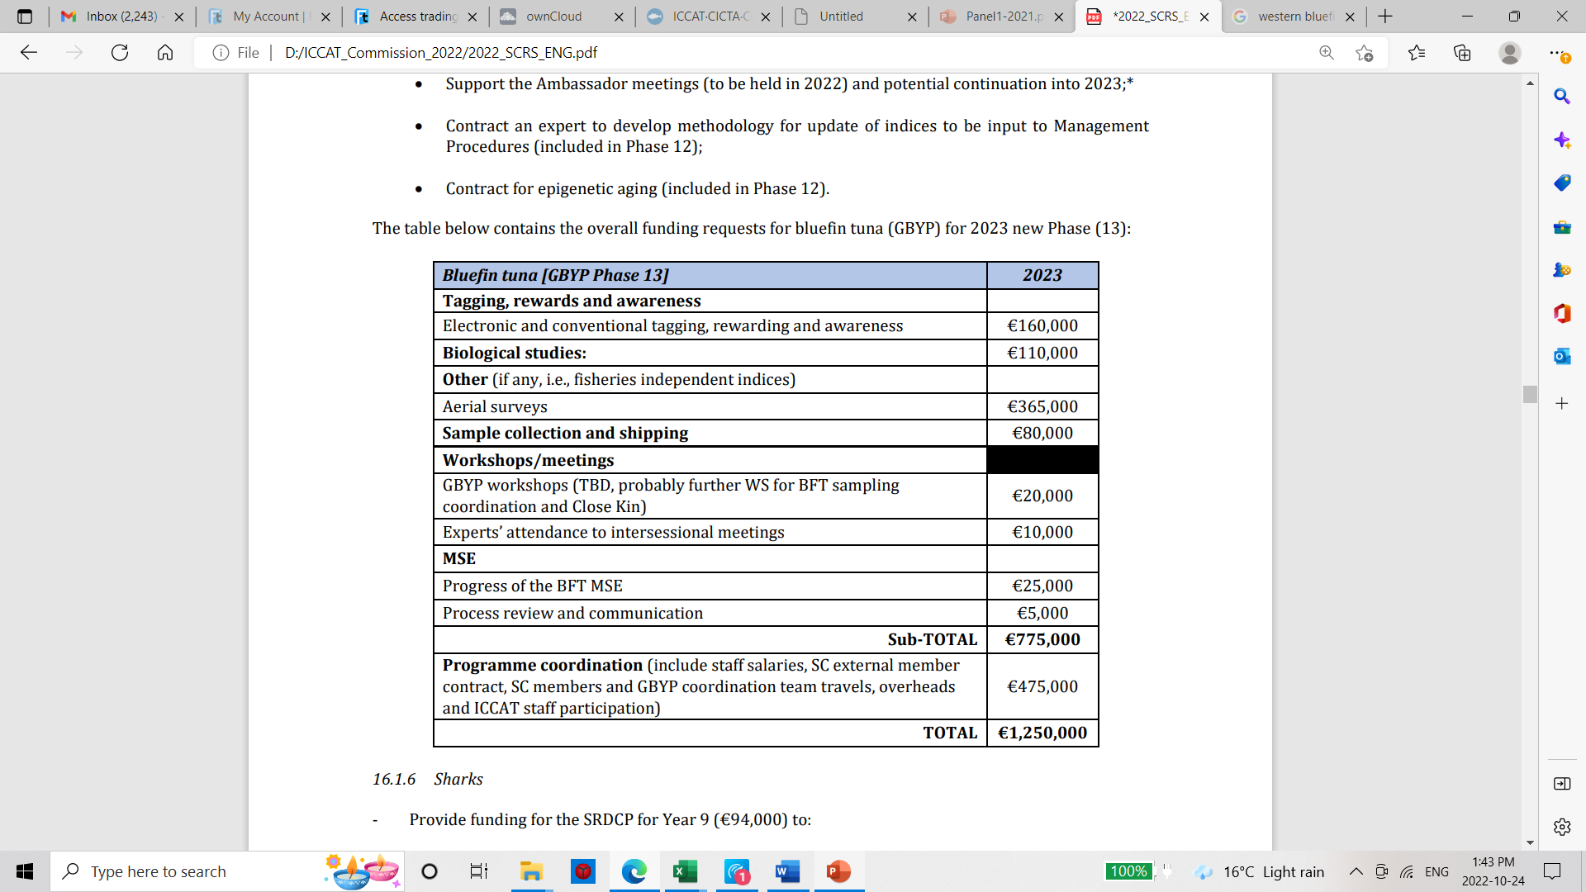
BFT Research Recommendations with financial implications
2023 BFT Budget:

Slide 25
ABFT Progress on MSE -2022
The SCRS has made substantial progress in testing candidate management procedures (CMPs) and considers the MSE to be complete. There are now two CMPs remaining, providing viable, robust options for setting total allowable catches (TACs) for both Atlantic bluefin tuna stocks in 2023 and beyond.
The OMs were reconditioned to reflect catch and index data through 2020, reviewed and accepted.
The 6 Ambassador Programme meetings (2 meeting in 3 languages), provided valuable insight on the MSE process and outcomes for all stakeholders.
Key performance statistics have been identified for Management Objectives for status, safety, yield and stability.
The reference grid of 48 OMs contains 4 Factors: Recruitment (3 levels), Spawning fraction/Natural mortality rate for both stocks (2 levels), Scale (4 levels), and Length composition weighting in likelihood (2 levels). OM Plausibility weights were also adopted.
A MSE Code review indicated that ICCAT can be confident about the validity of implementation of the main code components.

Slide 26
2022 MSE Decisions
Operational management objective for Safety: LD*10% of LD*15% [No CMPs meet LD*10%, SCRS recommends using decision point 2 for added precaution,
Operational management objective for Stock Status: 60% or 70% PGK. [This is the most influential decision on the yield vs. status tradeoff.]- Data to be provided on 65%
Management cycle length: 2- or 3-yr TAC setting. [Either interval can meet PA2 objectives but see (4), below.]
Operational management objective for Stability: for 3-yr TAC setting and PGK60% [For 60%PGK and 3-yr, SCRS recommends moving the default stability from +20/-30% to +20%/-35% to meet LD*15%.]
Management procedure: BR, FO, LW or TC. Only BR and FO remain
Timeframe for review of Management Procedure: Agreed to 6 years at last P2 meeting

Slide 27

2022 ABFT Responses to the Commission
17.11 The SCRS to provide new TAC advice in 2022 if the MP is not available yet. Rec. 21-07, para C
Background: Should the MSE process not be completed in order to allow adoption of a management procedure (MP) in 2022, the Commission shall establish a TAC for 2023 taking into account additional SCRS advice in 2022, which would include consideration of updates of the fishery indicators. In support of the development of this advice, CPCs shall make special efforts, inter alia, to update abundance indices and other fishery indicators in 2022 and provide them to the SCRS
The SCRS has updated all indices used for the western area up to year 2021. With the completion of the MSE, the full suite of CMPs is now available (see section 17.14). With regards to western TAC advice, should the Commission not adopt a management procedure in November, the SCRS sees no undue risk to the stock for a rollover of the existing TAC for the West (2726t) for 2023 based on the updated indices.

Slide 28
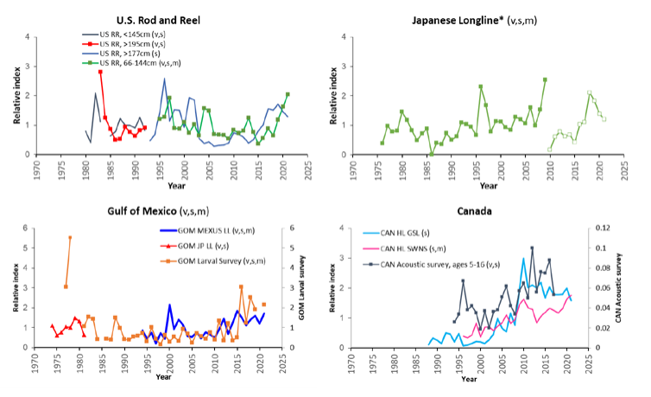
2022 ABFT Responses to the Commission
Indices of abundance for western Bluefin tuna.

Slide 29
2022 ABFT Responses to the Commission
17.12 The SCRS to provide advice on any potential impacts due to uncertainties of implementing an
F0.1 strategy. Rec. 21-07, para.
Background: By 2022, the SCRS shall provide the Commission with advice on any potential impacts due to uncertainties (including regarding the spawner-recruit relationship) of implementing an F0.1 strategy, and, for any identified risks, advise how they could be addressed in future management decisions.
The Committee notes that many of the concerns about the risks of an F0.1 strategy, either with respect to danger to the stock or loss of yield arise out of potential incorrect assumptions about the spawner-recruitment relationship. For instance, F0.1 could be higher or lower than FMSY, depending on the nature of the spawner recruit relationship. In contrast, all of the CMPs tested in the MSE achieve operational management objectives regardless of the assumed underlying stock recruitment relationship indicating inherent robustness to this fundamental source of uncertainty.

Slide 30
2022 ABFT Responses to the Commission
17.13 The SCRS to provide new TAC advice in 2022 if the MP is not available yet. Rec. 21-08, para 5
Background: The total allowable catches (TACs), inclusive of dead discards, for 2022 shall be set at 36,000 t, in accordance with the SCRS advice. The TACs for 2023 and thereafter shall be decided at the 2022 Commission annual meeting in accordance with an MP or based on new SCRS advice in 2022 if the MP is not available yet.
Should the Commission not adopt a management procedure in 2022, the Committee sees no undue risk to the stock for a rollover of the present eBFT TAC for 2023 (36,000 t).

Slide 31
2022 ABFT Responses to the Commission
17.14 The SCRS shall continue its MSE work, testing candidate management procedures, including HCRs, which would support management objectives to be agreed by the Commission. Rec. 21-08, para 11
Background: Based on the SCRS inputs and advice, and a dialogue process between scientists and managers, the Commission shall select in 2022 a management procedure for Atlantic bluefin, including pre-agreed management actions to be taken under various stock conditions for the provision of the TAC advice starting for 2023.
The SCRS has nearly completed a multi-year process of development of MPs in partnership with Panel 2. It anticipates Panel 2 being able to recommend one or a short-list of MPs for adoption by the Commission at its November meeting for TAC setting for 2023 and beyond. The Committee has also provided (SCRS/2022/169) details on results and performance of the CMPs.
Exceptional circumstance protocols that cover situations where the advice from the MP could potentially not be followed, requiring some alternative TAC advice are scheduled for 2023. The occurrence of exceptional circumstances will be checked annually by the SCRS.

Slide 32
2022 ABFT Responses to the Commission
17.15 The SCRS should review fishing capacity parameters of the different CPCs no later than 2022,
including specific rates for gear type and fishing area. Rec. 21-08, para 16
Background: Each CPC shall adjust its fishing capacity to ensure that it is commensurate with its allocated quota by using relevant yearly catch rates by fleet segment and gear proposed by the SCRS and adopted by the Commission in 2009.
Last year the SCRS reviewed and updated catch rates of fleets targeting eastern bluefin tuna by main fishing gear and vessel size category. Of the 3,000 registered vessels, a small fraction (~12%) accounts for approximately 86% of the catch. These represents a constant and active fleet which allows providing reliable estimates of nominal catch rates (CPUE, tons per day fished) by vessel and gear category. Due to the workload this year, the BFT Species Group has not been able to define an estimate of "potential fishing activity“. Unfortunately, only one CPC (SCRS/2020/017)for one fleet provided information to the Secretariat and the SCRS in the last two years.

Slide 33
2022 ABFT Responses to the Commission
17.16 Based on the result of the trials and other scientific information available, the SCRS shall review
and update the growth table published in 2009. Rec. 21-08, para 27 - SCRS ongoing research for several years to develop a farm growth model.
Farm growth rates were estimated based on the in-situ tagging experiments, ROP cage harvest data, and cross-checked with data from modal progression analysis, differed from wild growth rates.
Weight at harvest modeled as a function of the time spent in farm, the initial size at caging, and other factors that may account for the differences among farms. Time steps were monthly for the 1st year and quarterly for the 2nd and 3rd year due to low number of observations.
Although the area, month of harvest, year and month of catch were statistically significant, their influence on the predictions were minor, and they were not used for the purpose of producing a table of expected weight at harvest.

Slide 34
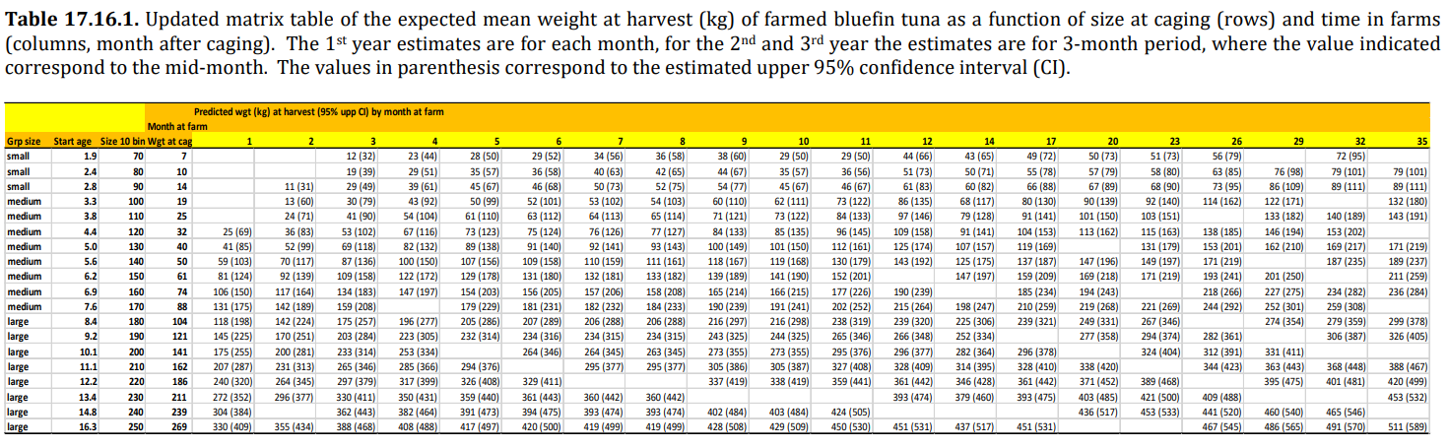
2022 ABFT Responses to the Commission
Summary modeled growth rates of BFT in Farm cages (weight):

Slide 35
2022 ABFT Responses to the Commission
17.17 The SCRS to advise to what extent the fishing seasons for different gear types and/or fishing
areas might be extended and/or modified. Rec. 21-08, para 32
Background: Not later than 2022, the Commission shall decide to what extent the fishing seasons for different gear types and/or fishing areas might be extended and/or modified based on the SCRS advice without negatively influencing the stock development and by ensuring the stock is managed sustainably.
The Committee has never provided advice on the appropriate length or timing of fishing seasons in relation to stock development, and the length of the current fishing seasons was determined without input from the Committee. This request is broad in scope, considering fleet diversity, spatial coverage and seasonality. The Committee requests more detail on the issues to be addressed in order to conduct proper data compilation and analysis. Assuming the Commission provides clarification to the SCRS in 2022, a response could be available by 2023.

Slide 36
2022 ABFT Responses to the Commission
17.18 The SCRS shall report on the coverage level achieved by each CPC and provide any recommendations to improve the effectiveness of CPCs’ observer programmes. Rec. 21-08, para 99
Background: For the scientific aspects of the programme, the SCRS shall report on the coverage level achieved by each CPC and provide a summary of the data collected and any relevant findings associated with those data. The SCRS shall also provide any recommendations to improve the effectiveness of CPCs’ observer programmes
The Committee cannot respond to the observer coverage request this year due the lack of available/appropriate data.
The SCRS reminds the Commission that Rec. 21-08 paragraph 98 states that the requirements and procedures required to undertake this analysis are to be developed by the Commission by 2023 taking into account CPC confidentiality requirements.
The SCRS looks forward to understanding what these requirements and procedures are so that it may provide recommendations on how to improve the effectiveness of CPC’s observer programmes (specified in paragraph 99).

Slide 37
2022 ABFT Responses to the Commission
17.19 The SCRS should evaluate procedures and results related to the stereoscopic camera programme (or alternative methods) provided by CPCs and report to the Commission at the next annual meeting. Rec. 21-08, para 173
Background: Each farm CPC competent authority shall submit the procedures and results related to the stereoscopic camera programme (or alternative methods) to the SCRS by 31 October annually. The SCRS should evaluate such procedures and results and report to the Commission at the next annual meeting.
ICCAT Recommendations require that the reports should be submitted with a specified list of information, but there is no requirement for stereo camera footage to be sent.
The SCRS has concerns about the 20% minimum requirement (Rec. 21-08) for SFL sampling intensity being sufficient or representative of the fish in the cage.
The SCRS recommends that CPCs provide the entire stereo camera footage for each transfer operation to the Secretariat, so that the SCRS can take a random sample to study this issue in different regions.
The SCRS will continue to investigate AI technology as a means of making the counting and size/weight determination of caged fish

Slide 38
2022 ABFT Responses to the Commission
17.20 The SCRS should develop an algorithm to convert length into weight for fattened and/or farmed
fish. Rec. 21-08, para 217
Background: The caging of the bluefin tuna at the farm of destination shall be subject to the requirements for caging operations laid down in paragraphs 156 to 171, including a video record to confirm the number and weight of the bluefin tuna caged and the verification of the operation by an ICCAT Regional Observer. The determination of the weight for caged fish from another farm, shall not apply until the SCRS has developed an algorithm to convert length into weight for fattened and/or farmed fish.
The solution cannot be found by estimating a generic L-W relationship from fish harvested on the farms, as doing so would ignore the gain in weight and size as a function of time at the particular farm and depending on the initial size of the fish at caging.
This request is addressed with the updated growth table for E-BFT as a function of the initial size of the fish at caging and the time spent on the farm (Item 17.16).

Slide 39
2022 ABFT Responses to the Commission
17.21 The SCRS shall review the stereoscopic cameras systems specifications, and if necessary, provide
recommendations to modify them. Rec. 21-08, Ann. 9, item vii
Background: The report on the results of the stereoscopic program should include details on all the technical specifications above, including the sampling intensity, the way of sampling methodology, the distance from the camera, the dimensions of the transfer gate, and the algorithms (length-weight relationship). The SCRS shall review these specifications, and if necessary, provide recommendations to modify them
The issue of sampling intensity is addressed in item 17.19 of the 2022 SCRS report, Unfortunately, due to the workload of the Bluefin Tuna Species Group, the Committee was unable to review the technological detail of the stereoscopic camera system in 2022.

Slide 40
Tentative SCRS 2023 Calendar
Note: Slight changes from SCRS Report.
1 week postponement for the Tropical Tuna Species Group (including MSE) and the PA4 on N-SWO MSE due to a 90 day notification requirements.

Slide 41
Thank You

Slide 42
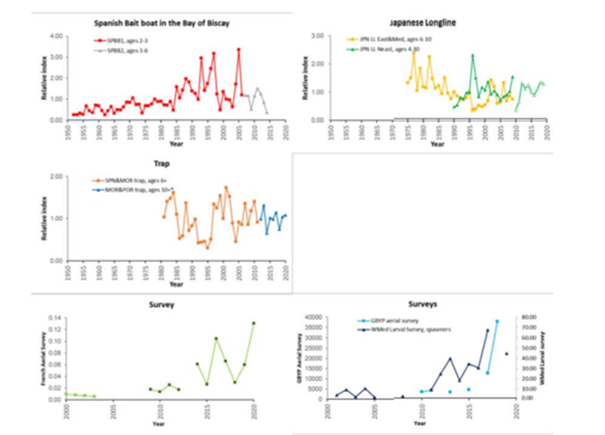
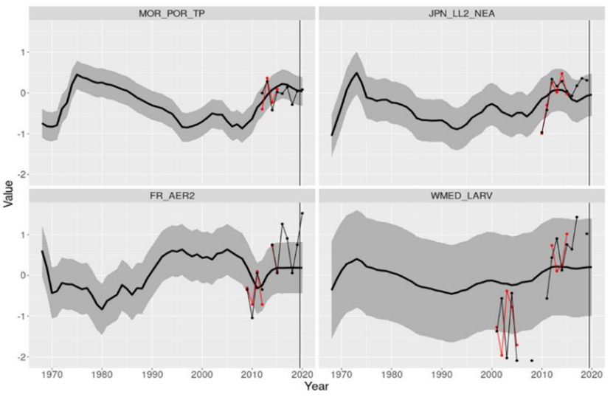
2021 ABFT Responses to the Commission
Eastern Atlantic bluefin tuna
21.24 The SCRS shall annually advise on the TAC. Rec. 20-07, paragraph 1 (Rec. 19-04, para. 5)
Figure 21.24.1. Updates of indices of abundance for the E-BFT presented in 2021.
Figure 21.24.2. Updated indices (values post 2019, black line) compared with the 80% prediction intervals from the 2017 VPA projected forward.

Slide 43
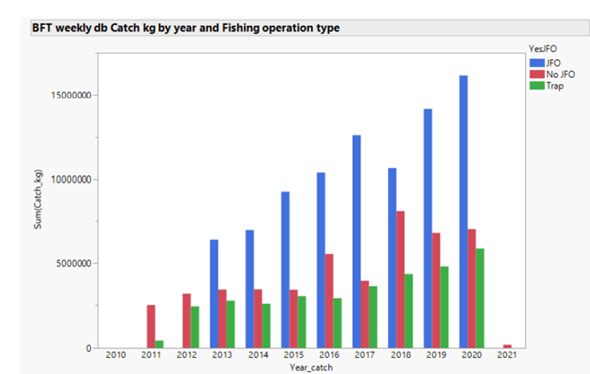
2021 ABFT Responses to the Commission
Eastern Atlantic bluefin tuna
21.25 SCRS should review no later than 2021, and each time an eastern Atlantic and Mediterranean
bluefin tuna stock assessment is performed, CPCs fishing capacity is commensurate with its allocated
quota by using relevant yearly catch rates by fleet segment and gear proposed by the SCRS and adopted
by the Commission in 2009. Rec. 20-07, para 4 (18)
The ICCAT Commission in 2019 requested to review and update the catch rates of fleets targeting E-BFT by main fishing gear and vessel size category to the SCRS. Since 2010 several changes and regulations have been implemented (Rec. 10-04, Rec. 12-03, Rec. 14-05, Rec. 18-02, Rec. 19-04) that impacted the activity of the fleets targeting this resource, bluefin farming operations have become the main destination of the catches, and e so-called “Joint-Fishing = Operations” (JFO)have become the primary type of fishing operation for the East bluefin stock in terms of total catches (Figure 21.25.1).

Slide 44
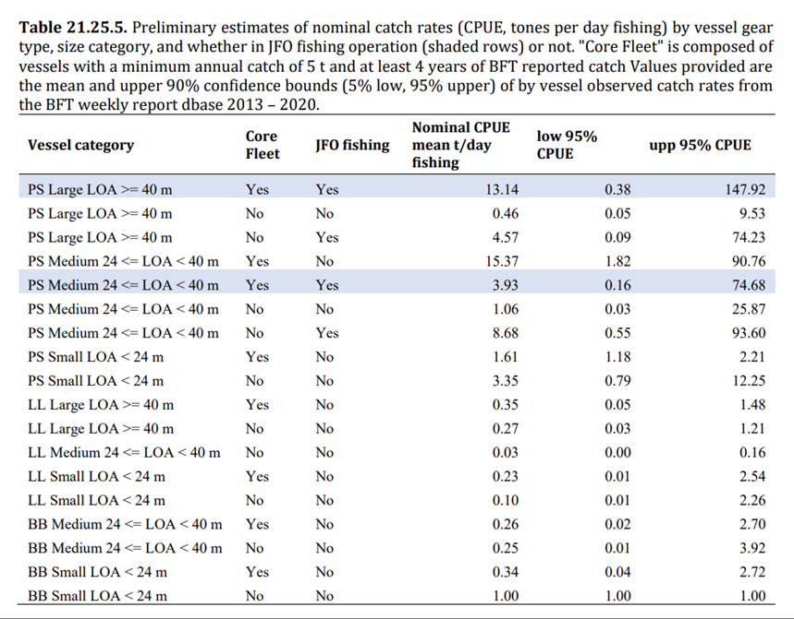
The SCRS defines catch rates as nominal CPUE
(CPUE) per vessel (i.e. catch and effort, measured as fishing days from the VMS data that is associated with each vessel).
Note:There are over 3000 vessels registered for E-BFT fisheries, however of these vessels (~12%) account for about 86% of the
Catch.

Slide 45
ABFT Responses to the Commission
21.26 SCRS to identify growth rates including in weight and size gains during the fattening period, and
review and update the growth table published in 2009, and the growth rates utilized for farming the
fish referred to under paragraph 35 c, and considering the difference among geographic areas
(including Atlantic and Mediterranean) in updating the table. Rec. 20-07, para 8 (Rec. 19-04, para 28)
The SCRS initiated, through the GBYP, numerous farm-based field studies in different geographical areas and established a Subgroup to analyze the data and facilitate the elaboration of a single and coordinated answer.
Major limitations encountered during the early stages of the study for individual fish measurements tagged in cages (high mortality of large tagged fish).
The Subgroup concluded that different methodological approaches, from individual growth studies (based on tagging) and whole cage-based growth studies to a broader analysis based on the available length/weight data from stereo camera measurements at caging, harvesting sampling data and eBCDs, should be combined to address the Commission’s request.
Due to time constraints, only results for the whole farm caged fish population. not split by geographical area or other parameters are available. The finalized tables require additional analyses and will be completed in 2022.

Slide 46
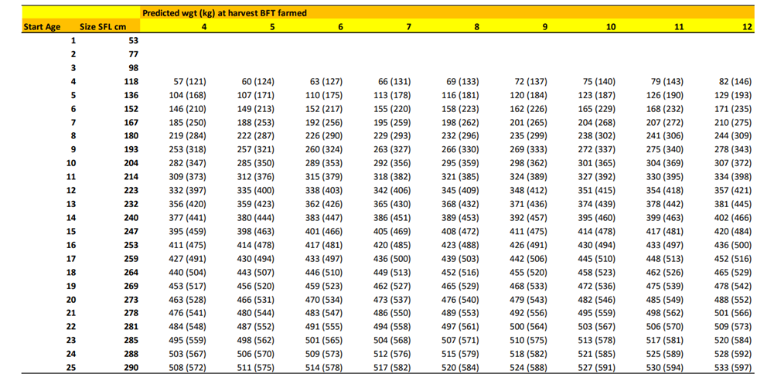
ABFT Responses to the Commission
Table 21.26.1. Updated matrix of the expected “mean weight” at harvest of farmed bluefin tuna as function of length and weight (straight fork length, FL; round weight, RWT) at caging (rows) and time in farms (columns, months after caging). The values in parenthesis correspond to the upper 90% confidence interval, which could be considered a reasonable proxy for the ‘maximum’ growth rate.

Slide 47
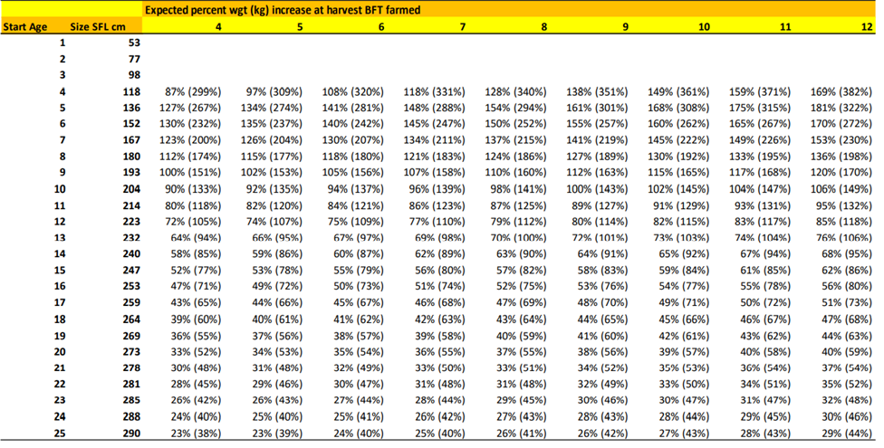
ABFT Responses to the Commission
Table 21.26.1. Updated matrix of the expected “percent weight gain” at harvest of farmed bluefin tuna as function of length and weight (straight fork length, FL; round weight, RWT) at caging (rows) and time in farms (columns, months after caging). The values in parenthesis correspond to the upper 90% confidence interval, which could be considered a reasonable proxy for the ‘maximum’ growth rate.

Slide 48
ABFT Responses to the Commission
21.27 SCRS advice, not later than 2022, on possible extension on the fishing seasons for different gear types and/or fishing areas, without negatively influencing the stock development and by ensuring the stock is managed sustainably. Rec. 20-07, para 9 (Rec. 19-04, para 33).
Background: 33. Not later than 2022, the Commission shall decide to what extent the fishing seasons for different gear types and/or fishing areas might be extended and/or modified based on the SCRS advice without negatively influencing the stock development and by ensuring the stock is managed sustainably.
No new information was presented to the Committee on this matter in 2021. However, this request is broad in scope considering the diversity of fleets, spatial coverage and seasonality. The Committee requests more details on the questions to be addressed in order to undertake the appropriate data compilation and analysis. Specific objectives of the request would be helpful given that some CPC fleets could not fill their quota during the fishing season.

Slide 49
ABFT Responses to the Commission
21.28 The SCRS shall report on National observer programmes. Rec. 19-04, para 83
Background: For the scientific aspect of the programme, the SCRS shall report on the coverage level achieved by each CPC, and provide a summary of the data collected and any relevant findings associated with that data. The SCRS shall also provide any recommendations to improve the effectiveness of CPCs observer programmes.
No new information was provided in 2020 or 2021, possibly due to the constraints imposed by the global pandemic crisis.

Slide 50
ABFT Responses to the Commission
21.29 Programmes to estimate the number and weight of bluefin tuna to be caged – The SCRS should
evaluate such procedures and results and report to the Commission. Rec. 19-04, para 99
The specific analyses of transfer records to estimate minimum sample size that is representative of the bluefin tuna being caged have not been carried out, since full raw data from stereo camera videos are not still available to the Secretariat.
An ad hoc study on this matter could be planned and carried out within GBYP Phase 12, if the data are made available.

Slide 51
ABFT Responses to the Commission
21.30 SCRS shall provide new advice on the TAC for the following year when the goal of maintaining the biomass around B0.1 (to be achieved by fishing at or less than F0.1) is not achieved and the objectives of this plan are in danger. Rec. 19-04, para 114
Background: When, as a result of a scientific evaluation, the goal of maintaining the biomass around B0.1 (to be achieved by fishing at or less than F0.1) is not achieved and the objectives of this plan are in danger, the SCRS shall provide new advice on the TAC for the following year.
Response: The Committee concluded that there is no evidence to recommend a change in the current TAC advice for 2022. See response 21.24 of the report.

Slide 52
ABFT Responses to the Commission
21.31 Standards and procedures for stereoscopic cameras systems in the context of caging operations
Rec. 19-04, Annex 9, item 1 iii
Background: When the length measurements of the fish present a multi-modal distribution (two or more
cohorts of distinct sizes), it shall be possible to use more than one conversion algorithm for the same caging operation. The most up to date algorithm(s) established by SCRS shall be used to convert the fork length of a single fish into weight, according to the size category of the fish measured during the caging operation.
Response: A recent study related to length-weight relationships for bluefin tuna in the Gulf of Cadiz/Southern cost of Portugal (SCRS/2021/146), using data collected over 15 years from the Portuguese traps was reviewed.
The Committee recommends four different equations to be used by the stereoscopic-system for the estimation of the BFT catches transferred to cages:
Atlantic Moroccan traps (Rodriguez-Marin et al., 2015),
Portuguese traps for the period June to August (Lino et al., 2021),
purse-seine catches for juveniles in the Adriatic Sea (Katavic et al., 2018), and
purse seine catches in the Mediterranean (Deguara et al., 2017).

Slide 53
ABFT Responses to the Commission
21.32 SCRS shall review the specifications and, if necessary, provide recommendations to modify them.
Rec. 19-04, Annex 9, item vi
Background: The report on the results of the stereoscopical programme should include details on all the
technical specifications above, including the sampling intensity, the way of sampling methodology, the
distance from the camera, the dimensions of the transfer gate, and the algorithms (length-weight
relationship). The SCRS shall review these specifications, and if necessary, provide recommendations to modify
them.
Response:
The Committee revised some technical specifications as indicated in the responses to the Commission's requests: items 21.29, 21.31 and 21.33 of this report. The Committee will continue this process and revise other aspects of the technical specifications, such as the sampling methodology being applied at caging and the distances between the sampled fish and the stereocamera.
Automated techniques to measure caged fish are being explored, potentially making it easy to increase the percentage of sampled fish.

Slide 54
ABFT Responses to the Commission
21.33 Method proposed for the calculation of a margin of error and range of the stereoscopic camera
system, Rec. 19-04, Annex 9, section 2
Background: In accordance with what was agreed at the Intersessional Meeting of Panel 2 (March 2020)
«Clarify section 2 of Annex 9 of Rec. 19-04, paragraph iii concerning the determination of the percentage
range».
Response:
The proposed method is a 5-step calculation that uses the size measurement input of each fish measured, the estimated round weight (RWT) of each fish (using a user-defined weight-size relationship), the margin of size measure error (error%) provided by the software, the count of fish measured, and the total number of fish counted in the recording file (total count).
Conclusions of SCRS analysis:
- This procedure simply uses the size error measurement from the video file and software to
estimate the range for the estimated total biomass of caged fish.
- The procedures are computationally correct.

Slide 55
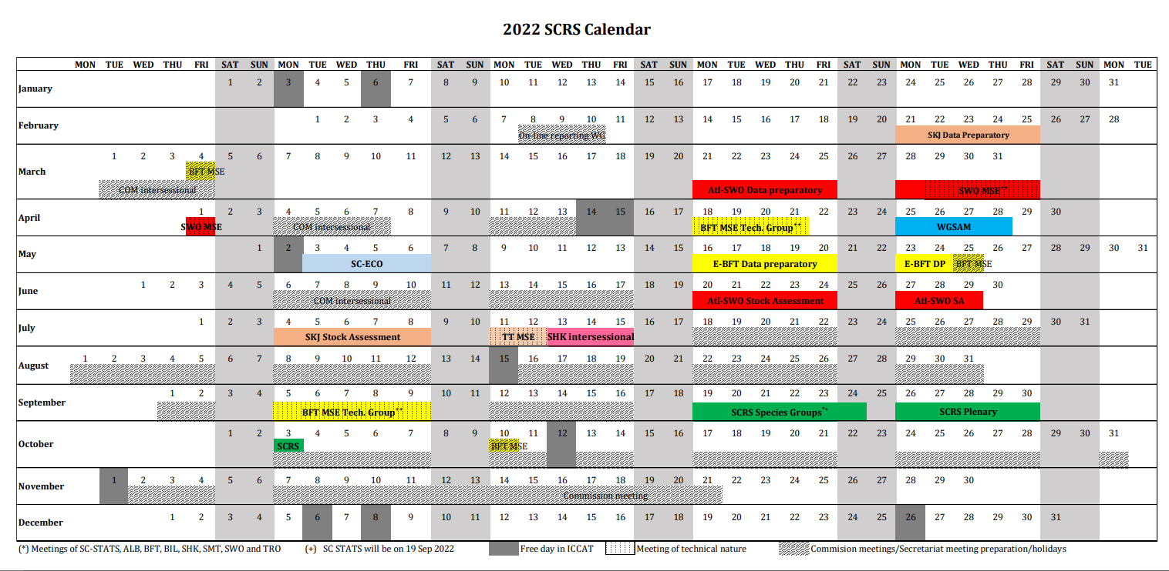

Slide 56
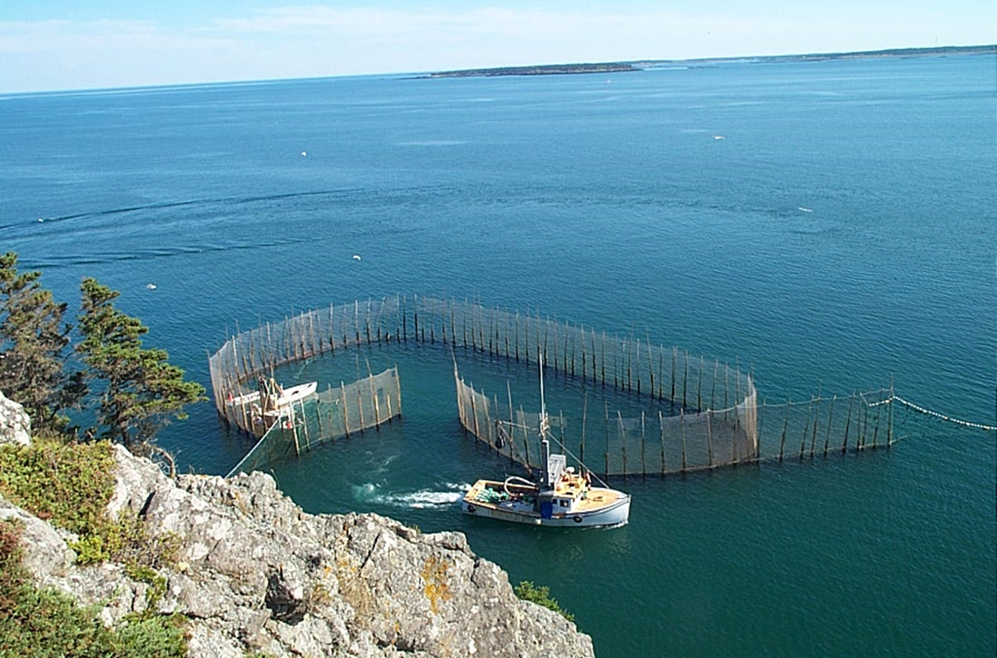
Thank You

