Slide 1

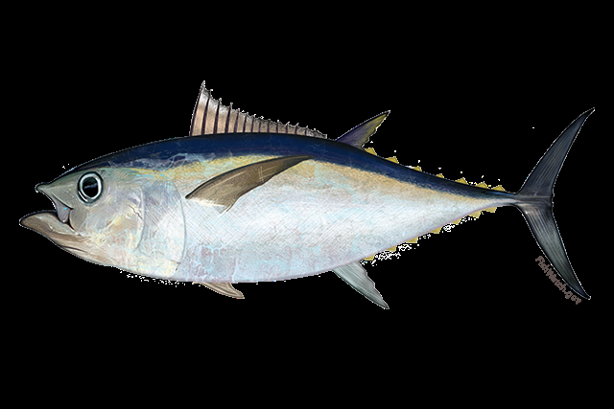
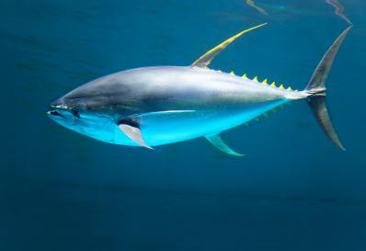
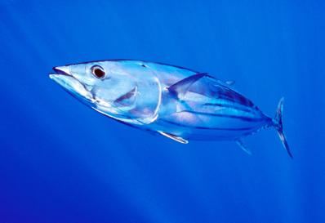
2022 SCRS Report
Bigeye
Panel 1- Tropical Tunas
ICCAT Commission
Meeting
2022
Yellowfin
Skipjack

Slide 2

Tropical Tuna Presentation Summary
Presentation Summary
  Brief Review of State of Stocks and Outlook for YFT and BET
  2022 SKJ stock assessment and Executive Summary
    Effects of Current regulations
    Management recommendations
  Responses to the Commission
  Work Plan
  MSE Progress

Slide 3


YFT Stock Assessment
Stock Assessment 2019 – Input data up to 1950-2018
Ages up to 18 years were observed in otoliths and validated using 14C bomb radiocarbon.
Growth of YFT estimated using a Richards function than a von Bertalanffy function (AOTTP information)
Age-specific natural mortality function (e.g. Lorenzen) based on T max of 18 rather than 11 used in previous assessment.
Several New Indices used in the 2019 assessment.
Yellowfin Tuna

Slide 4
YFT Fishery Indicators
A TAC of 110,000 t was adopted in 2012.
Catches (t) - all gears
2020 2021
Total 156,692 110,602
East 124,675 83,820
West 32,017 26,783
Purse seine vessels targeting tropical tunas in the eastern Atlantic increased in the last five years but declined in 2021.
Catches above TAC from 2014 to 2020.
Landings Updated to 2021

Slide 5
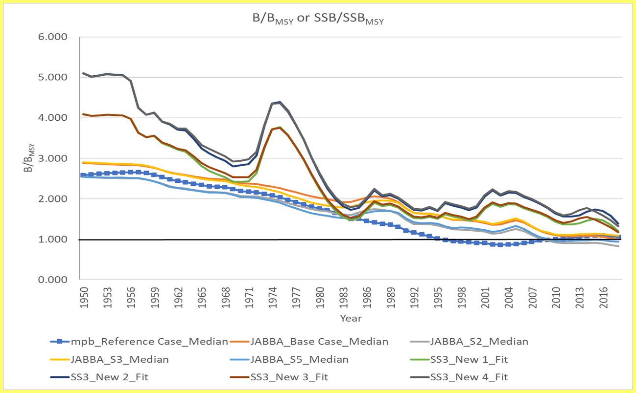
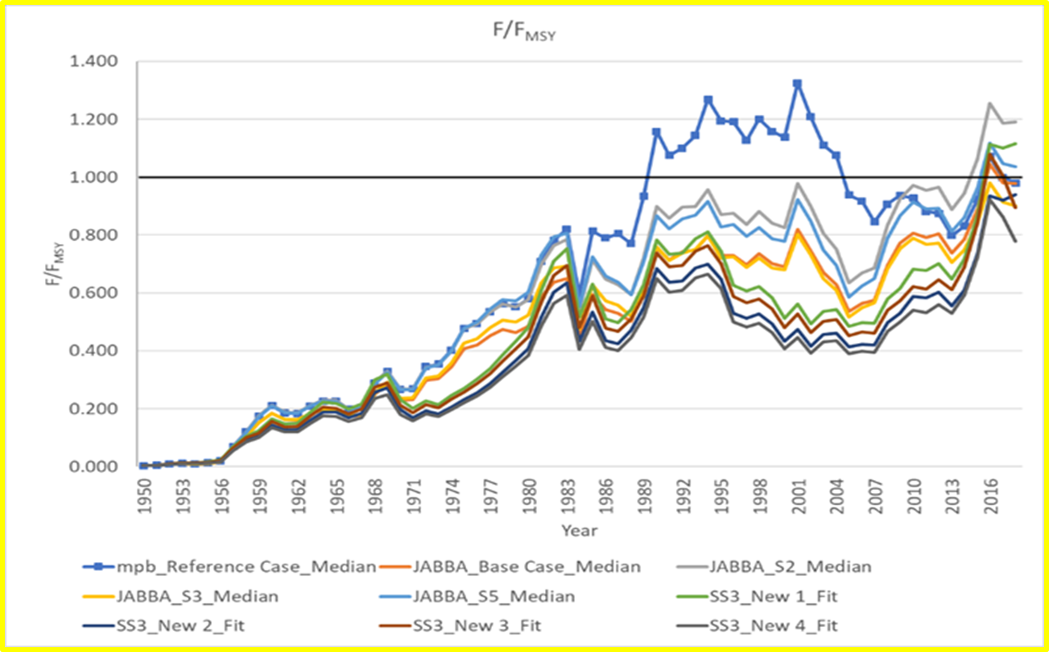
YFT Stock Assessment
Assessment Results
Biomass relative to Bmsy
Fishing Mortality relative to Fmsy

Slide 6
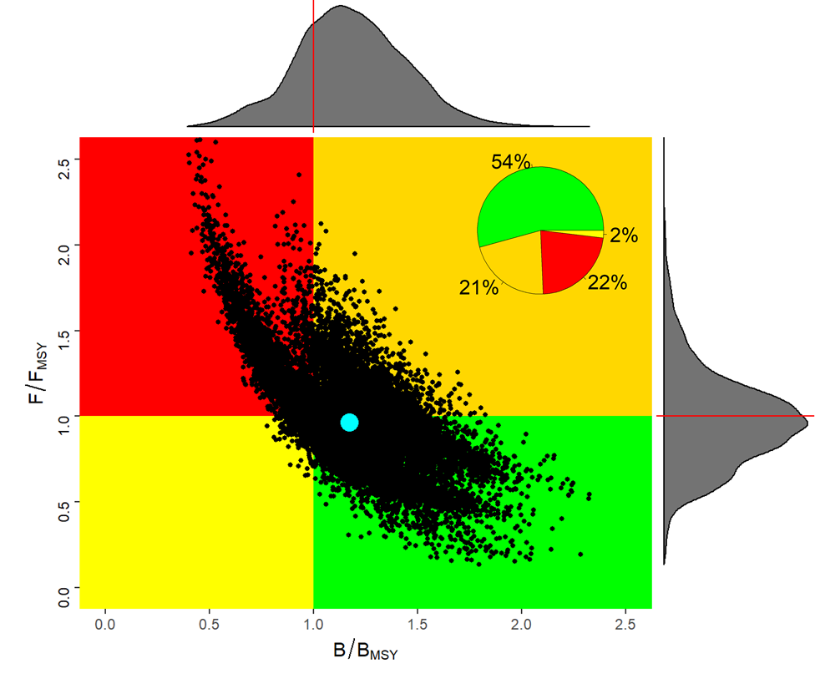
YFT Stock Status
Stock Assessment Results:
Combined Results of Stock Synthesis, JABBA and MPB
B/B_{MSY} = 1.17
  Not Overfished
F/F_{MSY} = 0.96
  Not Overfishing
MSY = 121,298 t
  Mean MSY 2016-2018
The 2019 result appears more optimistic than in 2016. However, the group cautioned that the difference in the results is not due to stock recovery. Instead, the perceived improvement is more likely due to changes in key data inputs (M, growth, indices) and the suite of models applied (JABBA, MPB, SS).

Slide 7
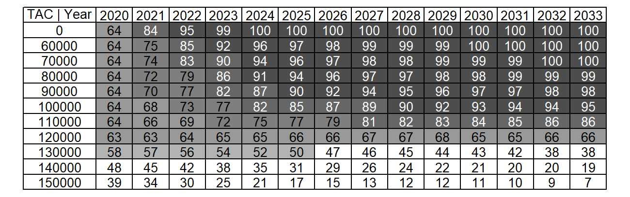
YFT Stock Outlook
A TAC of 120,000 t is expected to maintain a healthy stock status (no overfishing, not overfished) through 2033 with at least 63% probability
Joint Probability that F≤F_{MSY} and B≥B_{MSY}

Slide 8
Management Recommendations
Yellowfin Tuna – Unchanged since 2019 SCRS Report
Catches above 120,000 t are expected to degrade the condition of the yellowfin stock. Since 2016, catch have averaged 138,000 t, but increased to 156,692 in 2020. Catches above 140,000 t carry an increased risk of driving the stock below 20%B_{MSY} (13% by 2033).
Overages are frequent and significant. Existing conservation and management measures appear to be insufficient. The Group recommends that the Commission strengthen such measures.
Increased harvests on small yellowfin and bigeye tunas will have negative consequences on both long-term sustainable yield and stock status.
Should the Commission wish to increase long-term sustainable yield, the Group recommends that effective measures be found to reduce fishing mortality on small yellowfin and bigeye tuna.

Slide 9
Stock Status - Bigeye Tuna (BET)
Latest assessment 2021 based on data to 2019
Update of fishery indicators:
  Catch (1950-2020)
  Juvenile index of abundance based on acoustic buoys from FOBs/FADs (2010-2019)
New Joint Longline index developed in 2021 (1979-2019).
Significant changes made in the assessment Inputs (i.e., maximum age and natural mortality assumptions, the relative abundance indices used and the fleet structure.
Modeling approaches, included non-equilibrium (MPB) and Bayesian state-space (JABBA) production models as wells an integrated statistical assessment models (Stock Synthesis) which was used to provide management advice.

Slide 10
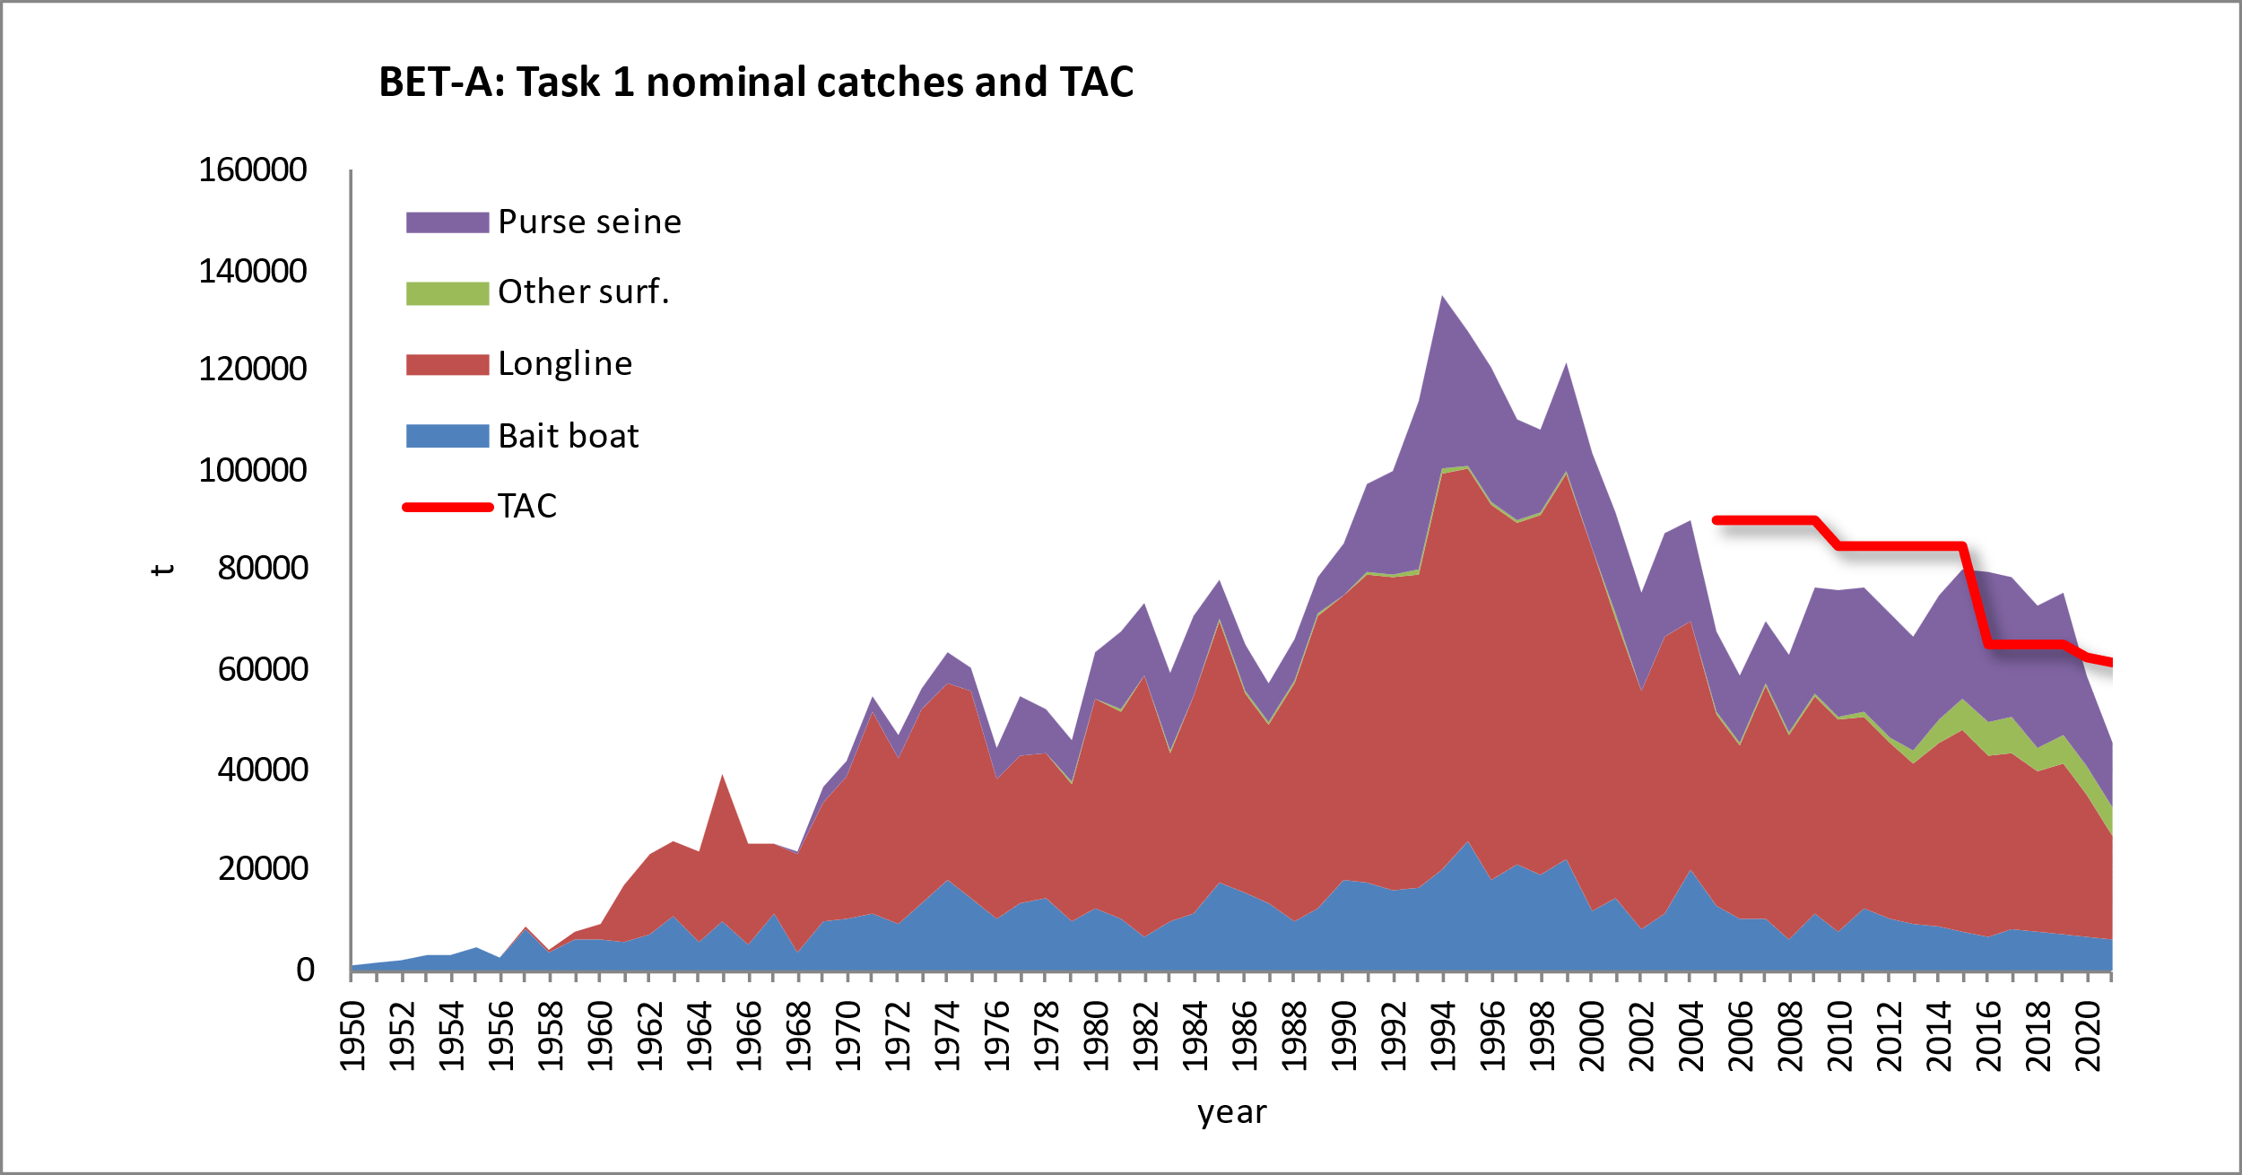
Stock Status - Bigeye Tuna (BET)
Nominal catches exceeded TAC (65,000 t) between 2016 and 2019 by 13-21%. In 2020 the catch was approximately 9% (59,033) below the TAC. And, in 2021 16% below the TAC.
2021 TAC 61,500 t
2019 Catch 75 563 t
2020 Catch 59 033 t
2021 Catch 45,959 t

Slide 11
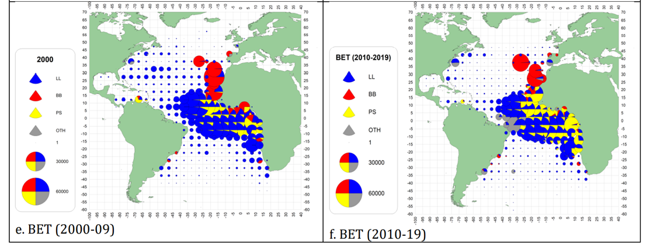
Stock Status - Bigeye Tuna (BET)
Geographical distribution of the bigeye tuna catch by major gears 2000-09 and 2010-2019.

Slide 12
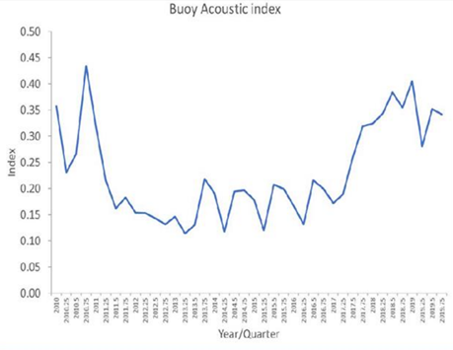
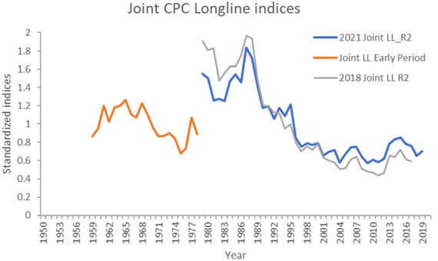
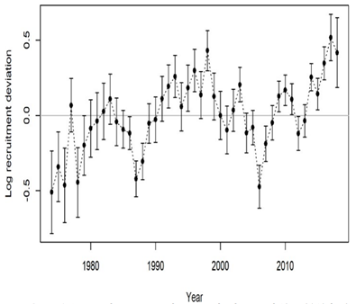
BET Fishery indicators and Recruitment
Quarterly Buoy acoustic index. (2010-2019).
Recruitment Deviations.
(1974-2018)
Joint Longline index (1959-1978 without vessel identification and 1979-2017 with vessel identification included in the standardization.

Slide 13
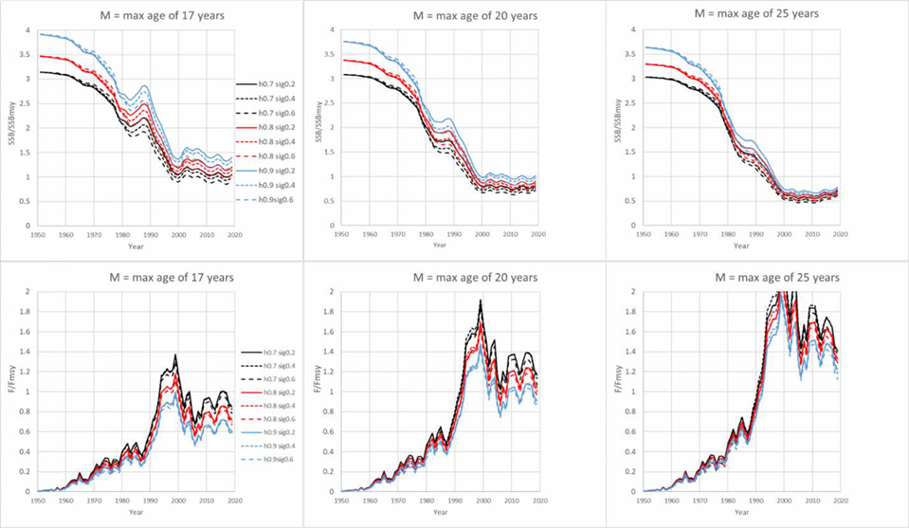
BET SS Stock Trends
Outputs:
BET-Figure 7. stock status trends across the 27 Stock Synthesis models of the uncertainty grid. Panels in each row represent the different assumptions of maximum age and thus natural mortality. Upper panels represent SSB/SSBMSY trends and lower panels F/FMSY trends. Individual lines represent different combinations of steepness and Sigma R.
All model configurations show increasing F and decreasing biomass trajectories from 1950-2019. However, the trends slowed from 1998 with a slight upward trend in SSB/SSBmsy and decrease in F/Fmsy in the last few years.

Slide 14
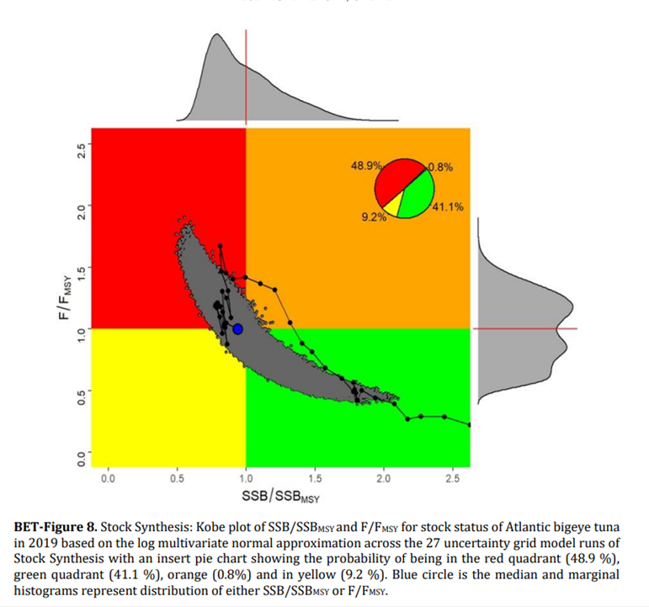
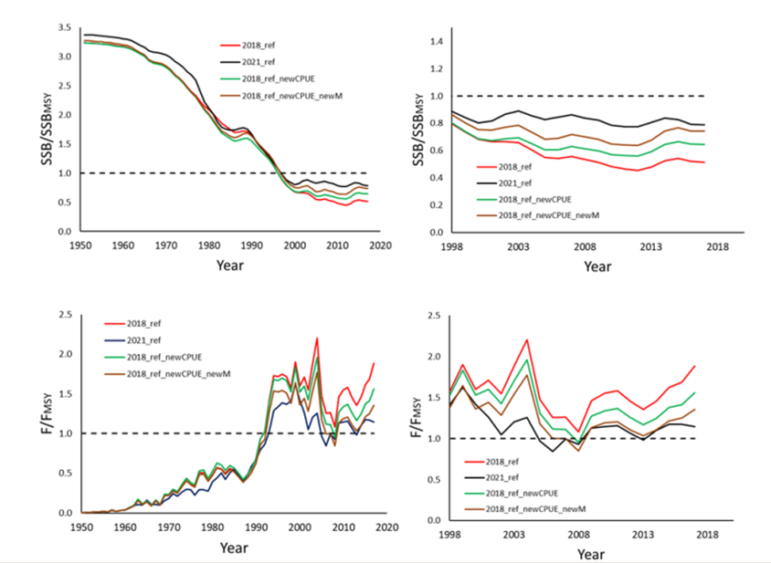
BET Stock Status
Sensitivity runs showing time series of stock status trends (left 1950-2017, right 1998-2017, for SSB/SSBMSY and F/FMSY) demonstrating the effects of changes
in stock status resulting from the incorporation of the 2021 joint longline index and the new assumptions
about natural mortality.

Slide 15
BET Stock Status
ATLANTIC BIGEYE TUNA SUMMARY
Maximum Sustainable Yield 86,833 t (72,210-106440 t)¹
Current (2020) Yield 57,486t²
Relative Spawning Biomass (SSB₂₀₁₉/SSB_{MSY}) 0.94 (0.71-1.37)¹
Relative Fishing Mortality (F₂₀₁₉/F_{MSY}) 1.00 (0.63-1.35)¹
Stock Status (2019) Overfished: Yes
Overfishing: No

Slide 16
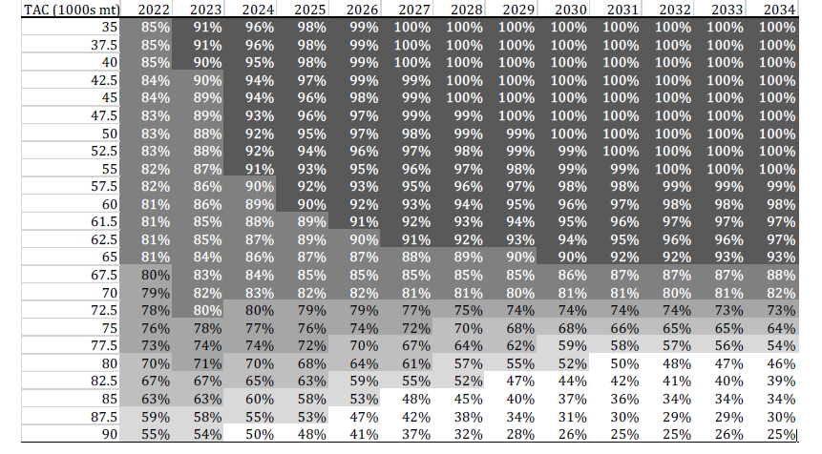
BET Probability of being in Green
Probability of Not Overfished (SSB >= SSBmsy) and Overfishing not occurring (F <= F_{MSY})
TAC

Slide 17
Tropical Tuna Management Recommendations
BET - Management Recommendations
Status has improved since 2017 and was estimated to be overfished but not undergoing overfishing in 2019
A future constant catch of 61,500 t, which is the TAC established in Rec. 19-02, will have a high probability (97%) of maintaining the stock in the green quadrant of the Kobe plot by 2034.
However, current stock status and the outlook for the stock are more uncertain than portrayed in the Summary Table and the K2SM. The SCRS advises that Projection probabilities should be interpreted with caution.
2021 optimistic outlook is related to updates to the data and biological parameters, changes in the methodology and data used for the joint longline index, use of the buoy index, changes to the fleet structure (in SS models), and the relatively low catches of BET for 2020 and 2021 (=TAC).
The Commission should consider adopting a TAC that would shift the stock status of BET towards the green zone of the Kobe plot with a high probability.
Keep in mind that an increase harvest of small yellowfin and bigeye tunas will have negative consequences on both long-term sustainable yield and stock status.

Slide 18
2022 SJK Stock Assessment Overview

Slide 19
Stock Status Skipjack (SKJ)
Last stock assessment for east and west Skipjack was in 2014.
New stock assessment conducted in 2022.
Two Intersessional meetings in 2022
Skipjack Data Preparatory Meeting was held online from 21 to 25 February 2022.
  Review the new data on fisheries, biology and tagging.
  Agreed to use 2020 as the last year for the assessment models.
Skipjack Stock Assessment Meeting was held between 23 and 27 May 2022.
  updates on catch statistics, fisheries and biology information, and the new relative indices of abundance.
  Indices were updated for MSE and the 2022 assessment to 2020.
Overall Catches updated to 2021.
Stock assessments finalized at the Species Working Group mtg.

Slide 20
Stock Status Skipjack (SKJ)
The 2022 East and West Skipjack stock assessment:
First time a full assessment was conducted for both stocks.
The new assessments used fishery data from 1950-2020 and 1952-2020, respectively,
Indices of relative abundance were calculated through 2020.
Both stocks were evaluated using Surplus Production (JABBA) and Statistically Integrated (SS3) models.

Slide 21
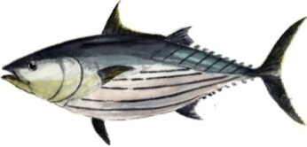
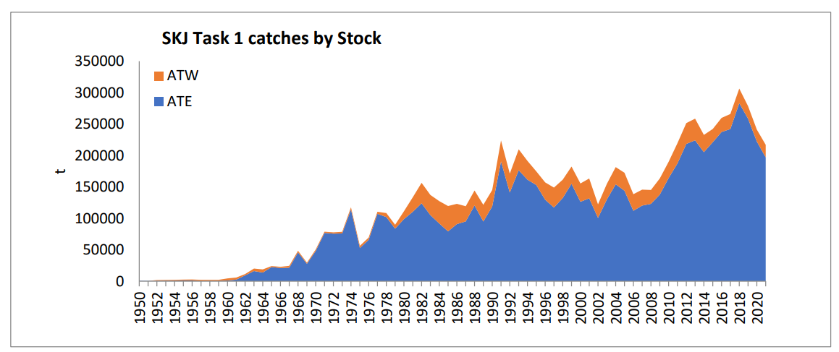
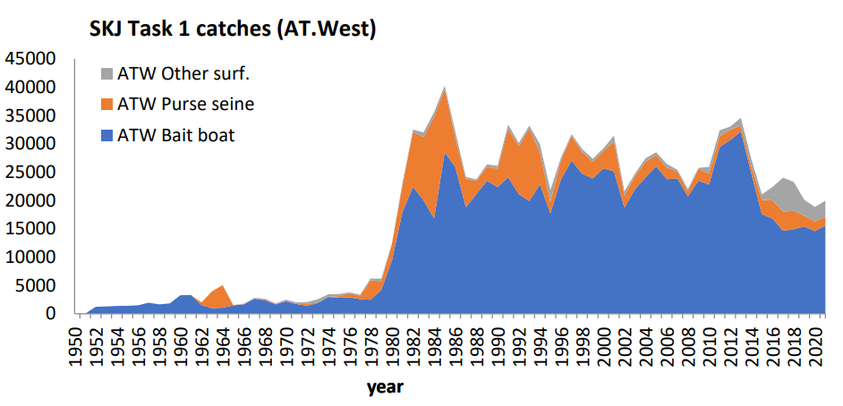
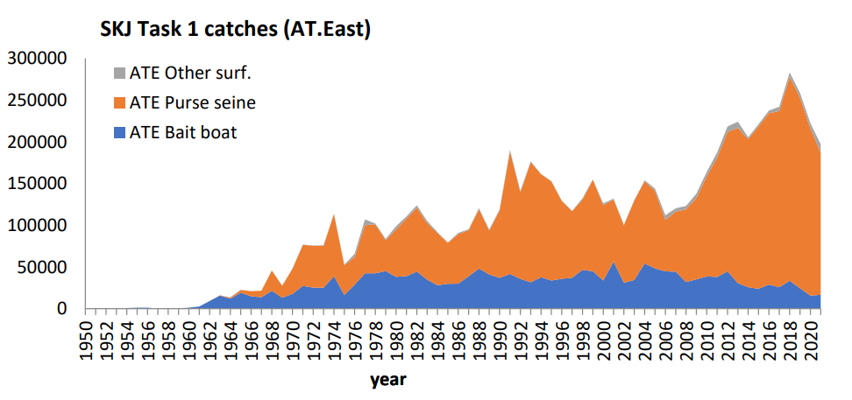
Fisheries indicators
Catches – Tasks I Updated to 2021
General decline in the total SJK catch in the last 3 years. There was 9.6% decline from 2020 to 2021 assuming the preliminary catches don’t change.
Most of the decline occurred in the east stock purse seine fleet.
Slight increase in catches in the west in 2021.
2021 - 216,939 t
2021 – 19,951 t
2020 - 18,859 t
2021 – 196,987 t
2020 – 222,231 t
2022-11-16
21
SKJ EXECUTIVE SUMMARY
Notes:
21

Slide 22
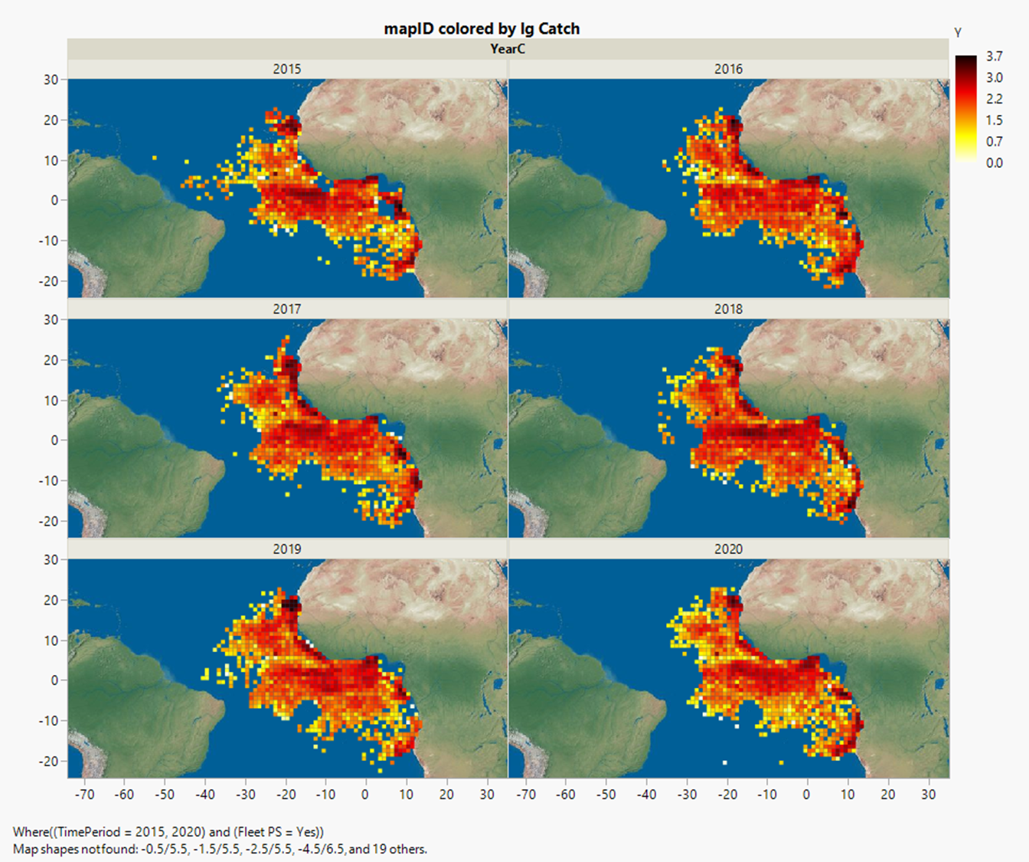
Fisheries indicators
Spatial distribution of SKJ for the PS fisheries
Annual Purse Catches of SJK 2015-2020.
(2000-2018)
2022-11-16
22
Notes:
22

Slide 23
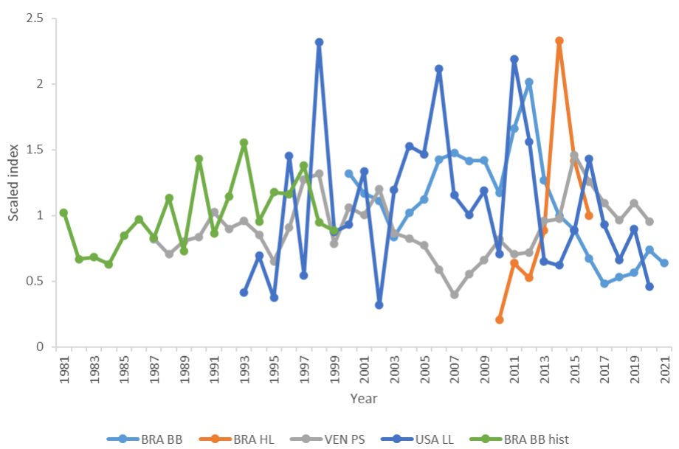
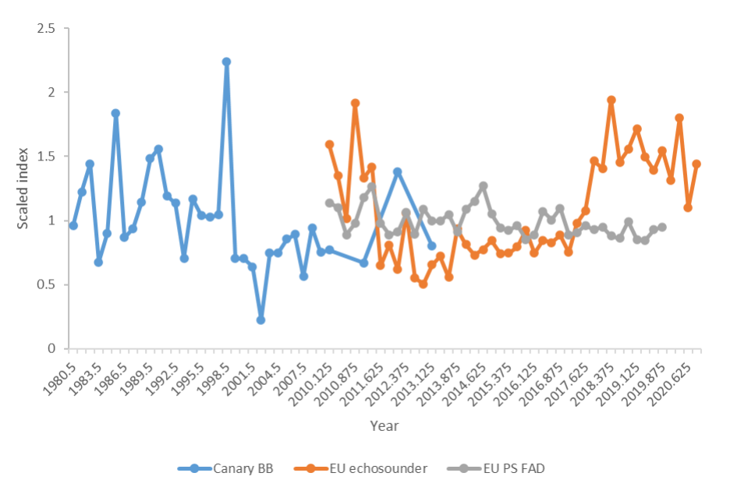
Indices of Abundance
Skipjack Tuna – Indices of Abundance (West – East)
West
East

Slide 24
The Assessment
2022- Skipjack Tuna – East and West assessment
Eastern Stock Assessment:
The stock assessment was conducted applying production models (JABBA) and one integrated statistical assessment model (Stock Synthesis). The Group decided to combine the results of JABBA and Stock Synthesis, with equal weighting, to estimate stock status and develop management advice to capture all major uncertainties in the population dynamics.
West Stock Assessment:
The stock assessment was conducted using a Bayesian state-space production model (JABBA) and an integrated statistical assessment model (Stock Synthesis), however, given that both models agreed, the final stock status and management advice is based on the combined results from the 9 distinct Stock Synthesis runs derived from the uncertainty grid proposed for the western skipjack stock.

Slide 25
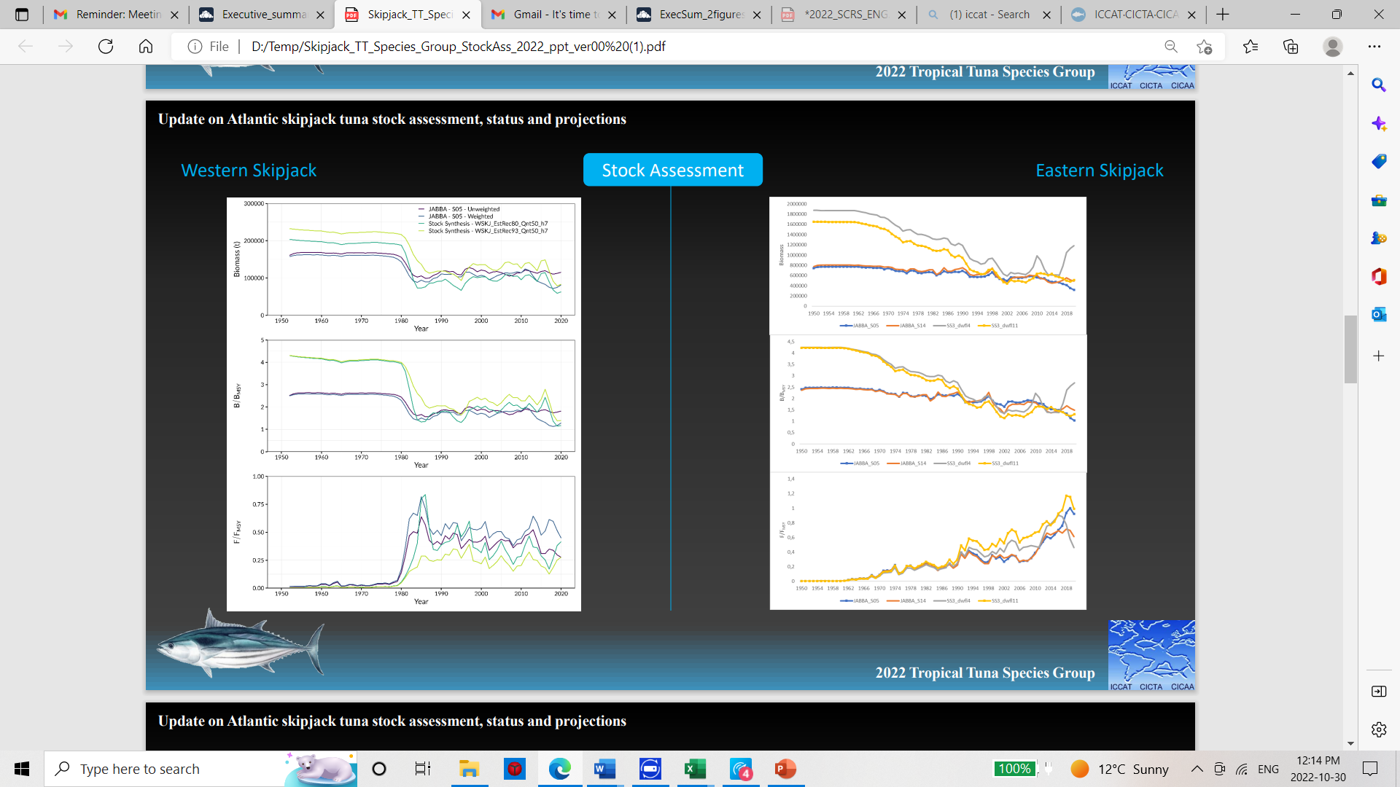

Slide 26
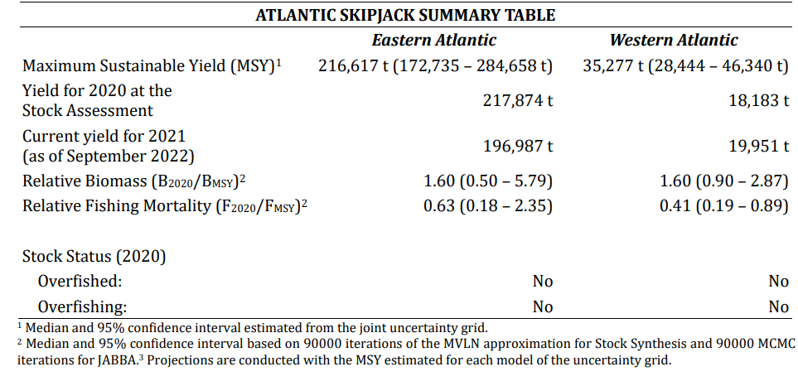
Stock Assessment Results

Slide 27
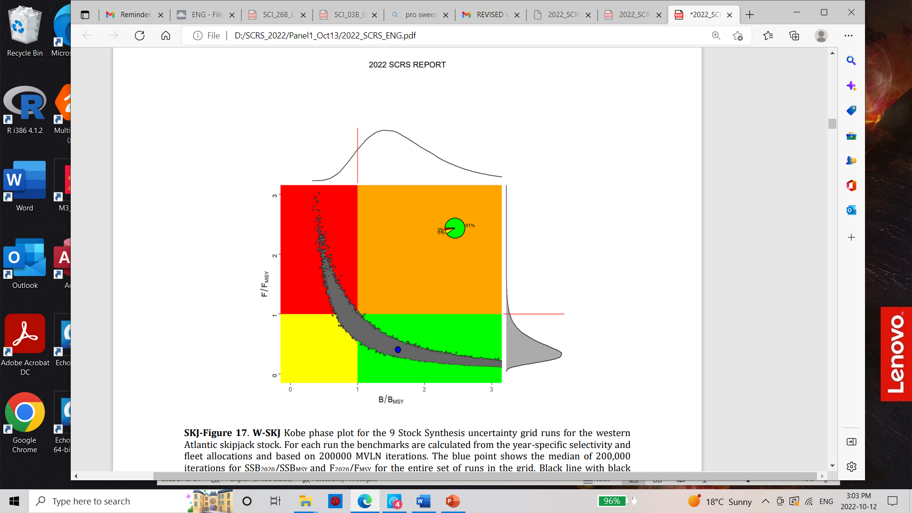
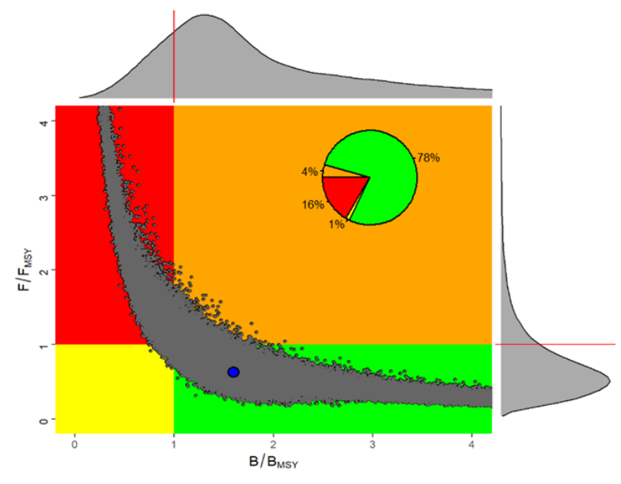
STATE OF THE STOCKS
Kobe Phase Plots as of 2020
Western Skipjack
Eastern Skipjack.
2022-11-16
27
Notes:
27

Slide 28
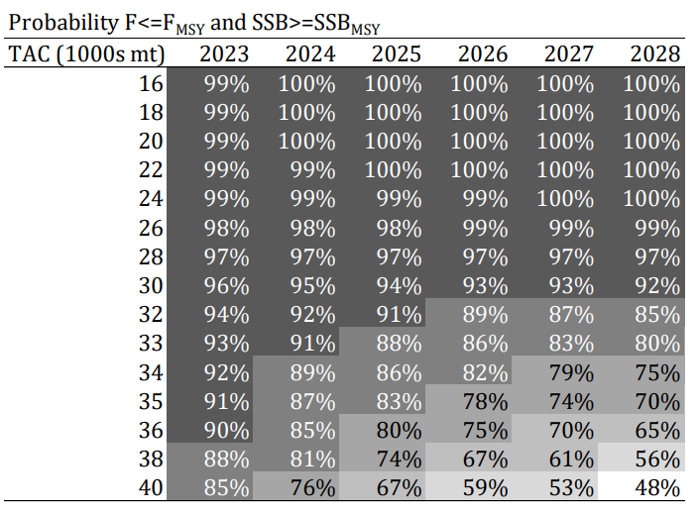
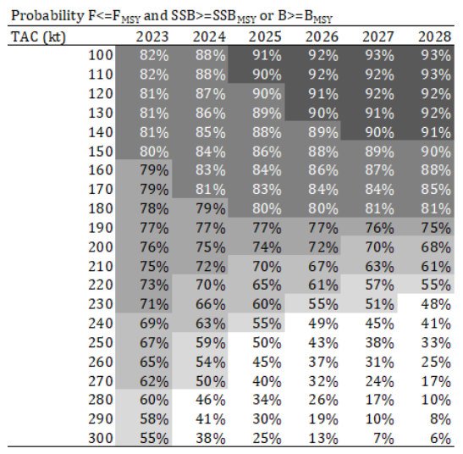
STATE OF THE STOCKS
TAC Probability combined F<Fmsy and B>Bmsy
Western Skipjack
Eastern Skipjack.
MSY
MSY
2022-11-16
28
Notes:
28

Slide 29
Management Recommendations/Summary
The stock status of the East Atlantic skipjack tuna in 2020 was estimated with a high probability (78%) to be in a sustainable condition. A future constant catch of the median MSY (216,617t) will have about 55% probability of maintaining the stock in the green quadrant of the Kobe plot through 2028. However, given the large uncertainty the probability of the stock biomass being below 20% of BMSY in 2028 is about 17%, and the probability of stock biomass being below 10% in 2028 was about 14%.
The Western Atlantic skipjack stock in 2020 was estimated with a high probability (91%) to be in healthy condition. A future constant catch of the median MSY(35,277t) will have about 70% probability of maintaining the stock in the green quadrant of the Kobe plot by 2028. Assuming a constant catch at MSY, the probabilities of the stock biomass being below 20% or 10% of the BMSY until 2028 are less than 1%.
The Committee reminds the Commission that catches of SJK will have an impact on juvenile BET and YFT, especially in the purse seine FOB fisheries.

Slide 30
Management Strategy Evaluations (MSE)
Highlights for 2022: Tropical Tunas
Tropical Tuna: - Parallel development of two MSE frameworks – western Skipjack and the multispecies (YFT, BET, and SKJ).
Major focus in 2022 was on the east and west Skipjack stock assessment, while continuing the development of MSE.
For WSKJ MSE the initial operating models were conditioned with data for 1952 to 2020 following the 2022 skipjack stock assessment.
Robustness tests were conducted for recruitment variability and different levels of catch overages.
Some technical aspects are still under development and need to be address (Contract TOR) to continue the WSKJ development in 2023.
Notes:
. (E.g., increase transparency, sources of uncertainty, better representation of results to illustrate variability of results across models, clarification of some parameters and additional checks to explain and understand the unexpected behaviour of some Operating Models)

Slide 31
Management Strategy Evaluations (MSE)
Highlights for 2022: Tropical Tunas
The Multi-stock MSE is not as advanced as the wSKJ MSE.
At present, yellowfin and bigeye single-species operating models (OM) are available and preliminary conditioning is complete for the OMs
Tasks to be completed include Harmonization of the fleet structure, conditioning the skipjack OM’s following the results of the 2022 E-SKJ stock assessment model, and linking the conditioned OMs of the three stocks. These are not simple tasks.
In summary the Committee noted the importance of communication with stakeholders and recommended a Panel 1 meeting for MSE discussions in 2023 and the possibility of ambassador meetings similar to what was done for BFT.
Continue Training workshops on MSE and HCR for scientists and managers.
Notes:
. (E.g., increase transparency, sources of uncertainty, better representation of results to illustrate variability of results across models, clarification of some parameters and additional checks to explain and understand the unexpected behaviour of some Operating Models)

Slide 32
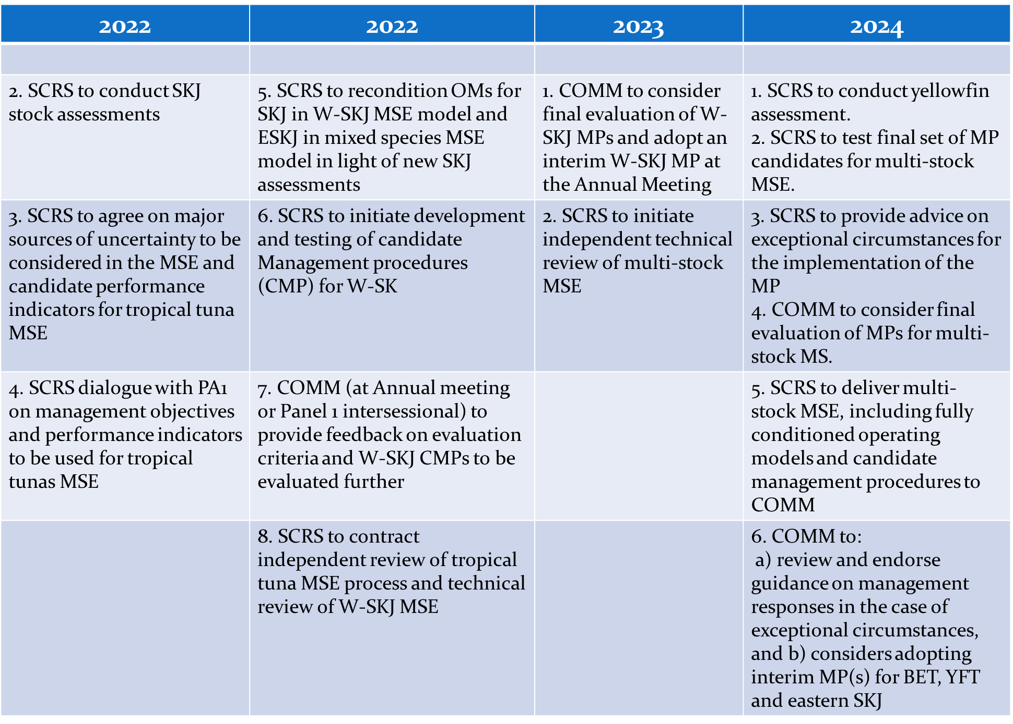
Atlantic Skipjack MSE Road Map: (2022-2024)
Complete Table (2015-2025) shown in Appendix 16

Slide 33
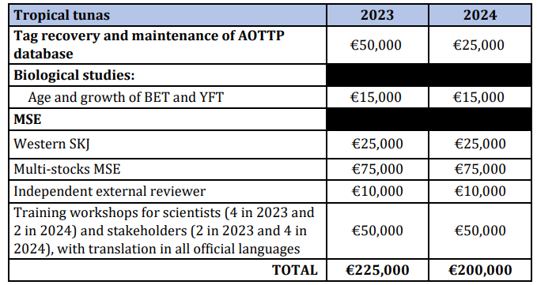
Tropical tuna Workplan -2023
Tropical Tunas Workplan for 2022/2023
  CPUE indices of all tropical tuna stocks to be updated to explain changes in catches.
  Improvement of basic fishery and biological data. Identify data gaps and research on growth, maximum age and natural mortality for the three species of tropical tuna.
  Committee recommends that the next stock assessment for yellowfin tuna be conducted in 2024 to focus on MSE in 2023.
  MSE Activities will include.
    implementation of an independent technical review of WSKJ MSE
    organization and implementation of training workshops on MSE
    prepare documents and presentations describing
    progress on MSE for Panel 1.
    Continue to develop the multi-stock and the western
    Skipjack MSE
Estimated Budget 225,000 Euro in 2023

Slide 34
Response to the Commission
17.24 Discards in purse seine fisheries, Rec. 17-01, para 4.
Background: In 2020, the SCRS shall assess the effectiveness of this Recommendation(to retain and land) and submit recommendations to the Commission regarding potential improvements.
The Committee was unable to provide a detailed response again this year. However, previous studies estimated that these discards were small for Spanish purse seiners in the mid-2000s (0.2 t per free school set and 1.1 t per FOB set).
Two data sources exist, Task 1 reports of dead discards and data collected by on-board observers and reported in ST09. Task 1 reports should represent the same weight or higher observer discard reports. The Committee noted that discards are only reliable for the most recent period and data from purse seine likely more so since they have 100% coverage. New guidelines and best practices adopted by fleets and the discard prohibition (Rec. 17-01) that entered into force in 2018 suggest that current discards are probably fewer than the levels indicated in the earlier study.

Slide 35
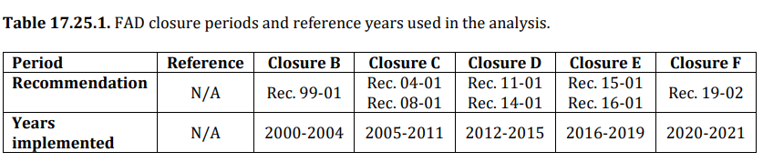
Response to the Commission
17.25 Fishing prohibited with FADs, Rec. 21-01, para 28.
Background: 1 January to 13 March 2022, throughout the Convention area. This should be reviewed and, if necessary, revised based on advice by the SCRS taking into account monthly trends in free school and FAD associated catches and the monthly variability in the proportion of juvenile tuna in catches. The SCRS should provide this advice to the Commission in 2022.
The Committee noted that reporting of historical FOB/FAD set data is mandatory as per Rec 21-01. The historical data on the number of sets conducted on FOB remains incomplete.
The Committee investigated the monthly pattern of purse seine catch based on the data available at the Secretariat for the period 1991-2020. The analysis separated the data into six periods, a reference period from 1991-1999, and five different FAD closure periods.

Slide 36
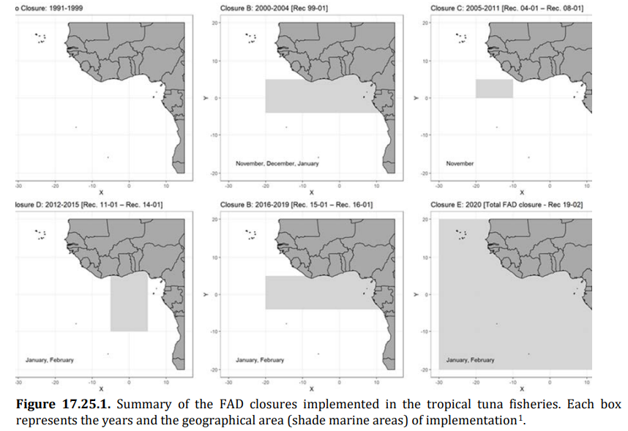
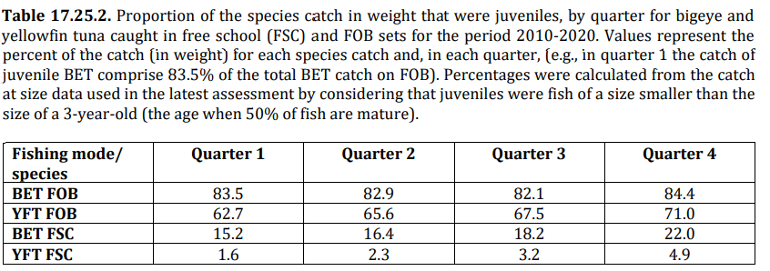
Response to the Commission
17.25 Fishing prohibited with FADs, Rec. 21-01, para 28.
The catch of juvenile BET and YFT was consistently higher for FOB then free school and varies across quarter. On a monthly basis catches of BET juveniles are greater in the first and fourth quarter and the annual pattern shows high variability between years. Catches of juvenile YFT are greater in the fourth quarter.

Slide 37
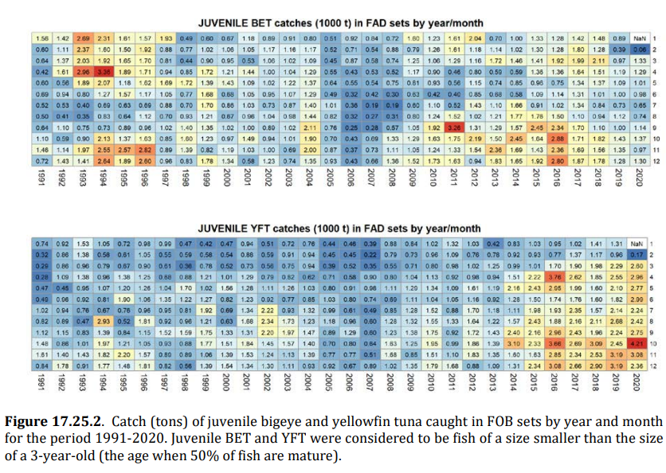
Response to the Commission
17.25 Fishing prohibited with FADs, Rec. 21-01, para 28.

Slide 38
Response to the Commission
17.26 The SCRS to inform on CPCs that have provided by 31 July 2022 the required historical FAD set
data. Rec. 21-01, para 31
Background: With a view to establishing FAD set limits to keep the catches of juvenile tropical tunas at
sustainable levels, in 2022 the SCRS should inform the Commission about the maximum number of FAD sets which should be established per vessel or per CPC. To support this analysis, CPCs with purse seine vessels shall urgently undertake to report to the SCRS by 31 July 2022 the required historical FAD set data. CPCs that do not report these data in accordance with this paragraph shall be prohibited from setting on FADs until such data have been received by the SCRS.
In 2021 the Committee provided a summary of the challenges faced by the Committee to provide an answer to this request. The Committee was unable to resolve these challenges this year. In summary, there has not been any improvements in the information available to the Committee to provide advice on the maximum number of FAD sets per vessel as requested by the Commission.

Slide 39
Response to the Commission
17.27 The SCRS to inform on CPCs that have provided by 31 July 2022 the required historical FAD set
data. Rec. 21-01, para 33.
Background: Further analysis shall be conducted by the SCRS on the impact of support vessels on the catches of juvenile yellowfin and bigeye tuna to be considered in 2022..
The Committee provides some additional information on support vessels in document SCRS/2022/15 (list of vessels), but was unable to determine which support vessels were active. The Committee is unable to provide a more final response to this request from the Commission.

Slide 40
Response to the Commission
17.28 The SCRS shall refine the MSE process in line with the SCRS roadmap and continue testing the
candidate management procedures. Rec. 21-01, para 62.
Background: The SCRS shall refine the MSE process in line with the SCRS roadmap and continue testing the candidate management procedures. On this basis, the Commission shall review the candidate management procedures, including pre-agreed management actions to be taken under various stock conditions. These shall take into account the differential impacts of fishing operations (e.g. purse seine, longline and baitboat) on juvenile mortality and the yield at MSY
The Committee proposed a few changes (mostly timing) to the roadmap for both Tropical Tunas MSE’s (see section 13.4 of the SCRS report).

Slide 41
Response to the Commission
17.29 Efficacy that full fishery closures along the lines of those proposed in PA1_505A/2019, Rec. 21-
01, para 66a.
Background: The SCRS shall explore the efficacy that full fishery closures along the lines of those proposed in PA1-505A/2019 might have to reduce the catches of tropical tunas to the agreed levels; and the potential of such scheme to reduce the catches of juvenile bigeye and yellowfin tunas, in line with recommendations from the SCRS.
The Committee reviewed the work previously done on the evaluation of full fishery closures (Sharma and Herrera (2019) and Herrera et al. (2020)). A proposed method to evaluate full fishery closures as an alternative management tool for tropical tuna stocks rather than TAC was explored. Estimates based on the length of the closure, biomass from the latest assessment and a target catch level for one stock, with catch caps of others. It was noted that recent assessments of skipjack and yellowfin have slightly changed the assumptions about the size of 50% maturity.
Analysis suggests that predictions of tropical tunas catches from total purse seine effort will have considerable uncertainty due to changes in access rights and or to changes in the spatial distribution of the stocks. It is important that any evaluation of total effort closures is accompanied by estimates of the uncertainty of the prediction that account for such potential changes in fleet distribution.

Slide 42
Response to the Commission
17.30 Estimate of capacity in the Convention area, to include at least all the fishing units that are
large-scale or operate outside the EEZ of the CPC they are registered in, Rec. 19-02, para 66b
In 2022, the Committee considered two documents that estimate capacity for large-scale purse seine fisheries.
The Committee estimates that at least 67 - and possibly 72 - large-scale purse seiners were operating in the Convention area as of the first half of 2022 (Table 17.30.1). The combined Fish Hold Volume (FHV) of the 72 vessels was 99,326 m3, which is equivalent to about 77,363 t.
Based on this the current capacity is higher than necessary to meet current catch recommendations. The 2022 capacity estimate is similar to the 2020 capacity and lower than the capacity estimate in 2021.
The Committee notes that estimates are intended to measure active capacity, not potential capacity. In 2022, there were 99 large scale purse seiners authorized to fish for tropical tunas.
The Committee intends to evaluate the capacity and number of other fleet components (e.g., support vessels, BB, LL) in the future.

Slide 43
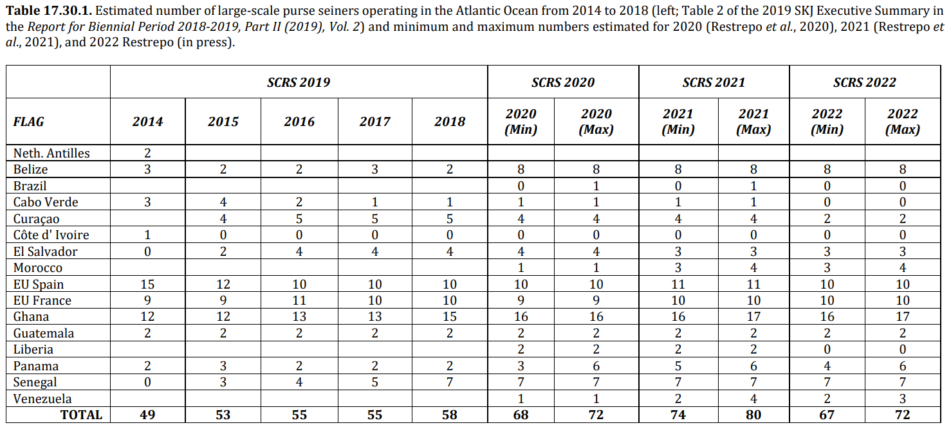
Response to the Commission
17.30 Estimate of capacity in the Convention area, to include at least all the fishing units that are
large-scale or operate outside the EEZ of the CPC they are registered in, Rec. 19-02, para 66b

Slide 44
Response to the Commission
17.31 The SCRS and the Secretariat shall prepare TORs to carry out an evaluation of the monitoring,
control and surveillance mechanisms in place in ICCAT CPCs. Rec. 21-01, para 66c.
Background: The ICCAT Secretariat shall identify a Consultant to carry out an evaluation of the monitoring, control and surveillance mechanisms in place in ICCAT CPCs. The ICCAT Secretariat shall work with SCRS
scientists to prepare a TOR for this work as soon as possible.
The Committee agreed that a Sub-group of experts on tropical tuna fisheries should work together through online correspondence with the Secretariat to develop the specific TORs for a consultant to carry out a technical evaluation to respond to this request.

Slide 45
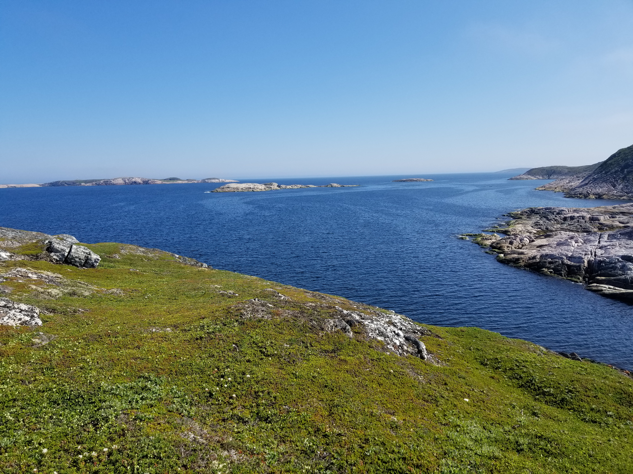
Thank You

