Slide 1

ICCAT ATLANTIC-WIDE RESEARCH PROGRAMME FOR BLUEFIN TUNA (GBYP):
OVERVIEW, MAIN ACHIEVEMENTS AND FUTURE PLANS
Side-event
ICCAT 26th Regular Meeting of the Commission
Palma de Mallorca, Spain, 18 to 25 November 2019
Notes:
First of all, thank you all for coming after a hard working-day. I’m Francisco Alemany, the current GBYP program Coordinator. The purpose of this side event is to inform you about the main achievements, current activities and future plans of GBYP, paying special attention to the ongoing study on growth in farms requested last year by the Commission.
To this end I’ll give you first this short introductory talk, consisting in a quick global overview of GBYP Program. Then we invite you to enjoy some appetizers and drinks and move around to explore what is being done regarding the different lines of GBYP program, which is summarized in the roll up posters that you will see in different areas of this hall.

Slide 2

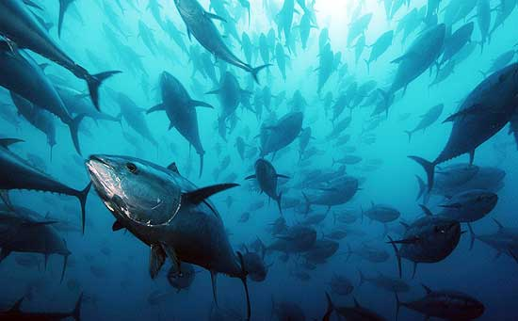
GBYP is the broadest among the Special Research Programs used by ICCAT to help focus, coordinate and complement national research activities
It started officially at the end of 2009, with the aim of improving the scientific basis to inform management decisions for Atlantic Bluefin tuna
Notes:
Let’s start remembering what is GBYP. It is the broadest among the Special Research Programs used by ICCAT to help focus, coordinate and complement national research activities
It started in 2009, aiming at improving the scientific basis to inform management decisions for Atlantic Bluefin tuna

Slide 3
GBYP OBJECTIVES
IMPROVEMENT OF:
I. basic data collection
II. understanding of key biological and ecological processes
III. assessment models and provision of scientific advice on stock status
Notes:
The GBYP general objectives, as recommended by SCRS, are the improvement of ABFT:
basic data collection
understanding of key biological and ecological processes
assessment models and provision of scientific advice on stock status

Slide 4
It is funded by EU (80%) and by other contracting and cooperating parties (20%), as Albania, Algeria, Canada, China, Croatia, Egypt, Iceland, Japan, Korea, Libya, Morocco, Norway, Syria, Tunisia, Turkey, United States of America and Chinese Taipei, which provide donations according to national quotas or voluntary contributions
Phase 1 | Phase 2 | Phase 3 | Phase 4 | Phase 5 | Phase 6 | Phase 7 | Phase 8 | Phase 9
€ 750,000 | € 2,502,000 | € 1,925,000 | € 2,875,000 | € 2,125,000 | € 2,125,000 | € 1,808,985 | € 1,750,000 | € 1,750,000
Notes:
It is funded mainly by EU, but many other donors, those you can see listed in this slide, are also supporting this program. The mean total budget by phase, each of which last usually one year, is around two million euros. This is an important amount of money but, as you will see, it has allowed to fund a lot of activities relevant for the proper management of Atlantic bluefin stocks, in line with the strategic objective of the program.

Slide 5
GBYP IN NUMBERS…
98 entities
161 contracts
24 countries
344 reports & 281 scientific papers
Notes:
Only to give you a general idea about the scale of the program, here you have some numbers. So, along these last nine years GBYP has signed 161 contracts with 98 different entities located in 24 countries, which have resulted in 344 reports and 281 scientific papers.

Slide 6
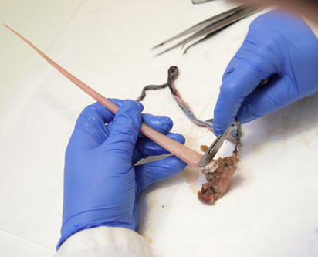
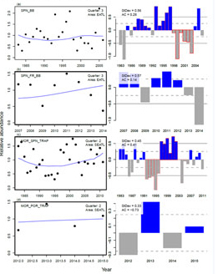
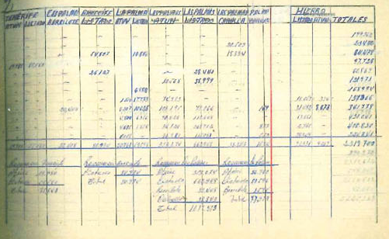

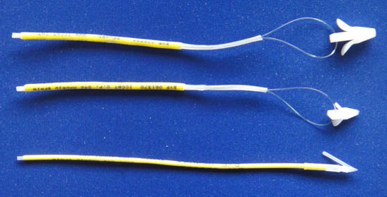
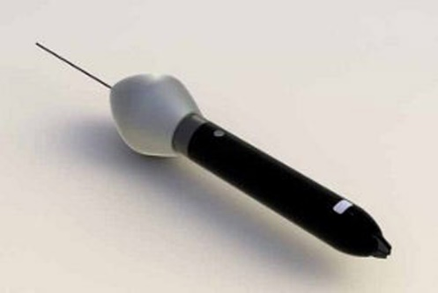
Biological studies
Program structure
Modelling
Coordination
Data recovery & mining
Abundance indices
Tagging
Notes:
To achieve the aforementioned general objectives the program was structured from the beginning in six main lines of activity, as has been already explained by Dr. Melvin in previous presentations. However, what I want to point out now is that this doesn’t mean the program activities has become a routine, since these general lines have been evolving year after year in different ways, as:
adapting themselves to the changes in the SCRS research priorities, launching new specific studies within these broader lines whenever necessary
improving continuously the methodologies, taking advantage of the accumulated experience,
or covering the successive phases of multiannual work-plans

Slide 7
Data generation
Data management
Data analyses
Data dissemination
Standardisation & Coordination (protocols, quality control, workshops…)
Notes:
It is also worth to point out that most of GBYP studies usually cover all the steps in applied scientific research, from data generation to data dissemination, which in this case includes providing relevant information to target “final users”, as stock assessment and management responsibles, and that the time required to complete this cycle can be very different depending on the type of study. Therefore, sometimes the whole process is covered within a single year (for example a calibration survey), whereas others require several years, as for example the BFT MSE implementation process or the study of growth in farms. In other cases the final goals can only be achieved repeating the same cycle in successive years, for example when developing abundance indices time series or updating ALKs.

Slide 8
RELATIVE IMPORTANCE
Data generation
Data management
Data analyses
TIME
Notes:
At a global level the program has also evolved, from the first phases, where most efforts were dedicated to establish initial protocols and to data recovery or generation activities, to fill as soon as possible the important knowledge gaps detected in those years, to the current situation, where increasing attention is paid to the development of relational databases in order to facilitate the analysis of the huge amount of info gathered by GBYP, and also to the revision of results and improvement of methodologies. This is driving the program to a new scenario, where the efforts will be mainly focused on the consolidation and updating of these DB and on the promotion of collaborative studies based on such DBs.

Slide 9
Strategies Evaluation
More relevant GBYP outputs directly used in BFT
stock assessments/MSE implementation
LINE OF RESEARCH | TYPE OF OUTPUT
Data recovery | Historical BFT catch, size and catch per unit effort data, non-GBYP electronic tags tracks
Fishery independent indices | 7 years long series of aerial survey Spawning Eastern Stock Abundance index
Tagging | Conventional and electronic tags spatial data (matrix of movements between spatial strata by stock and quarter)
Biological studies | Length/weight correlations, growth and reproductive parameters, age-length keys, stock of origin assignations (degree of mixing)
Modelling | MSE software (ABTMSE), operating model (M3), Space Assessment Model (SAM) application
More info about GBYP outputs in:
https://www.iccat.int/GBYP/en/
Notes:
All the GBYP activities have contributed in some way to the strategic objective of improving the scientific basis for ABFT stocks management. In this table you can see a summary of the GBYP outputs directly used up to now in ABFT stock assessments and the implementation of ABFT Management Strategies Evaluation.
For example….
More details about each one of GBYP lines and their outputs are provided in the roll up posters that you can see all around.

Slide 10
Notes:
These are the seven posters in which the main achievements, ongoing activities and future plans of each GBYP line have been summarized, plus another one dedicated specifically to the growth in farms ongoing study. Each one will be attended by SCRS, ICCAT Secretariat or GBYP Coordination team members.

Slide 11
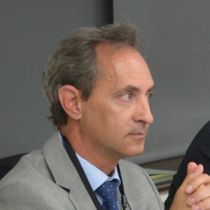


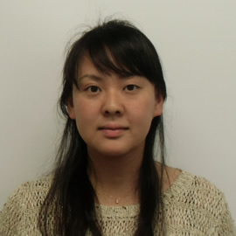
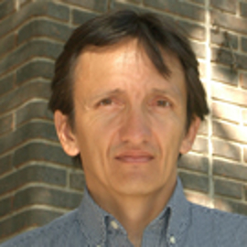
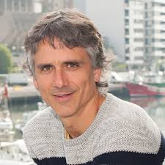
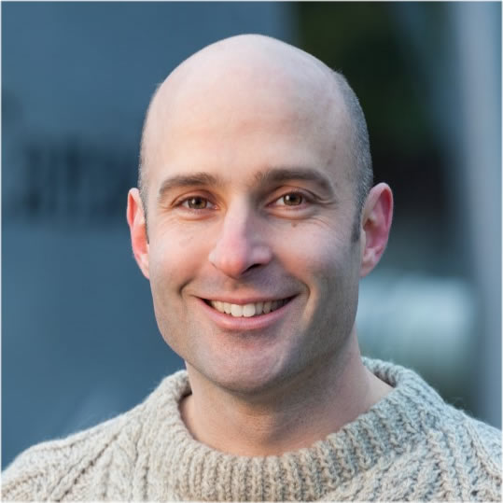
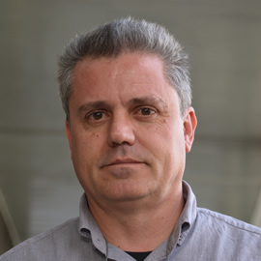
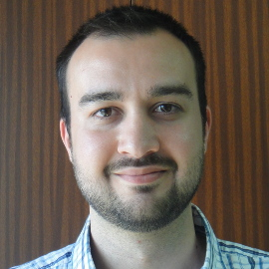
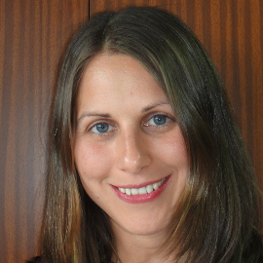
SCRS
Miguel
Ana
ICCAT Secretariat
Gary
Ai
Francisco
Mauricio
Haritz
Stasa
Nathan
Alfonso
GBYP Coordination team
Notes:
Those are the colleagues that you will find attending the different posters, or that can answer more general questions, as the ICCAT Assistant Executive Secretary, Miguel, or myself. For questions related to the use of data provided by GBYP to improve stock assessment you can ask the Head of Science and Statistics Department of ICCAT Secretariat, Mauricio, and, finally, for general questions about the role of GBYP in supporting SCRS you can address the SCRS Chairman and the ABFT Eastern stock rapporteur, Gary and Ana, respectively

Slide 12
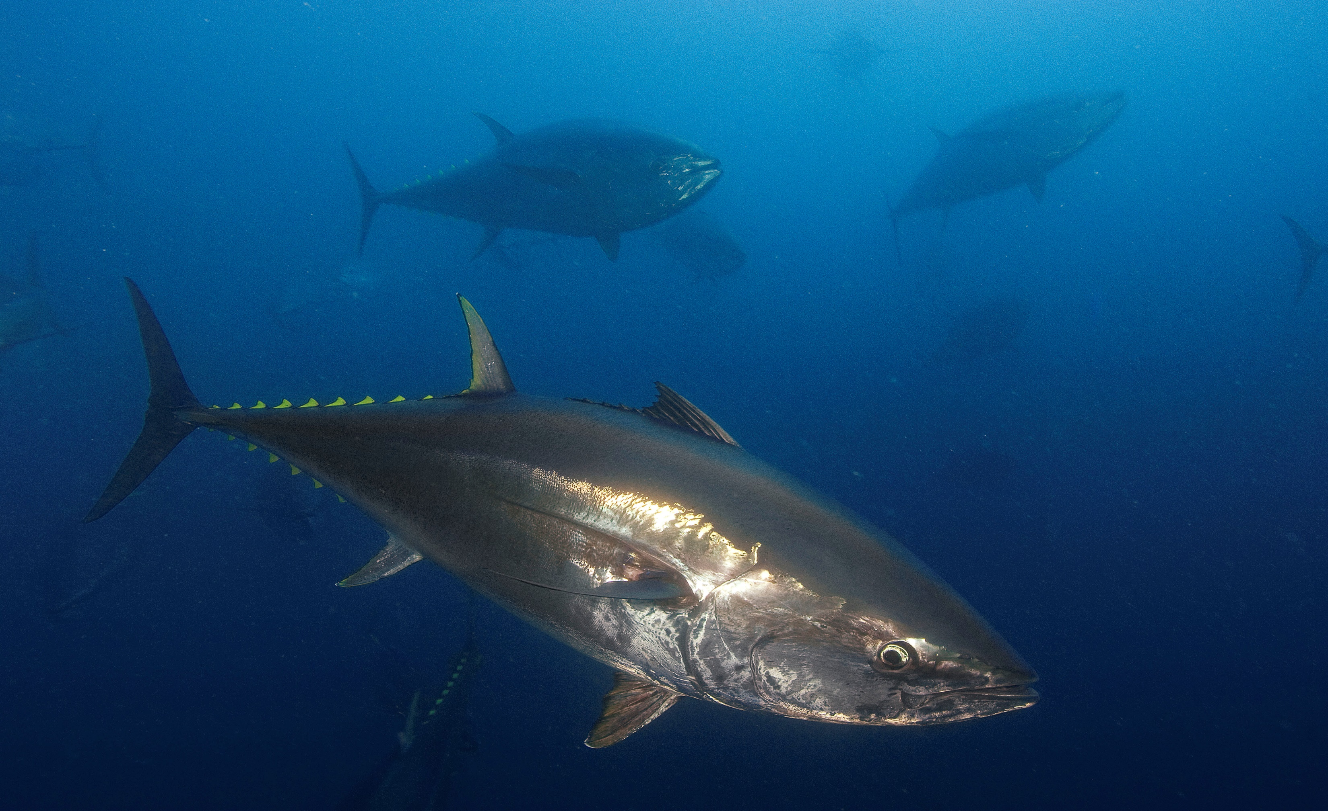
Thanks for your attention and enjoy the appetizer!

