Slide 1
AI technology to analyze stereoscopic camera footage developed by NEC corporation
Fisheries Agency of Japan

Slide 3
Copyright © NEC Corporation 2019, All rights reserved.

Slide 4
Advantage
Save human resource (automatic analysis)
No bias (all the fish suitable for the measurement will be analyzed)
Easy to use (take the video and upload it on cloud server of the NEC)
High repeated accuracy and precision

Slide 5
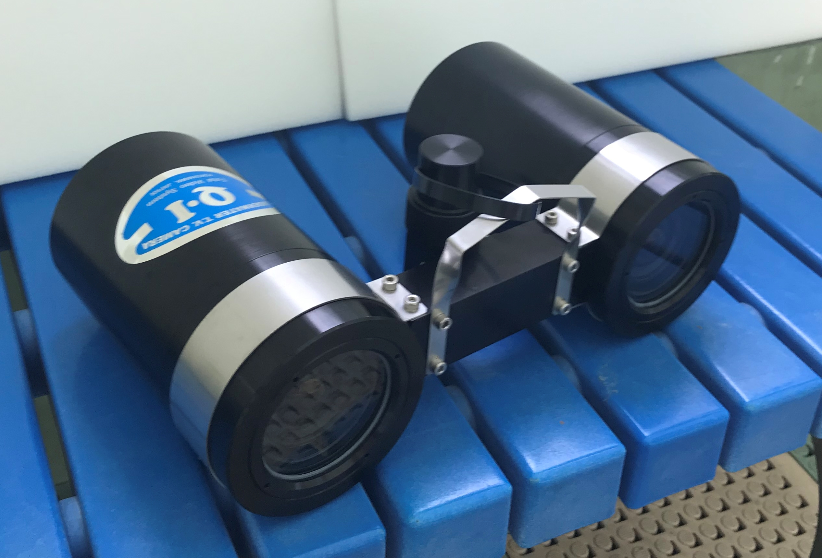
Constraint
If a user buys stereoscopic camera QSC-100 from NEC, the devices are calibrated at the beginning. (Videos from AM-100 device are also analyzable but the camera need to be sent to NEC for calibration)
A function to automatically count No. of fish is still under development
Underwater stereo camera QSC-100
“Compact & light weight”
“High accuracy”
“Made in Japan quality”

Slide 6
For further information…
Please email NEC Corporation:
info@aqua.jp.nec.com
(English and Japanese only)

