Slide 1

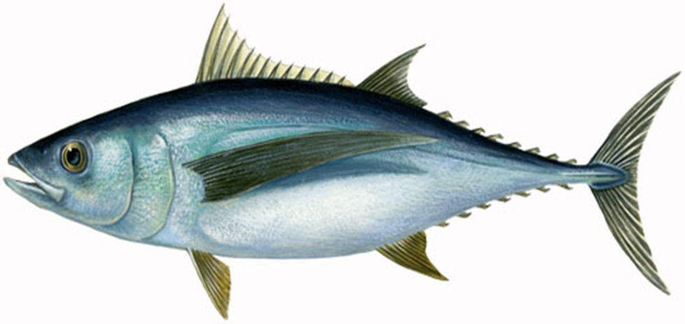
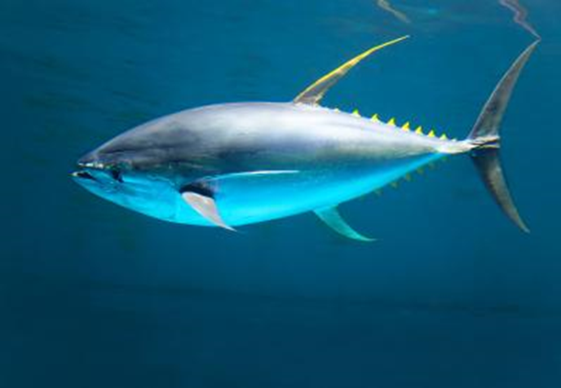
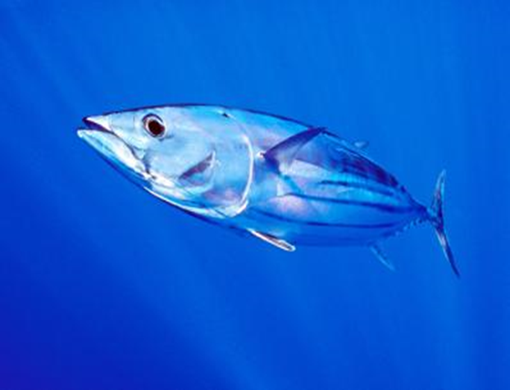
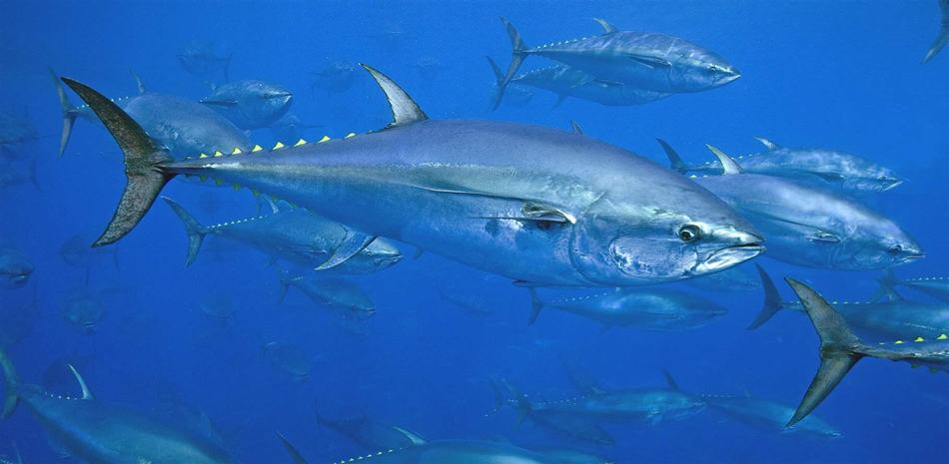
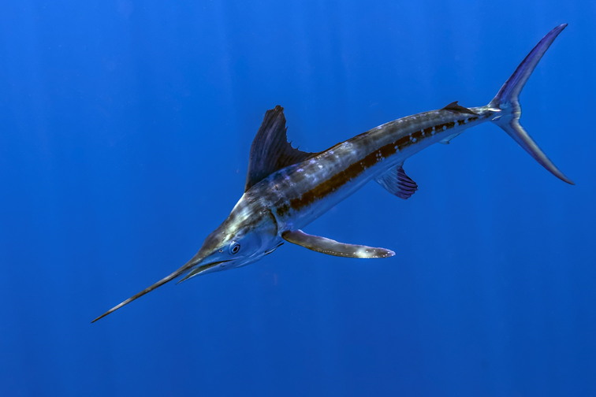
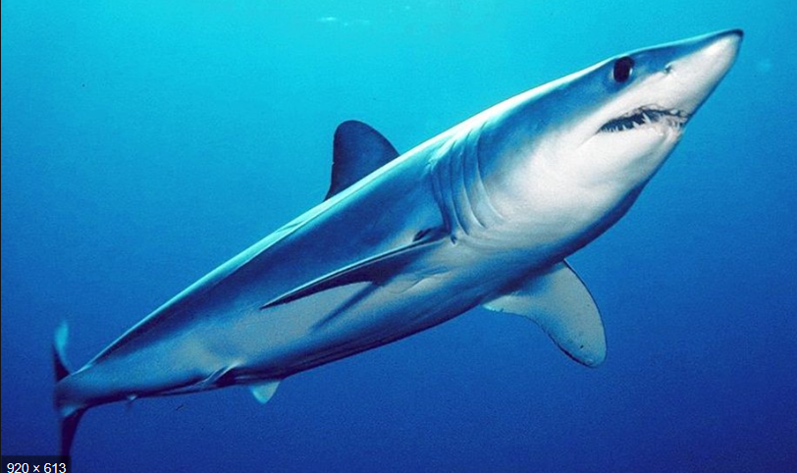
Report of the 2019 Standing Committee of Research and Statistics (SCRS)
Plenary 2019
Madrid, Spain. September 30 to October 4, 2019

Slide 2
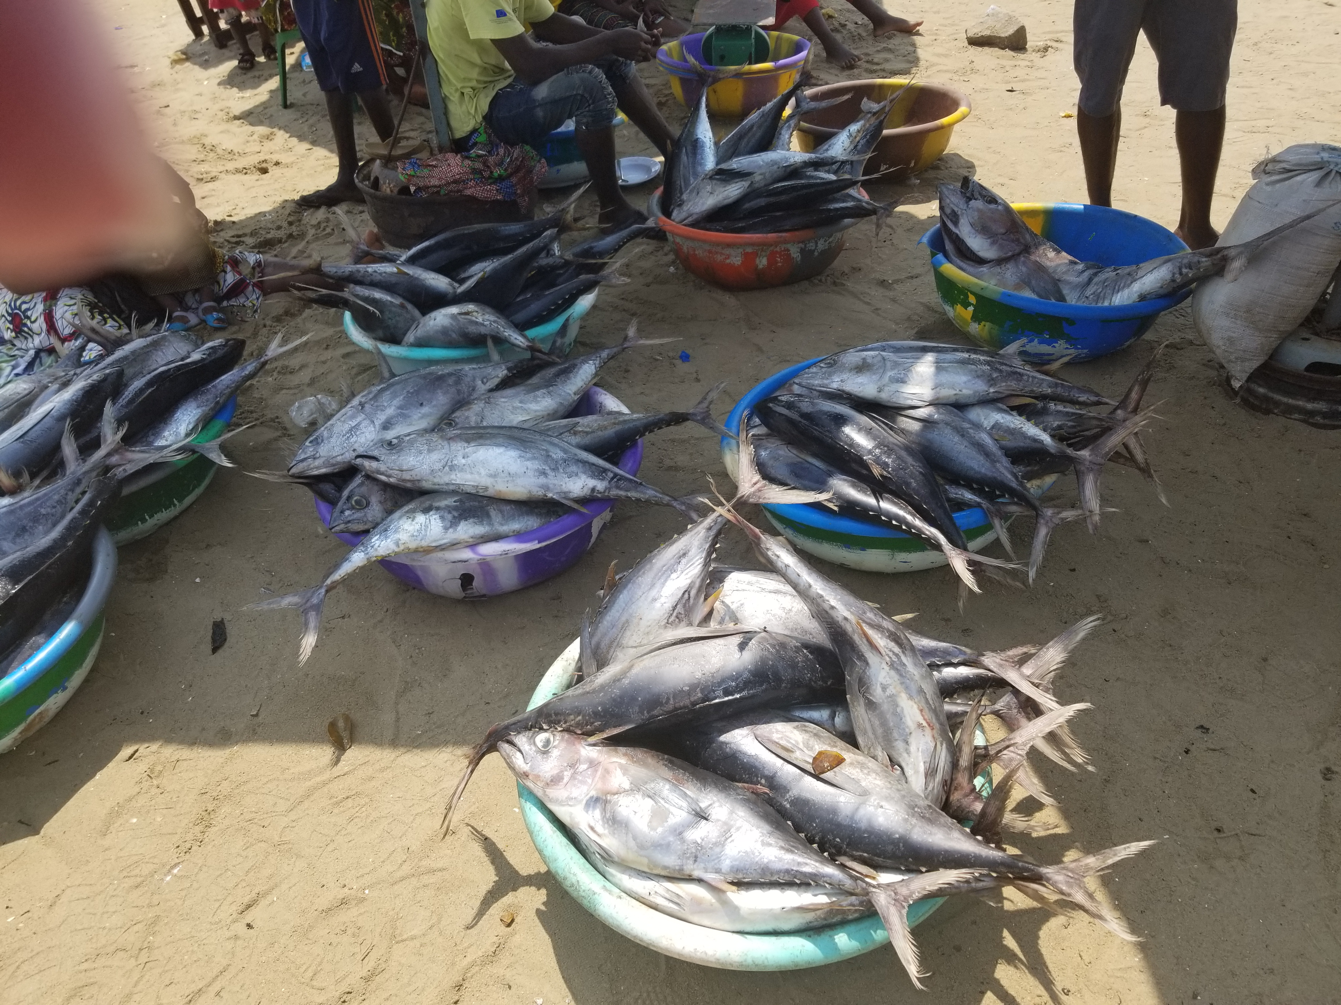
- SCRS Accomplishments and Challenges
- Secretariat activities in research and statistics
- Report of Intersessional SCRS meetings
- Executive Summaries (Details provided in Panel)
- Research Programs
- Management Strategy Evaluation (MSE)
- Recommendations to Commission
- Responses to the Commission
Presentation Overview - Plenary

Slide 3
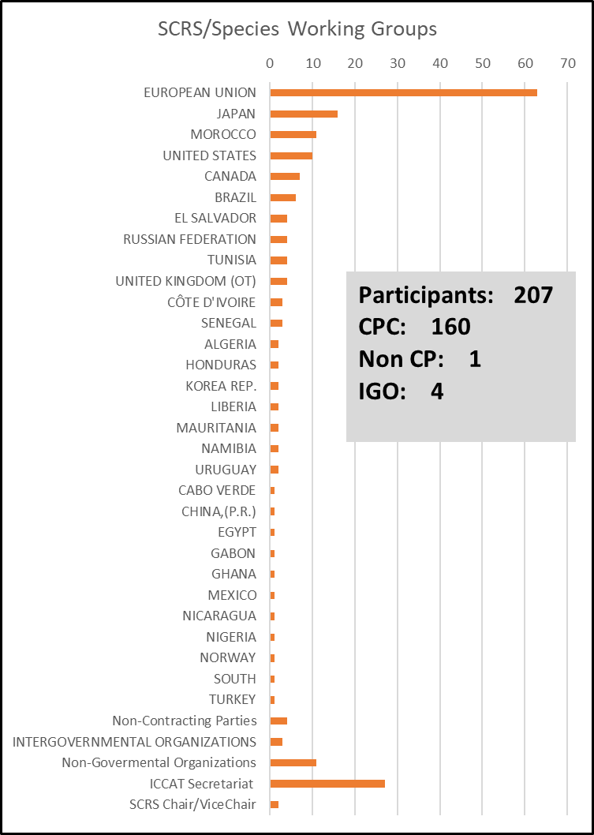
2019 SCRS Accomplishments and Challenges
Very Busy and demanding year for all involved.
- Three Stock Assessments: YFT, WHM, SMO (update)
- Six Intersessional Meetings: BFT, SWO, ECO, WGSAM, Panel 2, SMT
- Three BFT MSE TT
- 3 Joint tRFMO: FAD, EBFM, By-catch
Report of 2019 SCRS Species working groups/Plenary Meetings
- Participants from 30 CPC’s
- 204 SRCS Papers submitted
- 77 Presentations
Major Challenges:
Increased workload on CPC’s and the Secretariat
Management Strategy Evaluations (MSE)

Slide 4
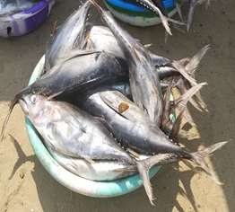
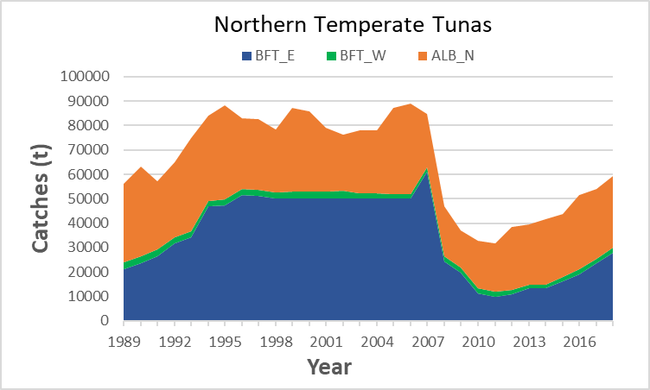
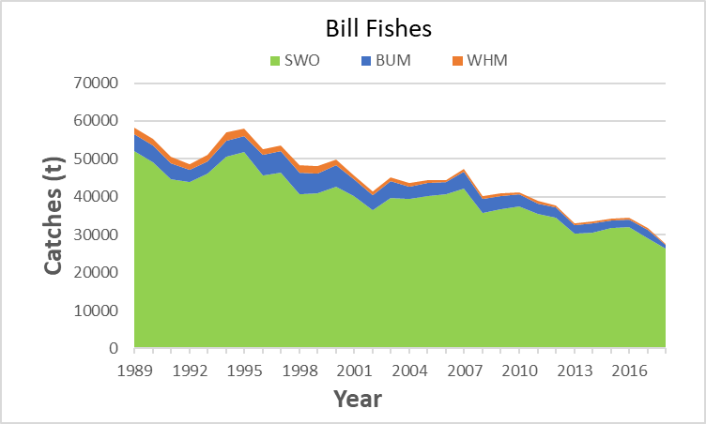
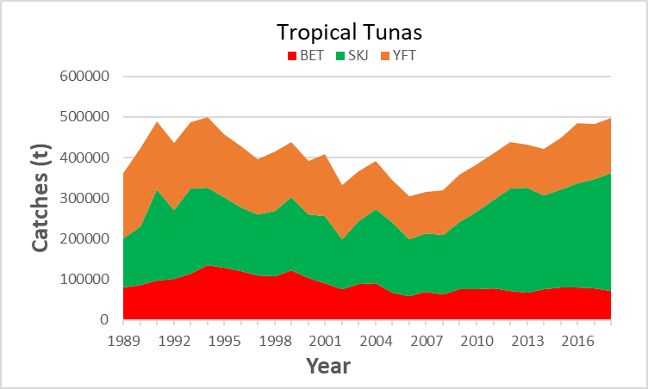
Secretariat Activities in Research and Statistics
The ICCAT Secretariat provides critical technical and logistical support to the SCRS in all the aspects of the Standing Committee’s work. This includes support for multiple research programs, database management of fishery data reported to ICCAT, coordination of SCRS report and document publication, meeting coordination, capacity building initiatives, and training. (Details presented Section 6).
Reported Catches

Slide 5
Secretariat Activities in Research and Statistics
Highlights:
Significant contribution to the development of the ICCAT Integrated Online Management System (IOMS)
Publication of ICCAT documents - ICCAT Collective Volume of Scientific Papers; meeting reports, and the Statistical Bulletin
Management of the Data Fund and other ICCAT funds that included:
  Participation of 58 Scientists to attend SCRS meeting
  Enhanced Capacity for data collection in the industrial and artisanal fisheries
  Rebuilding of the statistical and fisheries data collection system in Liberia (supported by JCAP)
  Capacity building courses to enhance participation of managers in MSE processes
Short-term Contracts for data collection and recovery, MSE modelling approaches (SWO,ALB) , CPUE standardization, electronic tagging (ALB, SWO, Sharks), enhanced studies on Porbeagle and Mako sharks
Notes:
IOMS), a system designed to manage online all the ICCAT data requirements in the future. This is a long-term project intended to replace entirely the current ICCAT data reporting system. Two new senior software developer experts, were hired for one year to work full-time on the IOMS implementation.
SCRS activities funded the following: • Short-term contract for ICCAT collection of biological samples for the study of growth of billfish in the eastern Atlantic; • Short-term contract Atlantic blue marlin Gulf of Mexico reproductive biology study (to be signed); • Short-term contract for ICCAT SMTYP for the biological samples collection for growth, maturity and genetics studies; • Short-term contract for ICCAT swordfish biological samples collection for growth, reproduction and genetics studies; • Short-term contract for modelling approaches: support to ICCAT North Atlantic swordfish MSE process; • Short-term contract for Mediterranean swordfish data recovery; • Swordfish workshop on sampling and processing protocols aiming at growth and reproduction studies; • Short-term contract for the addition of swordfish distribution model to the longline simulator study (contract expected to be signed soon); • Short-term contract for improvement of the North Atlantic albacore management strategy evaluation (MSE) framework; • Collaborative analysis using longline operational data to standardized Atlantic yellowfin tuna CPUE indices; • Electronic PSAT tagging of Atlantic swordfish, northern albacore and Atlantic pelagic sharks; Study on genetic stock structure of shortfin mako shark based on mitochondrial analysis; • Study on the reproduction of northeastern Atlantic porbeagle; • Experts workshop to evaluate the impact of fishing on seabirds; • Attendance of intersessional SCRS meetings (e.g. seabird expert).

Slide 6
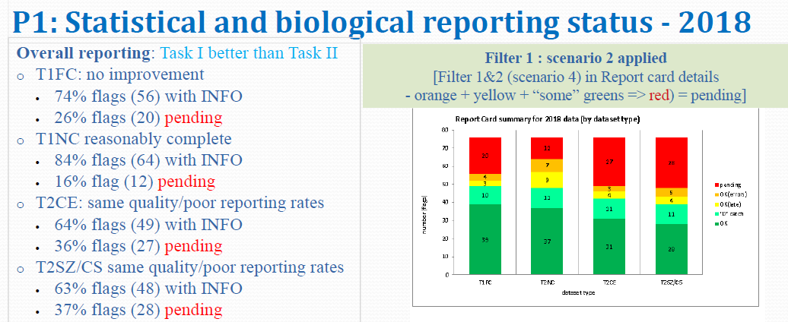
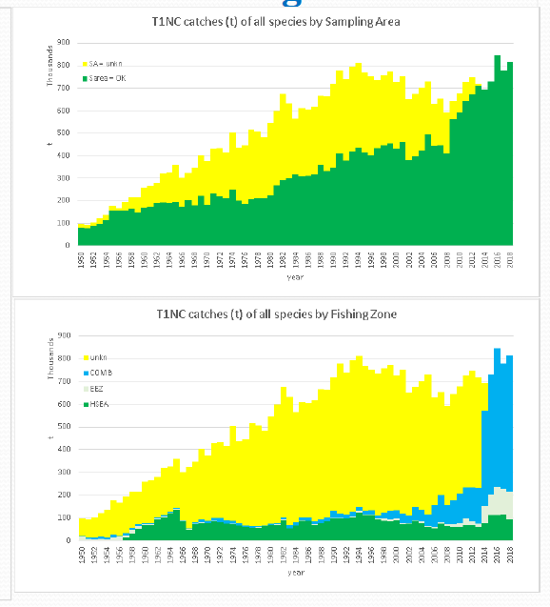
Plenary 2019
Long term Data Recovery and Improvements
Detailed Reports on Reported Statistics

Slide 7
Score Card on Fisheries Data Availability
Adopted by WGSAM in 2019
The scale adopted 0-10 with
4 categories (4 quartiles).
Quartile | Interval | Data availability
1 | [0, 2.5] | bad
2 | [2.5, 5] | poor
3 | [5, 7.5] | reasonable
4 | [7.5, 10 | good

Slide 8
Report of intersessional SCRS meetings
Nine Intersessional meetings held in 2019
Intersessional meeting of the bluefin Species Group - Madrid, Spain, 11-15 February. Objectives were to approve final set of Operating Models, to review Candidate Management Procedure, and to provide input on the MSE to Panel 2 intersessional meeting.
Outputs – Due to delays two options were identified for providing the 2021 bluefin tuna TAC advice: (a) to continue the MSE development process as outlined in the roadmap, or (b) to begin planning for a 2020 bluefin tuna stock assessment.
Bluefin MSE Technical Group meetings. (3 meetings)
- Madrid, Spain, February 7-9
- St. Andrews, Canada, July 23-27
- Madrid, Spain, September 19-21
Outputs – Technical errors, data additions/revisions and coding errors prevented much of the work from being completed and limited progress. Recommendation made at St Andrews meeting to undertake some form of stock assessment for 2021 TAC advice. Details in Panel 2 presentation. tunas Species Group

Slide 9
Report of intersessional SCRS meetings – Slide 2
Intersessional meeting of the swordfish Species Group. Madrid, Spain 25-28 February.
Discussion centred around data availability and quality for northern and southern swordfish stocks, stock status, progress on biology and stock structure research, plans for future sampling activities, progress on Species Distribution Modeling, and progress on MSE. Concern expressed about the lack reporting discards of undersized Mediterranean swordfish. Why - regulations prohibited even catching undersized swordfish. A regulation change is needed to allow sampling of undersized fish.
Meeting of the ICCAT Working Group on Stock Assessment Methods (WGSAM), Madrid, Spain, 8-12 April . Recognized that several of the ICCAT species assessed are in “data limited” situations and recommended a series of Data Limited Workshops to characterize stock assessment uncertainties. The Group approved the ICCAT score card on data availability. Recommended an Independent Peer Review team(1-3 reviewers) to provide advice for the overall ICCAT MSE process..sessional meeting of the small tunas Species Group

Slide 10
Report of intersessional SCRS meetings – Slide 3
5. Shortfin Mako stock assessment update meeting Madrid, Spain, 20-24 May.
The fishery statistics (Task I and Task II) and the conventional tagging data were revised for BSH, SMA, POR. Projection results showed that:
i) a zero TAC will allow the stock to be rebuilt by 2045 (53% probability);
ii) the stock will continue to decline until 2035 before any biomass increases can occur;
iii) a TAC of 300t or less is required to be in the green quadrant of the Kobe plot (60%) by 2070,
iv) a TAC of 700 tons would end overfishing immediately (57%), but probability of rebuilding the stock by 2070 is 41%.
Given the recent CITES listing, and the non retention rule collecting, and returning samples of this species is problematic. Concerns were also expressed about the feasibility of a close-kin mark-recapture study for shortfin Mako due to sampling limitations.

Slide 11
Report of intersessional SCRS meetings – Slide 4
White marlin data preparatory and stock assessment meetings. Data prep - (Madrid, Spain, 12-15 March ). Objectives were to revise/update the available catch and size data, indices of abundance, relevant biological data and fisheries information in preparation for the stock assessment. Stock assessment (Miami, USA,10-14 June) used two assessment models: Stock Synthesis (SS3) and a Bayesian production (JABBA) and the combined results to produce the advice on stock status and outlook. The Group noted if catches continue to exceed the TAC (400t), rebuilding of the stock will proceed more slowly, or be put at risk of further declines.
Yellowfin data preparatory and stock assessment meetings. Data Prep (Madrid, Spain 22-26 April). Objectives - to revise/update the available catch and size data, indices of abundance, relevant biological data and fisheries information in preparation for the stock assessment. Stock assessment (Grand Bassam, Côte d’Ivoire,8-16 July). Three models were used: production models (MBP and JABBA), and Stock Synthesis (SS3) that incorporated substantial revisions made to historical fishery data and new information on life history.

Slide 12
Report of Intersessional SCRS meetings – Slide 5
Intersessional meeting of the small tunas Species Group. Olhão, Portugal, 24-27 June. - Substantial revisions of Task I and II were noted,
- New data sets provided for several important fisheries and improvements in sample collection for growth, maturity, and genetics knowledge.
- The status of the Small Tuna Year Programme (SMTYP) was reviewed.
- A workshop on data limited MSE approaches for managing data-limited stocks was recommended (Applicability questioned).

Slide 13
Report of the Sub-committee on Ecosystems and By-catch
Sub-Committee on Ecosystems and By-catch (Madrid, Spain . 8-12 April).
- Ecosystem Report Card features 11 ecosystem components:
- SCRS has developed a protocol that formalizes the review and adoption of indicators
- SCRS also created an indicator checklist which catalogues and characterizes the indicators that were adopted.
- Important to note that the report card is still in development and subject to an iterative process involving consultation.
- To operationalise EBFM the SCRS Sub-committee has recommended to initially focus on two regions: i) the tropical Atlantic and ii) the Sargasso Sea areas of the Atlantic Ocean.

Slide 14


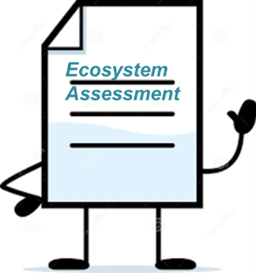

Progress on the Components of the Ecosystem Based Fisheries Management Plan
Developed appropriate conceptual and operational objectives for a management framework consisting of 11 components.
Indicators developed and updated for most components.
Thresholds for indicators and reactions to poor status have not been defined.
Case studies scheduled to provide regional overviews of known direct/indirect impacts of ICCAT fisheries on the different components of 2 regions (tropical Atlantic, Sargasso Sea) and describe known links between the environment and fisheries productivity.
These studies will provide context and direction for the ecosystem assessments and development of the ecosystem report card.
Currently assessments for the 11 ecosystem components have yielded detailed descriptions for the indicators , their calculation, data sources, factors causing observed trends, their implications and link with fisheries management.
A second annual ecosystem report card (Doc. No. SCI_76 / 2019) has been completed.
Future efforts to focus on finalizing report card indicators.
Potential regions for reporting. Details dependent on the component that is assessed. No single solution.

Slide 15
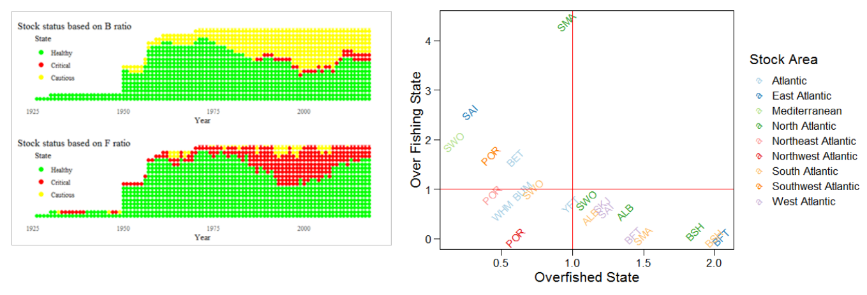
Progress towards 2019 Report Card
Significant progress made on development of status and pressure indicators for Retained Assessed, Retained non-Assessed, Seabirds, non-Retained Sharks, Sea Turtles, Marine Mammals, Food Web/Trophic Relationships, Fishing Pressure, Habitat, Environmental Pressure, Socio-economic
Sub-Committee Updated the 2018 indicator with most recent data available
Developed Kobe plot based on terminal B and F ratios
Need to create separate indicator for stocks with undetermined F and B ratios
Example for Retained Assessed Species

Slide 16
Overview Executive Summaries
Section 9 of Report. Details to be presented during the panel meetings.
Summary ICCAT Stock Status – 25
Overfishing (F>Fmsy) |  |  | Overfished (B<Bmsy)
Yes | No | Unknown | Yes | No | Unknown
5 | 16 | 4 | 11 | 9 | 5

Slide 17
Overview Executive Summaries
Section 9 of Report. Details be be presented during the panel meetings.
Stock | Overfishing | Overfished | Year | Projections | TAC
SKJ_E | Not Likely | Not Likely | 2013 | No | No
SKJ_W | No | No | 2013 | No | No
YFT | No | No | 2018 | Yes | Yes
ALB_N | No | No | 2014 | Yes | Yes
ALB_S | No | No | 2014 | Yes | Yes
ALB_Med | Not Likely | Not Likely | 2015 | No | No
SAI_W | Not Likely | Not Likely | 2014 | No | No
SWO_N | No | No | 2015 | Yes | Yes
BSH_N | Not Likely | Not Likely | 2013 | No | Yes
BFT_E | No | Unknown | 2015 | Short Term | Yes
BFT_W | No | Unknown | 2015 | Short Term | Yes
No Overfishing and not Overfished

Slide 18
Overview Executive Summaries
Section 9 of Report. Details will be presented during the panel meetings.
Stock | Overfishing | Overfished | Year | Projections | TAC
BET | Yes | Yes | 2017 | Yes | Yes
BUM | Yes | Yes | 2016 | Yes | Yes
WHM | No | Yes | 2017 | Yes | Yes
SAI_E | Possibly | Yes | 2014 | No | Yes
SWO_S | No | Yes | 2015 | Yes | Yes
SWO_Med | Yes | Yes | 2015 | Yes | Yes
SMA_N | Yes | Yes | 2015 | Yes | No
SMA_S | Possibly | Possibly | 2015 | No | No
POR_NW | No | Yes | 2008 | No | Yes
POR_SW | Undetermined | Yes | 2008 | No | No
POR_NE | No | Yes | 2008 | No | No
Overfishing,Overfished, or Both
Stock Assessment 2019

Slide 19
Overview Executive Summaries
Section 9 of Report. Details will be presented during the panel meetings.
Insufficient information to rate

Slide 20
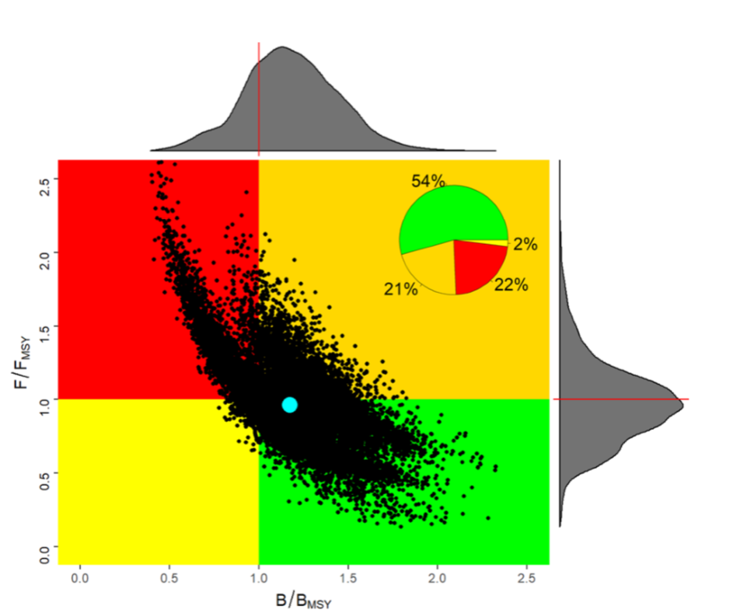
Executive Summaries
The SCRS discussed changes to the Executive Summary format to reduce the size of these summaries and to provide more effective communication. In 2018 the SCRS provided a summary of the new format to the Commission for feedback. SCI-81/2019 provides an example of the new format for YFT.
The Commission supported the following modifications:
• distinguishing the two yellow quadrants in the current Kobe plot; the upper right quadrant should be orange.
• Always include the three Kobe matrices;
probability in the green quadrant (B>BMSY and F<FMSY), probability of not overfishing (F<FMSY) and,
probability of not overfished (B>BMSY).
Unfortunately, there was uncertainty regarding when the new format would be implemented. The SCRS requests clarification from the Commission on implementation of the new format.

Slide 21

Research Programs: GBYP
Overview of GBYP Program
Started in October 2009,
  Currently active in Phase 8 (Feb 2018 - Sept 2019)and,
  Phase 9 (Jan 2019 –Dec 2019)with,
  Phase 10 in the proposal stage.
General objectives:
  Improving basic data collection
  Improving understanding of key biological and ecological processes
  Improving assessment models and provision of scientific advice on stock status
  Annual budget
  Voluntary contribution of CPCs and other entities (80% European Union; 20% others)
  Annual funding scheme makes long-term planning of the activities difficult!

Slide 22
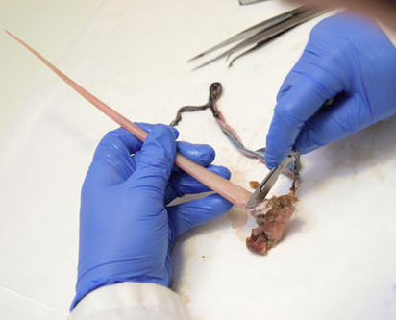
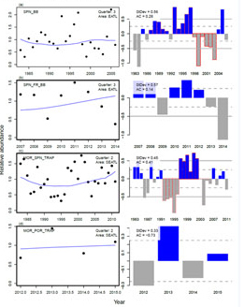
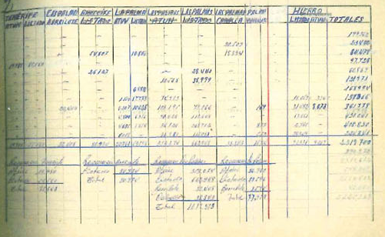
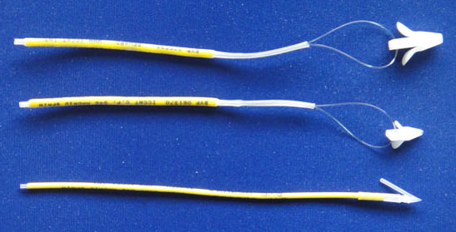

Overview of GBYP Program
Six main lines of activity - plus genetics (Phase 10):
Biological studies
Coordination
Modelling
Data recovery
Fishery independent
indices
Genetics
Close-Kin Analysis
Tagging

Slide 23
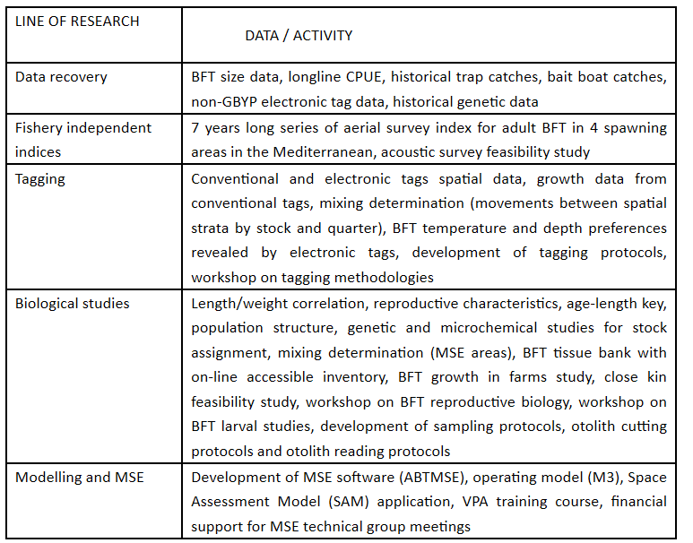
Research Programs - GBYP
GBYP Coordination:
GBYP has coordinated a total of 161 contracts to 98 entities located in 24 countries; 344 scientific and technical reports and 281 scientific papers.

Slide 24
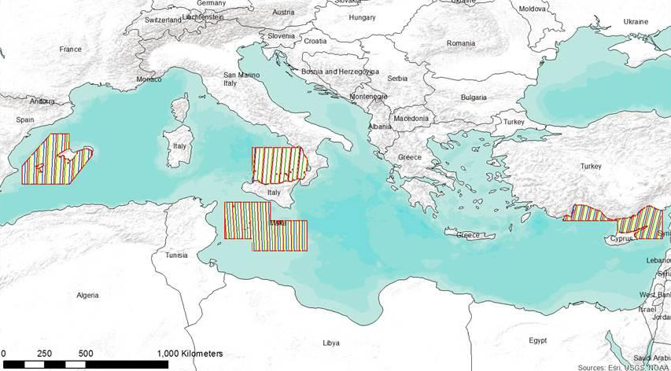
Aerial survey: Independent indices:
Research Programs - GBYP
Biological Studies/Sampling
GBYP tissue bank
Collecting tissue samples and otoliths - maintained by AZTI
Population structure and mixing
Otolith microchemistry
Genetic analysis (SNPs)
AGE-Length Key (ALK)
Ageing – otolith reading
Improvements in ageing methodology
Growth and reproductive parameters
BFT reproduction workshop (SCRS/2019/180)
Workshop on BFT Growth (SCRS/2019/132 and 144)
Growth rates in farming facilities
Growth in farms study (5 farms) (SCRS/2019/198)
Standard sampling strategy established in 2017
surveys conducted on the 4 main spawning areas
Time series available: 2010, 2011, 2013, 2015, 2017, 2018, 2019

Slide 25
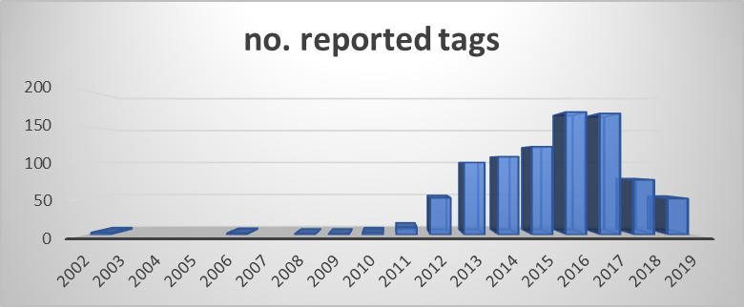
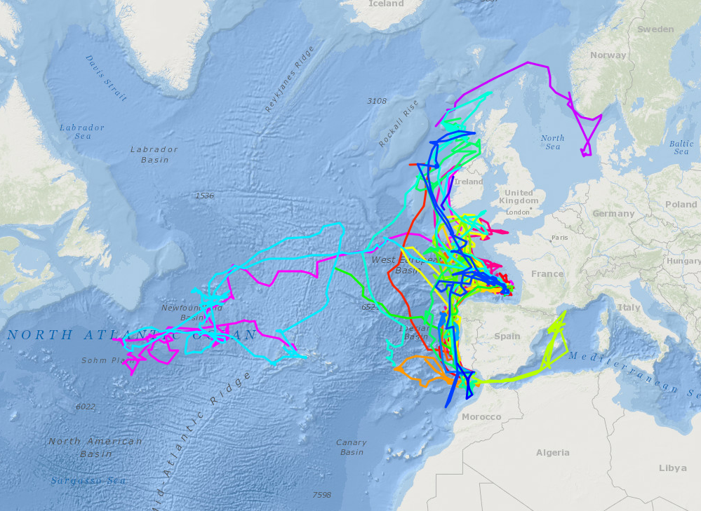
Tagging
Research Programs - GBYP
Continuation conventional tagging carried out by CPCs.
Electronic tagging objectives 2018-2019:
  Estimate the degree of mixing of western and eastern bluefin tuna stocks along the different statistical areas (MSE needs)
  42 electronic tags deployed in 2018 (30 off Portugal, 10 off Ireland, 2 off Norway).
  37 electronic tags to be deployed in 2019 (7 off Portugal, 15 off Ireland, 15 Skagerrak)
Workshop on e-tags deployment methodology

Slide 26
MSE
Research Programs - GBYP
Phase 10
Funding for MSE development expert.
Support for BFT MSE Technical Group, funding the attendance of Chair, contracted expert and several members of the group to relevant meetings.
Meetings supported in 2019:
  MSE BFT Technical Group meetings held in Madrid in February 2019,
  MSE BFT Technical Group meetings held in Saint Andrews in July 2019 and,
  MSE BFT Technical Group meetings held at ICCAT headquarters in September 2019.
Continuation of key elements related to:
Fishery independent indices:
Data recovery
Tagging:
Biological studies:
Modelling:
Feasibility study for the application of acoustic surveys to the development and validation of fishery independent indices
Hold workshop on close-kin methodologies
Development and application of habitat models in CPUE standardization
Continue implementation of “BFT growth in farms study

Slide 27
The Atlantic Ocean Tropical tuna Tagging Programme (AOTTP)
Research Programs - ATTOP
The 5-year project officially began in June 2015 and will end 30 Nov 2020.
The overall objective of the AOTTP Programme is to contribute to food security and economic growth of the Atlantic coastal states by ensuring sustainable management of tropical tuna resources in the Atlantic Ocean.
Program activities
include:
  Tagging of tropical tuna in the Atlantic
  Training and capacity building in ‘developing’ CPCs
  Coordinating shore-based tag recovery and awareness teams
  Developing publicity campaigns and incentive schemes (e.g. rewards)
  Collecting and verifying all data and populating ICCAT databases
  Analysing, summarising and making data available to SCRS (ICCAT’s scientific body)
  Facilitating and promoting collaborative research and stock assessments

Slide 28
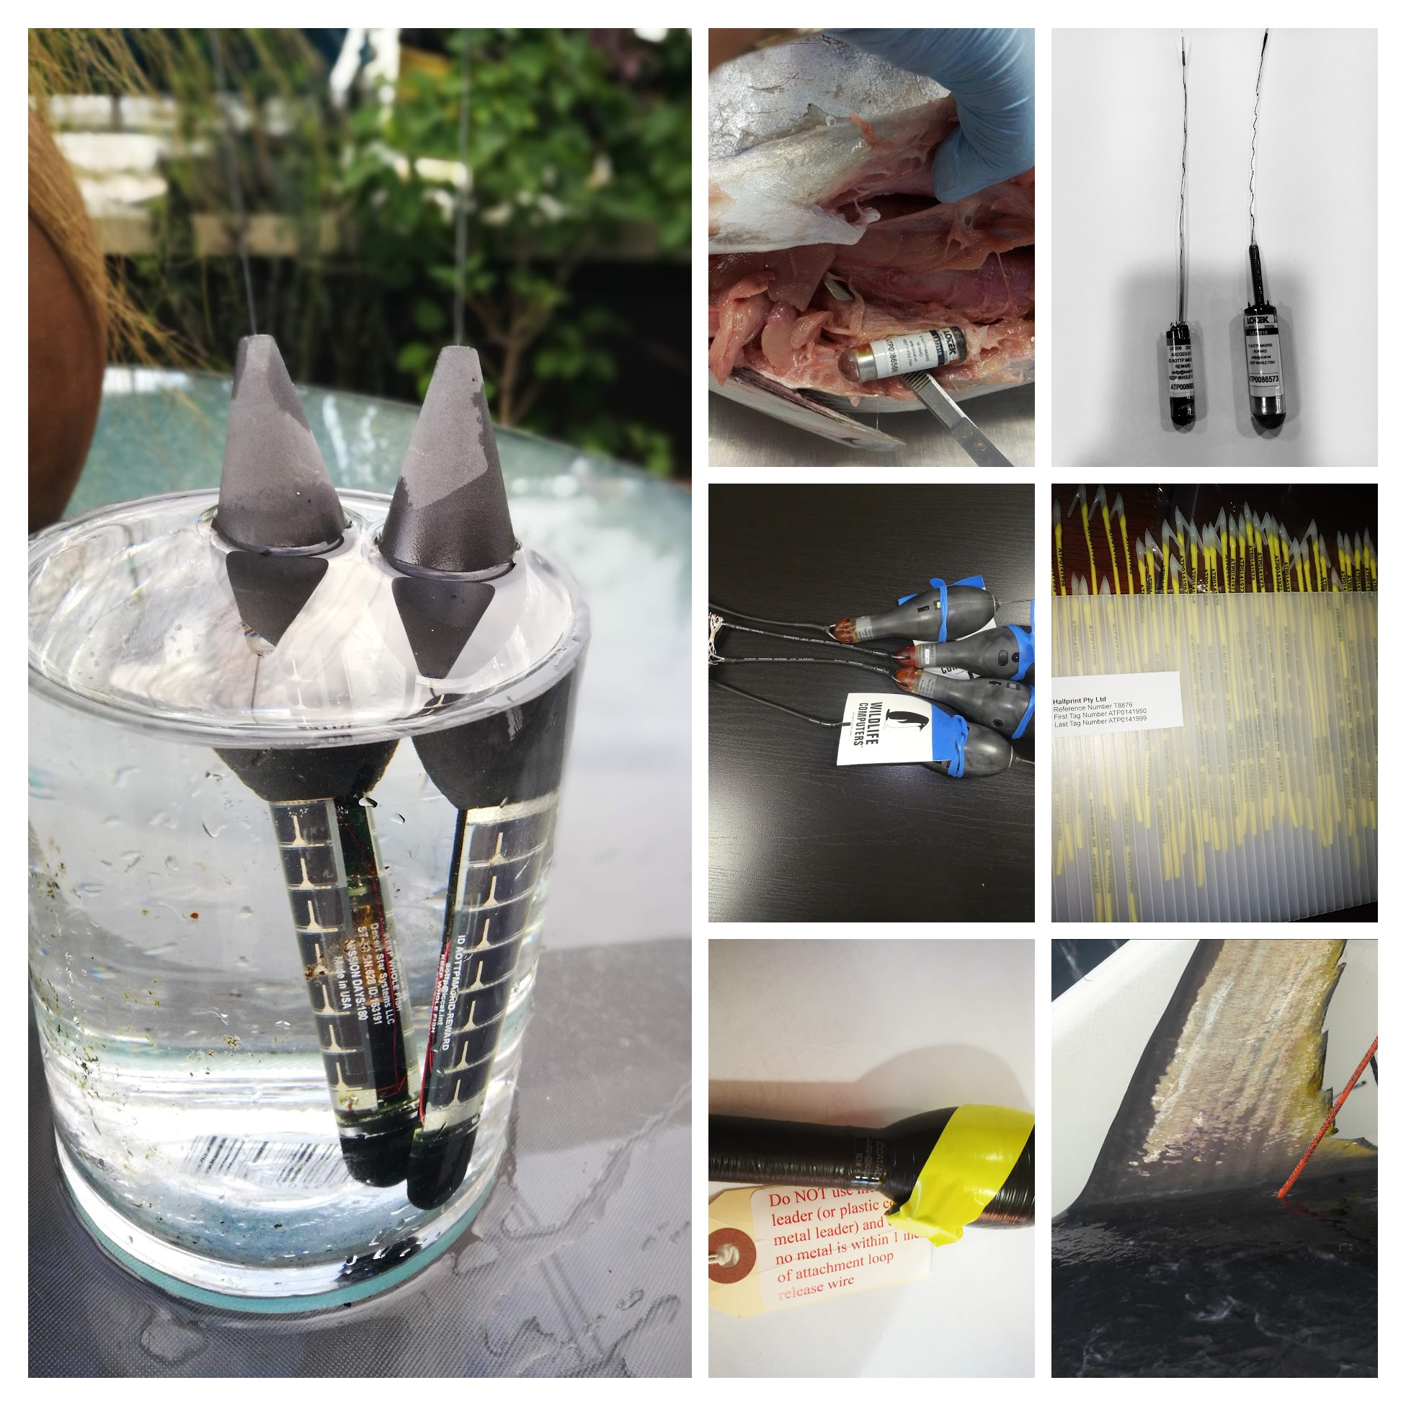
AOTTP - tag types
Research Programs - ATTOP
Examples of tags deployed

Slide 29
AOTTP – release and recovery (spaghetti)
Research Programs - ATTOP
 | Releases | Recoveries | Recovery rate (%)
Bigeye | 21988 | 4514 | 20.5
Little tunny | 7770 | 569 | 7.3
Skipjack | 46259 | 3291 | 7.1
Wahoo | 277 | 3 | 1.1
Yellowfin | 37376 | 7300 | 19.5
Totals | 113670 | 15677 | 13.8

Slide 30
Research Programs - ATTOP
All AOTTP electronic tag deployment
 | BET | SKJ | YFT
DS | 22 | 0 | 7
LOTEK ARCGEO9 | 27 | 0 | 2
LOTEK LAT2810 | 121 | 9 | 229
Microwave | 9 | 0 | 6
WC | 30 | 0 | 71
Total | 209 | 9 | 315
AOTTP archival tag recovery rates
 | released | recovered | %
BET | 148 | 20 | 13.5
SKJ | 9 | 0 | 0
YFT | 231 | 21 | 9.1

Slide 31
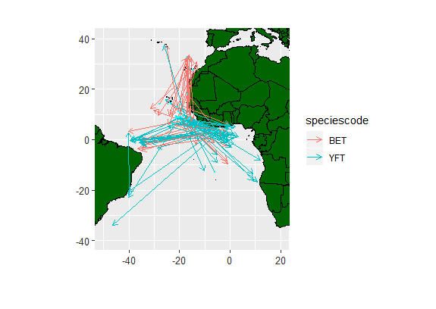
Tuna movements
Research Programs - ATTOP
Species | Mean | Max
Bigeye | 226 NM | 2212 NM
Little tunny | 100 NM | 929NM
Skipjack | 203 NM | 2803 NM
Yellowfin | 164 NM | 3247 NM
>1000 NM only

Slide 32
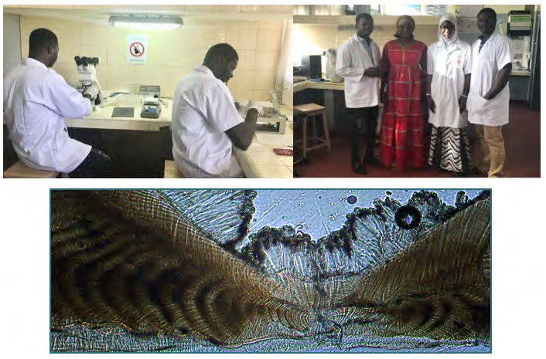

AOTTP – Capacity building
Research Programs - ATTOP
Training in tagging at sea
Training in shore-based tag-recovery
Three data-analysis workshops last year
Two hardpart reading workshops this year
Integrate data-analytic activities

Slide 33
AOTTP – Future - Programme ends Nov 2020
Research Programs - ATTOP
Tagging:
USA & Caribbean
St Helena
Northern Brazil
Research:
Targeted research projects ongoing
Final AOTTP Symposium will be held Dakar, Senegal - June 2020.
Special volume (Fisheries Research)-Guest Editors needed.
Data quality and checking will continue
‘Raw’ log-book data
VMS data
Final Evaluation
Exit Strategy
(TROs cease in Jan 2020)

Slide 34
- Small Tunas Research Programme (SMTYP)
To recover small tunas historical data (statistical and biological data) from the main ICCAT fishing areas.
- Shark Research and Data Collection Programme (SRDCP)
To improve shark data collection and research, the current knowledge on many fisheries and basic biology and to improve the quality and reduce the uncertainty of the scientific advice on sharks provided to the Commission.
- Enhanced Programme for Billfish Research (EPBR)
To obtain more complete detailed catch and effort statistics for billfishes, to carry out an expanded tagging program, and to carry out studies on age and growth.
- Other research program requests: Albacore, Swordfish, Ecosystems
Research Programs - Other

Slide 35
The roadmap for MSE was developed by the Commission to match the delivery of MSE products to the needs for advice. Implement of this roadmap has been very challenging, for both the SCRS and the Commission.
Progress on the MSE process has been hampered by:
- the lack/limited experience on MSE in ICCAT, and CPC’s
- technical challenges in stock specific simulation frameworks and,
- limited resources to participate in both the MSE process and in the current stock assessment and management process.
In 2018 the Commission recommended slowdown and a preference to focus on one or two of the ongoing species without guidance on priorities. In 2019 the ICCAT MSE process focused on BFT and SWO_N, limited work on ALB_N, and little on the tropical tuna MSE.
Management Strategy Evaluations (MSE)

Slide 36
BFT - Substantial progress made in improving the OMs, although some problems remain (with the revised OMs) that require more time. Limited progress on CMP. Roadmap has been revised accordingly. Delay will require stock assessment in 2020 to provide advice for 2021.
SWO_N – Main objective was to finalize the OM’s. The MSE framework and a case study were outlined using the base-case stock synthesis assessment from 2017. The current operating framework is composed of an uncertainty grid of 288 OM’s with alternative assumptions.
ALB_N – Focus on addressing the recommendations by the peer reviewer and producing a consolidated report.
Tropical Tuna: - No activity but the acknowledgement of the need to restart the MSE process.
Management Strategy Evaluations (MSE)
Highlights for 2019:
Notes:
. (E.g., increase transparency, sources of uncertainty, better representation of results to illustrate variability of results across models, clarification of some parameters and additional checks to explain and understand the unexpected behaviour of some Operating Models)

Slide 37
• Finding mechanisms to gather input on operational objectives from the Commission (E.g., (SWGSM, Panels)
• Identification of approaches to obtain input of stakeholders outside of the scientific community
• Re-engage the Tropical tuna Working Group in their MSE process
• Obtaining sufficient funding to properly support the process.
• Simultaneously running so many MSEs for different stocks (limited number of experts)
• Conduct MSE training courses for scientists and managers. No training/capacity building in 2019.
• Implementation of a standard set of principles to guide and facilitate the coordination process for MSE.
Management Strategy Evaluations (MSE)
MSE Challenges – Basically unchanged from last year
Notes:
. (E.g., increase transparency, sources of uncertainty, better representation of results to illustrate variability of results across models, clarification of some parameters and additional checks to explain and understand the unexpected behaviour of some Operating Models).
Principles:Transparency • Continuous and thorough review • Creation of a technical MSE Group for each species • Maintenance of a living document with specifications of the Modelling Framework; • Use of standardized communication tools for MSE results • An annual SCRS intersessional meeting on MSE • Updates of progress to each SWGSM; • Having regular agenda items on MSE at meetings of Commission panels • Development of a detailed roadmap for each stock specific MSE • If progress on MSE does not comply with the roadmap to adjust the schedule of stock assessments.

Slide 38
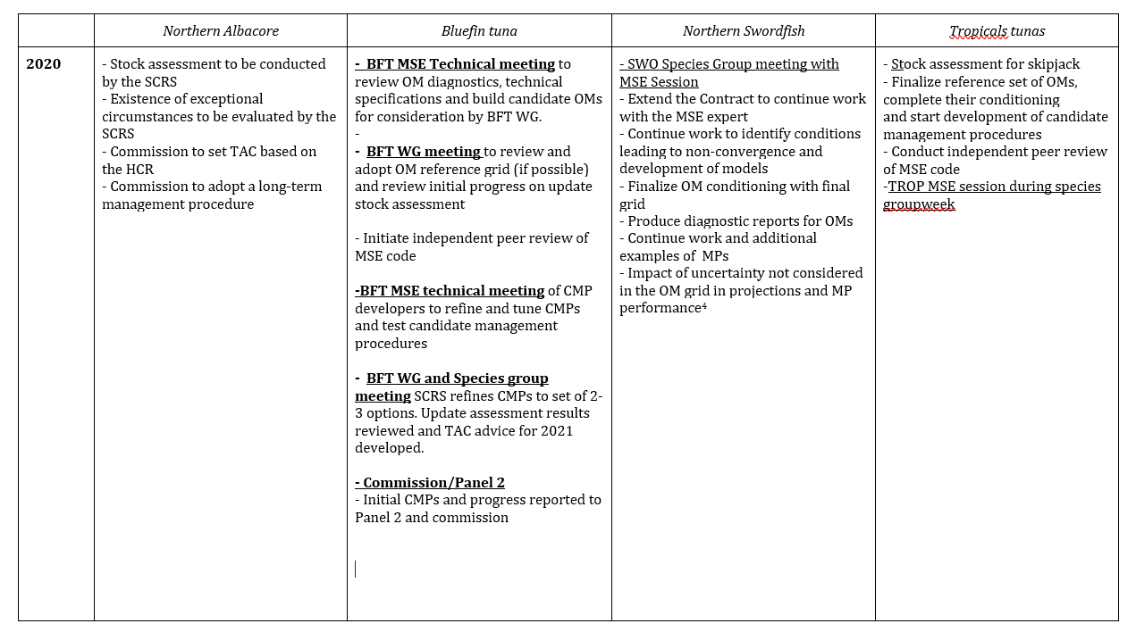
Management Strategy Evaluations (MSE)
ROAD MAP FOR THE DEVELOPMENT OF MSE AND HCR
Roadmap revised based on operational challenges and requirements.
Detailed MSE Roadmap for 2015 to 2023 presented in Appendix 16 of SCRS report
Main modifications:
ALB assessment rescheduled from 2021 to 2020. Adoption of long-term MP in 2020
BFT – process delayed by a year with multiple TT meetings in 2020. Plus Panel 2 meeting to report on progress. Set TAC 2022/24 based on CMP.
SWO_N. – Activities advanced 1 year. Commission adoption Interim MP in 2021 not 2022.
Tropical tunas- SKJ assessment (2021). Roadmap essentially unchanged. Interim MP in 2021.
Notes:
. (E.g., increase transparency, sources of uncertainty, better representation of results to illustrate variability of results across models, clarification of some parameters and additional checks to explain and understand the unexpected behaviour of some Operating Models).
Principles:Transparency • Continuous and thorough review • Creation of a technical MSE Group for each species • Maintenance of a living document with specifications of the Modelling Framework; • Use of standardized communication tools for MSE results • An annual SCRS intersessional meeting on MSE • Updates of progress to each SWGSM; • Having regular agenda items on MSE at meetings of Commission panels • Development of a detailed roadmap for each stock specific MSE • If progress on MSE does not comply with the roadmap to adjust the schedule of stock assessments.

Slide 39
Other Activities
Time issues prevented the detailed discussion of a number of issues including the following:
- SCRS 2020-2024 Strategic Plan
- Dissemination of Data-Data requests
- Submission of scientific paper/presentations at meetings
- Concerns regarding the increasing number of SCRS activities being held annually
- Composition of Program Steering Committees
- Follow up on the Second Performance Review Panel
- Publication guidelines and Peer review
The Group recommended that these and other similar issues be addressed at the proposed SCRS Process and Protocol meeting to be held early in 2020.

Slide 40
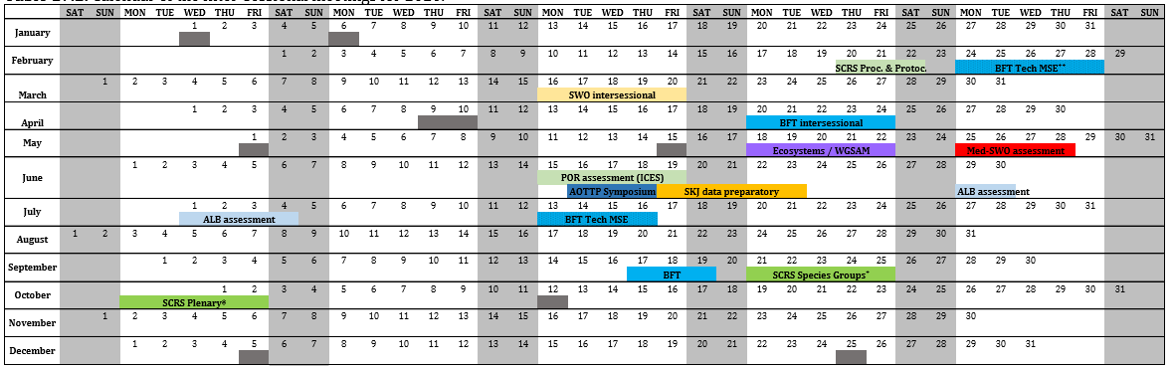
Calendar for 2020
Inter-sessional SCRS meetings 2020
Assessments: SKJ, MED _SWO, ALB, BFT TT
New : SCRS Procedures and Protocols

Slide 41
Recommendations with financial implications
Species working group recommendations with financial implications will be presented in each panel.
Stock assessment methods
- A series of Data Limited Workshops be conducted to specifically address the needs of ICCAT.
- The swordfish Species Distribution Model and the Longline Simulator [CPUE standardization.
- A panel of one to three reviewers independent of ICCAT to review the ICCAT MSE process to date.
Sub-committee on Ecosystems and By-catch
- financial assistance to support for CPC (3-5) scientists to attend a collaborative workshop to evaluate the impact of ICCAT fisheries on sea turtles.
The Sub-committee on Statistics
– Continued support for the developing of the ICCAT Integrated Online-Management System and the Online Reporting Technical Working Group.
Other - SCRS Process and Protocol meeting 2020.
- Further develop the SCRS Strategic Plan and SCRS issues.

Slide 42
Responses to Commission - Plenary
Species specific Responses will be presented in the appropriate Panel.
19.3 Develop a new data collection initiative as part of the EPBR to overcome the data gap issues of those fisheries, in particular artisanal fisheries of developing CPCs. Rec. 18-04, paragraph 10.
Several initiatives have been recommended to improve the collection of statistics of these fisheries.
- General collaboration with another RFMO (WECAFC)
- Despite efforts since the 1980s data collection gaps in mostly artisanal fisheries is still an issue. - funds had been secured to allow continuing support of sampling billfish fishing activities and to improve the quality of data on billfish collected from artisanal fisheries in the eastern Atlantic.
- Proposal to hold two regional workshops, one in West Africa and another in the Caribbean, to bring together the CPC statistical correspondents.
- Recommends to initiate trial studies with local scientific institutions to develop applications (electronic phone e-forms) and portable databases to easily record fishing effort, catches, catch composition, photo-id of species, for remote port sampling of artisanal fisheries.

Slide 43
Commission Requests reported to Plenary
19.6 Summary of the scientific data and information collected and reported pursuant to Rec. 16-14 and any relevant associated findings, Rec. 16-14, paragraph 12(c) and (d).
The SCRS has adopted and recommended the implementation of minimum standards (SCRS/2016/180) for the use of Electronic Monitoring System for purse seine vessels in the tropical tuna fishery.
The Committee encourages the following actions:
- CPCs resubmit old data in new format including the 2018, 2019 submissions as well as old submission that could not be imported.
The Secretariat will advise CPCs on which submission are required; and provide clear instructions on how aggregated fields should interpreted for sampling and mitigation measures;
Encourages all CPCs to be compliant with data submission requirements to improve National Observer Program coverage and completeness.

Slide 44
Commission Requests reported to Plenary
19.7 The SCRS will provide an update on the progress of the work on Ecosystem Based Fisheries Management in 2018 and report back to the Commission with available findings in 2019, if possible. Res. 16-23, paragraph 2
The Sub-committee provided a response in 2018, and there were no available findings in 2019 for the case study. Progress to date was provided in the report of Sub-committee on Ecosystems and By-catch . (Progress was made on the report card)

Slide 45
Commission Requests reported to Plenary
19.14 Conduct another fishery impact assessment to evaluate the efficacy of these mitigation measures. Based on this fishery impact assessment, make appropriate recommendations, if necessary, to the Commission on any modifications. [Rec. 11-09], paragraph 8.
The Committee recalled that the paucity of seabird by-catch data submitted to the ICCAT Secretariat following requirement for the implementation of mitigation measures still prevents the full assessment required by Rec. 11-09.
The FAO Common Oceans/ABNJ Tuna project has achieved a preliminary estimate of seabird by-catch mortality for pelagic longline fisheries in the Southern Hemisphere using aggregated data. Currently, it not possible to obtain the anticipated outcome of providing pre-regulation and post-regulation total estimates of by-catch due to the paucity of data.
Collaborative work is in its third year and ICCAT CPCs national scientists continue to analyze seabird bycatch based on detailed operational level observer data.
The Committee agreed to continue its effort to deliver the response to the Commission.

Slide 46
Thank You

