Slide 1

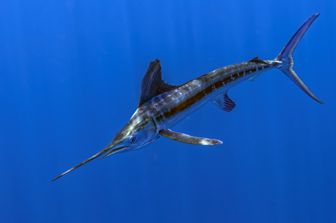
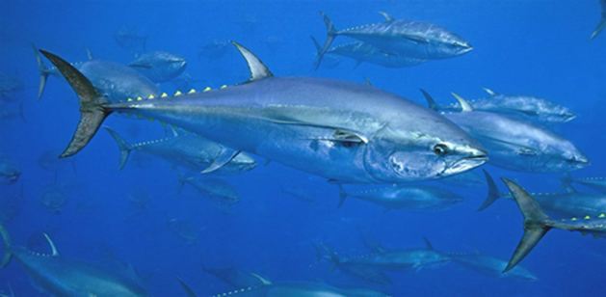
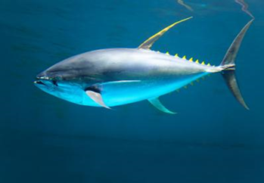

Report of the 2021 Standing Committee of Research and Statistics (SCRS) to the ICCAT Plenary
Plenary 2021
Virtual Meeting
November 15, 2021
Dr. Gary D. Melvin
SCRS Chair
Complete Report available online

Slide 2
Presentation Overview
General Activities
- SCRS Accomplishments and Challenges
- Secretariat activities in research and statistics
- Summary of Intersessional SCRS meetings
-. Research Programs
Specific Activities:
- Executive Summaries (Details provided in Panel)
- Management Strategy Evaluation (MSE)
- Recommendations to Commission
- Responses to the Commission

Slide 3
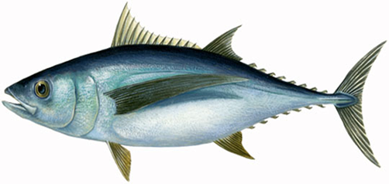
SCRS Challenges:
A Major Challenge for SCRS has been the non-traditional Operational Capabilities due to Covid 19 since March 2020 resulting in:
  Transition from in-person to virtual meetings
  Adapting to Reduced time for interactions during meetings (4.5 hr days vs 8)
  Increased workloads for SCRS members and the Secretariat
  Postponement of several important meetings and workshops
  Need for Prioritization of SCRS activities and reporting
      Exec Summaries for stocks with assessments (Approximately 3/year)
      Workplans for each working group
      Research Recommendations
      Responses to the Commission
  Adoption of some SCRS Report sections by correspondence
Other challenges included expansion of MSE

Slide 4
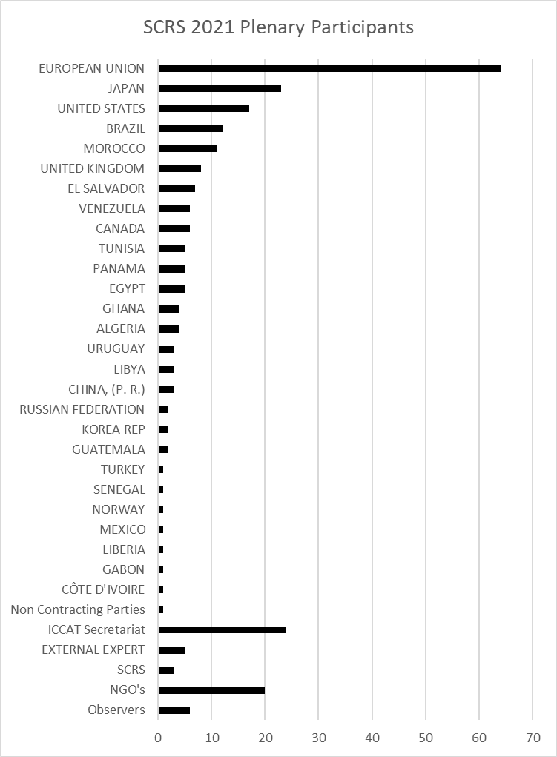
2021 SCRS Accomplishments
Extremely Demanding and Busy year for all involved with the SCRS
Three Stock Assessments: BET, wBFT, ALB-MED
Thirteen Intersessional Meetings: BFT, BET,SWO, ECO, WGSAM, billfish, Panel 2, SMT, ALB
Numerous ad hoc virtual meetings to deal with WG specific issues
Multiple MSE meetings associated with; BFT, ALB, TT and SWO
2019 2021
Participants: 207 258
CPC: 160 199
Non CP 1 1
NGO’s: 4 20
Secretariat: 27 24
Participation at the 2021 SCRS Species working groups/Plenary Meetings
- Participants from 27 CPC’s
- 157 SRCS Papers submitted up to Sept 2021
- 63 Presentations

Slide 5
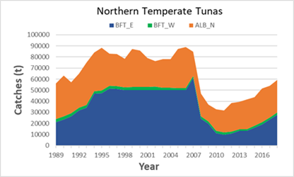
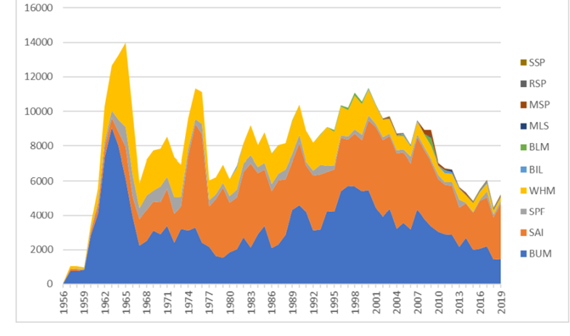
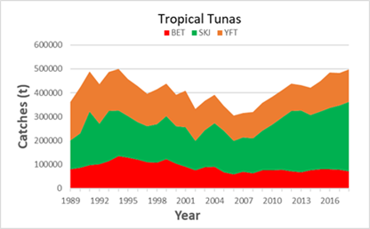
Secretariat Activities in Research and Statistics
The ICCAT Secretariat provides critical technical and logistical support to the SCRS in all the aspects of the Standing Committee’s work. This includes support for multiple research programs, database management of fishery data reported to ICCAT, coordination of SCRS report and document publication, contracting, meeting coordination, capacity building initiatives, and training. (Details presented Section 6).
BillFishes

Slide 6
Secretariat contribution
Some Additional Activities in 2021
Development of the webpage and search engine for scientific documents has been completed to enables searches for SCRS documents published in the ICCAT Collective Volume of Scientific Papers since 1973,
Enhancement of scientific capacity building partially under JCAP:
Updating tagging data received by the Secretariat, and the develop of related relational databases and web-based tools to facilitate data analysis.
16 short term contracts dealing with a wide variety of issues/activities
International cooperation. The Secretariat putted forward project proposals on compliance, the IOMS system, testing Ecosystem Indicators, and harmonization among t-RMFOs under the second phase of the FAO Common Oceans/ABNJ Tuna Phase II project,
And much more!!!

Slide 7
Report of intersessional SCRS meetings
Total of 13 Intersessional meetings held in late 2020 and 2021 – Details of each meeting available in the meeting reports.
2020 Third Intersessional Meeting of the Bluefin Species Group –Virtual Meeting, December 1-3, 2020.
  Primary focus was on several decision points related to the MSE process. This included review of the OMs and their robustness (eg mixing axis and senescence vector), plausibility weighting, the overall BFT workplan for 2021 and the SCRS MSE roadmap. A number sub-group and GBYP issues were also addressed at the meeting.

Slide 8
Report of Intersessional SCRS meetings – Slide 2
Intersessional Meeting of the Billfishes Species Group – Virtual meeting. March 8-12, 2021.
Information was provided on the sampling of hard parts for age and growth studies, the October protocol workshop, and blue marlin reproductive research in the Gulf of Mexico. ToRs for the small scale (artisanal) fisheries workshops in the Caribbean (2023) and West African (2022) regions were developed. CPCs provided a summary of the status and inventory of small scale (artisanal) fisheries, including discards. Two subgroups were initiated to address the Commission requests on Electronic Monitoring Systems and potential technical changes to reduce bycatch and bycatch mortality.
Tropical Tunas MSE Technical Group Meeting. - Virtual meeting. March 29-31, 2021. Reviewed the development of MSE OM’s for western SKJ, the stock-specific operating models for YFT, BET, SKJ, and multi-stock options. The Group also addressed major axis of uncertainty for operating models, performance metrics, updating of the roadmap (including single stock vs. multi-stock), communications, and capacity building.
Notes:
Electronic Monitoring Systems (Rec. 19-05, para. 20),
reduce bycatch and bycatch mortality (Rec. 19-05, para. 21)

Slide 9

Report of intersessional SCRS meetings – Slide 3
Bluefin Tuna Intersessionals in 2021:
Multiple BFT intersessional meeting primarily related to the WBFT stock assessment and aspects of BFT MSE. Most details discussed in the Panel 2 Presentation.
- First BFT intersessional and wBFT data prep meeting - April 3-13.
- BFT Technical Group meeting – July 5-10.
- Second BFT Intersessional meeting – Sept 2-9.
- Western BFT Stock assessment Meeting – Aug 30-Sept 1
- BFT MSE Ambassador Meetings – October 13-15.
- Panel 2 Meeting on BFT MSE – Nov 11
In addition, there were numerous ad hoc and subgroup meetings to prepare for the above meetings.
Notes:
Most of the BFT assessment modeling was conducted by subgroup and presented to the WG.

Slide 10
Report of intersessional SCRS meetings – Slide 4
Bigeye Tuna Data Preparatory Meeting – April 22-30. The Group agreed to use 2019 as the last year for the assessment models. Growth, sex ratios, tagging parameters, and indices of abundance were updated. A new maximum age of 17 years was adopted (previously15) resulting in new estimates of natural mortality by age. The Group also recommended using the Joint longline and the Buoy echo-sounder indices for the assessment with a main uncertainty grid of natural mortality, steepness, and Sigma R. The group supported the recovery of long-term recaptures (multi-year) from the AOTTP.
Bigeye Tuna Stock Assessment Meeting – July 19 – 29. The stock status was assessed using two production models (JABBA, MPB) and a Stock Synthesis model using data for 1950-2019. All models results showed similar trends of relative biomass and fishing mortality, with some differences in recent status, However, management advice was derived only from Stock Synthesis. Details are presented in the Assessment meeting report and the Bigeye tuna Executive Summary (section 9.1).

Slide 11
Report of intersessional SCRS meetings – Slide 5
Working Group on Stock Assessment Methods Meeting (8.10) – May 7-10. The Group discussed broad themes and recommendations related to: ICCAT MSEs, standard diagnostics for stock assessment models, CPUE standardization, and an upgrade to the longline simulator (LLSIM). The Group noted the importance of and recommended ways for two-way communication between scientists, managers, and other stakeholders throughout the MSE process. They also discussed the desirability of including environmental variables in CPUE standardization.
Intersessional Meeting of the Small Tunas Species Group (8.11) – May 17-21. The Group revised the most up-to-date information available in the ICCAT database for the 13 major small tuna species and reviewed the available information on biology, life-history parameters of small tunas and stock structure. An update on Data Poor Methods and related developments on appropriate assessment approaches was presented. The status of the Small Tuna Year Programme (SMTYP) was also reviewed (biological samples aimed at growth, maturity and stock structure studies).

Slide 12
Report of intersessional SCRS meetings – Slide 6
Intersessional Meeting of the Swordfish Species Group (8.12) May 31-June 7. Major focus on the swordfish biological and stock structure project, and the development of the NA SWO MSE. Swordfish assessments were rescheduled for 2022. Updates were provided on the SWO program, life history components, including age and growth (all stocks), and stock structure based on genetics. The North Atlantic swordfish MSE workplan was discussed, including: finalizing the OM uncertainty grid, OM validation, performance metrics, advice intervals, and exceptional circumstances. Finally, the ICCAT MSE roadmap was revised.
Intersessional Meeting of the Albacore Species Group (and Med ALB Stock Assessment) (8.13) June 22-30. Focus on the Med Alb stock assessment. The assessment used a Bayesian Surplus production model, with eight indices of abundance for data up to 2019. Results show the current catch level (~2,700 t) would recover the biomass to the BMSY (>50% probability) in about ten years. Detail to be presented to Panel 2.

Slide 13
Report of the Subcommittee on Statistics
The Subcommittee was informed about the current CPCs reporting status (SCRS Report Cards), improvements made in statistics (historical revisions and recoveries), associated data management tools (databases, infrastructure, applications), and progress made on ongoing projects (historical data recoveries, IOMS).
Emphasized again the failure of most CPCs to comply with the mandatory reporting of both dead and live discards in Task 1
The Subcommittee acknowledged the importance of the IOMS project and reiterates its full support for the IOMS project, and its development.
Details of the Secretariat activities are contained in Appendix 11 of this report
Notes:
Ongoing tasks in addition regular activities include:
Continue the development of EFFDIS
Prepare a draft proposal for a workplan to guide the development of the Task 3 Biological database
Prepare and make readily available the list of head of scientific delegations
CPCs recover historical catch and effort data and apply the proper units of effort
Species Groups provide the Secretariat with the range of lengths and weights that are considered biologically acceptable for each species.

Slide 14
4. Brief overview of data deficiencies pursuant to Rec. 05-09
  SCRS scorecard (1991-20) on Task 1/2 data availability (right)
    Unique table with scores (0-10) for all major species (including SMT species)
    Each value scores 1 SCRS catalogue
    Right column: % comparison with previous 30 years series (90-19)
    Retrospective “scores” available (SMA-N below)
OWNCLOUD: “.../Species_Groups\Statistics\_others\SCI07data/ScoresT1T2_v1.xlsx
ICCAT Secretariat

Slide 15
Report of the Subcommittee on Statistics
Workplan for 2022: Priority tasks for 2021/2022
Replace the stand-alone MS-ACCESS Task 2 databases on the web by SQLite equivalent ones;
Improve the “client applications” that manage the databases of the ICCAT-DB system;
Continue the tagging database redesign, including the addition of the model structure for electronic tagging;
Continue the standardization of the electronic forms (TG: tagging forms, CP: compliance forms);
Extend the automatic data integration tools for the standardized electronic forms;
Continue the development of the GIS project (create a PostGIS server and geo-reference for all the ICCAT data available in ICCAT-DB);
The adaptation/migration of all the databases of the ICCAT-DB system to the new ICCAT IOMS system (currently only the Vessel registry database is under this migration process).
Recommendations with Financial implications:
The Subcommittee recommended continued development of front-end applications for making and publishing graphically dashboards of ICCAT statistical datasets and provide the necessary financial resources for its initial implementation (€6,000). The full development of these important tools will require additional funding.
The Subcommittee Group supports the Billfish recommendation for a Regional workshops in West Africa and Caribbean to improve statistical data collection and reporting.

Slide 16
Report of Subcommittee on Ecosystems and Bycatch
The Subcommittee reviewed: progress on developing an ecosystem report card. how to improve the reporting of the impact of ICCAT fisheries on the ecosystem; plans for a collaborative workshop on the relevance and the methodology to delineate candidate ecoregions to foster discussion on operationalizing the EBFM; developing an informal meeting format for the SCRS to work with managers; and the availability of information on interactions between marine mammals and ICCAT fisheries.
Activities for 2022 include:
  Conduct 4th ecosystem assessment to improve/update indicators for the Ecosystem Report Card (EcoCard)
  A subgroup will review how to improve reporting of impacts of ICCAT fisheries on the ecosystem (EcoCard) so that it is relevant to the Commission (SCRS/2021/069)
  Host collaborative workshop in 2022 on developing candidate ecoregions for EcoCard reporting (SCRS/2021/070)
  Develop a survey to elicit feedback from CPC’s in order to establish ecosystem-based management goals and objectives.
  Host a collaborative workshop to continue the evaluation of ICCAT fisheries impact on marine turtles, with the use of detailed fishery observer data.

Slide 17
Subcommittee on Ecosystems and Bycatch –Recommendations with financial implications
Ecosystem Component:
Financial assistance to complete the development of a quasi-quantitative tool for evaluating species of priority for management, by 1) incorporating species with potential interaction with tunas and tuna fisheries, including crustaceans, cephalopods, ctenophores, seabirds, marine turtles, and marine mammals. (6,000 Euro)
Financial assistance to support the attendance of five to seven CPC scientists at a collaborative workshop to discuss the relevance and the methodology used to delineate candidate ecoregions and to foster discussion on operationalizing the EBFM. (15,000 euro).
Bycatch Component:
Financial assistance to support the attendance of five to eight CPC scientists at a collaborative workshop to continue the evaluation of ICCAT fisheries impact on marine turtles, with the use of detailed fishery observer data. (15,000 euro)

Slide 18
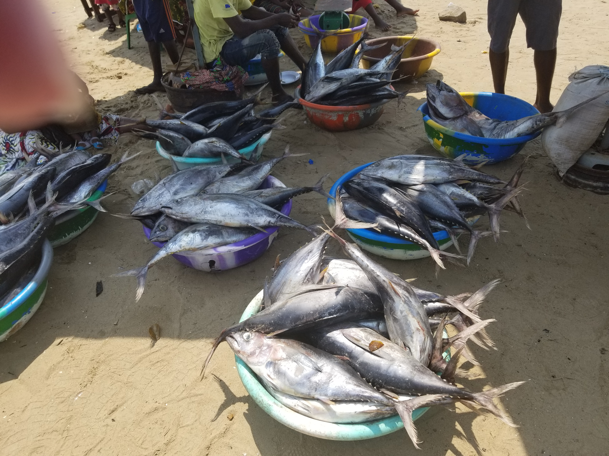
Overview Executive Summaries
Details of assessments to be presented during the panel meetings.
Summary 2021 ICCAT Stock Status – 25
Overfishing (F>Fmsy) |  |  | Overfished (B<Bmsy)
Yes | No | Unknown | Yes | No | Unknown
3 | 16 | 6 | 10 | 10 | 5

Slide 19
Overview Executive Summaries
Section 9 of Report. Details be be presented during the panel meetings.
No Overfishing and not Overfished

Slide 20
Overview Executive Summaries
Section 9 of Report. Details will be presented during the panel meetings.
Stock | Overfishing | Overfished | Data Year | Assessment Year | Projections | TAC
BET | No | Yes | 2019 | 2021 | Yes | Yes
BUM | Yes | Yes | 2016 | 2018 | Yes | Yes
WHM | No | Yes | 2017 | 2019 | Yes | Yes
SAI_E | Possibly | Yes | 2014 | 2016 | No | Yes
SWO_S | No | Yes | 2015 | 2017 | Yes | Yes
SWO_Med | Yes | Yes | 2018 | 2020 | Yes | Yes
SMA_N | Yes | Yes | 2015 | 2017 | Yes | No
SMA_S | Possibly | Possibly | 2015 | 2017 | No | No
POR_NW | Not Likely | Yes | 2018 | 2020 | No | Yes
POR_SW | Not Likely | Undetermined | 2018 | 2020 | No | No
POR_NE | No | Yes | 2018 | 2020 | No | No
Overfishing,Overfished, or Both
Stock Assessment 2021

Slide 21
Overview Executive Summaries
Section 9 of Report..
Insufficient information to rate

Slide 22

Overview of SCRS 2021 Research Programs and Outputs
Main Research Programs
Atlantic-Wide Research Programme for Bluefin Tuna (GBYP) - Largest
Atlantic Ocean Tropical tuna Tagging Programme (AOTTP) – Finished 2021
Small Tunas Year Programme (SMTYP)
Shark Research and Data Collection Programme (SRDCP)
Enhanced Billfish Research Programme (EBRP)
Other Research Programs
  Albacore
  Swordfish Biology Program

Slide 23
Research Programs: GBYP
Overview of GBYP Program
Program Started in October 2009,
  Currently in Phase 10 and 11
    Phase 10 (12 months) started on 1 January 2020, extended until 31 July 2021)
    Phase 11 (12 months) started on 1 January 2021 with a likely extension.
General objectives:
  Improving basic data collection
  Improving understanding of key biological and ecological processes
  Improving assessment models and provision of scientific advice on stock status
  Annual budget
  Voluntary contribution of CPCs and other entities (80% European Union; 20% others)

Slide 24
GBYP Main Research Research Activities: Slide 1
Five Main Research Components
Data mining, recovery and management:
  Major effort of earlier Phases. Current work focused on development of relational databases for data storage and analysis of raw data relevant for BFT management (e.g., growth, biological and tagging data).
  These efforts will continue in Phase 11 and include the collection and evaluation of new available data.
Aerial survey on bluefin tuna spawning aggregations:
  Due to uncertainties in the index, a thorough review of the GBYP aerial survey programme was carried out by external experts
  Analysis code was fully reviewed, revised and the whole series of indices re-calculated.
  A pilot survey (2021) was conducted that included not only the standard human observer-based system but also a continuous recording of high-resolution images over all the surveyed transects to explore the feasibility of using automatic digital systems for BFT aerial surveys.
  The aerial survey index was not used in the 2021 MSE OM-reconditioning exercise, but it will be included in the next steps of the MSE process and future stock assessments.

Slide 25
GBYP Main Research Research Activities: Slide 2
Tagging:
  Conventional tagging continuesd in 2021.
  In 2021, under a MOU, 80 satellite and 5 archival tags will be deployed in the North Atlantic and around the Mediterranean.
  An online Electronic Tagging Workshop was held in March 2021, to improve and optimizing BFT tagging campaigns.
Biological studies:
  Focused on collecting tissue samples and otoliths to determining the population structure and mixing, and to improving the accuracy of the age length key, used for stock assessments and MSE
  A revision of otolith age estimates (FAS - contract) and the calibration exercise among ICCAT scientists will allow 4000 new length-age data to the next eastern stock assessment.
  Otolith microchemistry studies continued to show interannual variations in the mixing proportion of West and East stock individuals in the East Atlantic.
  Growth in farms studies initiated in 2019 continued into 2021 and will be discussed in detail under the Responses to the Comm.

Slide 26
GBYP Main Research Research Activities: Slide 3
Modelling:
The work on MSE development continued in 2021(reconditioning of OM’s, reference set approval, and CMP development) and is on track to provide TAC advice for 2023 on both eastern and western BFT stocks.
Major initiative underway to improve communication and understanding of MSE process among stakeholders.
An external MSE code review was initiated 2021with the final results available by years end.

Slide 27
GBYP Future Research Activities: Slide 4
Represents a Strategic shift from data production to data management and coordination, in close collaboration with the Secretariat, SCRS and CPCs.
Objective: To improve GBYP efficiency and adapt it to a future scenario of likely decreasing funds, future GBYP activities could focus on:
    Improvement of data management systems: support to creation of new broad databases within ICCAT Secretariat (Biological data, e-tagging), and promote the joint use of these databases
    Continue support to MSE implementation
    Improvement of BFT sampling by strengthening the coordination between GBYP and CPCs sampling activities
    Development of improved fishery independent indices.
    Continued support for priority biological analysis and tagging activities, following SRCS research needs, to provide basic data sets for stock assessment and management

Slide 28
The Atlantic Ocean Tropical tuna Tagging Programme (AOTTP)
Research Programs - ATTOP
The 5-year project officially began in June 2015 and end early 2021.
Program activities
include:
Support for continuing tags returns being provided ICCAT
Very successful program with a large amount of information collected on tropical tunas which is being used in the tropical tuna stock assessments (see Symposium report)
Special Issue of Fisheries Research Journal currently being prepared.
  Tagging of tropical tuna in the Atlantic
  Training and capacity building in ‘developing’ CPCs
  Coordinating shore-based tag recovery and awareness teams
  Developing publicity campaigns and incentive schemes (e.g. rewards)
  Collecting and verifying all data and populating ICCAT databases
  Analysing, summarising and making data available to SCRS (ICCAT’s scientific body)
  Facilitating and promoting collaborative research and stock assessments

Slide 29
Enhanced Billfish Research Programme (EBRP) - 1
Objectives: To obtain more detailed catch and effort statistics for billfishes, to carry out an expanded tagging program, and to carry out studies on age and growth.
Objectives expanded during 2021 Billfish Species Group meetings to evaluate adult habitat use, study spawning patterns, and billfish population genetics.
2021 Activities:
Enhanced collection of samples onboard industrial vessels,
Analyses of length and age data for estimating the growth parameters based on spines of the main billfish species that occur in the eastern Atlantic. Otoliths sent to the FAS in Australia for age reading,
Sampling of artisanal and small-scale fisheries (catch and effort) in the eastern Atlantic (Côte d’Ivoire, and Senegal).
A workshop held (Oct 25-28) for standardizing protocols among laboratories and creating a reference set of main billfish species.

Slide 30
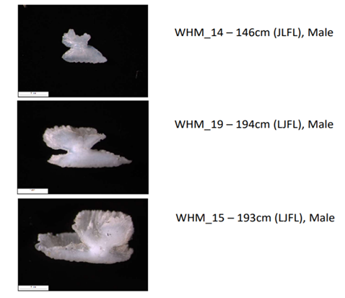
Enhanced Billfish Research Programme (EBRP) - 2
2022 Proposed Activities:
Collection of billfish biological samples off West Africa;
Support the blue marlin biological and photographic sampling in Gulf of Mexico;
Host a workshop on growth and aging techniques involving researchers from both eastern and western Atlantic;
Monitoring of billfish catches from West African artisanal fishing fleets (i.e. Côte d’Ivoire, Ghana, São Tomé e Príncipe and Senegal);
A regional workshop for CPC statistical correspondents on artisanal fisheries data collection in eastern Atlantic;
The development of an App for mobile phones for the collection and report of fisheries data from artisanal fisheries in collaboration with local scientific institutions.

Slide 31
Small Tunas Year Programme (SMTYP) (10.3)
Primary Goal: Collection of biological samples for growth, maturity and stock
structure studies on small tunas species (LTA, BON, WAH). Research is conducted under contract to a consortium involving 11 entities from 9 CPCs. Research results to date were summarized in papers and presentations at 2021 Intersessional Meeting of the Small Tunas Species Group (Anon, 2021).
Samples collected in 2020/21 include 145 BON,139 LTA, 90 WAH for a total of 374 from a broad geographical area (ATL-NE,ATL-SE, ATL-SW, and the MED).

Slide 32
Shark Research and Data Collection Programme (SRDCP)
To improve shark data collection and research, to improve data quality and to reduce the uncertainty of the scientific advice on sharks provided to the Commission.
Focused on shortfin mako until 2017 then extended to include porbeagle, silky shark, oceanic whitetip shark, and hammerheads in the Atlantic Ocean. Research Activities include:
Age and growth of shortfin mako.
Genetic analysis of shortfin mako
Post-release mortality of shortfin mako in the Atlantic Ocean
Reproduction of shortfin mako and porbeagle
Movements, stock boundaries and habitat use of shortfin mako, Porbeagle, silky, oceanic whitetip, longfin mako, and hammerhead sharks in the Atlantic Ocean
Other activities include investigation of Close-Kin Mark-Recapture (CKMR) for shortfin mako sharks and the updating of ICCAT Manual with ICCAT Manual new subchapters for silky shark, longfin mako. crocodile shark and pelagic stingray.
Details in Appendix 8.

Slide 33
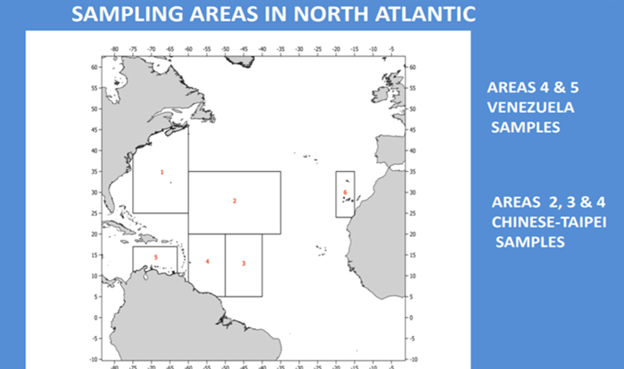
Albacore and Swordfish Research Programs
Although significant progress in species specific research/data collections have been made by both programmes, they are not formal SCRS Research Programmes. Both WG their intent to develop proposals in 2021/2022.
Albacore Research Program
Research objectives are to increase knowledge on the biology and reproductive biology for the northern Atlantic stock : maturity schedules (L50) and egg production (size/age related fecundity).
Small scale at the moment. 252 Female and 61 male samples during 2020/21 from 6 areas over 11 months.
Future work includes processing of new samples, a histological exchange to determine maturity stage and fecundity, and an increase the number of ALB spines samples to determine maturity profile by age.

Slide 34
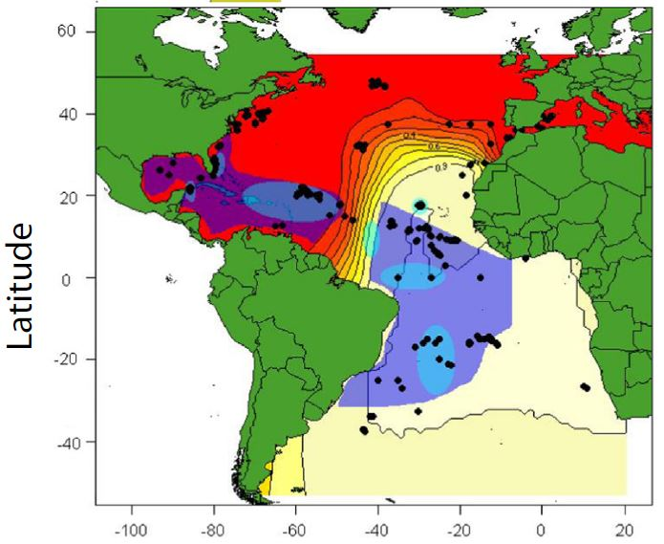
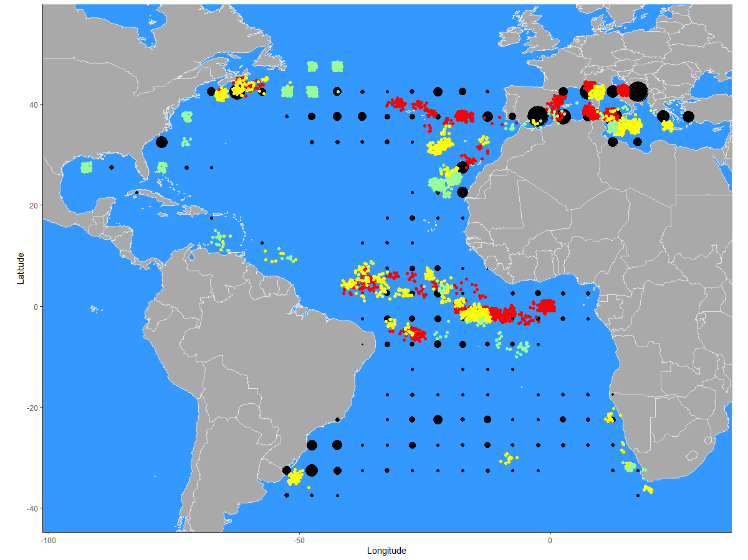
Swordfish Research Program
Objectives for the 3 SWO Atlantic Stocks
Resolve the spatial-temporal distribution of the three known swordfish stocks using genetic tissue analysis
Resolve the age and size at maturity
Characterize the age composition of the catch and validate the growth curves for each swordfish stock.
Determine the spawning period and areas of each stock.
Develop a protocol/template for the assignment of tissue samples to a particular stock.
Develop a biological database
Update the ICCAT Manual with new pertinent information.
Samples under Phase 1-3

Slide 35
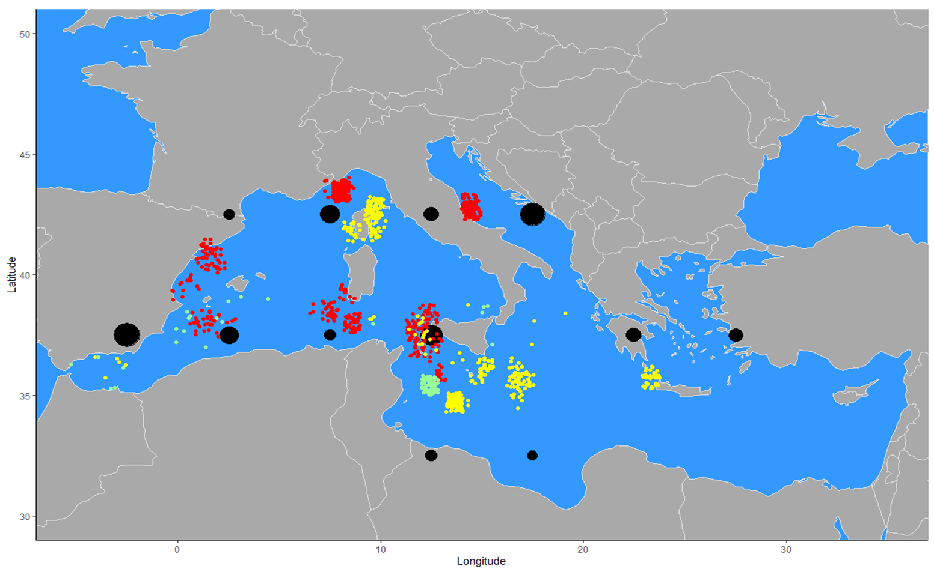
Swordfish Research Program
Proposed activities for Phase 4 (2021/22)
Continue sample collection with sampling in priority spatial-temporal areas
Ageing and Growth
Reproduction and Maturity Studies
Genetics Investigation
Hold a Technical workshop in 2022
Reporting of outcomes in 2022
Samples under Phase 1-3
Multi-institutional Program with members (20) on both sides of the Atlantic

Slide 36

Management Strategy Evaluations (MSE)

Slide 37
- MSE began around 2015 with frameworks proposed for Northern Albacore, Tropical tunas, Bluefin tuna and northern swordfish to match the delivery of MSE products to the needed for advice.
- Early development was slow and complicated by model development (inexperience, technical challenges, and limited resources) and the need to continue with multiple assessments to provide advice until the MSE process was completed.
- In 2018 the Commission recommended a preference to focus on one or two of the ongoing species without guidance on priorities. In 2019 the SCRS focused on BFT and SWO_N, limited work on ALB_N, and little on the tropical tuna MSE.
- However, in 2000 the SCRS initiated a concerted effort to move forward with MSE on all 4 species, albeit the level of effort varied from species to species. Main activities are described in the MSE Road Map.
Management Strategy Evaluations (MSE)

Slide 38
Significant Progress made on all MSE frameworks. Specifically:
ALB_N – Preparation for a new MSE framework using the Stock Synthesis (SS) model, evaluated existence of and responses to exceptional circumstances, and review the interim HCR and adoption of a long-term MP, including the TAC.
SWO_N – Initiated independent peer review of MSE code, continuation of work on criteria for determining exceptional circumstances, revised and expanded OM grid (216 to 288 axis), recommend initial operational management objectives and identified performance indicators, and continued development of CMPs. As well as continued work on analyses related to minimum size limits and discarding estimation.
Management Strategy Evaluations (MSE)
Tentative timeline: Adoption of a final management procedure for northern albacore in 2020/21, interim management procedures for bluefin tuna in 2022, northern swordfish in 2022 and tropical tunas as soon as 2023, however all is contingent on funding, prioritization, and other work of the Commission and SCRS.
Highlights for 2021: Northern Albacore and Northern Swordfish
Notes:
.

Slide 39
BFT - Reconditioned OM with data up to 2020. Adopted a BFT reference grid and established plausibility weighting of OMs, Reviewed robustness tests, Updated the trial specifications document (TSD), as well as Review Progress of 9 CMP’s currently under development and discussed the process for selection of CMPs for illustrative purposes and performance Indicators to the Commission.
Critical stage in the BFT MSE Process where enhanced communication among stakeholders is required.
- Request for increased interactions/meetings with all stakeholders.
- Developing plots/tables to illustrate primarily the trade-off between catch and stock status for the MP’s
- Established an ambassador program (People who are able to speak about the MSE to various CPCs, groups, and stakeholders) and communication material (one-page summary, an Executive summary (~4 pages), and standard slide presentations) for a better understanding of the MSE
- Initiated a series of informal webinars to describe the BFT MSE process.
Management Strategy Evaluations (MSE)
Highlights for 2021: Bluefin Tuna

Slide 40
Tropical Tuna: - Two MSE frameworks – western Skipjack and the multispecies (YFT, BET, and SKJ).
- Conducted bigeye stock assessment.
- SCRS agreed on major sources of uncertainty to be considered in the MSE and candidate performance indicators for the tropical tuna MSEs.
- recommended modifying OM for wSKJ to include the whole of the western Atlantic
- Under JCAP/ICCAT initiated Training workshops on MSE and HCR for Portuguese and Spanish speaking scientists and managers
- Reconditioning of OM’s for SKJ (east and west) scheduled for after the SKJ assessment.
Management Strategy Evaluations (MSE)
Highlights for 2021: Tropical Tunas
Notes:
. (E.g., increase transparency, sources of uncertainty, better representation of results to illustrate variability of results across models, clarification of some parameters and additional checks to explain and understand the unexpected behaviour of some Operating Models)

Slide 41

2022 SCRS REVISED ROADMAP FOR THE DEVELOPMENT OF
MANAGEMENT STRATEGY EVALUATION (MSE) AND HARVEST CONTROL RULES (HCR)
Document PLE 113

Slide 42
Intersessional Meetings proposed for 2022.

Slide 43
Intersessional Meetings proposed for 2022.
Based the Commission decisions in recent years, the 2022 calendar of the intersessional meetings “should” include stock assessments for North and South Atlantic Swordfish, East and Western Skipjack, Eastern Atlantic and Mediterranean Bluefin tuna, East and West Atlantic Sailfish, and North and South Atlantic Blue shark. 9 stock assessments in a single year. This is an impossible workload for the SCRS and the Secretariat.
Given the situation the SCRS has had to prioritized its 2022 activities and recommends the following. Stock assessments will be conducted for Atlantic swordfish and skipjack stocks, and data preparatory meetings (swordfish, skipjack, blue shark and sailfish and eastern bluefin) plus 5 ongoing MSE processes.
This represents 26 meetings and approximately 102 days of SCRS associated meetings in 2022.

Slide 44
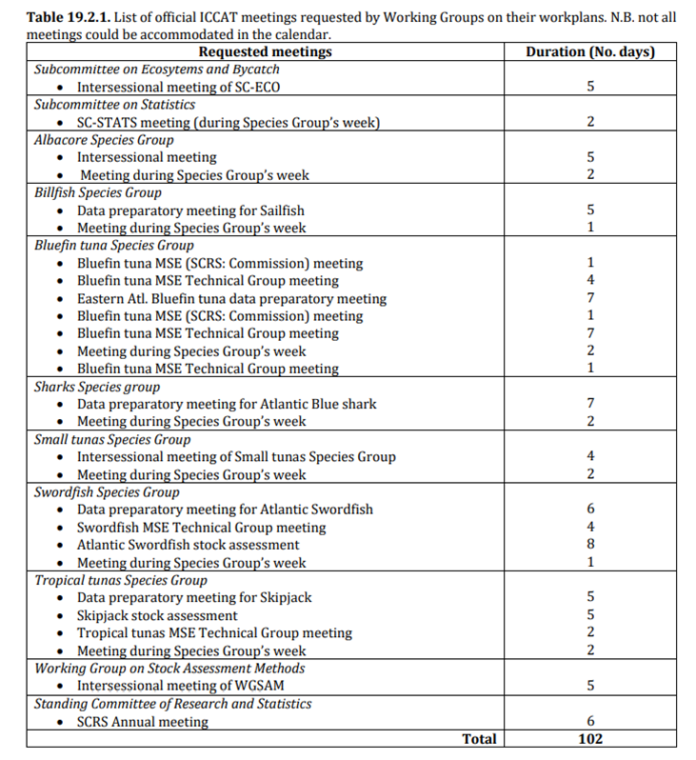
Intersessional Meetings proposed for 2022.
In addition to the proposed SCRS Meetings there are:
1. Commission/Panel Intersessional Meetings requiring SCRS and the Secretariat input, that have yet to be determined.
2. Scheduled ICES/ICCAT Joint NE Atlantic Porbeagle shark benchmark assessment in 2022.
  Data evaluation workshop 29 Nov – 3 Dec 2021
  the Benchmark assessment workshop 7-11 March 2022.
  The actual assessment to be held in June14-23.
The SCRS seeks the Commission’s guidance on participation and approval for representatives of the Secretariat and the SCRS (Assessment and shark experts) to include these meetings in the 2022 calendar.

Slide 45
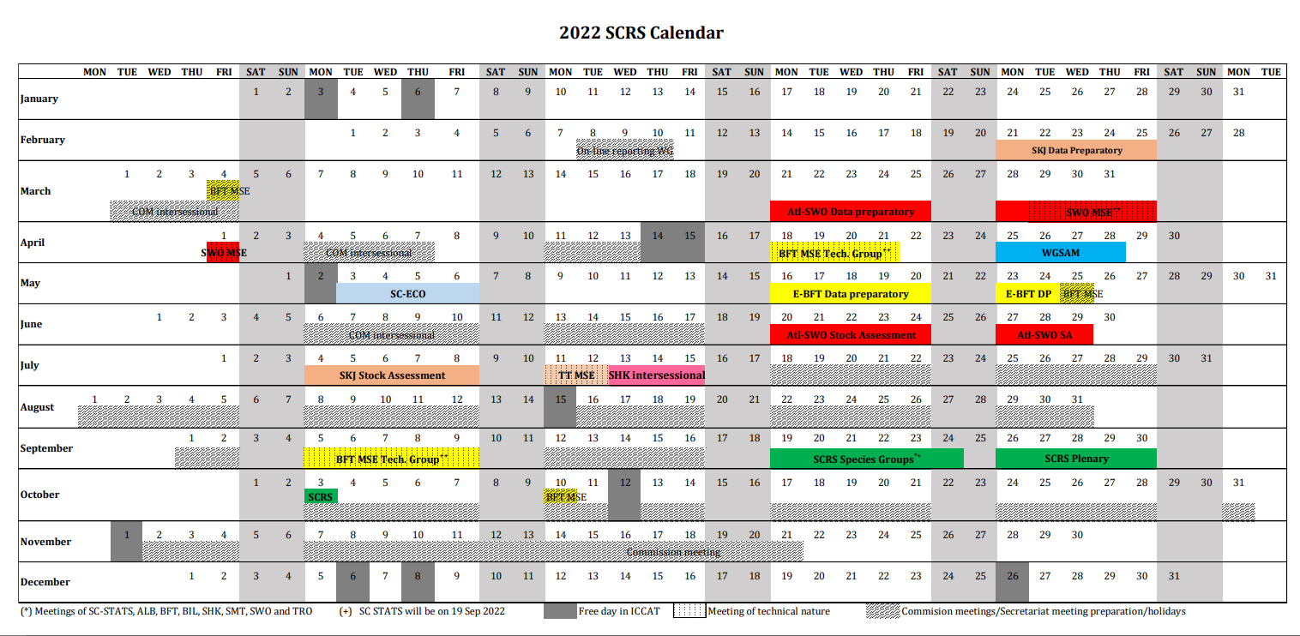

Slide 46
SCRS Proposed 2022 Budget (STF 209)
Note:
Species/stock specific details will be presented during the Panel presentations.
Revised budget based on SCRS priorities for a total of 2,269,500 (euro) of which 1,500,000 is GBYP.
Several SCRS working groups discussed the need for simultaneous interpretation in the 3 official ICCAT languages and recommended consideration be given to implementing such a policy. This was supported by the SCRS.
The cost (496,650 Euro) of implementing interpretation for official SCRS working group meetings was prepared separately from the overall budget for consideration by the Commission. This cost should be included in the regular budget, not in the Science Envelope.

Slide 47
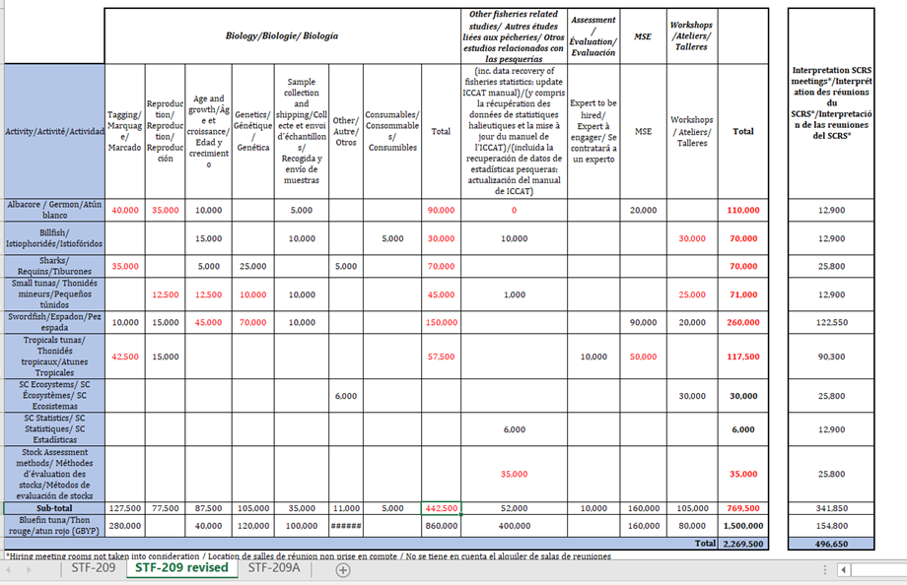
SCRS Proposed/Revised 2022 Budget

Slide 48
Other Issues:
Proposal for amendment of the rules and procedures for the protection, access to, and dissemination of data compiled by ICCAT (STF 114).
ICCAT and the Secretariat receive numerous requests for data from a wide variety of organizations annually. While ICCAT and the SCRS continue to promote Scientific Research of ICCAT species though the sharing of data and the participation of CPCs, national scientist and Academic and Research Centres, it is important that rules and procedures be defined to ensure that data collected from CPC’s and under specific research programs are properly evaluated and effectively used for scientific purposes. There is also a need to protect the confidentially of the data.
The rules and procedure were reviewed, updated and adopted by the SCRS in 2020 but there is uncertainty if the Commission adopted the rules and procedures during the correspondence phase. There is no mention of the document.
Conformation of adoption of the revised rules and procedures by the Commission is required.

Slide 49
Thank You
Gracias
Merci

Slide 51
Recommendations with financial implications
Note: Species working group recommendations with financial implications will be presented in the appropriate panel.
Stock assessment methods (WGSAM): (35,000 Euro)
- Development of a Bycatch estimation tool similar to SDM/LLSIM and the exploration to see if it meets the SCRS needs to estimate bycatch of species other than billfish and sharks. This work be carried out in 2022 under a contracted expert.
- Website engine search tool for scientific papers: Documents to be OCRed to make the contents searchable and indexed. Requires a dedicated staff member or a short-term contract to set system up.
Sub-committee on Ecosystems and By-catch (36,000 euro)
- financial assistance to complete the development of a quasi-quantitative tool for evaluating species of priority for management
- financial assistance for 5-7 scientists to attend a collaborative workshop on the relevance and delineation of candidate ecoregions within the ICCAT Convention area to foster discussion on operationalizing the EBFM.
The Sub-committee on Statistics (6,000 euro)
– The Committee recommended continued development of interactive front-end applications for making and publishing graphical dashboards of ICCAT statistical datasets and provide the necessary financial resources for its full implementation.

Slide 52
Overview of SCRS 2021 Research Programs and Outputs
Main Research Programs
Atlantic-Wide Research Programme for Bluefin Tuna (GBYP) - Largest
Atlantic Ocean Tropical tuna Tagging Programme (AOTTP) – Finished 2021
Small Tunas Year Programme (SMTYP)
Shark Research and Data Collection Programme (SRDCP)
Enhanced Billfish Research Programme (EBRP)
Other Research Programs
  Albacore
  Swordfish Biology Program

