Slide 1
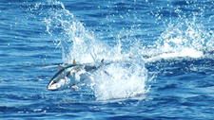
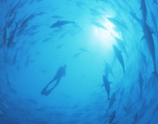
Southern Temperate Tunas
ICCAT Panel 3
South Atlantic Albacore
and
Southern Bluefin Tuna

Slide 2
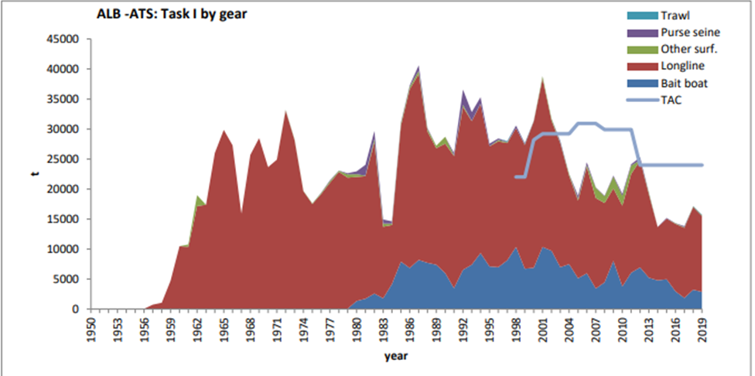
Fishery Indicators:
South Atlantic Albacore
South Atlantic Albacore
TAC 24,000t for 2017-2021
Catches well below TAC since 2002 with the exception of 2011
Catches in south Atlantic increased in 2018, but decreased again (15,640t) in 2019.
Catch Updated to 2019

Slide 3
Fishery Indicators:
South Atlantic Albacore
South Atlantic
Last assessment 2020 with data up to 2018.
Fishery indicators:
3 standardized CPUE indices updated to the most recent data available.

Slide 4
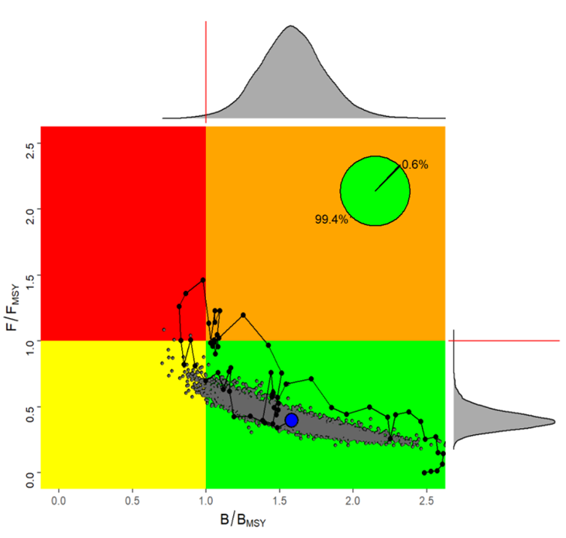
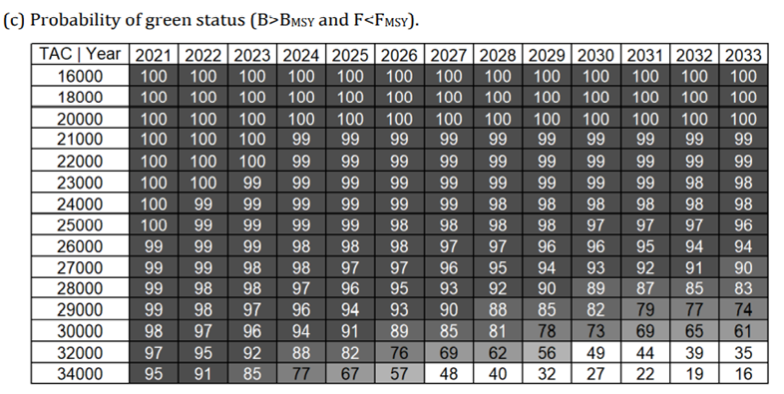
South Atlantic Albacore
South Atlantic albacore estimated probabilities (in %) based on Bayesian surplus production model that the stock fishing mortality is below FMSY biomass is above BMSY for constant catch levels (16000 t to 34000 t)
South Atlantic albacore (Kobe plot) with Stock status trajectories of B/BMSY and F/FMSY over time
(1956-2018)
31.0%
66.0%

Slide 5
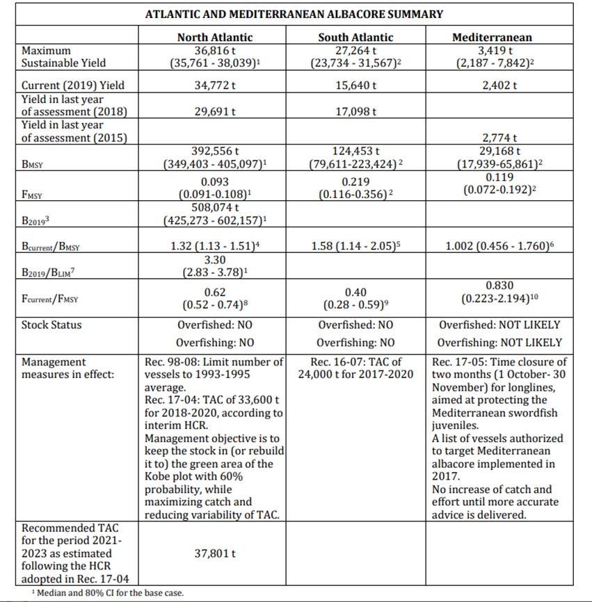
Outlook/Management Recommendations - Albacore
South - The South Atlantic albacore stock is not overfished and overfishing is not occurring.
Catches consistent with current TAC (24,000 t) showed a 98% probabilities of being in the green quadrant of the Kobe plot by 2033.

Slide 6
Work Plan
South Atlantic Stock Proposed Work Plan
Common Workplan:
To continue research activities for all the stocks and develop a comprehensive Albacore Research Programme with a focus on: biology and ecology, monitoring stock status, and management strategy evaluation, over the next 4 years. - One intersessional meeting is envisaged (5 days, scheduled within April to July)
South Atlantic Stock Workplan:
Consolidate activities on reproductive biology (including aging of analyzed individuals, using spines) and start electronic tagging.

Slide 7
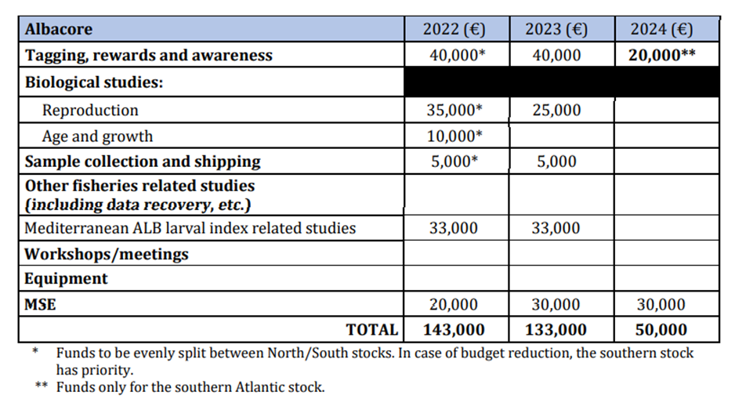
Recommendations with financial implications
South Atlantic: (combine with North)
The Committee recommends continued funding of the Albacore Research Programme for North and South Atlantic stocks, as well as to start funding the research for the Mediterranean stock. Research on the North and South Albacore stocks will focus on three main research areas (biology and ecology, monitoring of stock status, and management strategy evaluation).
For 2022 the Committee recommends to continue electronic tagging and reproductive biology
studies (with associated aging of samples) in the North and South Atlantic,

Slide 8
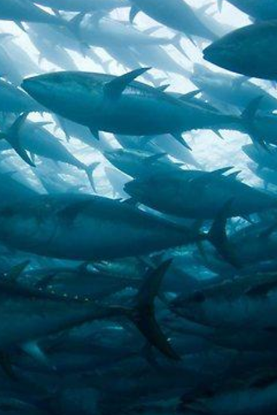
Southern Bluefin Tuna
The Commission for the Conservation of Southern Bluefin Tuna (CCSBT) is charged with assessing the status of southern bluefin tuna. Each year the SCRS reviews the CCSBT report in order to remain up to date on southern bluefin tuna research and the stock assessments carried out. The reports are available from the CCSBT.

Slide 9
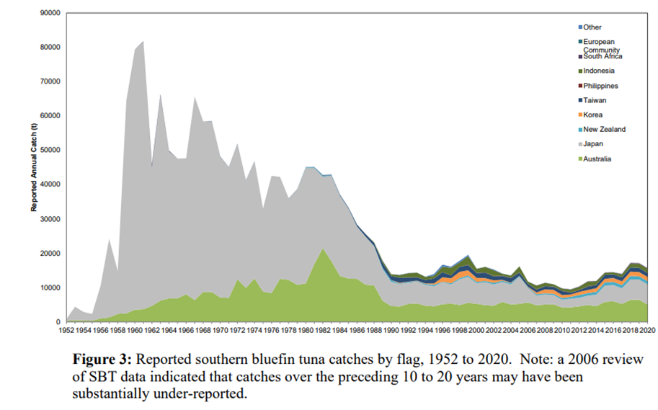
Southern Bluefin Tuna – Fishery Indicators
Annual reported catches by country for the period 1952-2020.
Catches decreased rapidly in the late 1980’s then continued to slowly decline until about 2010.
Catches have generally increased since 2010 to 16,441 in 2020.

Slide 10
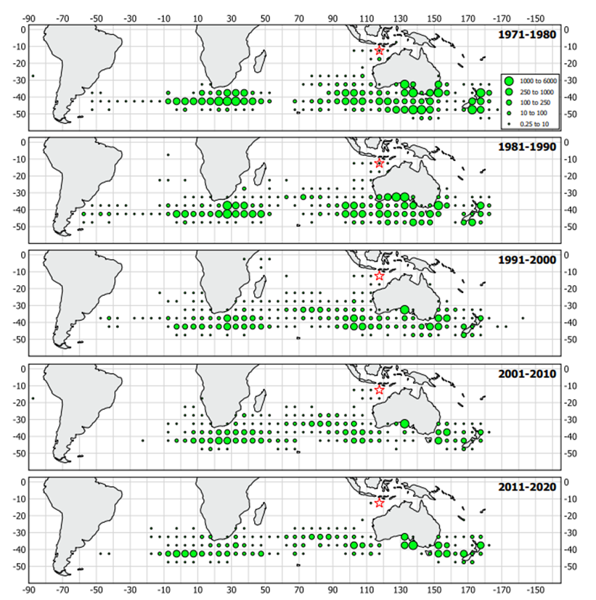
Southern Bluefin Tuna (SBFT)
Geographical distribution of average annual reported southern bluefin tuna catches (t) by CCSBT members and cooperating non-members over the periods 1971-1980, 1981-1990, 1991-2000, 2001-2010 and 2011-2020 per 5° block.

Slide 11
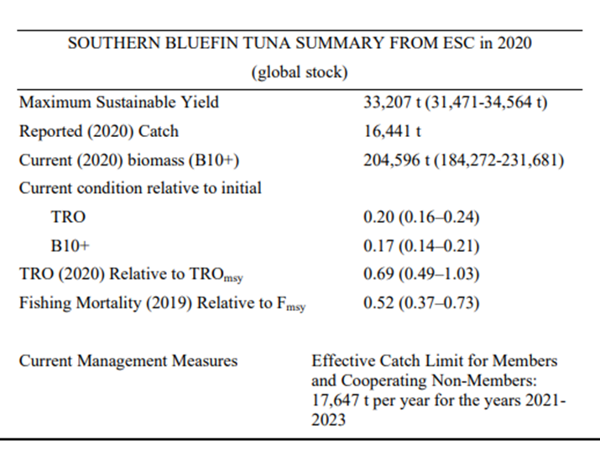
Southern Bluefin Tuna - Stock Status
Exploitation rate: Moderate (Below F_{MSY})
Exploitation state: Overexploited
Abundance level: Low abundance
Next stock assessment scheduled for 2023.
Stock Status:
Overfishing: No
Overfished> Yes

