Slide 1
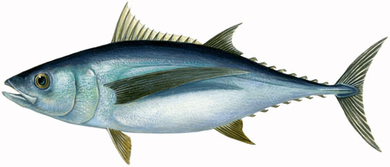
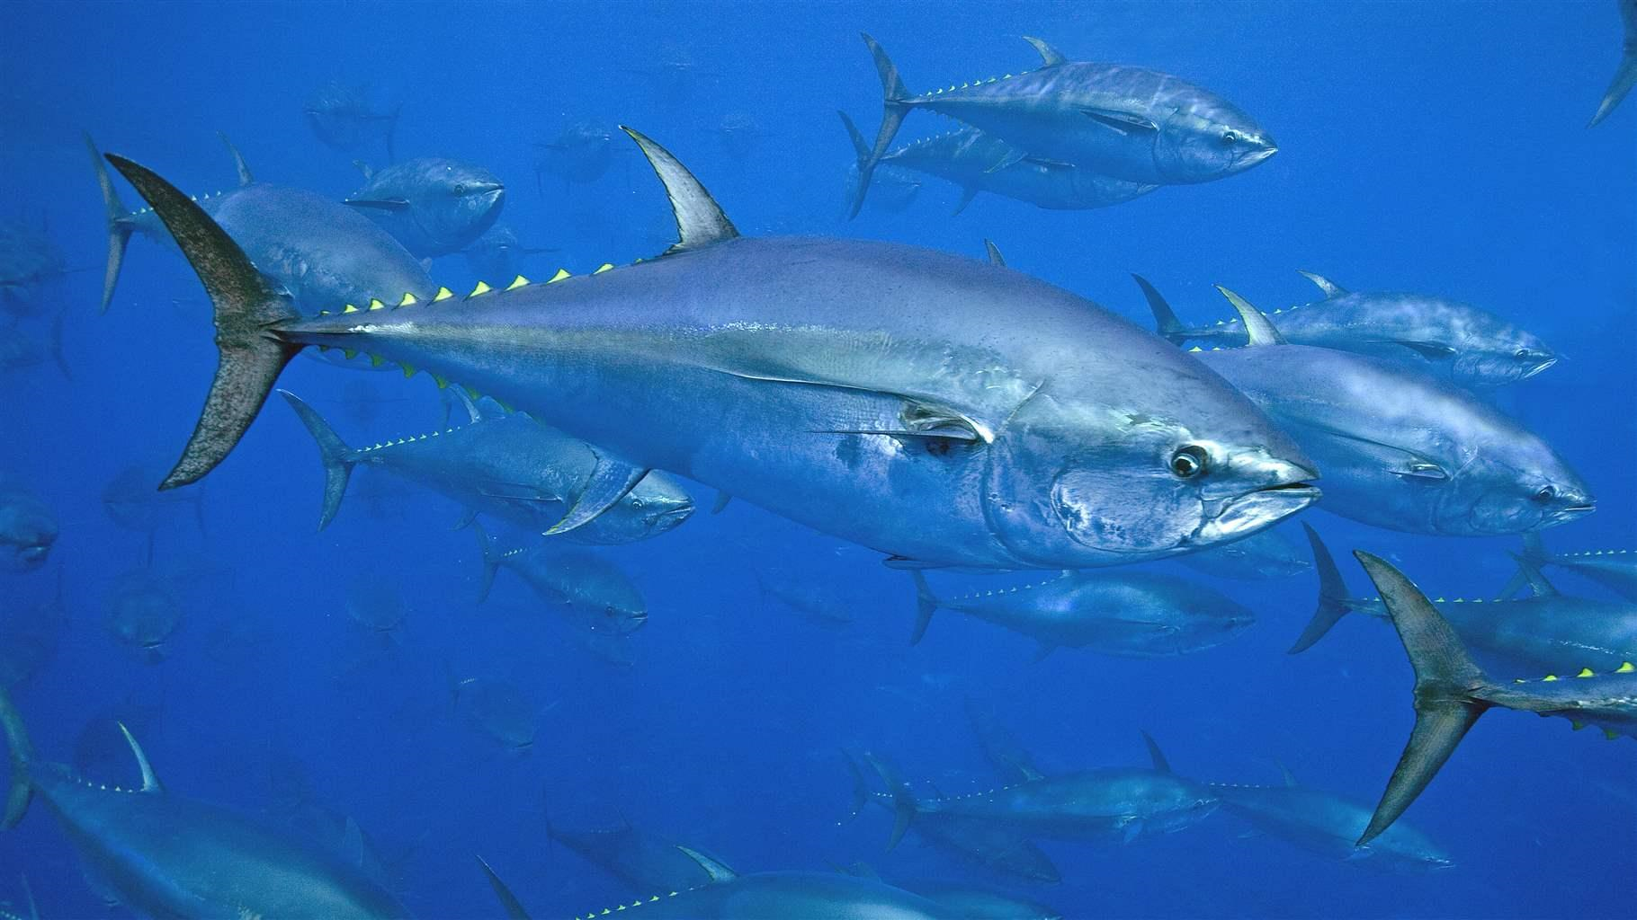
SCRS Report 2021
Panel 2 – Northern Temperate Tuna
Albacore Tuna
Bigeye
Yellowfin
Bluefin Tuna
Skipjack

Slide 2
Summary Northern Temperate Tunas
Note: Covid-19 continued to imposed restrictions on the operational capability of the SCRS, its Sub-committees and Working Groups. SCRS advice in 2021 to Commission focused on the 4 priority areas (assessed stocks, research recommendations, workplans and responses to the commission.
Presentation Summary
State of Stocks and Outlook (from Executive Summaries)
Med Albacore
Western Bluefin tuna
Effects of Current regulations (from Executive Summaries)
Management recommendations(from Executive Summaries)
Workplan
Recommendations with financial implications
Responses to the Commission

Slide 3
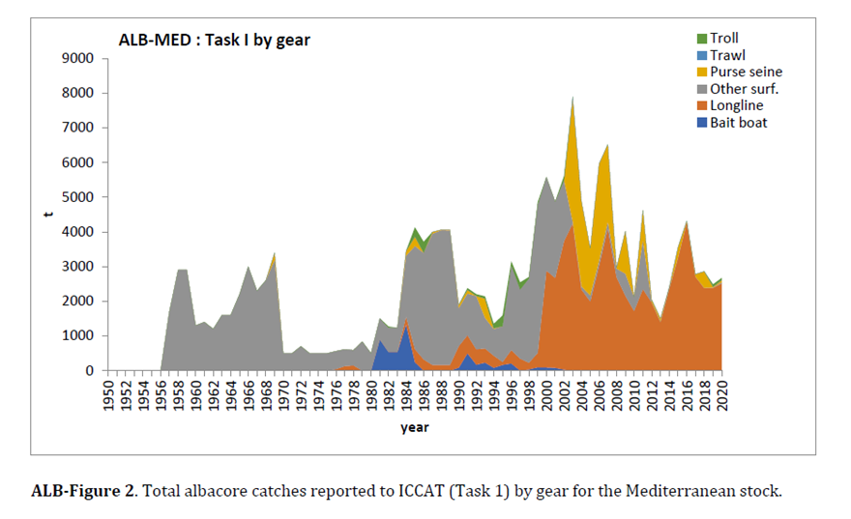
2021 State of the stock - Albacore
Total albacore catches in the North Atlantic, South Atlantic and the Med stocks to 2020.
- North Atlantic Catches were less than the TAC (33,600t for 2018-2020) in 2020 (31,188).
- South Atlantic Albacore catches decreased in 2019 and increased in 2020 to 17,971t
- Albacore Catches in MED decreased between 2016 and 2019 but increased to 2,675t in 2020. The fishery has been dominated by longline gear since 2012.

Slide 4
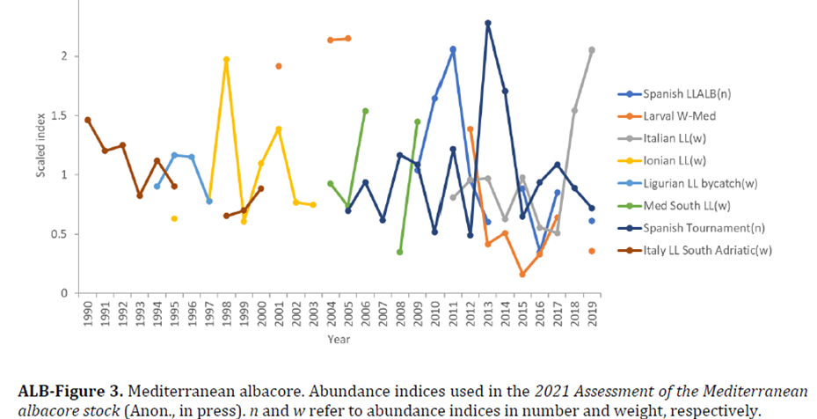
2021 Fishery Indicators – Mediterranean Albacore
Stock assessment conducted in 2021 with data to 2019 using, A Bayesian state space surplus production model (JABBA)
Fishery indicators
Catch Updated to 2019
8 abundance indices updated to 2019 where possible.
Data inputs to the model remain uncertain, including possible under-reporting of the catch and limitations both in spatial and temporal coverage.

Slide 5
State of the Stock – MED Albacore
MED - There is considerable uncertainty about current stock status and the ability of the available CPUE series to monitor stock trends is limited.
Current fishing mortality levels (2019) are above FMSY (1.2), Median and the current biomass is below the BMSY level (0.57).

Slide 6
State of the Stock- MED Albacore
MED Albacore.
- Overfished
- Overfishing Occurring

Slide 7
Mediterranean Albacore
Effects of current regulations:
The seasonal closure (2012) aimed at protecting swordfish in the Mediterranean(Rec. 16-05, Rec. 13-04, and Rec. 11-03) also affects the albacore fisheries in the Mediterranean.
Management recommendations:
Catches on the order of those observed in the first decade of the 2000s (5,000 t) are not sustainable and catches exceeding 4,000 t have a high probability of driving the stock to extremely low levels,
Catches of 2,700 t, close to the average of the last three years (2017-2019), would allow the stock to recover to the green quadrant of the Kobe plot with a greater than 50% probability by 2032.
Catches higher than 2,700 t will delay the recovery of the stock and have a greater than 17% probability for B below 0.2*BMSY(ALB-Table 3).
Decreasing catches below 2,700 t would allow for faster recoveries and/or higher probabilities of being in the green quadrant.

Slide 8
MED - Albacore
Mediterranean albacore estimated probabilities (in %) based on Bayesian surplus production model that the stock fishing mortality is below FMSY and biomass is above BMSY. Projections for constant catch levels (0 t to 4,000 t. Assumed catches for 2020 and 2021 were 2,700 t (average of the 2017-2019 period).

Slide 9
Albacore Research and Workplan
Common Workplan: (North, South, Mediterranean)
- To continue research activities for all the stocks and develop a comprehensive Albacore Research Programme with a focus on: biology and ecology, monitoring stock status, and management strategy evaluation, over the next 4 years. - One intersessional meeting is envisaged (5 days, scheduled within April to July).
North Atlantic Stock Proposed Workplan:
- The main objectives for 2022 are to build a new reference case for the North Atlantic stock assessment,
- evaluate exceptional circumstances for this stock, and
- to continue the reproductive biology (including aging of analyzed individuals, using spines) and electronic tagging.
South Atlantic Stock Proposed Workplan:
Consolidate activities on reproductive biology (including aging of analyzed individuals, using spines) and start electronic tagging.
Mediterranean Stock Proposed Workplan:
The 2022 research will focus on setting up an information network to promote collaboration among scientists working on this species in the Mediterranean. The main objective will be the development of a detailed research plan.

Slide 10
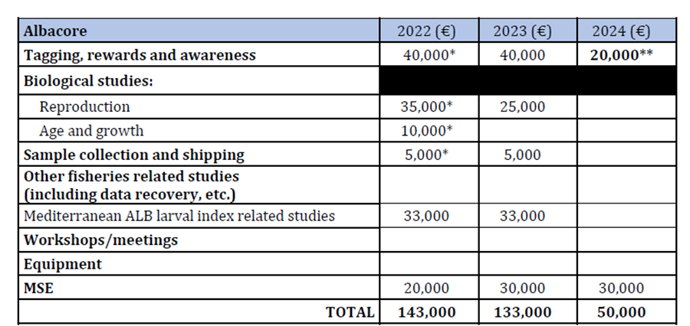
Albacore Research Recommendation with financial implications
The Committee recommends continued funding of the Albacore Research Programme for North and South Atlantic stocks, as well as to start funding the research for the Mediterranean stock. Of high priority is the continuation of electronic tagging and reproductive biology studies (with associated aging of samples) in the North and South Atlantic, and to progress on the North Atlantic albacore MSE.
The Committee also supports the larval research and recommends further research on the use of larval indices in stock assessments, including development of larval habitat models, corrected abundance indices and their impact in the MED ALB stock assessment.

Slide 11
2021 ALBacore Responses to the Commission
21.34 Taking into account relevant scientific advice, the Commission shall review, and revise Rec. 17-04 as amended by this Recommendation and Rec. 16-06 as amended by Rec. 20-03, including consolidation of relevant provisions into a single recommendation at its 2021 Commission meeting. Rec. 20-04, para 4 (18)
Following the 2021 Panel 2 (PA2) intersessional meeting, the Committee was requested to:
1. Review the “ALB EC Protocol for SCRS review.doc”.
2. Provide its plan to formalize i) a set of data to be used; and ii) stock assessment methods.
The Committee has conducted substantial effort on the ALB MSE. The number of CPUE series that need to be available and the percentage by which catch data are underreported, that would trigger an exceptional circumstance has not been determined. However, the Committee is confident that the proposed indicators would be effective in detecting exceptional circumstances.
Based on a bank and borrow concept, exceptional circumstances would be triggered if annual catch exceeded the TAC by more than 20%. Successive years with catch exceeding TAC by
20% or more have not been tested in the MSE.

Slide 12
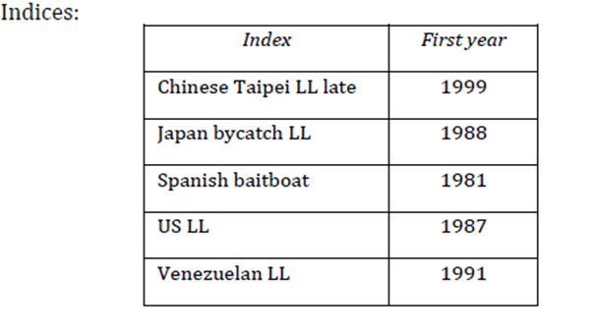
2021 ALBacore Responses to the Commission
21.34 Taking into account relevant scientific advice, the Commission shall review, and revise Rec. 17-04 as amended by this Recommendation and Rec. 16-06 as amended by Rec. 20-03, including consolidation of relevant provisions into a single recommendation at its 2021 Commission meeting. Rec. 20-04, para 4 (18) - Continued
Provide its plan to formalize i) a set of data to be used; and ii) stock assessment methods. Technicial specifications to assemble a full North Atlantic albacore MP are listed below.
Software: mpb
- Model: Fox (biomass dynamic), with the following specifications:
- Catch time series start year: 1930
- Catch and CPUE time series final year: t-1 preferably (t-2 otherwise)).
- Biomass at the start of the time series = K
- Variance treatment for the CPUE indices: model weighted

Slide 13
Bluefin Tuna

Slide 14
2021 Eastern Bluefin Tuna – Summary
A Stock update (role over of inputs) was conducted in 2020, with the previous assessment conducted in 2019.
2021 Summary:
The updated eastern abundance indicators were evaluated by the Group to determine whether they support the current TAC advice of 36,000 t. Overall the indices fit reasonably well within the prediction intervals and do not suggest that the TACs advice needs to be revisited.
Eastern BFT catches in 2020 were 34,965 t and below the TAC.
2022 TAC advice for EBFT remains at 36,000t.
2023 TAC Advice to be determined under an MSE framework with the MP to be selected by the Commission in 2022.

Slide 15
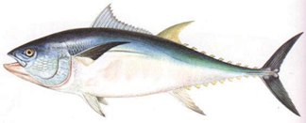
2021 Western Bluefin Tuna – Summary
Summary.
Previous assessment in 2020 was a strict update. The 2021 assessment was a new and full stock assessment but restricted to two stock assessment models (VPA and Stock Synthesis) for management advice.
Significant changes to the model specifications and input data were made in 2021.
The 2021 stock assessment used 10 CPUE and two survey indices up to and including 2020 of which 5 underwent major revisions.
Management advice was based on MSY reference points with short-term advice based on an F0.1 reference point using recent recruitment.
The low recruitment observed in the 2020 assessment was estimated to have increased and returned to levels at or above the 2017 estimate.
Major differences in stock status were observed from 2020 wBFT stock assessment.
An external expert was recruited to review the assessment process and results.

Slide 16
2021 Western Bluefin Tuna – Fishery Indicators
Catches in the western Atlantic were updated to 2020.
Essentially catches have been increasing since 2012 tracking the increasing TAC.
LL catches declined slightly in 2020 from recent highs in 2018 and 2019.
Catches have been below the TAC since 2012.

Slide 17
2021 Western Bluefin Tuna – Fishery Indicators
Indices of relative abundance for western bluefin tuna. Most indices showed an upward trend since the previous assessment except the Japanese Longline.
Note:
Indices denoted with “*” represent revised indices rather than strict updates of indices used in the 2020 stock assessment. Indices denoted with an “s” were used in Stock Synthesis and indices with a “v” were used in VPA.
U.S. Rod and Reel 66-114 and 115-144 indices are shown for illustrative purposes but were superseded by the combined 66-144 index.

Slide 18
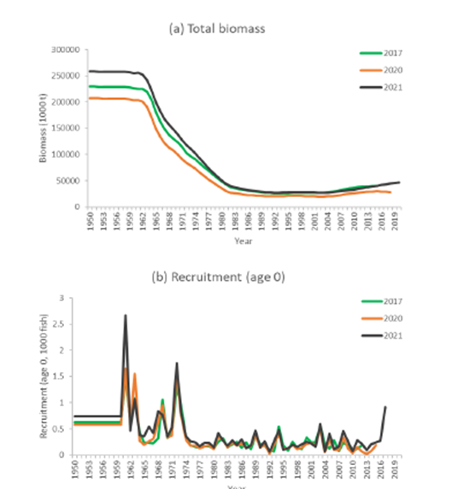
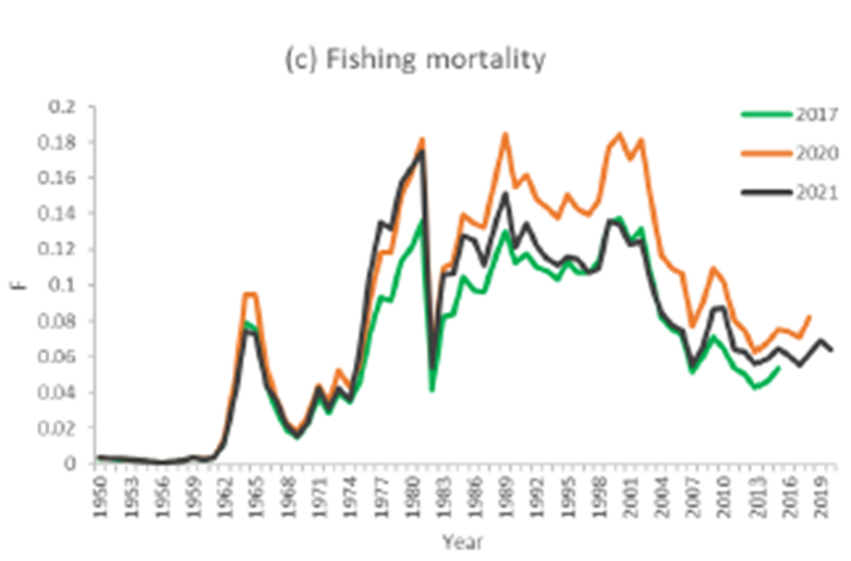
2021 Western Bluefin Tuna – Biomass, Recruitment, Fishing mortality
Major differences between assessments observed with the addition of 2 years data, revised and new indices and changes in selectivity. Outputs are based on Stock Synthesis only for the 2021 assessment.

Slide 19
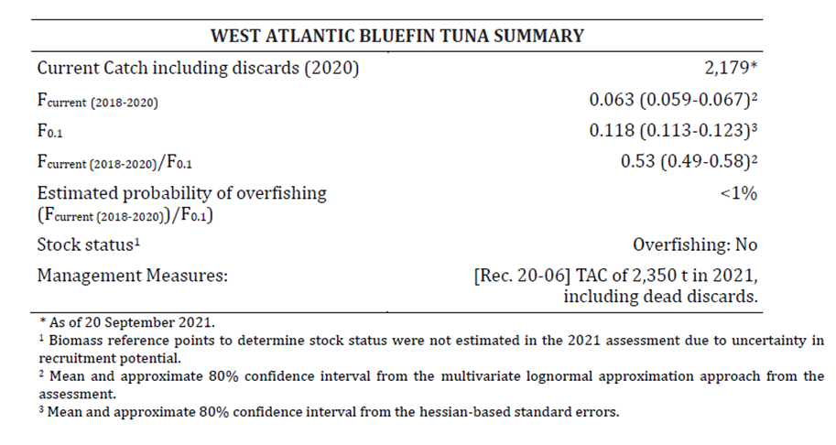
2021 Western Bluefin Tuna – State of the Stock
The SCRS cautions that conclusions from the latest assessment (Anon., 2021d), using data through to 2020, do not capture the full degree of uncertainty in the assessments and projections.
Factors contributing to uncertainties include mixing between the stocks, recruitment, age composition, age at maturity, the possibility of regime shifts, assumptions regarding selectivity, and indices of abundance.
The Committee deemed only Stock
Synthesis suitable for projections and specific management advice. The VPA was rejected due to a severe retrospective pattern.
An independent review recommended against using either the VPA or Stock Synthesis for management advice.
Management advice is based on a F reference point to project short-term catches based on recent recruitments. F0.1 was considered a reasonable proxy for FMSY since 2018.

Slide 20
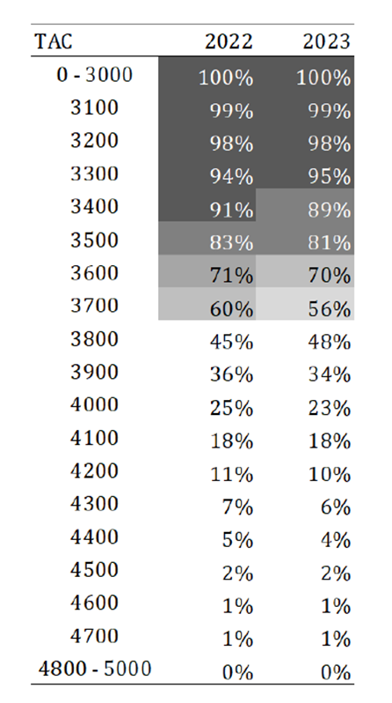
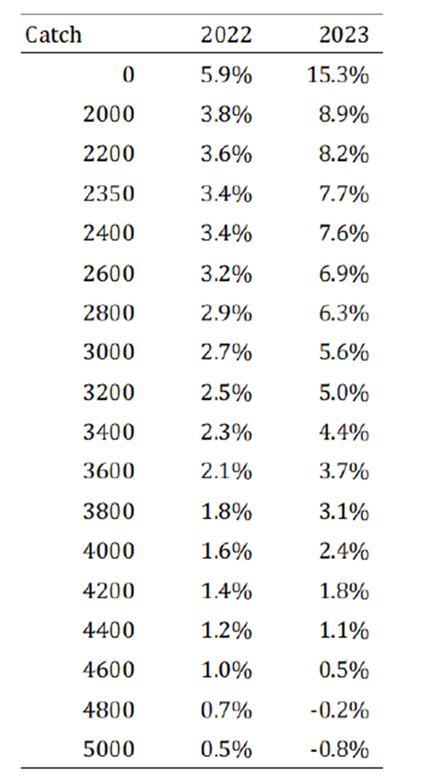
2020 Western Bluefin Tuna – Projections
Kobe II matrix giving the probability that the fishing mortality rate (F) will be less than the F reference point (F≤F0.1, overfishing not occurring) over the next two years for alternative constant annual catches, based on results from the 2021 Stock Synthesis (combined two maturity specifications).
Percentage change in total stock biomass for alternative constant
annual catches, based on results from the 2021 Stock Synthesis(combined two maturity specifications).

Slide 21
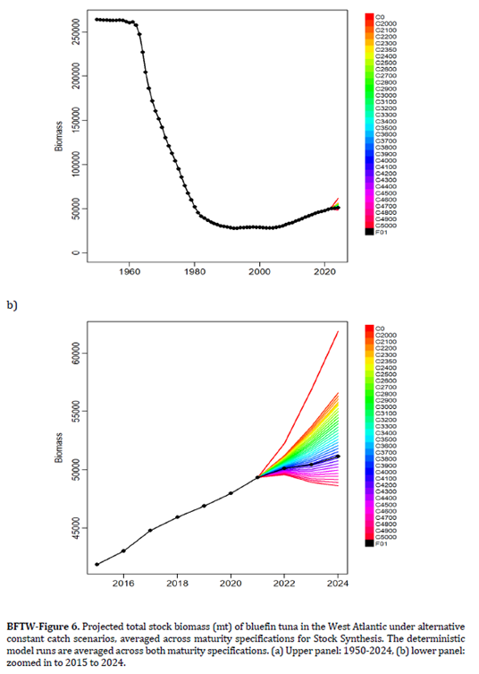
2021 Western Bluefin Tuna – Outlook
The 2021 assessment indicates that recent (2012-2017) recruitments were higher than those estimated for the same period in the 2020 assessment and the averages assumed for the 2020 projections.
In 2017 the population was projected to decline by ~7.5% from 2017 to 2020 at the current (2020) TAC of 2,350 t and in 2020 the population estimated to have experienced an 11.7% decline over the same time period.
The current assessment estimates that the total biomass has experienced a 9% increase from
2017-2020.

Slide 22
Western Bluefin Tuna - Management Recommendations
Variability in the estimation of the absolute scale of the population is an inherent property of stock assessment models. The Committee has long highlighted the uncertainty in western BFT management advice given the varying fraction of eastern migrants in the western management area. Considering the uncertainty associated with the revisions to the stock assessment, and the conclusions of the external review, the current advice should be used with caution
The Committee advises that the Commission could implement a moderate increase to the current W-BFT TAC of 2,350 t.
In determining this moderate increase, in addition to the K2SM, the results from alternative approaches to evaluate the current change in the western biomass and its response to future harvests were examined. The empirical approach indicated a 4% increase of the western area relative abundance and a 16% increase of the western spawning stock relative abundance, The MSE approach indicated a 28% increase based on the TAC that maintains annual increases in the Western stock SSB in the near term.

Slide 23
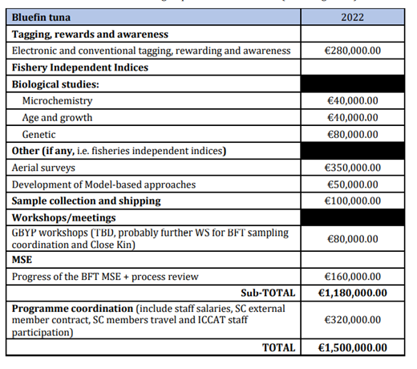
BFT Recommendations with financial implications
2022 Recommendations
Continued funding to support the essential work of GBYP including funding of Tagging and reward, biological studies, sample collection and shipping, other fisheries related studies (e.g. fisheries independent indices and Workshops), MSE development process, and the coordination.
Three Meetings devoted to MSE refinement and dialogue with Panel 2 (coordinated by GBYP).
Three Meetings of the Bluefin Tuna Species Group (2 MSE meetings and EBFT data preparatory).
Support for the specified sub-group (SG) on EBFT modelling (the request would be for travel for the modelling sub-group to an in-person meeting maximum of 9 modelers to be supported])
External expert to review EBFT assessment and to attend both DP in 2022 and SA meetings in 2023 (if required).

Slide 24
ABFT Progress on MSE -2021
The BFT MSE is on track to provide TAC advice for both stocks for 2023.
The Committee adopted the reference set of OMs along with a set of Robustness test OMs.
The OMs were reconditioned to reflect catch and index data through 2019, reviewed and accepted.
The reference grid of 48 OMs contains 4 Factors: Recruitment (3 levels), Spawning fraction/Natural mortality rate for both stocks (2 levels), Scale (4 levels), and Length composition weighting in likelihood (2 levels). OM Plausibility weights were also adopted.
The MSE Code review indicated that ICCAT can be confident about the validity of implementation of the main code components.
Development of 9 CMP.
Introduction of the Ambassador Programme, the preparation of Communication material, and MSE workshops in October.
New wBFT stock assessment conducted in 2021 with data up to 2020.

Slide 25
ABFT Workplan for 2022
Intersessional Meetings:
a) 1st MSE intersessional meeting (4 days) in about April;
b) E-BFT data preparatory meeting in May (5 days) with data until 2021;
c) 2nd MSE intersessional meeting (5 days) in about September
2. Work and dialogue related to the MSE
a) CMP developers continue work to refine CMPs and the BFT WG continue MSE work.
b) Dialogue with Panel 2:
1) Panel 2 November-December 2021 (present MSE update and CMP/indicators)
2) Panel 2 March 2022 (present update on CMP results)
3) Panel 2 May- June 2022 (present update on CMP results)
4) Panel 2 October/November 2022 (present update on CMP results)
3. Technical Subgroup Activities:
BFT Technical Subgroup on Abundance Indices (e.g. Trap indices potential new indices)
BFT Technical Subgroup on Assessment models (alternative assessment models for EBFT Stock Synthesis and ASAP).
BFT Technical Subgroup on Growth in Farms. Complete growth in farms studies and report findings

Slide 26
ABFT Workplan for 2022 -Continued
Responses to the Commission related work.
6. Other workshops (organized directly by GBYP will and that require the involvement of BFT SG)
- Technical workshop for the design and evaluation of the feasibility of a biological sampling scheme for the implementation of the CKMR approach to the Atlantic BFT Eastern Stock
- Workshop on BFT electronic tagging, focused on the development and joint use of a global ICCAT etagging database
- Workshop on the coordination and standardization of BFT larval surveys and potential development of larval basin scale indices.
- Workshop on coordination of BFT biological sampling at the international level.

Slide 27
ABFT Roadmap for 2021/22
Intersessional Meeting with Panel 2 on MSE and its development (Nov 2021)
COMM (PA2) intersessionally to:
Recommend final operational management objectives and identify performance indicators
Develop guidance on range of appropriate management responses should exceptional circumstances be found to occur.
SCRS to conduct data preparatory meeting for EBFT
SCRS to complete MSE, incorporating feedback from Commission through PA2
COMM (PA2) and SCRS to present final CMPs for review.
COMM to adopt a MP at the Annual Meeting, including TAC
SCRS to continue work on criteria for determining exceptional circumstances and will be informed by the Exceptional Circumstances Protocol developed by Panel 2 for northern albacore.

Slide 28
2021 ABFT Responses to the Commission
Western Atlantic bluefin tuna
21.22 Provide advice to the Commission on the appropriate management measures, approaches, and strategies, including, inter alia, regarding TAC levels for the western Atlantic bluefin tuna stock for future years. Rec. 20-06, para 6 (17).
The SCRS conducted a stock assessment for the western Atlantic bluefin tuna stock in 2021 to incorporate the most recent available data up to 2020, including the revised abundance indices adopted by the Bluefin Tuna Species Group. The results indicated that a moderate increase in TAC is warranted for 2022.

Slide 29
2021 ABFT Responses to the Commission
Western Atlantic bluefin tuna
21.23 SCRS to report to the Commission in 2021 on CPCs efforts to enhance the collection and analysis of biological samples from Atlantic bluefin tuna fisheries, such as through sample contributions to the coordinated sampling plan recommended by the SCRS. Rec. 20-06, para 8 (20). Specific to wBFT.
Many CPCs have substantially increased their collection of biological material for aging, genetics, growth and reproduction and stock of origin through systematic sampling of the fisheries. Sample coverage for wBFT averages 15% of the landed catch. The Committee notes that ongoing work by national programmes in the Eastern Atlantic and Mediterranean and the coordination of biological sampling by GBYP has also increased biological sampling coverage.

Slide 30
2021 ABFT Responses to the Commission
Eastern Atlantic bluefin tuna
21.24 The SCRS shall annually advise on the TAC. Rec. 20-07, paragraph 1 (Rec. 19-04, para. 5)
Background: 5. The total allowable catches (TACs), inclusive of dead discards, for the years 2021 and 2022 shall be set at 36,000 t, respectively, in accordance with the SCRS advice. However, the 2022 TAC shall be reviewed and amended, as appropriate, at the 2021 Commission annual meeting based on new SCRS advice in 2021.
The updated eastern abundance indicators were examined to evaluate whether or not it was necessary to change the current TAC advice of 36,000 t recommended for 2022 (Rec. 20-07). The updated biomass indicators and the projections of 2017 assessment did not provide any evidence to alter the current management advice. No change in the current TAC advice of 36,000 t is recommended for 2022.

Slide 31
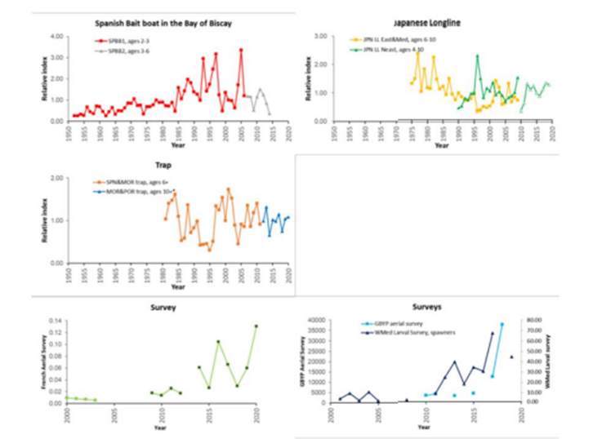
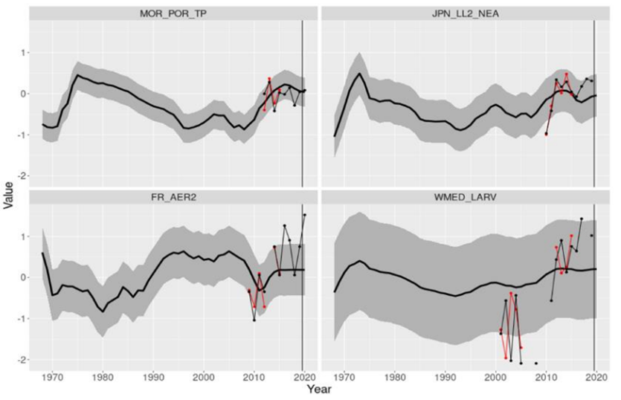
2021 ABFT Responses to the Commission
Eastern Atlantic bluefin tuna
21.24 The SCRS shall annually advise on the TAC. Rec. 20-07, paragraph 1 (Rec. 19-04, para. 5)
Figure 21.24.1. Updates of indices of abundance for the E-BFT presented in 2021.
Figure 21.24.2. Updated indices (values post 2019, black line) compared with the 80% prediction intervals from the 2017 VPA projected forward.

Slide 32
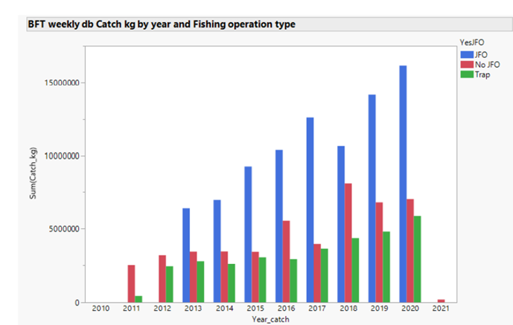
2021 ABFT Responses to the Commission
Eastern Atlantic bluefin tuna
21.25 SCRS should review no later than 2021, and each time an eastern Atlantic and Mediterranean
bluefin tuna stock assessment is performed, CPCs fishing capacity is commensurate with its allocated
quota by using relevant yearly catch rates by fleet segment and gear proposed by the SCRS and adopted
by the Commission in 2009. Rec. 20-07, para 4 (18)
The ICCAT Commission in 2019 requested to review and update the catch rates of fleets targeting E-BFT by main fishing gear and vessel size category to the SCRS. Since 2010 several changes and regulations have been implemented (Rec. 10-04, Rec. 12-03, Rec. 14-05, Rec. 18-02, Rec. 19-04) that impacted the activity of the fleets targeting this resource, bluefin farming operations have become the main destination of the catches, and e so-called “Joint-Fishing = Operations” (JFO)have become the primary type of fishing operation for the East bluefin stock in terms of total catches (Figure 21.25.1).

Slide 33
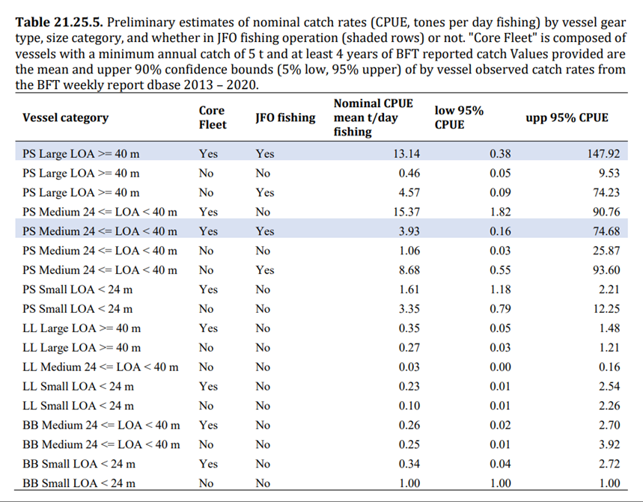
The SCRS defines catch rates as nominal CPUE
(CPUE) per vessel (i.e. catch and effort, measured as fishing days from the VMS data that is associated with each vessel).
Note:There are over 3000 vessels registered for E-BFT fisheries, however of these vessels (~12%) account for about 86% of the
Catch.

Slide 34
ABFT Responses to the Commission
21.26 SCRS to identify growth rates including in weight and size gains during the fattening period, and
review and update the growth table published in 2009, and the growth rates utilized for farming the
fish referred to under paragraph 35 c, and considering the difference among geographic areas
(including Atlantic and Mediterranean) in updating the table. Rec. 20-07, para 8 (Rec. 19-04, para 28)
The SCRS initiated, through the GBYP, numerous farm-based field studies in different geographical areas and established a Subgroup to analyze the data and facilitate the elaboration of a single and coordinated answer.
Major limitations encountered during the early stages of the study for individual fish measurements tagged in cages (high mortality of large tagged fish).
The Subgroup concluded that different methodological approaches, from individual growth studies (based on tagging) and whole cage-based growth studies to a broader analysis based on the available length/weight data from stereo camera measurements at caging, harvesting sampling data and eBCDs, should be combined to address the Commission’s request.
Due to time constraints, only results for the whole farm caged fish population. not split by geographical area or other parameters are available. The finalized tables require additional analyses and will be completed in 2022.

Slide 35
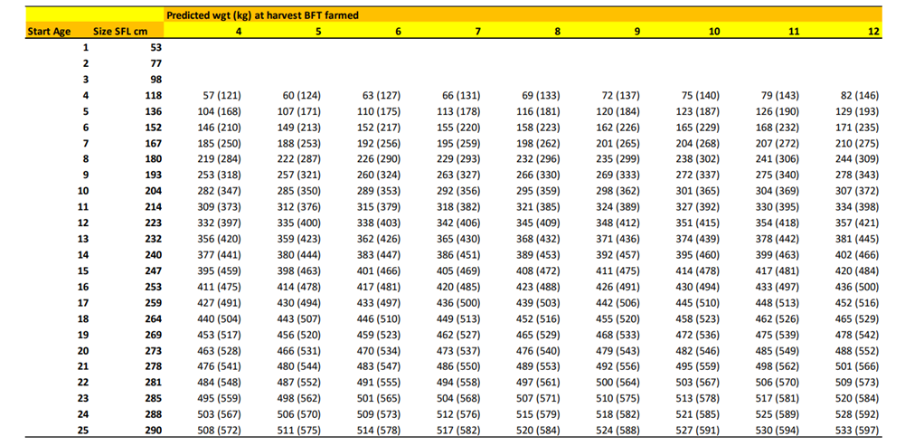
ABFT Responses to the Commission
Table 21.26.1. Updated matrix of the expected “mean weight” at harvest of farmed bluefin tuna as function of length and weight (straight fork length, FL; round weight, RWT) at caging (rows) and time in farms (columns, months after caging). The values in parenthesis correspond to the upper 90% confidence interval, which could be considered a reasonable proxy for the ‘maximum’ growth rate.

Slide 36
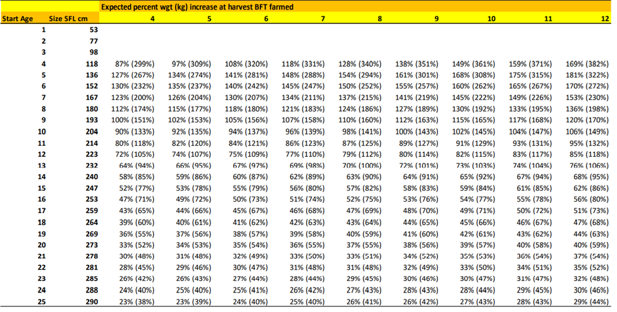
ABFT Responses to the Commission
Table 21.26.1. Updated matrix of the expected “percent weight gain” at harvest of farmed bluefin tuna as function of length and weight (straight fork length, FL; round weight, RWT) at caging (rows) and time in farms (columns, months after caging). The values in parenthesis correspond to the upper 90% confidence interval, which could be considered a reasonable proxy for the ‘maximum’ growth rate.

Slide 37
ABFT Responses to the Commission
21.27 SCRS advice, not later than 2022, on possible extension on the fishing seasons for different gear types and/or fishing areas, without negatively influencing the stock development and by ensuring the stock is managed sustainably. Rec. 20-07, para 9 (Rec. 19-04, para 33).
Background: 33. Not later than 2022, the Commission shall decide to what extent the fishing seasons for different gear types and/or fishing areas might be extended and/or modified based on the SCRS advice without negatively influencing the stock development and by ensuring the stock is managed sustainably.
No new information was presented to the Committee on this matter in 2021. However, this request is broad in scope considering the diversity of fleets, spatial coverage and seasonality. The Committee requests more details on the questions to be addressed in order to undertake the appropriate data compilation and analysis. Specific objectives of the request would be helpful given that some CPC fleets could not fill their quota during the fishing season.

Slide 38
ABFT Responses to the Commission
21.28 The SCRS shall report on National observer programmes. Rec. 19-04, para 83
Background: For the scientific aspect of the programme, the SCRS shall report on the coverage level achieved by each CPC, and provide a summary of the data collected and any relevant findings associated with that data. The SCRS shall also provide any recommendations to improve the effectiveness of CPCs observer programmes.
No new information was provided in 2020 or 2021, possibly due to the constraints imposed by the global pandemic crisis.

Slide 39
ABFT Responses to the Commission
21.29 Programmes to estimate the number and weight of bluefin tuna to be caged – The SCRS should
evaluate such procedures and results and report to the Commission. Rec. 19-04, para 99
The specific analyses of transfer records to estimate minimum sample size that is representative of the bluefin tuna being caged have not been carried out, since full raw data from stereo camera videos are not still available to the Secretariat.
An ad hoc study on this matter could be planned and carried out within GBYP Phase 12, if the data are made available.

Slide 40
ABFT Responses to the Commission
21.30 SCRS shall provide new advice on the TAC for the following year when the goal of maintaining the biomass around B0.1 (to be achieved by fishing at or less than F0.1) is not achieved and the objectives of this plan are in danger. Rec. 19-04, para 114
Background: When, as a result of a scientific evaluation, the goal of maintaining the biomass around B0.1 (to be achieved by fishing at or less than F0.1) is not achieved and the objectives of this plan are in danger, the SCRS shall provide new advice on the TAC for the following year.
Response: The Committee concluded that there is no evidence to recommend a change in the current TAC advice for 2022. See response 21.24 of the report.

Slide 41
ABFT Responses to the Commission
21.31 Standards and procedures for stereoscopic cameras systems in the context of caging operations
Rec. 19-04, Annex 9, item 1 iii
Background: When the length measurements of the fish present a multi-modal distribution (two or more
cohorts of distinct sizes), it shall be possible to use more than one conversion algorithm for the same caging operation. The most up to date algorithm(s) established by SCRS shall be used to convert the fork length of a single fish into weight, according to the size category of the fish measured during the caging operation.
Response: A recent study related to length-weight relationships for bluefin tuna in the Gulf of Cadiz/Southern cost of Portugal (SCRS/2021/146), using data collected over 15 years from the Portuguese traps was reviewed.
The Committee recommends four different equations to be used by the stereoscopic-system for the estimation of the BFT catches transferred to cages:
Atlantic Moroccan traps (Rodriguez-Marin et al., 2015),
Portuguese traps for the period June to August (Lino et al., 2021),
purse-seine catches for juveniles in the Adriatic Sea (Katavic et al., 2018), and
purse seine catches in the Mediterranean (Deguara et al., 2017).

Slide 42
ABFT Responses to the Commission
21.32 SCRS shall review the specifications and, if necessary, provide recommendations to modify them.
Rec. 19-04, Annex 9, item vi
Background: The report on the results of the stereoscopical programme should include details on all the
technical specifications above, including the sampling intensity, the way of sampling methodology, the
distance from the camera, the dimensions of the transfer gate, and the algorithms (length-weight
relationship). The SCRS shall review these specifications, and if necessary, provide recommendations to modify
them.
Response:
The Committee revised some technical specifications as indicated in the responses to the Commission's requests: items 21.29, 21.31 and 21.33 of this report. The Committee will continue this process and revise other aspects of the technical specifications, such as the sampling methodology being applied at caging and the distances between the sampled fish and the stereocamera.
Automated techniques to measure caged fish are being explored, potentially making it easy to increase the percentage of sampled fish.

Slide 43
ABFT Responses to the Commission
21.33 Method proposed for the calculation of a margin of error and range of the stereoscopic camera
system, Rec. 19-04, Annex 9, section 2
Background: In accordance with what was agreed at the Intersessional Meeting of Panel 2 (March 2020)
«Clarify section 2 of Annex 9 of Rec. 19-04, paragraph iii concerning the determination of the percentage
range».
Response:
The proposed method is a 5-step calculation that uses the size measurement input of each fish measured, the estimated round weight (RWT) of each fish (using a user-defined weight-size relationship), the margin of size measure error (error%) provided by the software, the count of fish measured, and the total number of fish counted in the recording file (total count).
Conclusions of SCRS analysis:
- This procedure simply uses the size error measurement from the video file and software to
estimate the range for the estimated total biomass of caged fish.
- The procedures are computationally correct.

Slide 44
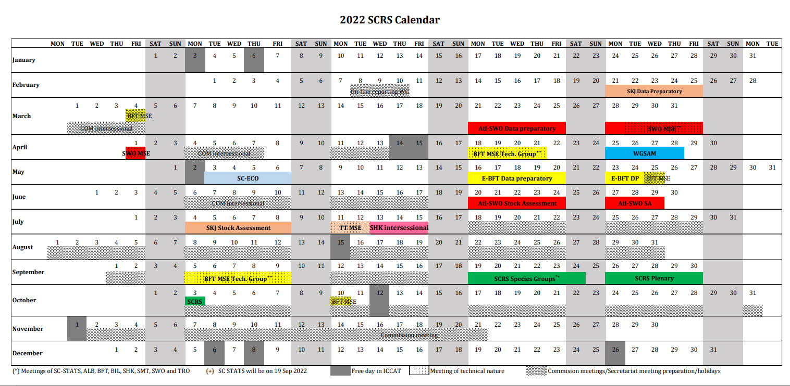

Slide 45
Thank You

Slide 46
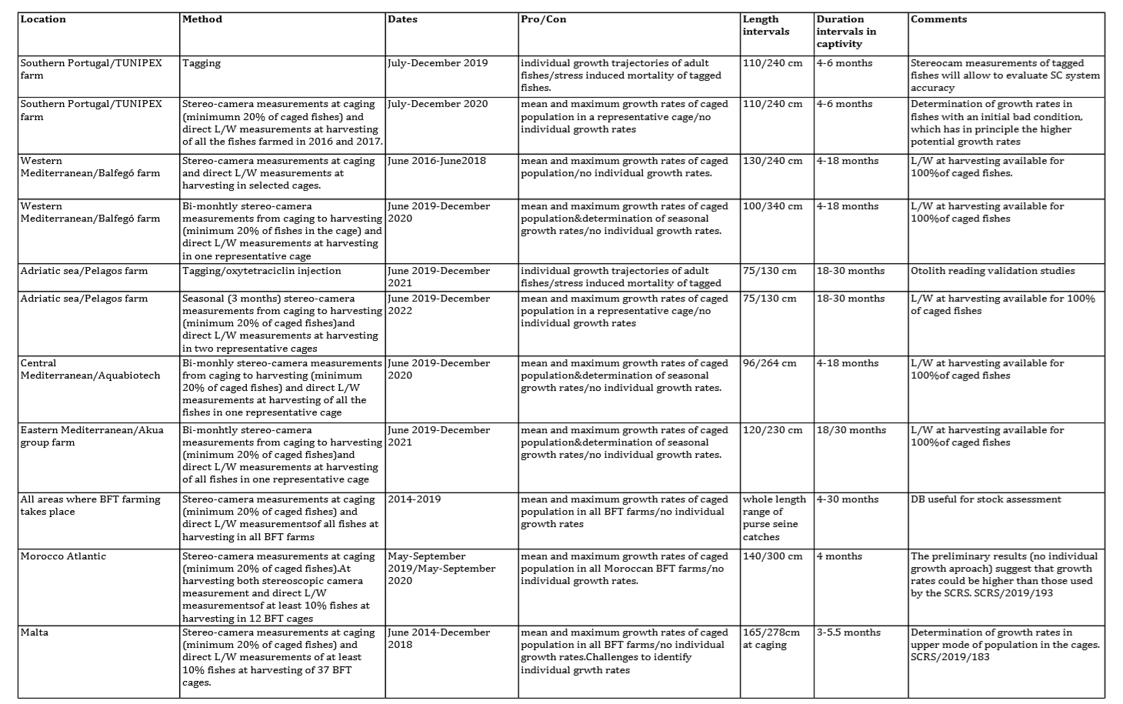
Growth Studies

Slide 47
North Atlantic ALB Workplan 2021
North Atlantic Stock Proposed Work Plan (Details Appendix 13)
Continue work on Exceptional Circumstance, update (up to 2019) the yearly standardized CPUEs, in weight, and determine if exceptional circumstance have occurred.
Japanese longline
Chinese-Taipei longline
US longline
Venezuela longline
Spanish baitboat
Prepare of Stock Synthesis model reference case assessment, including updating Irish and French mid-water trawl indices.
Hold an intersessional meeting in Nov/Dec to fit SS models to the data
Continue to Implement comprehensive Research Programme For 2021, the priority is to complete the reproductive biology and electronic tagging studies, and to start working on a Stock Synthesis model as part of the MSE activities

Slide 48
Mediterranean ALB Workplan 2021
An intersessional assessment meeting should be held. This meeting is high priority and all CPCs involved in Mediterranean albacore fisheries need to be involved. The meeting should cover the following topics:
Review of available data with emphasis in historical series.
Updated standardized CPUE indices for the most important fisheries. All data needs to be ready at least one month before the meeting, to allow for bringing a preliminary assessment ready by the start of the meeting.
Updated information on species biology
Identification of appropriate stock assessment approaches, including data poor methods, to increase confidence in the Jabba assessment.
Exploration of the potential of using alternative indicators and reference points (Lopt, measures based on reproductive potential, etc.).
Identifying research priorities (with a view to incorporate these in the ICCAT Albacore Research Program).

Slide 49
South Atlantic ALB Workplan 2021
The Group stressed the need to start incorporating research activities for this stock on the Albacore Research Programme . Consistent with the north Atlantic albacore workplan, it is prioritized to start activities on reproductive biology and electronic tagging.

Slide 50
ALB Recommendations with Financial Implocations
The Committee recommends continued funding of the albacore research program for North Atlantic albacore. The research will be focused on three main research areas: biology and ecology, monitoring of stock status, and management strategy evaluation. For the Mediterranean stock, although there are still considerable gaps in knowledge on the species biology, fisheries and statistics, to date, the Group has not set research priorities; therefore, no fund.
For 2021 the Group recommended to continue electronic tagging activities in the north Atlantic, to start tagging in the Southern Atlantic, to conduct reproductive biology studies in both stocks, and to progress on the north Atlantic albacore MSE.
The Group request funds to a short term-contract to support advances in larval studies in the Balearic Sea and other spawning areas (e.g. central and eastern Mediterranean), namely investigating the spatio-temporal distribution of larval habitats and dependencies with local mesoscale oceanography, and investigating the ecology of early life stages and the factors determining larval survival.
Requested funds for 2021 : 153,000 Euro

