Slide 1

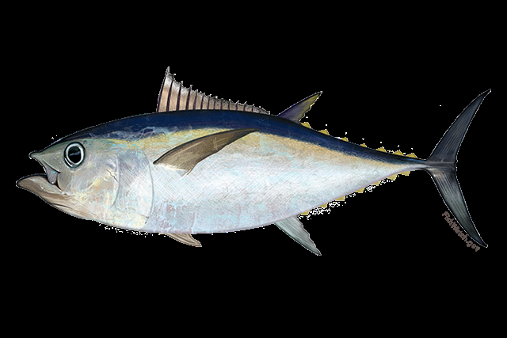
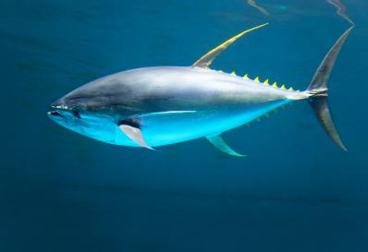
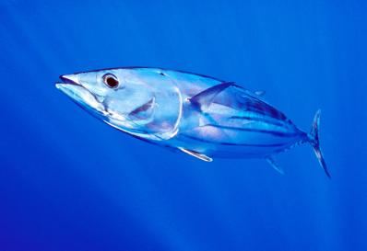
2021 SCRS Report
Bigeye
Panel 1- Tropical Tunas
Yellowfin
Skipjack

Slide 2

Tropical Tuna Summary
SCRS activities for 2021 focused on Exec Summaries for assessed stocks (BET), Research Recommendations, workplans and responses to the Commission.
Presentation Summary
  AOTTP
  Brief Review of State of Stocks and Outlook for YFT and SKJ
  2021 BET stock assessment and Executive Summary
    Effects of Current regulations
    Management recommendations
  Responses to the Commission
  Work Plan

Slide 3

Stock Status Skipjack (SKJ)
Two stocks –Eastern Atlantic and western Atlantic.
Last Stock assessment for east and west Skipjack was in 2014.
Next stock assessment scheduled for 2022.
There are currently no specific regulations in place for skipjack tuna.
Committee was not in a position to provide a reliable estimate of the maximum sustainable yield for the eastern stock.
Catches updated to 2020
Indices not updated since the last assessment.
Essentially no changes in advice.

Slide 4
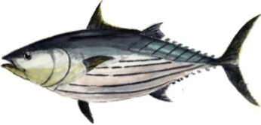
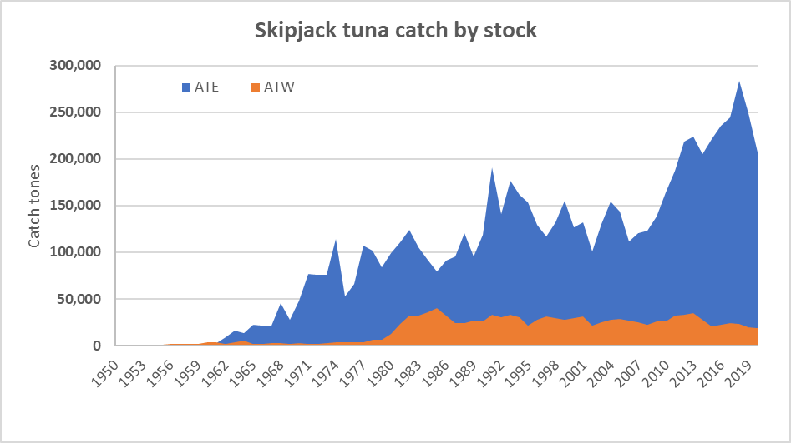
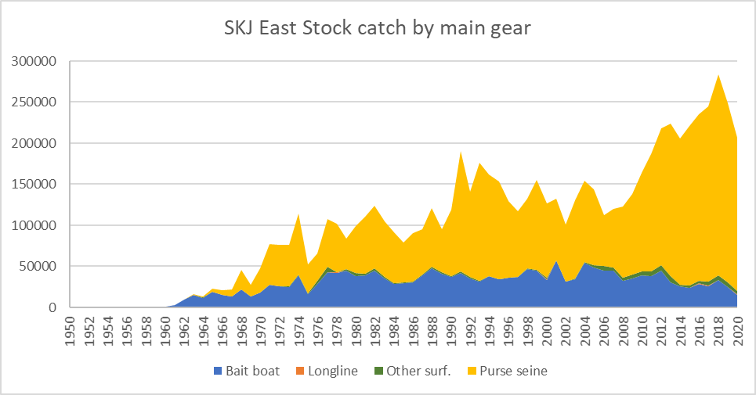
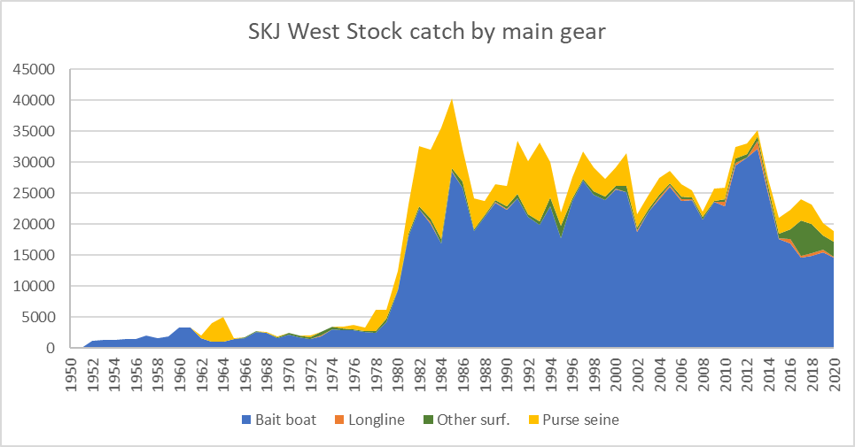
Fisheries indicators
Catches – Tasks I and II Updated to 2020
225,412t
Decline in catch since the early 1990s (due to a decrease in nominal fishing effort and/or to a moratorium effect), followed by a strong increase until 2018 then declining to 225,412t in 2020.
Catchability of SKJ increased in the early 1990s due to FADs fishing
206.589 t
18,824 t
13/11/2021
4
SKJ EXECUTIVE SUMMARY
Notes:
4

Slide 5
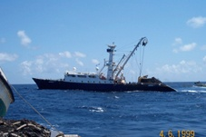
Fisheries indicators
Spatial distribution of SKJ for the PS fisheries
Purse seiner
(2000-2018)
13/11/2021
5
SKJ EXECUTIVE SUMMARY
Notes:
5

Slide 6
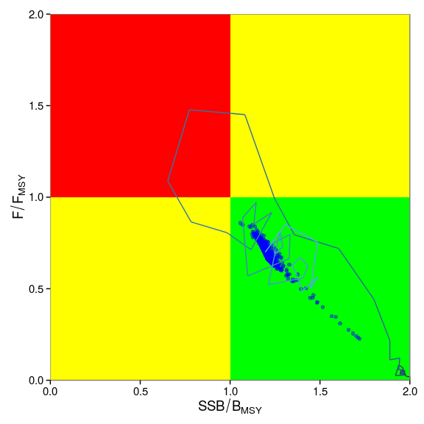
STATE OF THE STOCKS
State of the stocks
Western Skipjack
Likely Not Overfished and Overfishing not occurring.
 | East Atlantic | West Atlantic
Maximum Sustainable Yield (MSY) | Probably higher than previous estimates (143,000-170,000) | Around 30,000-32,000 t
Current yield (2020) | 206,589 t | 18,824 t
Current Replacement Yield | Unknown | Somewhat below 32,000 t
Relative Biomass (B₂₀₁₃/B_{MSY}) | Likely >1 | Probably close to 1.3
Mortality due to fishing (F₂₀₁₃/F_{MSY}) | Likely <1 | Probably close to 0.7
Management measures in force | Rec. 16-01 | None
13/11/2021
6
Notes:
6

Slide 7

YFT Stock Assessment
Stock Assessment 2019 – Input data up to 1950-2018
Ages up to 18 years were observed in otoliths and validated using 14C bomb radiocarbon.
Growth of YFT better estimated using a Richards function than a von Bertalanffy function (AOTTP information)
Age-specific natural mortality function (e.g. Lorenzen) based on T max of 18 rather than 11 used in previous assessment.
Several New Indices used in the 2019 assessment.
Yellowfin Tuna

Slide 8
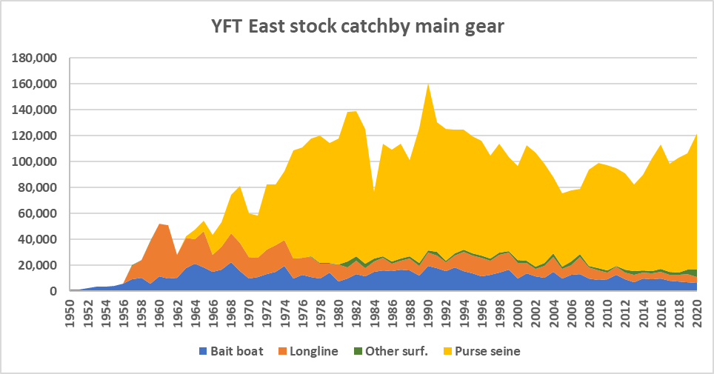
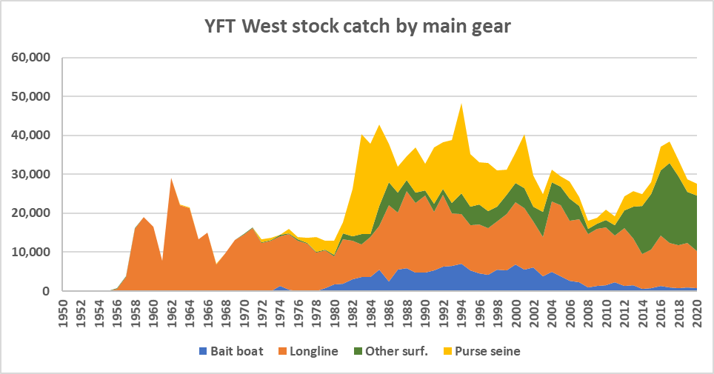
YFT Fishery Indicators
3 Major Gears (PS, BB, LL)
Highest landings (194,000 t) in 1990.
Decreased to 100,000 t by 2007.
A TAC of 110,000 t was adopted in 2012.
Purse seine vessels targeting tropical tunas in the eastern Atlantic has increased in the last five years.
Catches increased from 135,312 in 2019 to 149,202t in 2020, mainly in the East.

Slide 9
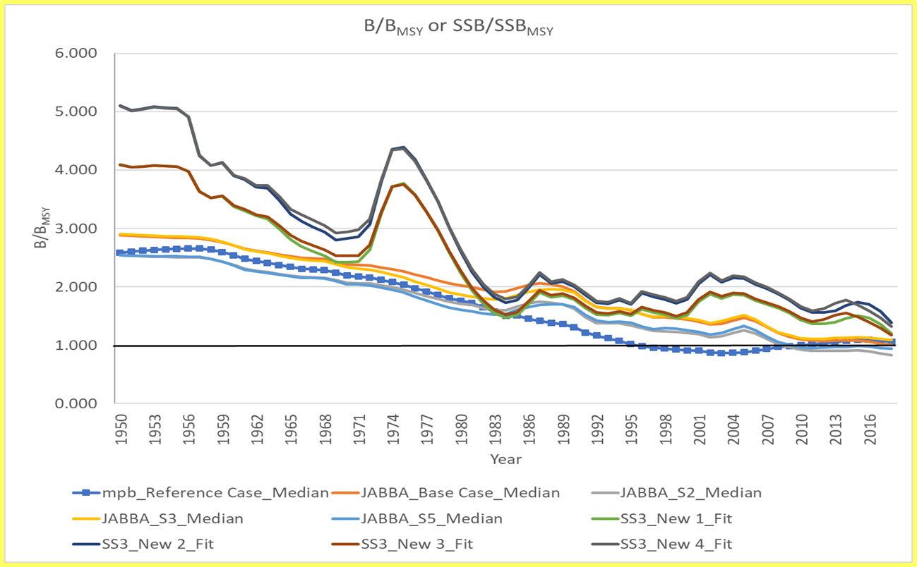
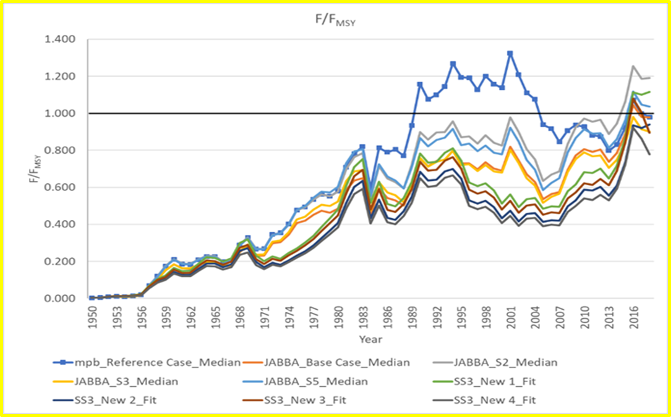
YFT Stock Assessment
Assessment Results
Biomass relative to Bmsy
Fishing Mortality relative to Fmsy

Slide 10
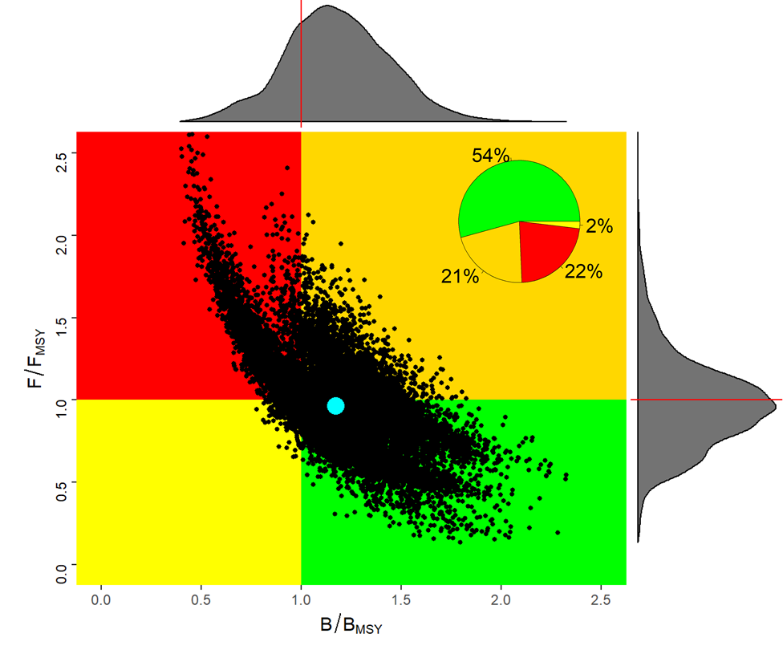
YFT Stock Status
Stock Assessment Results:
Combined Results of Stock Synthesis, JABBA and MPB
B/B_{MSY} = 1.17
  Not Overfished
F/F_{MSY} = 0.96
  Not Overfishing
MSY = 121,298 t
  Mean MSY 2016-2018
The 2019 result appears more optimistic than in 2016. However, the group cautioned that the difference in the results is not due to stock recovery. Instead, the perceived improvement is more likely due to changes in key data inputs (M, growth, indices) and the suite of models applied (JABBA, MPB, SS).

Slide 11
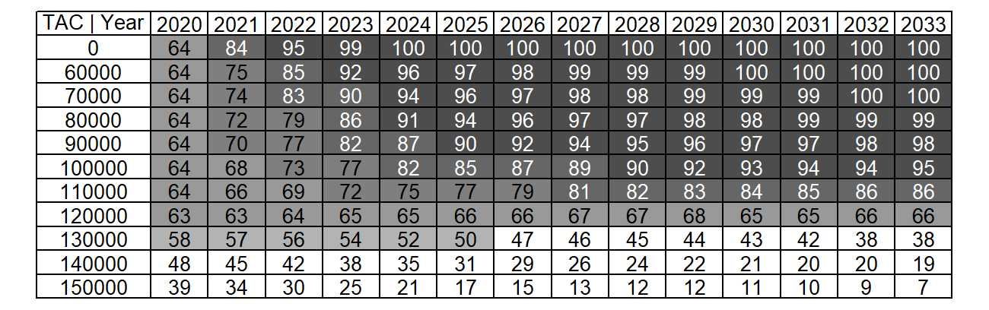
YFT Stock Outlook
Maintaining a TAC of 120,000 t is expected to maintain healthy stock status (no overfishing, not overfished) through 2033 with at least 63% probability
Joint Probability that F≤F_{MSY} and B≥B_{MSY}

Slide 12
Stock Status - Bigeye Tuna (BET)
Latest assessment 2021 based on data to 2019
Update of fishery indicators:
  Catch (1950-2020)
  Juvenile index of abundance based on acoustic buoys from FOBs/FADs (2010-2019)
New Joint Longline index developed in 2021 (1979-2019).
Significant changes made in the assessment Inputs (i.e., maximum age and natural mortality assumptions, the relative abundance indices used and the fleet structure.
Modeling approaches, included non-equilibrium (MPB) and Bayesian state-space (JABBA) production models as wells an integrated statistical assessment models (Stock Synthesis) which was used to provide management advice.

Slide 13
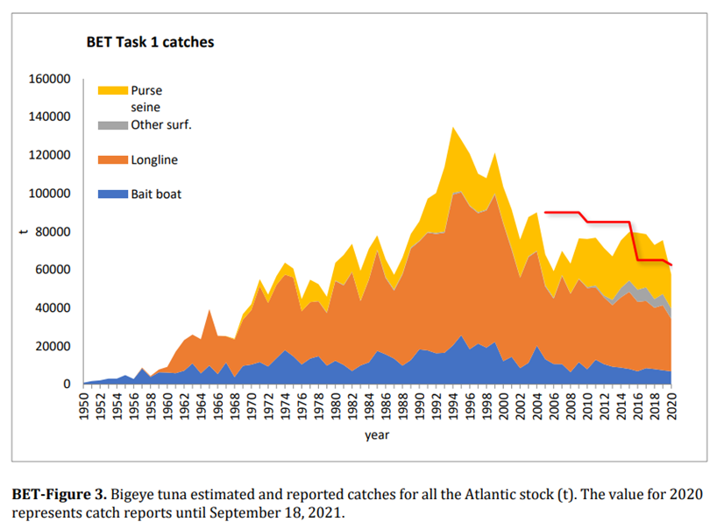
Stock Status - Bigeye Tuna (BET)
2016/19 TAC 65,000 t
2019 Catch 75 484 t
2020 TAC 62,500 t
2020 Catch 57,486 t
Nominal catches exceeded TAC (65,000 t) between 2016 and 2019 by 13-21% The 2020 catch was approximately 9% below the TAC.

Slide 14
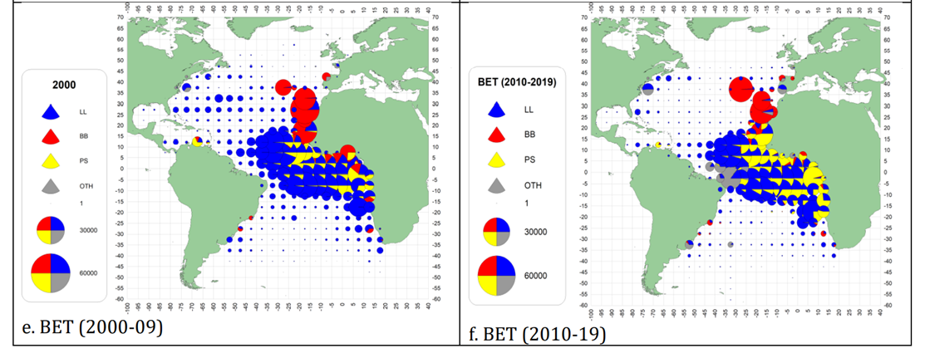
Stock Status - Bigeye Tuna (BET)
Geographical distribution of the bigeye tuna catch by major gears 2000-09 and 2010-2019.

Slide 15
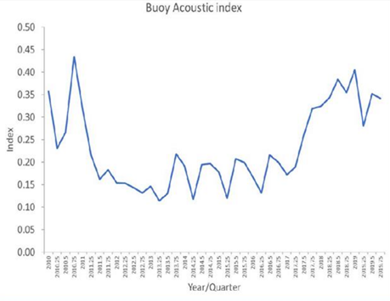
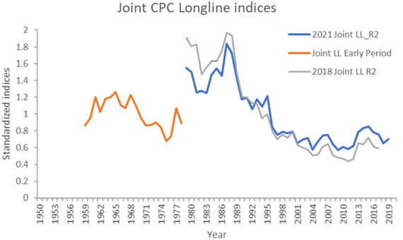
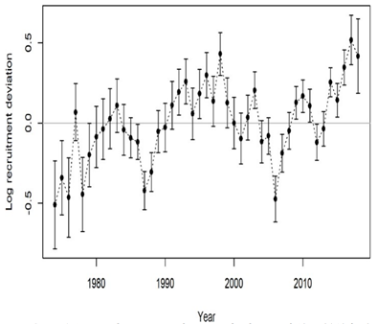
BET Fishery indicators and Recruitment
Quarterly Buoy acoustic index. (2010-2019).
Recruitment Deviations.
(1974-2018)
Joint Longline index (1959-1978 without vessel identification and 1979-2017 with vessel identification included in the standardization.

Slide 16
BET SS assessment Uncertainty
Outputs:
Only Stock Synthesis model used to provide Management advice.
The SS uncertainty grid includes 27 equally weighted model configurations,
The two production models, non-equilibrium and Bayesian state-space, although not used for management advice provided comparable perception of stock status.
The median relative biomass (B/BMSY) and relative fishing mortality (F/FMSY) trajectories from production models and the Stock Synthesis models depicted similar patterns within the SS uncertainty bounds.
BET Uncertainty Grid:
Parameter Value1 Value2 Value3
Max_Age 17 20 25
Steepness 0.7 0.8 0.9
Sigma R 0.2 0.4 0.6

Slide 17
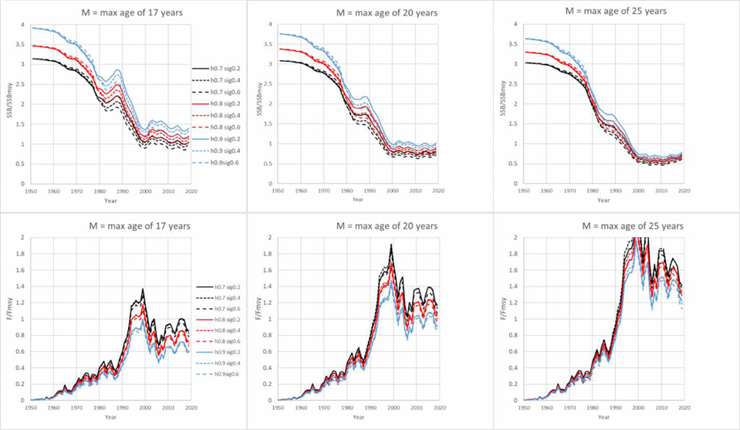
BET SS Stock Trends
Outputs:
BET-Figure 7. Time series of stock status trends across the 27 Stock Synthesis models of the uncertainty grid. Panels in each row represent the different assumptions of maximum age and thus natural mortality. Upper panels represent SSB/SSBMSY trends and lower panels F/FMSY trends. Individual lines represent different combinations of steepness and Sigma R.
All model configurations show increasing F and decreasing biomass trajectories from 1950-2019. However, the trends slowed from 1998 with a slight upward trend in SSB/SSBmsy and decrease in F/Fmsy in the last few years.

Slide 18
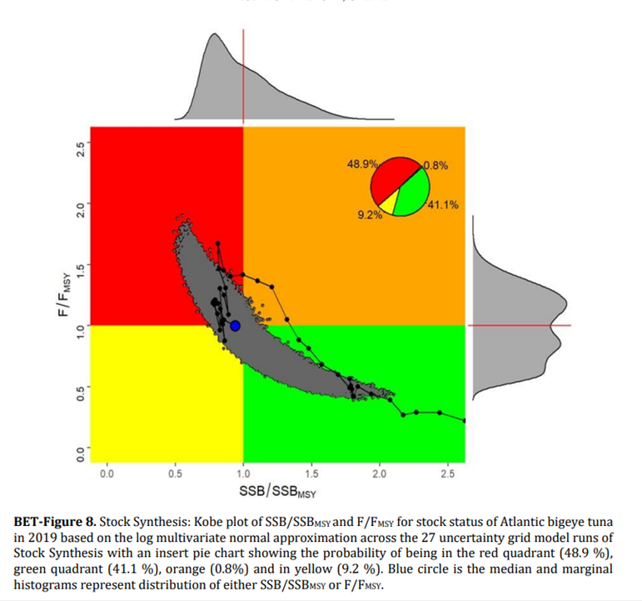
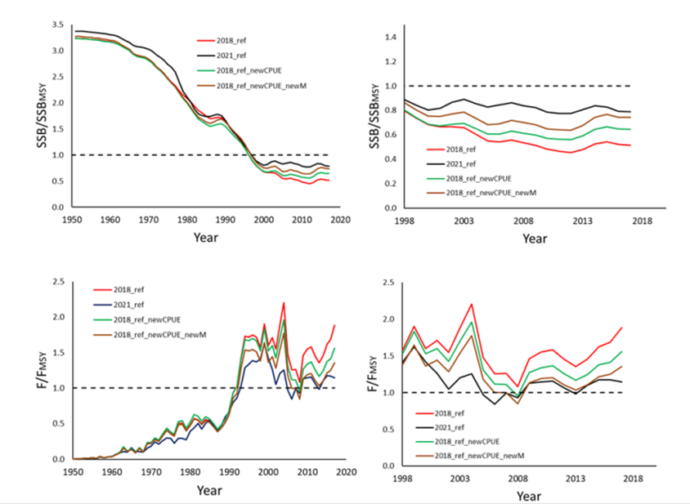
BET Stock Status
Sensitivity runs showing time series of stock status trends (left 1950-2017, right 1998-2017, for SSB/SSBMSY and F/FMSY) demonstrating the effects of changes
in stock status resulting from the incorporation of the 2021 joint longline index and the new assumptions
about natural mortality.

Slide 19
BET Fishery indicators
ATLANTIC BIGEYE TUNA SUMMARY
Maximum Sustainable Yield 86833 t (72,210-106440 t)¹
Current (2020) Yield 57,486t²
Relative Spawning Biomass (SSB₂₀₁₉/SSB_{MSY}) 0.94 (0.71-1.37)¹
Relative Fishing Mortality (F₂₀₁₉/F_{MSY}) 1.00 (0.63-1.35)¹
Stock Status (2019) Overfished: Yes
Overfishing: No
Important:
Increased harvests on small fishes could have had negative consequences for the productivity of bigeye tuna fisheries (e.g. reduced yield at MSY and increased SSB required to produce MSY).
Rec. 19-02 contains measures
aimed at increasing long-term sustainable yield by reducing the catch of juveniles of tropical tunas.

Slide 20
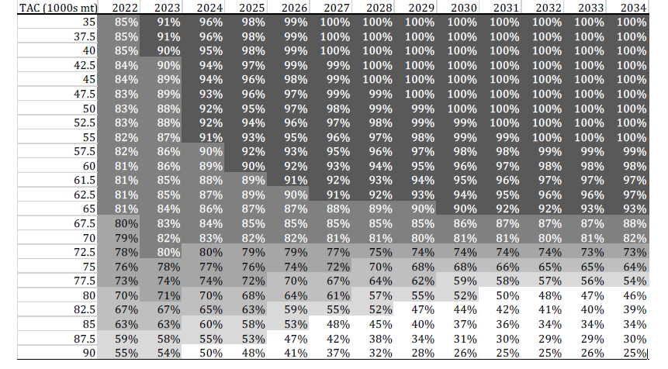
BET Fishery indicators
Probability of Not Overfished (SSB >= SSBmsy) and Overfishing not occurring (F <= F_{MSY})
TAC

Slide 21
BET Fishery indicators
Deterministic projections of SSB/SSBMSY and fishing mortality for the 27 Stock Synthesis uncertainty grid runs at 35,000-90,000 t constant catch for Atlantic bigeye tuna. The lines are the mean of 27 deterministic runs and the black line is for the current TAC (61,500 t). The grey bar represents the period when catches for 2020 and 2021 are fixed to 59,919 t and 61,500 t respectively.

Slide 22
Tropical Tuna Management Recommendations
BET - Management Recommendations
The Atlantic bigeye tuna stock status has improved since 2017 and was estimated to be overfished but not undergoing overfishing.
A future constant catch of 61,500 t, which is the TAC established in Rec. 19-02, will have a high probability (97%) of maintaining the stock in the green quadrant of the Kobe plot by 2034.
Current stock status and the outlook for the stock are more uncertain than portrayed in the Summary Table and the K2SM. Projection probabilities should be interpreted with caution
Uncounted uncertainties include the appropriateness of the range of natural mortalities used in the uncertainty grid and the change in methodology used to develop the joint longline index.
The Commission should consider adopting a TAC that would shift the stock status of BET towards the green zone of the Kobe plot with a high probability..
Increased harvests on small yellowfin and bigeye tunas have negative consequences on both long-term sustainable yield and stock status.

Slide 23
Management Recommendations
Skipjack Tuna – Unchanged since 2019 SCRS Report
Committee recommends that the catch and effort levels for the eastern stock do not exceed the 2012-2013 catch or effort. Catches in 2019 and 2020 decreased substantially.
The Commission should be aware that increasing harvests and fishing effort for skipjack could lead to involuntary consequences for other species caught in combination with skipjack in certain fisheries (juveniles of yellowfin and bigeye).
For the West Atlantic, the Committee recommends that the catches should not be allowed to exceed the MSY.

Slide 24
Management Recommendations
Yellowfin Tuna – Unchanged since 2019 SCRS Report
Catches above 120,000 t are expected to further degrade the condition of the yellowfin stock. Since 2016, catch have averaged 137,000 t, but increased to 149,202 in 2020. Catches above 140,000 t carry an increased risk of driving the stock below 20%B_{MSY} (13% by 2033).
Significant overages are frequent. Existing conservation and management measures appear to be insufficient. The Group recommends that the Commission strengthen such measures.
Increased harvests on small yellowfin and bigeye tunas has negative consequences to both long-term sustainable yield and stock status.
Should the Commission wish to increase long-term sustainable yield, the Group recommends that effective measures be found to reduce fishing mortality on small yellowfin and bigeye tuna

Slide 25
Tropical tuna Workplan -2022
Tropical Tunas Workplan for 2021/2022
  Data Prep and Assessment of skipjack stocks (2022)
  Advance the definitions of TRO MSE management objectives and performance indicators, as well as to continue to make progress on the MSE for the Western stock of skipjack.
  Explore the relationship between FOB management measures, including limitations of FOB fishing sets, number of FOB operational buoys, and number of FOB buoy / FAD deployments;
  Assess the efficiency (e.g. reduction of BET and YFT juveniles catches) and the appropriateness of the FOB closures in [Rec. 19-02]
  the Group recommended that the FAD Working Group be revitalized in 2022. Last met in 2017.

Slide 26
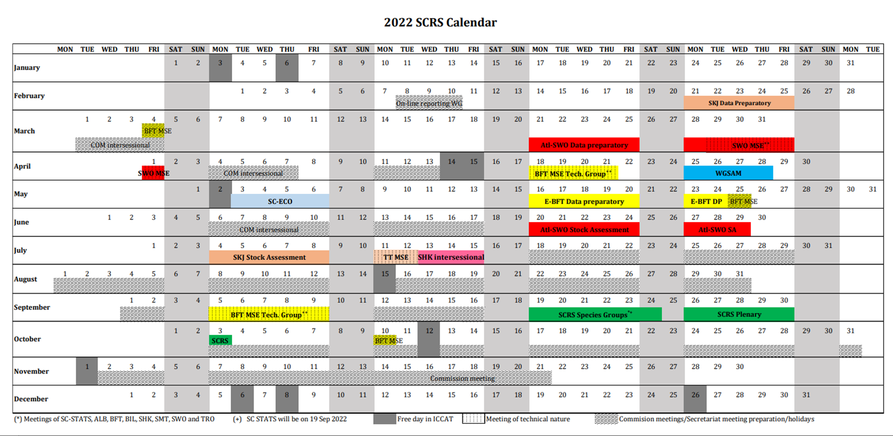
Inter-sessional SCRS meetings
SCRS Calendar for 2022
TT MSE
2022 – Data preparatory
2022 - SKJ Assessment

Slide 27
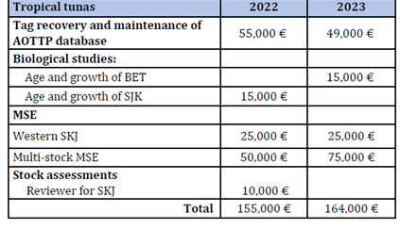
Recommendations with financial implications
Tropical Tuna
Support for the 2022 Skipjack Stock Assessment including
the SCRS scientists and the Secretariat to prepare the data,
investing in ageing spines collected under the AOTTP, and
contracting an external expert to review the full stock assessment process.
Support the continuation of MSE for tropical tunas:
Continue to invest in the recovery of AOTTP tagged fish and maintenance of the tagging database, and
Support to advance the development of the multi-stock MSE and the western skipjack MSE.
Budget Breakdown

Slide 28
Response to the Commission
21.1 Discards in purse seine fisheries, Rec. 17-01, para 4.
Background: In 2020, the SCRS shall assess the effectiveness of this Recommendation(to retain and land) and submit recommendations to the Commission regarding potential improvements.
The Committee was unable to provide a detailed response this year. However, previous studies estimated that these discards were small for Spanish purse seiners in the mid-2000s (0.2 t per free school set and 1.1 t per FOB set). New guidelines and best practices adopted by fleets and the discard prohibition (Rec. 17-01) that entered into force in 2018 suggest that current discards are probably fewer than the levels indicated in the earlier study.

Slide 29
Response to the Commission
21.2 Discards in purse seine fisheries, Rec. 17-01, para 5.
Background: In 2020, the SCRS shall examine the benefits of retaining non-targeted species catches. The work should examine the feasibility of both retaining on-board and processing of the associated landings of all species that are usually discarded for all major gears (i.e., purse-seines, longlines and gillnets), on the high seas and in waters under national jurisdiction.
Discards of the purse seine fleet are probably small because 1) most of the bycatch
(particularly small tunas species and other bony fish) form part of the so called “faux poisons”, and 2) of the discard prohibitions in Rec. 17-01. It was noted that Rec. 17-01 is not exclusively directed to purse seine fleets (para 5) but also to the other major gears targeting tropical tunas. Table 21.2.1 (next slide) shows the most important CPCs and gears contributing to the bigeye tuna catch and reporting discards in ST02 or ST09.

Slide 30
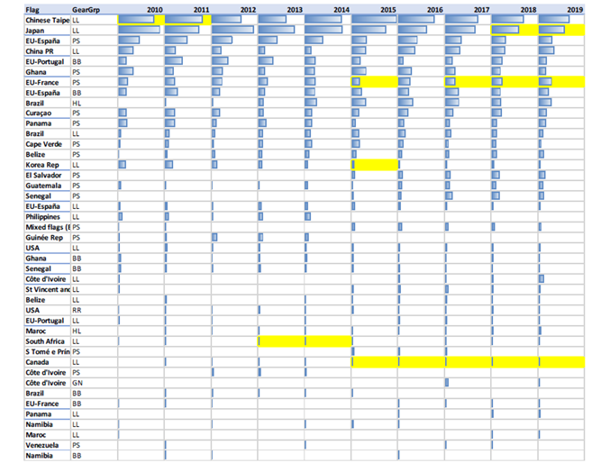
Response to the Commission
21.2 Discards in purse seine fisheries, Rec. 17-01, para 5.
Table 21.2.1. Combinations of CPCs and gears reporting bigeye tuna catches in the ICCAT Convention area. Only those that are responsible of more than 1000 tons in the decade are shown. CPC’s are ordered from high to low according to total catch in the 2010s. Blue bars indicate BET catch levels. In yellow are highlighted those combinations of CPC-gear-year that have provided dead discard reports.

Slide 31
Response to the Commission
21.3 The TAC for 2022 and future years, Rec. 19-02, para 3.
Background: The Total Allowable Catch (TAC) for bigeye tuna shall be 62,500 t in 2020 and 61,500 t in 2021.The TAC for 2022 and future years shall be considered in 2021 on the basis of SCRS advice..
A Stock Assessment for Bigeye Tuna was conducted in 2022. For more information on TAC refer to the outlook section of the Bigeye tuna Executive Summary (Item 9.1 of the SCRS Report).

Slide 32
Response to the Commission
21.4 Fishing prohibited with FADs, Rec. 19-02, para 28.
Background: FAD fishing prohibited 1 January to 28 February for 2020 and 1 January to 31 March in 2021, throughout the Convention area. This should be reviewed and, if necessary, revised based on advice by the SCRS taking into account monthly trends in free school and FAD-associated catches and the monthly variability in the proportion of juvenile tuna in catches. SCRS should provide this advice to the Commission in 2020.
The Committee noted that an analysis of historical monthly catches will be of limited use because it would not reflect the behaviour of fleets under the current FAD closure described in Rec. 19-02. Furthermore, it was also noted that the Commission request refers to catch in 2020 and 2021 but such catch data were not available to the Committee this year.
The Committee recalled an ATTOP study (Perez et al., 2021) that concluded both moratoria were efficient for limiting recaptures on juvenile skipjack and yellowfin during the November-February period, no conclusion could be drawn for bigeye due to the limited number of bigeye tuna released inside and outside the FAD time area closure.

Slide 33
Response to the Commission
21.4 Fishing prohibited with FADs, Rec. 19-02, para 28.
The Committee agreed to continue to work on this response in 2022 and to conduct the following analyses:
Prepare a table with the recent evolution of monthly PS tropical tuna catches by fishing mode and species, using Task 2 information from 2010 to 2020, indicating the different time area FAD closures that have been in place. The table should include percentages across months by species and across species by month.
An analysis identifying months that minimize yellowfin and bigeye juveniles while maintaining skipjack catches.
Derive from the most recent Stock Synthesis results for YFT and BET, appropriate indicators of the evolution of fishing mortality of one-year old for the major surface fleets.

Slide 34
Response to the Commission
21.5 Maximum number of FAD sets which should be established per vessel or per CPC, Rec. 19-02, para 31.
Background: With a view to establishing FAD set limits to keep the catches of juvenile tropical tunas at sustainable levels, in 2021 SCRS should inform the Commission about the maximum number of FAD sets which should be established per vessel or per CPC. To support this analysis,
Fishing effort associated with FADs is a complex interaction of factors such as number of FADs deployed, FADs monitored by vessel, technology of the buoy, and the use of supply vessels,
A recent SCRS paper prepared for Panel 1 (SCRS/2021/135) contains information on the available catch, effort in fishing time, number of FAD deployments, FAD loss, types of FADs and other variables for the purse seine fleets. Unfortunately, such information, can be challenging to interpret.

Slide 35
Response to the Commission
21.5 Maximum number of FAD sets which should be established per vessel or per CPC, Rec. 19-02, para 31.
CPCs have the option to report activities using one of multiple effort metrics. Most CPCs have not reported effort in number of FAD sets.
In short, there is not enough information at the present time to provide advice on the maximum number of FAD sets per vessel as requested by the Commission.
The Committee notes that unless new and detailed information becomes available (requested of CPCs), any guidance provided to the Commission on this matter would be on the maximum number of FAD sets per fleet and not per CPC or vessel.

Slide 36
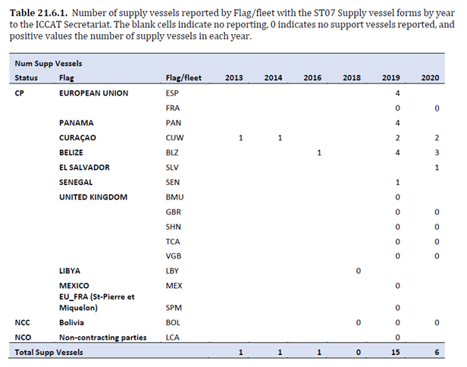
Response to the Commission
21.6 Impact of support vessels on the catches of juvenile yellowfin and bigeye tuna, Rec. 19-02, para 33.
Background: Further analysis shall be conducted by the SCRS on the impact of support vessels on the catches of juvenile yellowfin and bigeye tuna to be considered in 2020.
Data availability is limited (ST07) with no information available to make the linkage between catches of the PS vessels and the supporting supply vessel(s).
Ongoing EU analysis to standardize the PS FAD CPUE that incorporate a supply vessel effect in the standardization. To be completed for skipjack assessment in 2022.
The Committee is unable to provide a final response to this request at this time.

Slide 37
Response to the Commission
21.7 SCRS recommendation on presence of a human observer on board in accordance with Annex 7 and/or an Electronic Monitoring system, Rec. 19-02, para 55.
Background: Background: For longline vessels flying their flag 20 meters length overall (LOA) or greater targeting bigeye, yellowfin and/or skipjack in the Convention area, CPCs shall ensure a minimum of 10% observer coverage of fishing effort by 2022, through the presence of a human observer on board in accordance with Annex 7 and/or an Electronic Monitoring system. For this purpose, the Working Group on Integrated Monitoring Measures (IMM WG), in cooperation with the SCRS, shall make a recommendation to the Commission for endorsement at its 2021 Annual meeting:
No response was provided by the Committee however it was noted that a Subgroup within the Billfishes Species Group was created to start addressing this issue.

Slide 38
Response to the Commission
21.8 Refine the MSE process in line with the SCRS roadmap and continue testing the candidate management procedures, Rec. 19-02, para 62.
Background: The SCRS shall refine the MSE process in line with the SCRS roadmap and continue testing the candidate management procedures. On this basis, the Commission shall review the candidate management
procedures, including pre-agreed management actions to be taken under various stock conditions. These shall take into account the differential impacts of fishing operations (e.g. purse seine, longline and baitboat) on
juvenile mortality and the yield at MSY.
An updated roadmap was prepared for the tropical tunas MSEs based on the activities agreed during the intersessional meeting of the Tropical Tuna Species Group. This was integrated with the roadmaps for other species MSE (17.5 of the SCRS Report. Highlights for 2022 are presented in the following slide.

Slide 39
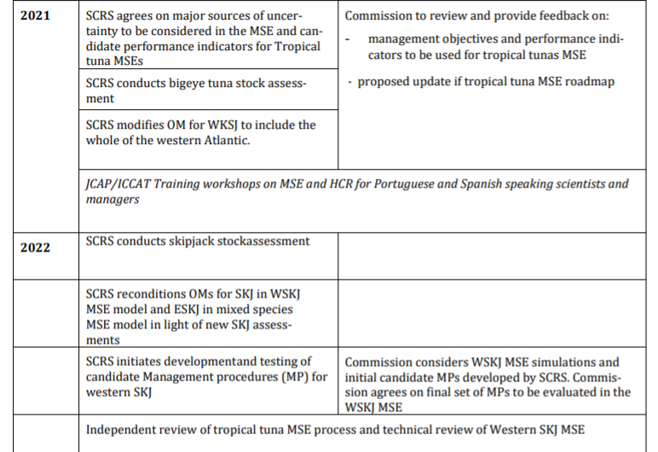
Response to the Commission
21.8 Refine the MSE process in line with the SCRS roadmap and continue testing the candidate management procedures, Rec. 19-02, para 62. Continued.
SCRS
Commission

Slide 40
Response to the Commission
21.9 Efficacy that full fishery closures along the lines of those proposed in PA1_505A/2019, Rec. 19-02, para 66a.
Background: Actions required from the SCRS and the Secretariat:
a) The SCRS shall explore the efficacy that full fishery closures along the lines of those proposed in PA1_505A/20195 might have to reduce the catches of tropical tunas to the agreed levels; and the potential of such scheme to reduce the catches of juvenile bigeye and yellowfin tunas, in line with recommendations from the SCRS;
The Committee did not advance the analysis of previous work on this closure. The Committee will attempt to conduct the analysis in 2022.

Slide 41
Response to the Commission
21.10 Estimate of capacity in the Convention area, to include at least all the fishing units that are large-scale or operate outside the EEZ of the CPC they are registered in, Rec. 19-02, para 66b.
The Committee can only presently report on capacity estimates of large-scale purse-seine vessels (hold capacity ≥335 m3).
The Committee estimates that at least 74 and possibly 80 large-scale purse seiners were operating in the Convention Area as of the first half of 2021. The combined Fish Hold Volume (FHV) of the 80 vessels was 114,864 m3, which is equivalent to about 89,472 t of fish carrying capacity. This suggests that the current capacity is higher than necessary to meet current catch recommendations (5-6 trips/year/vessel).
The Committee notes that these estimates are active capacity not potential capacity (88 vessels authorized)
The Committee wants to highlight that there is a need to agree on a set of indicators of capacity which are useful to both the Commission and the Committee.
The Committee intends to evaluate the capacity and number of other fleet components (e.g. Support vessels, BB, LL) in the future.

Slide 42
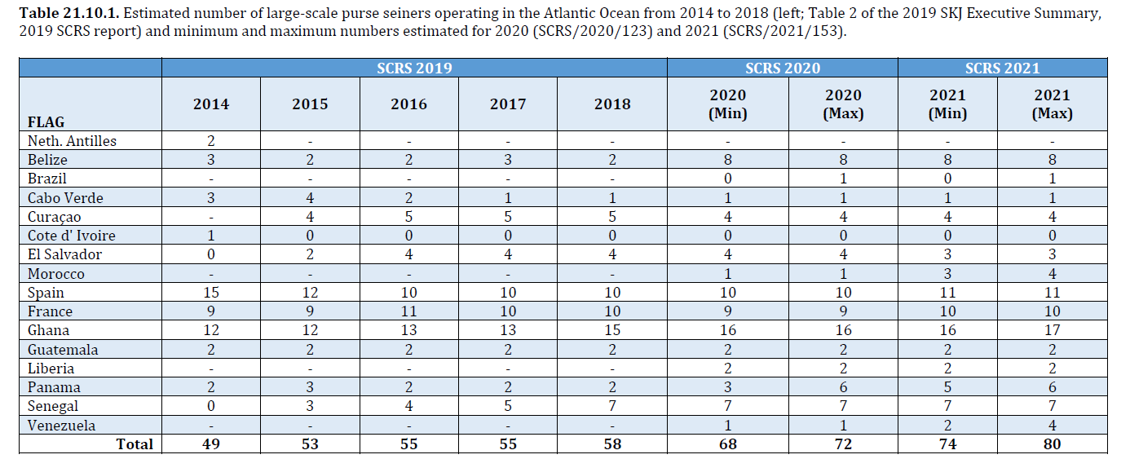
Response to the Commission
21.10 Estimate of capacity in the Convention area, Continued.

Slide 43
Response to the Commission
21.11 The SCRS and the Secretariat shall prepare TORs to carry out an evaluation of the monitoring, control and surveillance mechanisms in place in ICCAT CPCs. Rec. 19-02, para 66c.
The Committee and the Secretariat were unable to provide a detailed response this year.

Slide 44
Thank You

