Slide 1
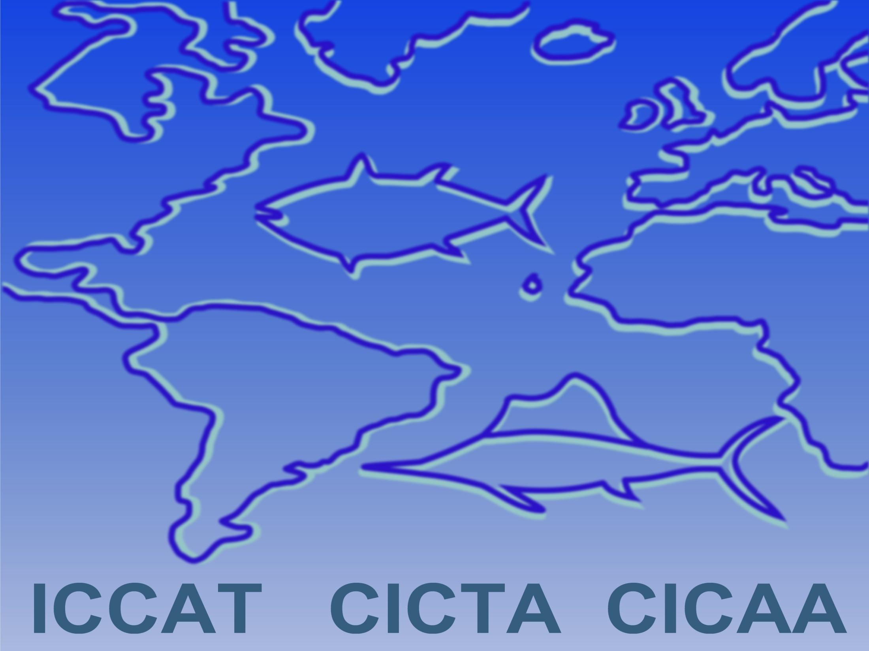
SCRS Report 2019
PANEL 4

Slide 2
Main contents of this presentation
Billfishes:
  Detailed results of the 2019 WHM Assessment
  Summaries for other species not accessed this year (BUM and SAI)
Swordfish
  Not assessed in 2019. Summary of previous Atl and Med assessments.
  Summary update on N-ATL swordfish MSE
Small tunas
  Updates on the progress of work
Sharks:
  Detailed results of updates for SMA projections
  Summaries of species not accessed this year (other sharks)
Sub-Committee on Ecosystems – Bycatch issues
Responses to the Commission
Recommendations with financial implications

Slide 3
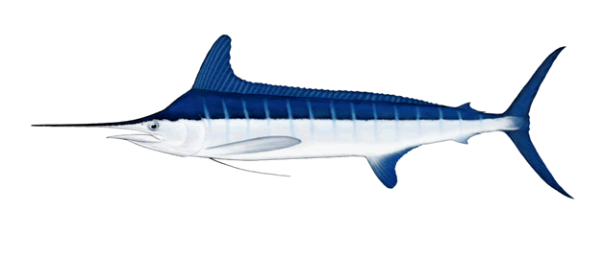
2019 WHM assessment
2019 stock assessment of white marlin (WHM)
Data preparatory meeting
(Madrid, 12-15 March, 2019)
Stock Assessment meeting
(Miami, 10-14 June, 2019)

Slide 4
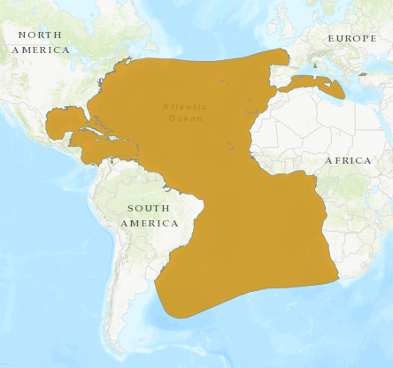
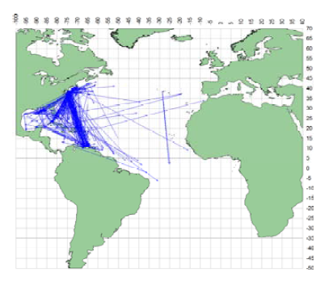
WHM Biology
Distributed in the Atlantic Ocean and Caribbean. Occasional in the Mediterranean.
Known spawning grounds:
  Tropical NW Atlantic: off East Florida, between La Hispaniola and Cuba, and north of Puerto Rico
  Equatorial Atlantic: off NE Brazil
  SW Atlantic: off southern Brazil.

Slide 5
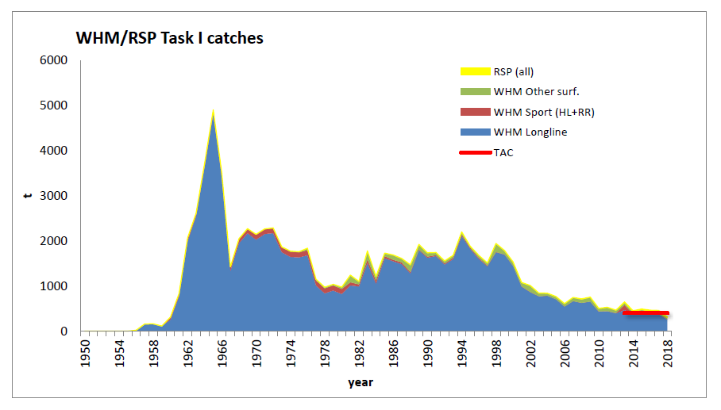
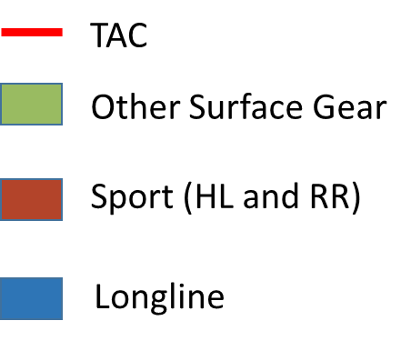
WHM Fishery Indicators
Annual catch by gear
Catch (2018): 314 t
TAC (2018): 400 t
White marlin landings reported to ICCAT include roundscale spearfish.
Studies in the west Atl show ratios of 23-27% RSP/WHM, but vary in time and space.
There is little information on those species ratios in the eastern Atlantic

Slide 6
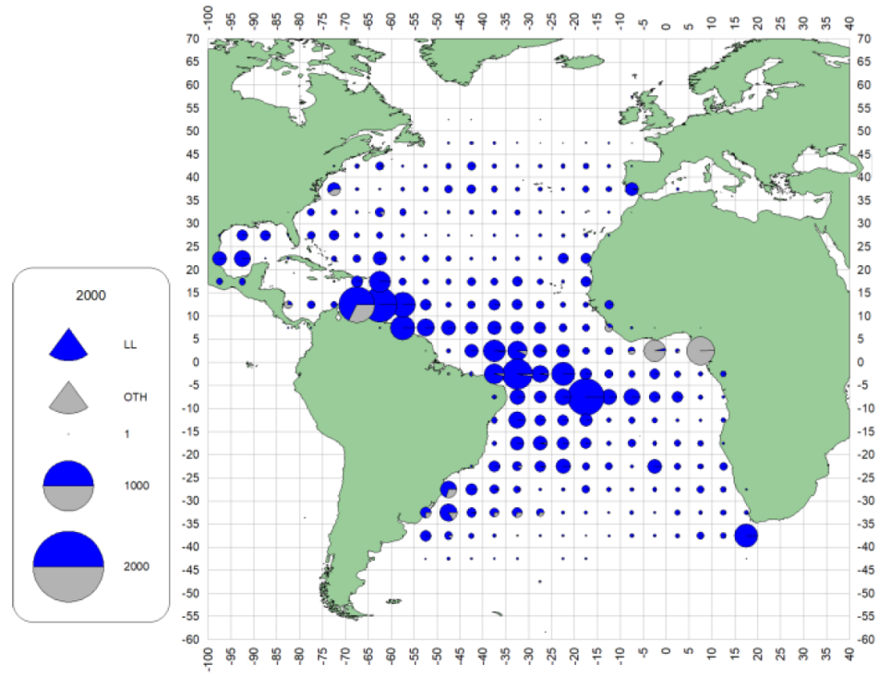
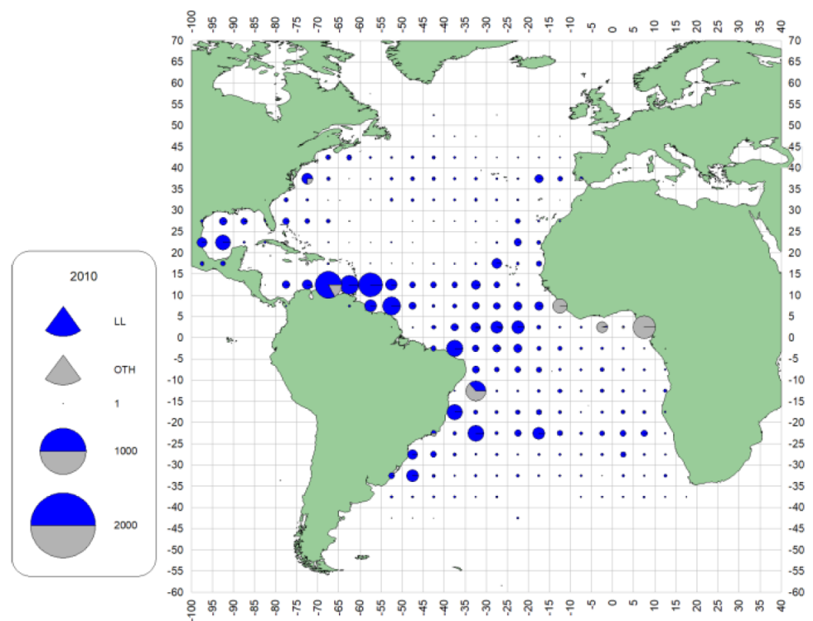
WHM Fishery Indicators
Geographic distribution of catches
More contribution from Artisanal fleets
2000-2009
2010-2017
LONGLINE
OTHER GEAR

Slide 7
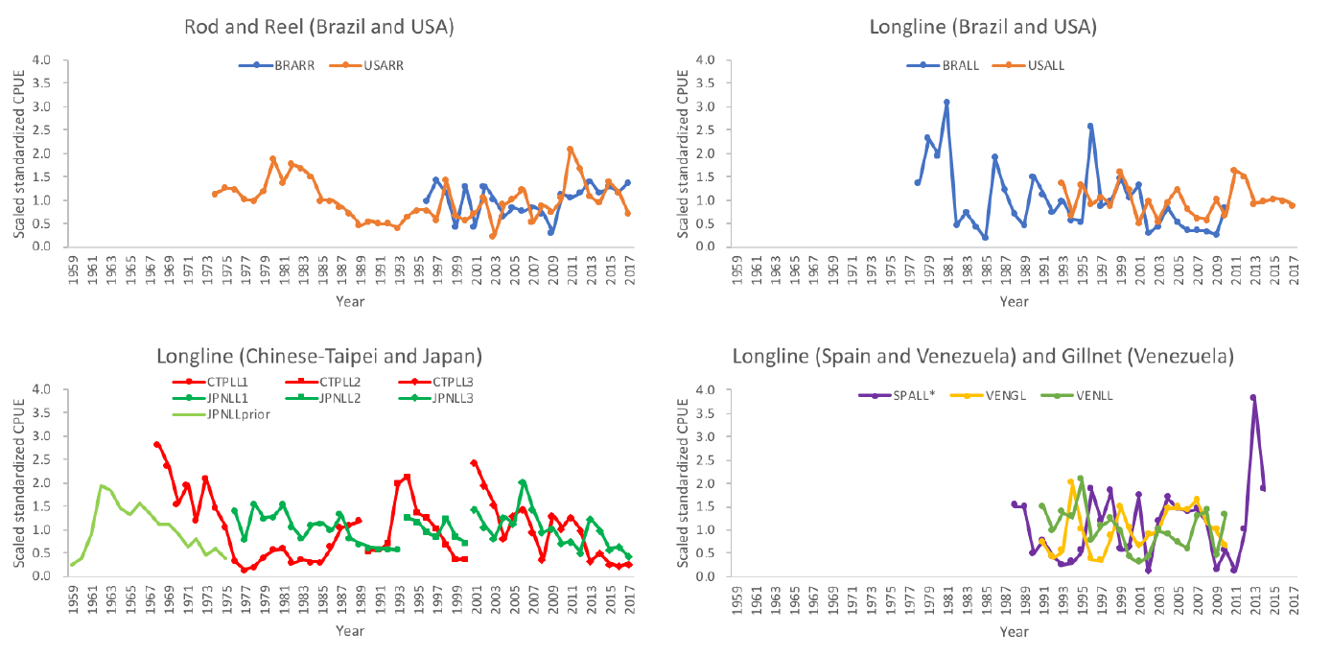
WHM Fishery Indicators
Indices of abundance
9 indices of abundance used
Including from longline, gillnet and recreational fisheries

Slide 8
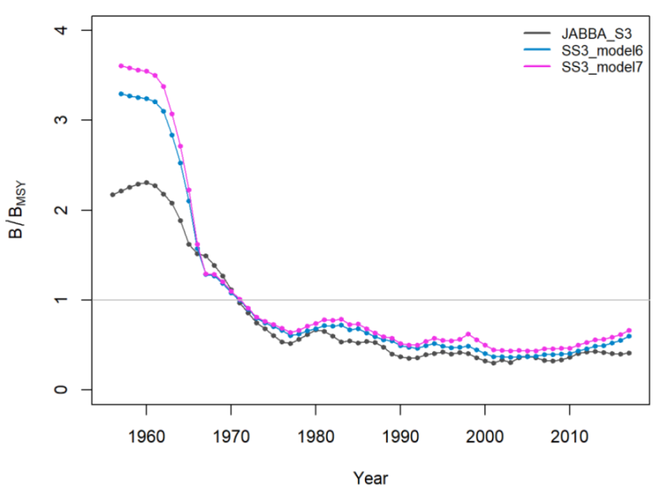
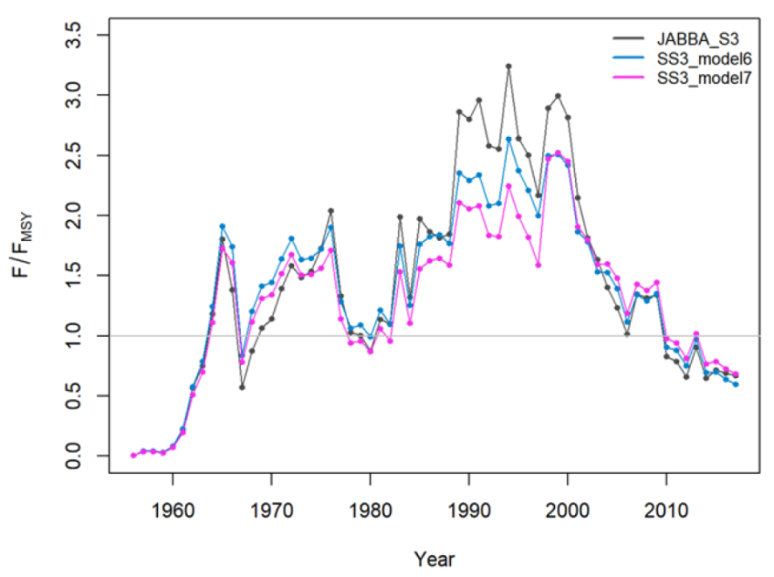
WHM State of the Stocks
2 types of models used:
  Surplus production models (JABBA)
  Integrated models (SS3):
    2 types of assumptions about discards
Relative Biomass
Relative fishing mortality

Slide 9

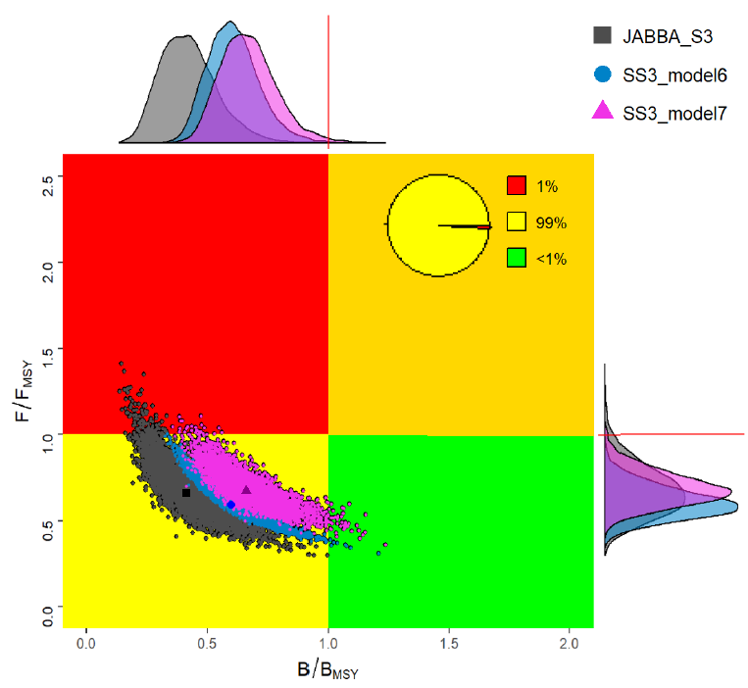
WHM State of the Stocks
The … stock of Atlantic white marlin was overfished but not undergoing overfishing.
High probability of being in the yellow quadrant of the Kobe plot (99%). Low probabilities of being in the red or green (<1%).
MSY is estimated at 1,495 t (95% confidence intervals: 1,316 t - 1,745 t)
… the Committee recognizes the high uncertainty with regard to data and productivity of the stock.
stock status (last data: 2017)

Slide 10
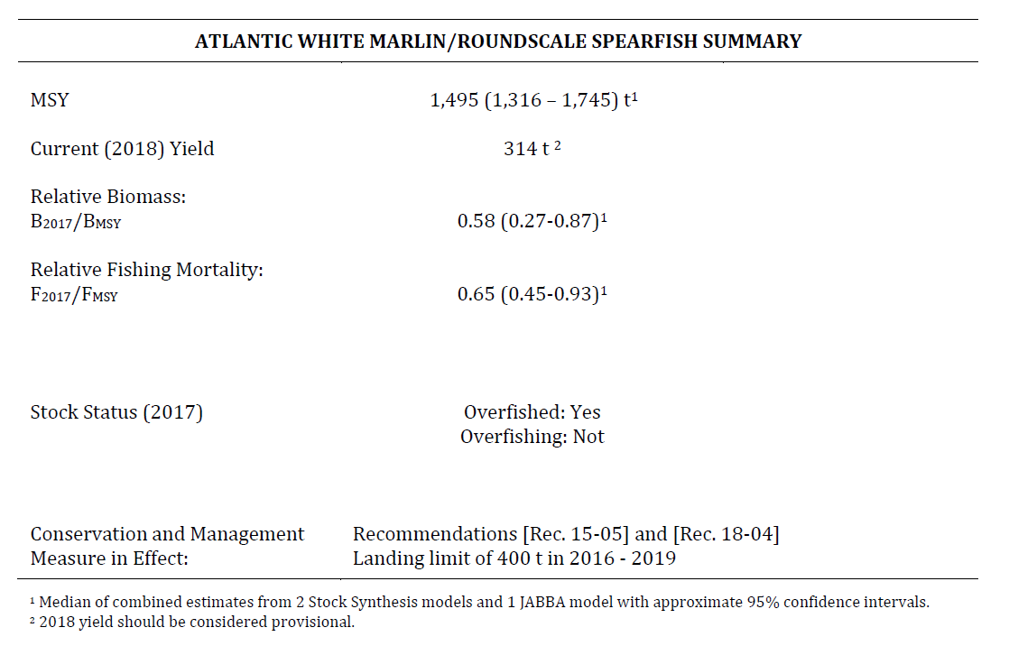
WHM Summary Table

Slide 11
WHM Effect of Current Regulations
On effects of current TAC
Latest plans to rebuild white marlin established annual limit of 400 t for white marlin/spearfish between 2016-2019 (Rec. 15-05, Rec. 18-04).
The Committee is concerned with the significant increase in the contribution from fishing by artisanal and small-scale fleets to the total white marlin harvest and that these fisheries are not fully accounted for in the current ICCAT statistics. Such data limitation precludes any analysis of the current regulations.
In addition, the Committee expressed concern of the status of white marlin due to the misidentification of spearfishes in the white marlin catches. This situation adds uncertainty to the stock assessment results.

Slide 12
WHM Effect of Current Regulations
On effects of circle hooks
Research has demonstrated that in some longline fisheries the use of non-offset circle hooks resulted in a reduction of billfish mortality, while the catch rates of several of the target species remained the same or were greater than the catch rates observed with the use of conventional J hooks or offset circle hooks.
On effects of live releases
The Committee noted that more countries have started reporting data on live releases in 2006. However, there is not enough information on the proportion of fish being released alive to evaluate the effectiveness of the ICCAT recommendation, relating to the live release of white marlin.

Slide 13
WHM Management recommendations
Recs 15-05 and 18-04 establish a TAC of 400 t for white marlin and all species of spearfish. This is inconsistent with the scientific advice, which includes only white marlin and round scale spearfish and not all species of spearfish.
  - Recommend that future management recommendations … be consistent with the scientific advice by explicitly stating only white marlin and round scale spearfish.
Measures should be taken to ensure that monitoring and reporting of all landings and discards, including live releases, are appropriate, accurate, and complete. This will likely require improvements to the observer programs of many CPCs, as well as the implantation of discard estimation methods using those data.
Efforts should be made, building on previous work, to fully account for the catches of artisanal and all recreational fisheries.
Notes:
Inability to accurately estimate fishing mortality will continue to compromise the Group’s ability to predict and monitor the stock’s recovery period. This is due to the inadequate reporting of discards, as well as the lack of reports from some artisanal and recreational fisheries that take marlin species.

Slide 14
WHM Management recommendations
Given the overfished status of the stock and the uncertainties in the data, including for both total removals and indices of abundance:
  - the Commission, at the minimum, should ensure that catches do not exceed current TAC until the stock has fully recovered.
Given that experimental research has demonstrated that in longline fisheries the use of circle hooks resulted in a reduction of marlin catch rates and haulback mortality, and noting that they have different impacts on both target and by-catch species; then to reduce the chance of exceeding any established TAC, the Commission should consider:
  - the use of non-offset circle hooks.
  - the release of all marlins that are alive at haul back in ways that maximize their survival.

Slide 15
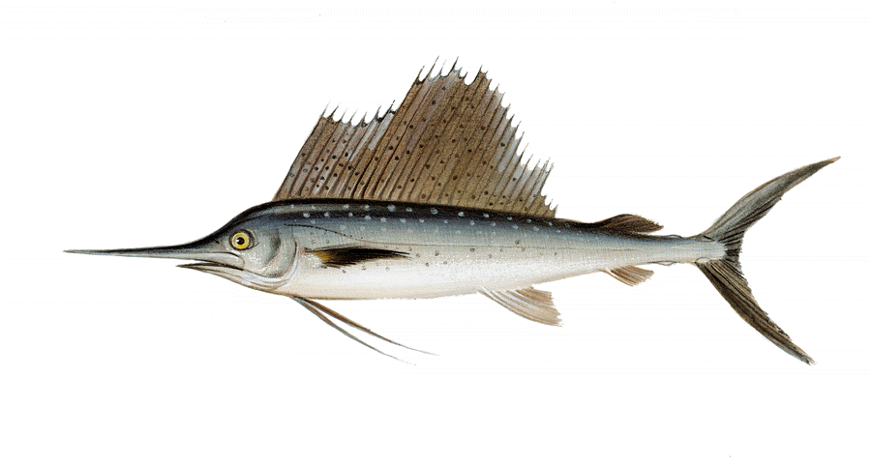
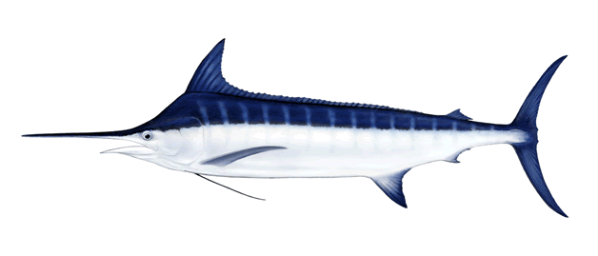
Other billfishes
Summary for other billfishes not assessed in 2019 (BUM and SAI)

Slide 16
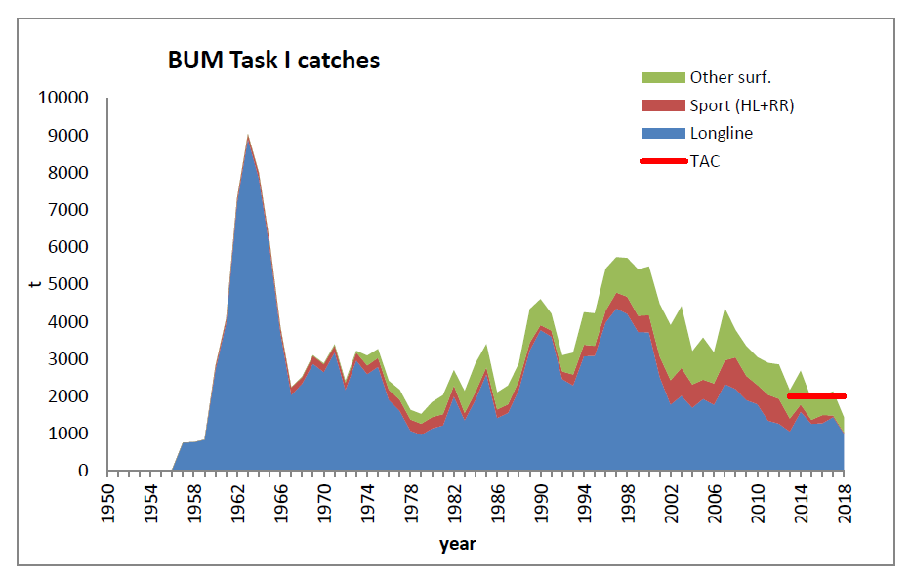
BUM Fishery Indicators
Catch (2018): 1,436 t
TAC (2018): 2,000 t
Annual catch by gear

Slide 17
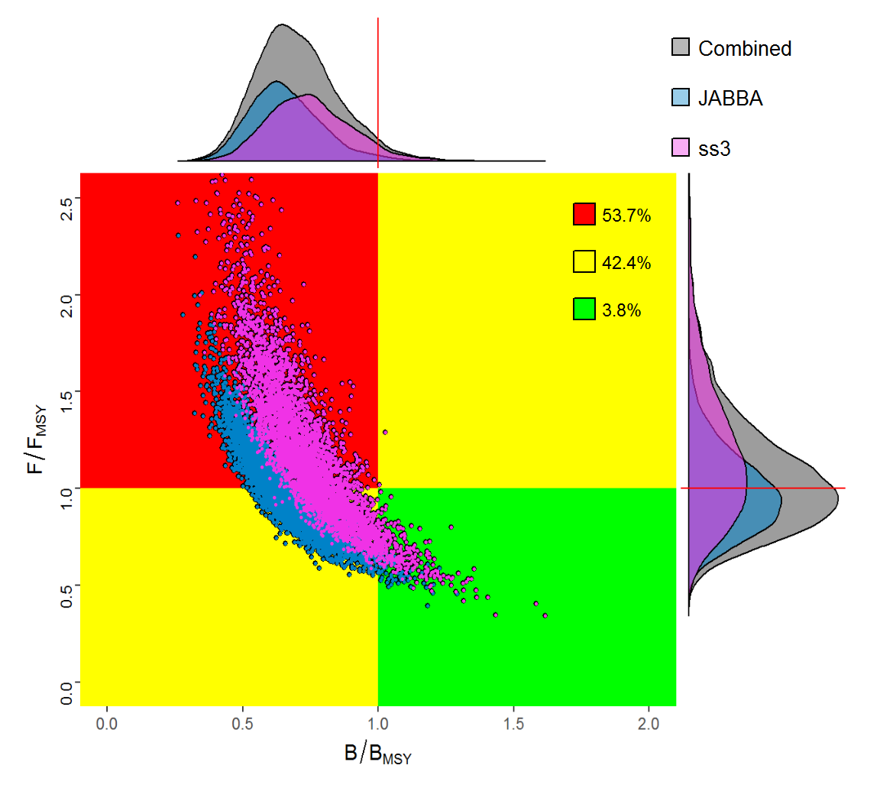
BUM State of the Stocks
Last assessment in 2018 (estimates of stock status for 2016)
Results showed that the stock was overfished and undergoing overfishing.
Stock status in 2016
Combined Kobe plot from production and integrated models
Notes:
The results of the 2018 assessment indicated that the current stock status is overfished and undergoing overfishing.
The estimated MSY was determined to be 3,001 t with 10% and 90% confident limits of 2,399 to 3,537 t
However, the Committee recognizes the high uncertainty with regard to data and the productivity of the stock.

Slide 18
BUM Management recommendations
The Committee recommends that the Commission should find ways to make sure that the catches are not allowed to exceed established TACs. Because the stock has not rebuilt catches need to be lower than the current TAC. Catches of 1,750 t or less are expected to provide at least a 50% chance of rebuilding by 2028.
The Committee recommends that if the Commission wants to further reduce fishing mortality and to reduce the chance of exceeding any established TAC, the Commission could consider doing so by modifying Rec. 15-05 (paragraph 2) so that fishermen are always required to release all marlins that are alive at haul back through methods that maximize their survival.

Slide 19
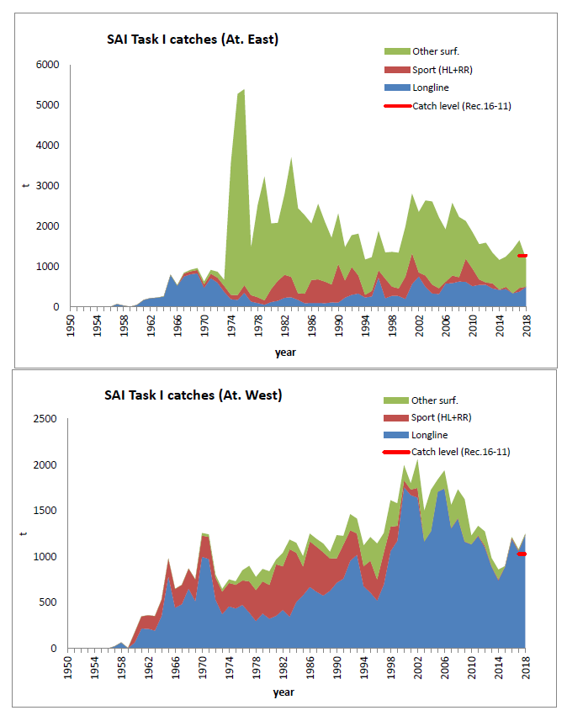
SAI Fishery Indicators
Annual catch by gear
EAST
East Stock
Catch (2018): 1,183 t
TAC (2018): 1,271 t
WEST
West stock:
Catch (2018): 1,250 t
TAC (2018): 1,030 t

Slide 20
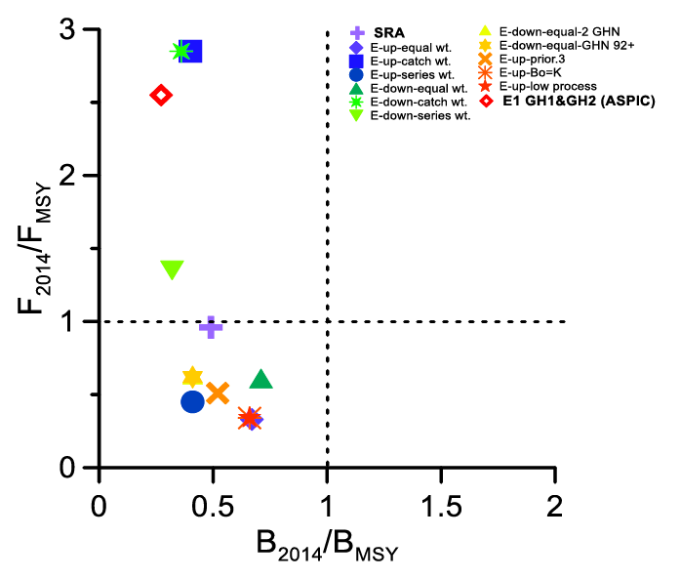
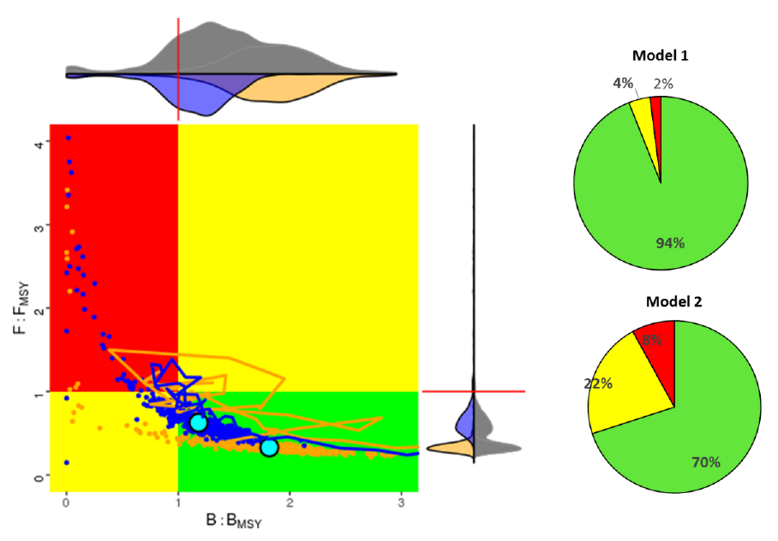
SAI State of the Stocks
EAST
WEST
Stock status in 2014
Last assessment in 2016 (estimates of stock status for 2014)
EAST: all scenarios considered the stock is overfished, but overfishing status is uncertain
WEST: both models indicated that the stock is neither overfished nor experiencing overfishing
Notes:
Models used:
EAST - Combined Kobe plot from a set production models and Stock Reduction Analysis
WEST - Combined Kobe plot two integrated SS3 models
Last assessment 2016 with estimates of stock status for 2014.
For the East all the scenarios considered for advice using the surplus production models indicated that the stock is overfished (0.27-0.71 BMSY), but overfishing status is uncertain (0.33-2.85 FMSY)
For the West both Stock Synthesis models indicated that the stock is neither overfished nor experiencing overfishing

Slide 21
SAI Effect of current regulations
[Rec. 16-11] establishes that if the total catch harvested any year exceeds 67% of the estimated MSY (1,271 t in the East and 1,030 t in the West),the Commission shall review the recommendation and effectiveness of this.
  East Atlantic: Catches in 2017 exceed this level, but preliminary catches in 2018 did not.
  West Atlantic: Catches in 2017 and preliminary catches in 2018 have exceeded this level.

Slide 22
BIL Responses to the Commission
19.3 Develop a new data collection initiative as part of the EPBR to overcome the data gap issues of those fisheries, in particular artisanal fisheries of developing CPCs. Rec. 18-04, paragraph 10.
CPCs shall provide their estimates of live and dead discards, and all available data including observer data on landings and discards for blue marlin, white marlin/spearfish, annually by 31 July as part of their Task I and II data submission to support the stock assessment process. The SCRS shall review the data and determine the feasibility of estimating fishing mortalities by commercial fisheries (including longline and purse seine), recreational fisheries and artisanal fisheries).
The Group did not have enough time for fully review the information regarding mortality of live discard for blue and white marlin/roundscale spearfish. Therefore, this item will be addressed in the workplan for 2020.

Slide 23
BIL Recommendations with financial implications
Enhanced Program for Billfish Research (EPBR) - The Group recommends continuing funding for the EPBR research activities for future years, to further improve knowledge gaps for the species and areas prioritized:
  Continue reproduction study of BUM in the Gulf of Mexico;
  Continue the growth study of the three priority BIL species in the eastern Atlantic;
  Workshop on growth and ageing techniques for BIL.
  Fund two regional workshops for statistical correspondents on artisanal fisheries data collection.
To develop a feasibility study on the development of an app for mobile phone to collect and report fisheries data on artisanal fisheries in collaboration with local scientific institutions.
Overall costs estimated at 152,000€

Slide 24
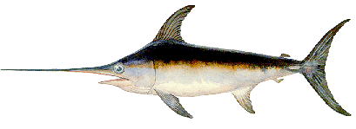
Swordfish Species Group
SWORDFISH
3 stocks (North Atlantic, South Atlantic, Mediterranean)

Slide 25
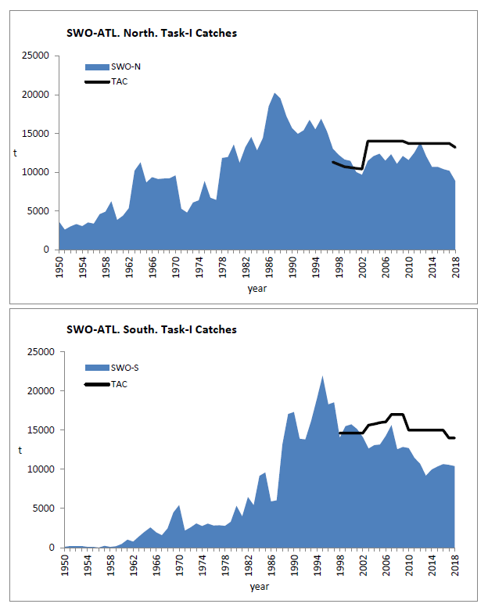
SWO Atlantic - Fishery Indicators
Atlantic Swordfish
North Atlantic:
Catch (2018): 8,858 t
TAC (2018): 13,200 t
South Atlantic:
Catch (2018): 10,404 t
TAC (2018): 14,000 t
Notes:
The status of the North and South Atlantic swordfish stocks was assessed in 2017, by means of applying statistical modelling to the available data up to 2015.
Complete information on the data availability and assessment can be found in the Reports of the 2017 ICCAT Swordfish Data Preparatory and Stock
Assessment Meetings

Slide 26
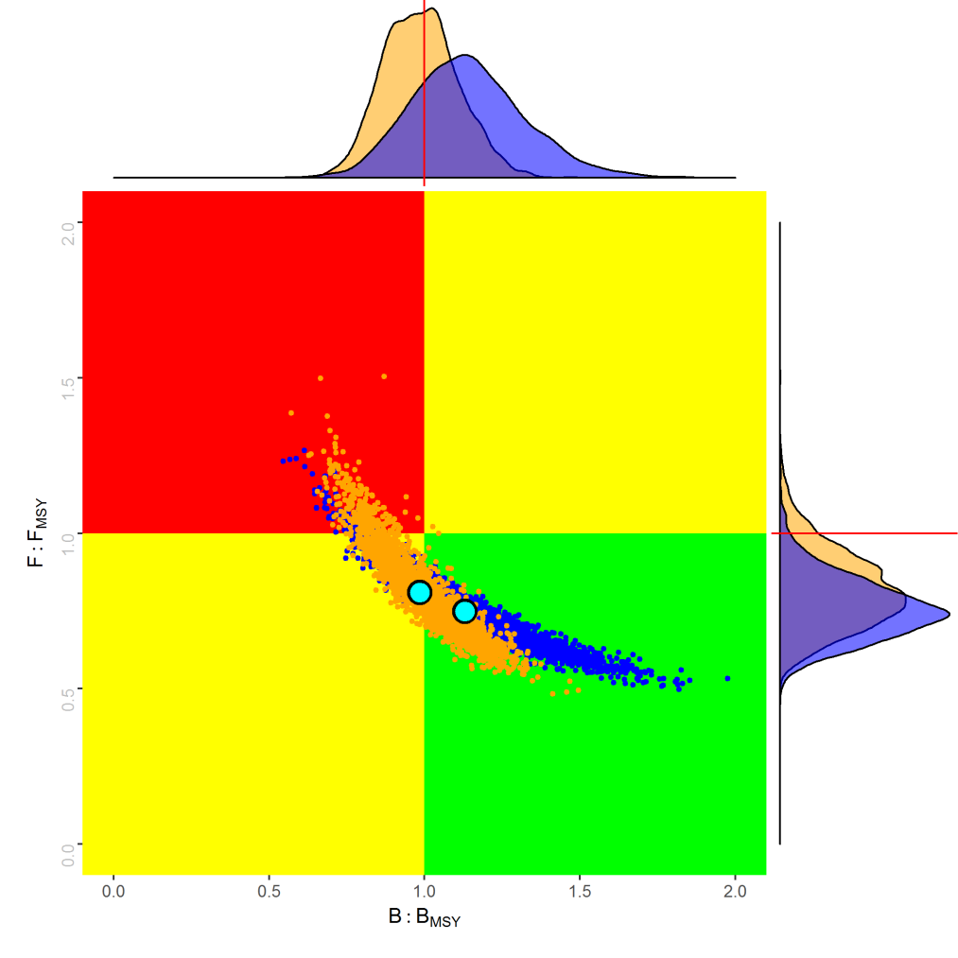
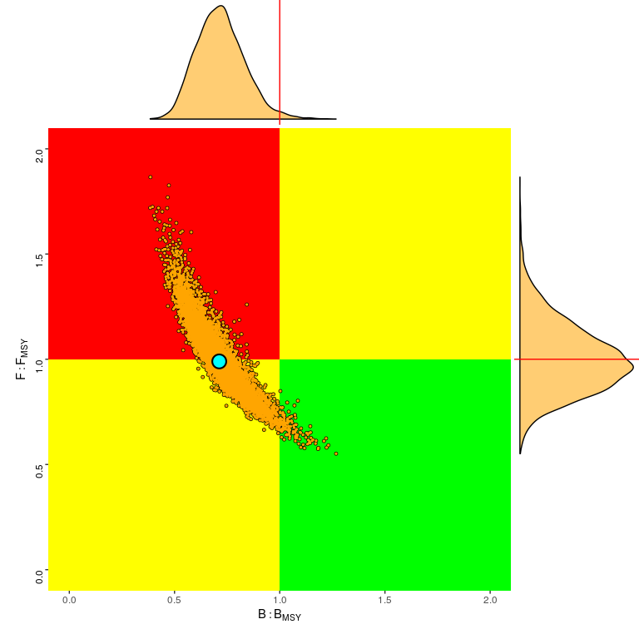
SWO State of the Stocks
Kobe plots from 2017 assessment
North Atlantic
South Atlantic
5%
2%
33%
51%
47%
61%
61% probability that stock is at or above MSY reference levels
Stock biomass is overfished; overfishing is either occurring or very close to occurring.
Notes:
Last assessment in 2017, data until 2015
Models used:
North - Production Model (JABBA - orange) and Integrated analysis (SS - blue)
South - Production Model (JABBA)

Slide 27
SWO Atl Management recommendations
North and South Atlantic Swordfish
The current TACs established by the Commission through Rec 17-02 and Rec 17-03 should ensure both stocks have at least a 50% probability of being in the green by 2028.
The SCRS recognizes that the above advice does not account for removals associated with the actual mortality of unreported dead and live discards, quota carryovers (15% in the North and 30% in the South Atlantic), quota transfers across the North and South stock management boundaries nor the total cumulative quota, which … would fall above the TAC if achieved.

Slide 28
MSE SWO-N
The main objective for 2019 was to advance the work on the overall framework and continue the technical specifications of the Operating Model (OM). A contractor was hired to work together with the SWO Species Group on this. Specific work and outputs done in 2019 (ongoing) was:
  Development of an SWO MSE R-package (code hosted in ICCAT Github).
  Draft MSE specifications document (living document) to reflect current assumptions and structure of the MSE process.
  Preliminary interactive application (R-Shiny) for presenting the MSE results.
For 2020 the workplan is for the SWO Species Group to continue the work with the contractor to finalize the OM conditioning with diagnostics and start work on development of Management Procedures (MPs).
Noting the progress done towards North Atlantic SWO MSE, the Committee recommends that the Commission continues to support this process.

Slide 29
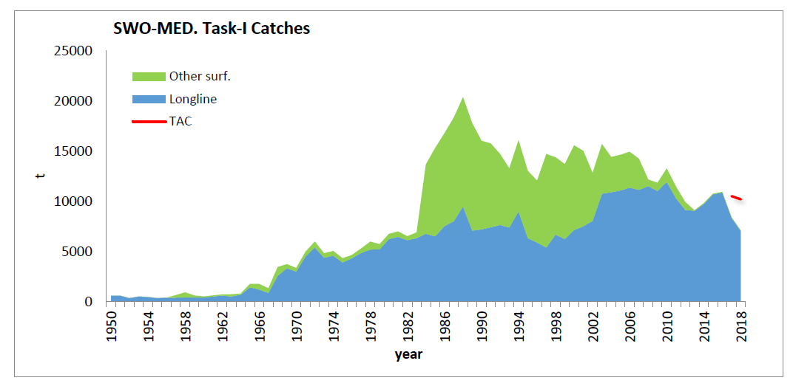
SWO Mediterranean Fishery Indicators
Mediterranean Swordfish
Catch (2018): 7,079 t
TAC (2018): 10,185 t

Slide 30
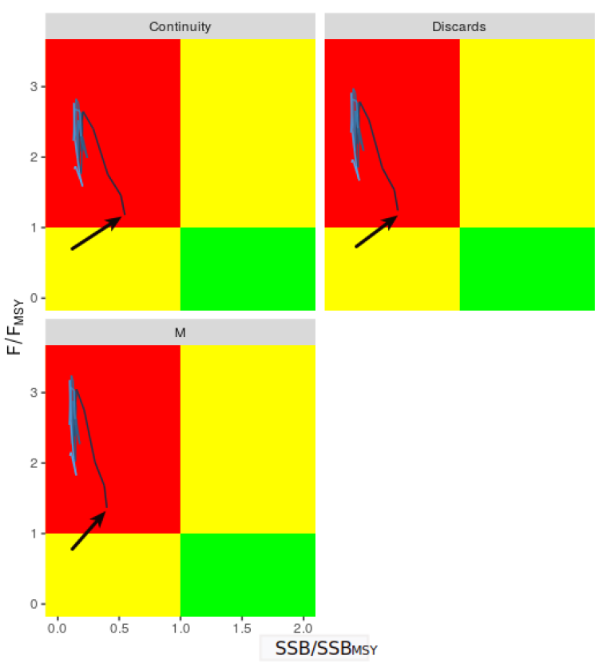
SWO Med State of the Stock
Kobe plots from 2016 assessment
Stock status from the 2016 assessment (data until 2015).
The stock was determined to be overfished and suffering overfishing.
Notes:
The Committee again noted the large catches of small size swordfish, i.e. less than 3 years old (many of which have probably never spawned) and the relatively low number of large individuals in the catches.
Fish less than three years old usually represent 50-70% of the total yearly catches in terms of numbers. A reduction of the volume of juvenile catches would improve yield per recruit and spawning biomass per recruit levels

Slide 31
SWO Mediterranean Management recommendations
In order for rebuilding to start taking place there will be a need for substantial reductions in harvest. Current quotas correspond to fishing mortality levels that are higher than FMSY.
Additionally, for the SCRS to be able to reduce uncertainty in regards to future recruitment, there will be a need to increase monitoring of landings and discards, also taking into account that since the establishment of minimum catching sizes, the discard levels of undersized swordfish may have increased.
Further information regarding differences in the exploitation pattern among the different longline gears is also essential for improving assessment estimates and management scenario evaluations
Commission established [Rec. 16-05] by increasing catching size, fishing capacity limitations, reductions in TACs [10,185 t in 2018] and a seasonal closure of the albacore fishery to reduce juvenile swordfish by-catches.
Notes:
Recommendations have not changed since the last assessment (2016)
Rec 16-05 mandates that Over the period 2018-2022, the TAC should be gradually reduced by 3% each year

Slide 32
Responses to the Commission
19.4 Updated assessment of the state of the Mediterranean swordfish stock on the basis of the most recent data available. Rec. 16-05, paragraph 45
An updated assessment has been foreseen in 2020 and this may allow to evaluate the effectiveness of the Recovery plan ….
Recent studies suggest that the adopted minimum size results in a high number of undersized dead discards.
The Committee showed concern that such discards are not being fully reported and reiterated that all dead discards should be reported in Task I NC for all fisheries.

Slide 33
SWO Recommendations with financial implications
Applied to all stocks (Atlantic and Mediterranean)
SWO Biology and stock structure project - This recommendation applies to both the North and South Atlantic and Mediterranean stocks: the Group recommends as high priority to continue funding of the project for biological studies on swordfish. The estimated costs for continuing the work in 2020 would be €280,000.
Specific for the North Atlantic SWO
MSE timeline and funding: The Group recommended funding for continuing the swordfish MSE work at least over the next 2-year period. The Group … recommended that the MSE timeline is extended. Funds requested for 2020 to continue this work are €90,000.
Specific for the Mediterranean SWO
Data recovery plan: the Committee recommended conducting a recovery of historical data, so that the entire history of the fishery is taken into account in the stock assessment models. Cost is estimated to be up to €10,000.

Slide 34
SMT - Small Tunas
BLF
SSM
LTA
BON
BLT
FRI
…and 7 more species
Notes:
They range in maximum size from more than 2 meters (wahoo) to just over half a meter (frigate tuna)

Slide 35
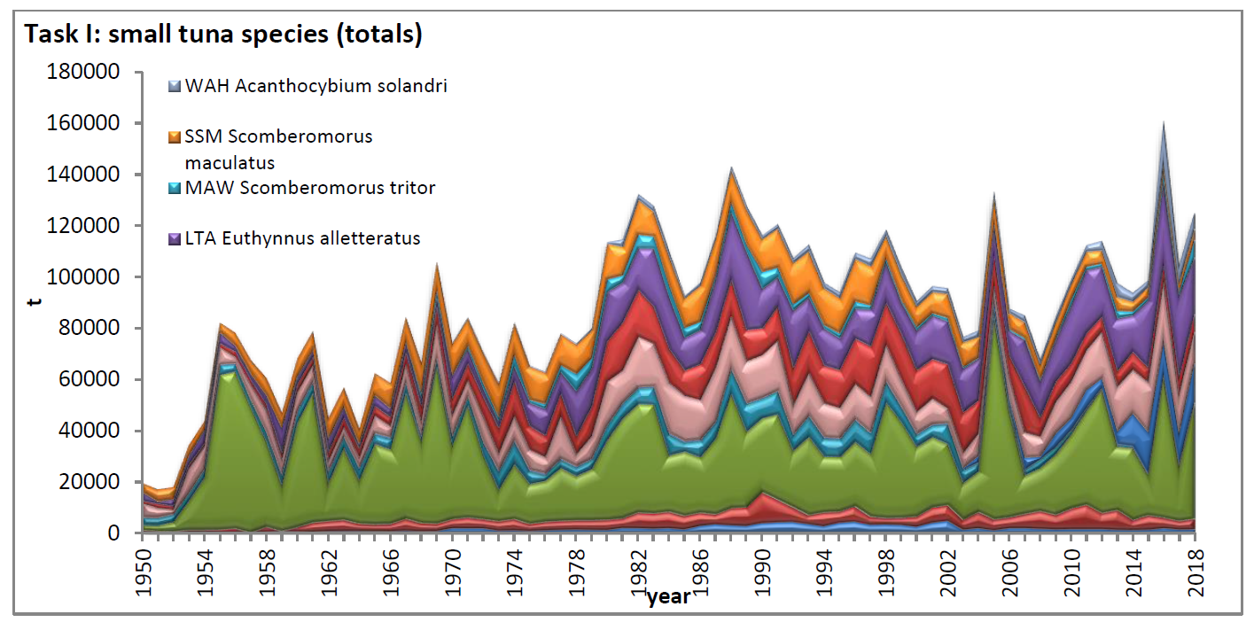
Small Tunas Fishery Indicators
Small tunas catches
Small tunas can reach high levels of catches and values in some years;
High relevance from a social and economic point of view;
Important for many coastal communities and a main source of food;
Likely underestimation of total landings, due to the difficulties in data collection.
Notes:
The 13 species of small tuna can reach high levels of catches and values in some years
Those species can have a very high relevance from a social and economic point of view, because they are important for many coastal communities in all areas and a main source of food.
Their social and economic value is often not evident because of the underestimation of the total landing figures, due to the difficulties in data collection…

Slide 36
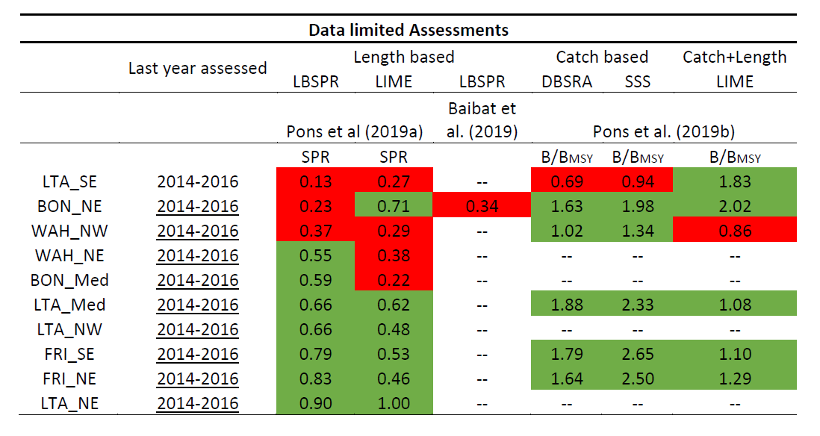
SMT State of the Stocks
State of the stocks is determined with a series of data-limited approaches (length based, catch based and integrated approaches).
In 2019 this was applied to 10 stocks: At this stage, LTA_SE and WAH_NW show some signs of overfishing, deserving special attention in the future.
Notes:
How are the Small tunas being assessed (data limited approaches):
- 2016-2017: Productivity/Susceptibility analysis - Defined species with high vulnerability
- 2018: First attempts for length-based Data-Limit models; evaluation of data-limited approaches
- 2019: Pons et al (2019):
- Applied Length Based Spawning Potential Ratio – LBSPR
- Length-based Integrated Mixed Effects – LIME
Note that catch data is highly unreliable, so at this point more trust is put in the length based models

Slide 37
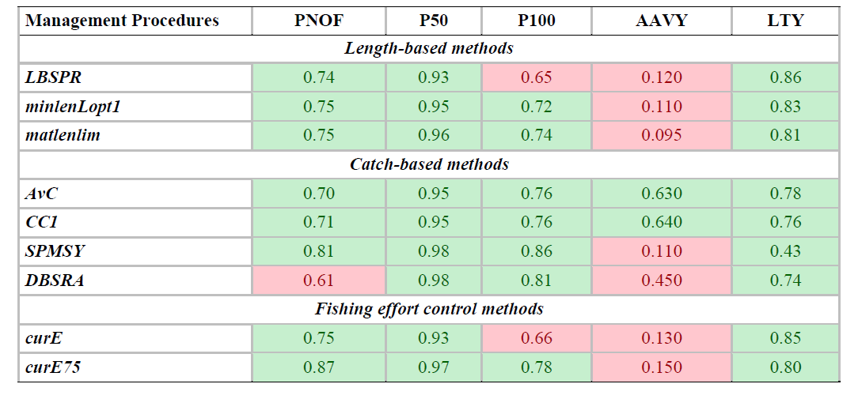
SMT State of the Stocks
Preliminary data-limited MSE for NW-WAH
Color cells coding used to denote if the particular MP falls within acceptable performance metric criteria.
Notes:
SMT-Table 4.
Summary of the Northwest Atlantic wahoo management strategy evaluation results for selected MPs using the DLMtool package (from SCRS/2019/041). Color cells coding is used to denote if the particular MP falls within acceptable performance metric criteria (green – acceptable and red – not satisfied). Probability of not overfishing (PNOF; F<FMSY); probability of spawning biomass being higher than half of spawning biomass at maximum sustainable yield (P50; SB>0.5 SBMSY); probability of spawning biomass being higher than spawning biomass at maximum sustainable yield (P100; SB>SBMSY);probability of average annual variability in yield being lower than 20% (AAVY; Prob. AAVY < 20%); probability of average yield being higher than half of reference yield (LTY; Prob. Yield > 0.5 Ref. yield). Acceptable management procedures were defined as those that supported PNOF>70%, P50>90%, P100>70%, AAVY>50% and LTY>50%.

Slide 38
SMT Management recomendations
Currently, management recommendations are not yet provided for small tunas.
The provision of robust management advice by the SCRS relies on accurate reporting of Task I and II data and life history parameters. However, due to the nature of small tuna fisheries (i.e. multi-gear, multi-species, artisanal fisheries, etc.), information on fisheries data is difficult to collect, however proper monitoring programs should be implemented by the CPCs.
Although the Group has improved in applying a range of Data-limited models, the robustness still needs to be evaluated before they can be used to provide management advice to the Commission.

Slide 39
SMT Recommendations with financial implications
Continuing support to the Small Tunas Year Program (SMTYP): The Group recommends continuing with the ICCAT SMTYP research program activities in 2020 to further improve the biological information (growth, maturity and stock identification) for the species/areas prioritized. The requested budget is €100,000.
Workshop for ageing and reproduction: Costs are estimated at €20,000.
Regional workshop for small tunas data-limited MSE: Costs estimated at €20,000.
AOTTP funding for additional tagging of wahoo and little tunny: Recommendation that within the AOTTP program, financial support be provided for additional inexpensive tagging of wahoo in the Canary Islands and little tunny in the Gulf of Cadiz and Alboran Sea (Portugal and Spain). Estimated costs are €20,000.
Revision of the ICCAT manual for small tunas species: Recommendation to extend the species description chapters of the ICCAT Manual for other small tuna species (most species last updated in 2006). Estimated costs are €5,000.

Slide 40
Sharks
SMA
BSH
POR
…and 21 more species (sharks and rays)
Notes:
Blue shark, shortfin mako and porbeagle are large pelagic sharks that the SCRS has assessed those with more traditional fishery assessment models.
The SCRS has conducted an Ecological Risk Assessment for these and another 13 Atlantic shark species ( a total of 20 stocks).
New ICCAT convention amendment has a list of 24 species (sharks and rays) that are oceanic, pelagic and highly migratory.
But the 3 main ones (BSH, SMA and POR) constitute the majority of the catches in ICCAT

Slide 41
2019 SMA projections
2019 updated projections for North Atlantic shortfin mako (SMA)
Sharks inter-sessional meeting
(Madrid, 20-24 May, 2019)

Slide 42
SMA Stock Status
2017 stock status from production models and integrated analysis (SS)
10%
North Atlantic
South Atlantic
38%
28%
90%
34%
stock status
in 2015
stock status
in 2015
F/Fmsy
F/Fmsy
B/Bmsy
B/Bmsy

Slide 43
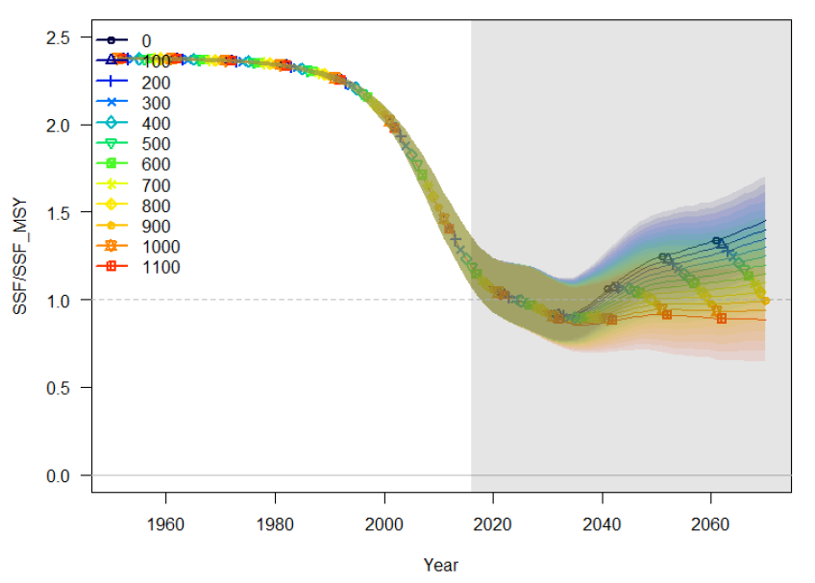
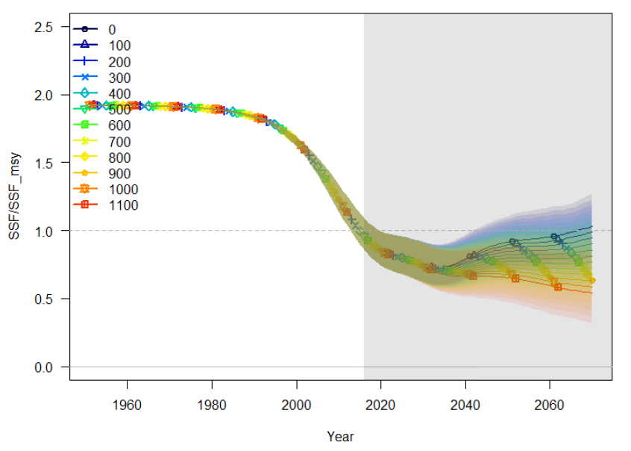
SMA updated projections
North Atlantic shortfin mako
In 2019, projections for the North Atlantic were carried out with Stock Synthesis.
Projections carried out to 2070 to incorporate two generation times.
Combination of two models, to reflect two hypothesis about productivity of the stock.
Notes:
In 2019, projections for the North Atlantic were carried out with Stock Synthesis only. The Committee noted that because the fishery mainly focuses on juvenile animals, the production models (BSP2JAGS and others) are only tracking juvenile abundance and thus the projections are not informative about trends in the mature population, which would lag behind the trends in the exploitable population by the number of years it takes new recruits to reach maturity.

Slide 44
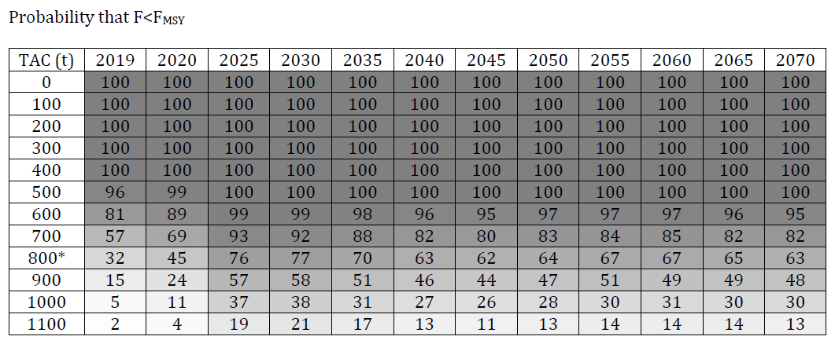
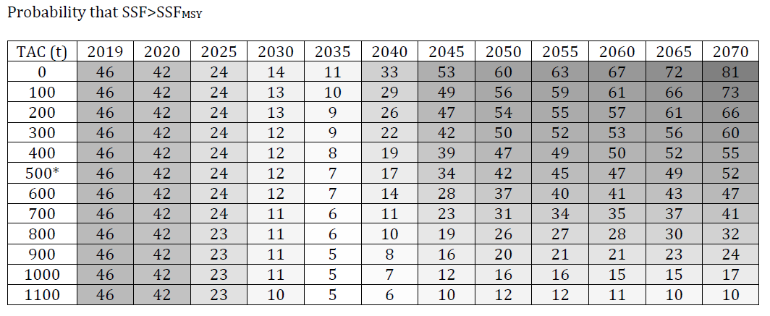
SMA updated projections
North Atlantic shortfin mako
Probability F < Fmsy
Probability SSF > SSFmsy
Notes:
Note that for sharks due to their life history, SSF (spawning stock fecundity) is used as a proxy for mature female biomass

Slide 45
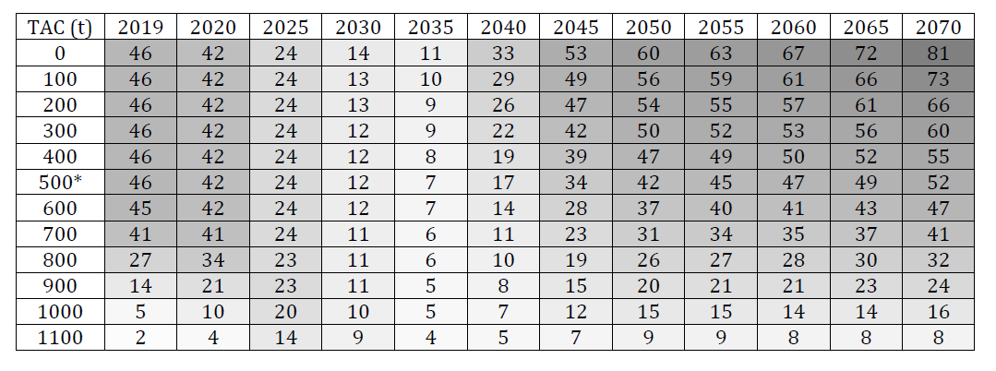
SMA updated projections
Joint probabilities
(F<Fmsy & SSF>SSFmsy)
i) a zero TAC will allow the stock to be rebuilt and without overfishing (in the green quadrant of the Kobe plot) by 2045 with a 53% probability;
ii) regardless of the TAC (including a TAC of 0 t), the stock will continue to decline until 2035 before any biomass increases can occur;
iii) a TAC of 500 t, including dead discards has only a 52% probability of rebuilding the stock to the green quadrant in 2070;
iv) to be in the green quadrant of the Kobe plot with at least 60% probability by 2070, the realized TAC has to be 300 t or less;
v) lower TACs achieve rebuilding in shorter time frames;
vi) a TAC of 700 t would end overfishing immediately with a 57% probability, but this TAC would only have a 41% probability of rebuilding the stock by 2070.
Notes:
Although there is large uncertainty in the future productivity assumption for this stock, the projections show that there is a long lag time (ca. 20 years) between when management measures are implemented and when stock size starts to rebuild due to the biology of the species.
The Committee emphasized that the Kobe II Strategy Matrix (K2SM) does not capture all the uncertainties associated with the fishery and the biology of the species.
In addition, the length of the projection period (50 years) requested by the Commission implies that estimates at the end of the projection period are highly uncertain. Therefore, the Committee advised that the results of the K2SM should be interpreted with caution. In particular, if the decrease in mature females is related not only to the catch of immature females, but to other, unknown causes, the management measures above may not lead to the recovery of the stock.

Slide 46
Effects of current regulations
The Committee reviewed the probability of success of several of the measures contemplated in ICCAT Rec. 17-08 through additional projections for shortfin mako. Specifically, alternative TAC, minimum size limit, and live release measures were explored with two tools: Stock Synthesis and the Decision Support Tool (DST).
The Committee noted that fixed TACs with size regulations (210 cm fork length for females and 180 cm fork length for males) accelerated stock recovery. However, these projections implicitly assumed that fish released below the size limit had 100% post-release survival.
The Committee also explored the effect of live release regulations (through reduction in fishing mortality but considering a post-release mortality rate of 25%) and found that all scenarios resulted in population declines until 2035 … and that the biomass that supports MSY was only reached by 2070 for the fishing mortality equal zero scenario.
Notes:
Work on the exceptions of 17-08:
Using SS projections, the Group examined the combined effects of size limits and different TACs. The results indicated that hypothetically, a minimum size regulation that is applied to the whole fishery could be a useful tool to increase the speed of the recovery under management by TAC provided that discard mortality is low.
Using SS projections, the Group also examined the effect of live release (through reductions in F) , finding that live release management measures alone are unlikely to be sufficient to rebuild the stock to the target within the projected period. They could be a way to reduce F only if discard mortality rates are low, but other management measures such as reduction of soak time, time-area closures, and safe handling and best practices for the release of live sharks may also be required.
Using the DST projections, if fishers are unable to avoid catching shortfin mako sharks, and the ones that are discarded have a substantial mortality rate, then it is necessary to greatly decrease the retained catch to allow the population to rebuild. The weight of dead discards is dependent on retention rates and discard mortality rates; thus, it is critical to estimate these parameters accurately for all fleets.

Slide 47
Effects of current regulations
Projections with DST revealed that if fishers are unable to avoid catching shortfin makos and those discarded have a substantial mortality rate, then it is necessary to greatly decrease the retained catch to allow the stock to rebuild. Size limits and other strategies to release live sharks must be accompanied by a reduction in retained catch.
The Committee thus concluded that a live release approach may be a way to reduce F if discard mortality rates are low, but other management measures such as reduction of soak time, time-area closures, and safe handling and best practices for the release of live specimens may also be required to further reduce incidental mortality.
The Committee also noted that a slot limit that protects some mature age groups may be appropriate, although selectivity on those ages is low.
Notes:
Work on the exceptions of 17-08:
Using SS projections, the Group examined the combined effects of size limits and different TACs. The results indicated that hypothetically, a minimum size regulation that is applied to the whole fishery could be a useful tool to increase the speed of the recovery under management by TAC provided that discard mortality is low.
Using SS projections, the Group also examined the effect of live release (through reductions in F) , finding that live release management measures alone are unlikely to be sufficient to rebuild the stock to the target within the projected period. They could be a way to reduce F only if discard mortality rates are low, but other management measures such as reduction of soak time, time-area closures, and safe handling and best practices for the release of live sharks may also be required.
Using the DST projections, if fishers are unable to avoid catching shortfin mako sharks, and the ones that are discarded have a substantial mortality rate, then it is necessary to greatly decrease the retained catch to allow the population to rebuild. The weight of dead discards is dependent on retention rates and discard mortality rates; thus, it is critical to estimate these parameters accurately for all fleets.

Slide 48
Effects of current regulations
2019 is the first full year during which Rec. 17-08 applies. The Committee will not be able to review 2019 shortfin mako catches until after 31 July 2020 (noting that it will provide the Committee with only one year of data).
The Committee had insufficient information to determine which ICCAT recommendations regarding possible conservation measures (Rec. 17-08) were implemented for which fleet, making it difficult to evaluate the effect of the possible conservation measures by fleet in the projections. Nevertheless, a general evaluation of the effect of the conservation measures was undertaken which showed that they are insufficient to rebuild the stock within the specified timeframe.
Notes:
Work on the exceptions of 17-08:
Using SS projections, the Group examined the combined effects of size limits and different TACs. The results indicated that hypothetically, a minimum size regulation that is applied to the whole fishery could be a useful tool to increase the speed of the recovery under management by TAC provided that discard mortality is low.
Using SS projections, the Group also examined the effect of live release (through reductions in F) , finding that live release management measures alone are unlikely to be sufficient to rebuild the stock to the target within the projected period. They could be a way to reduce F only if discard mortality rates are low, but other management measures such as reduction of soak time, time-area closures, and safe handling and best practices for the release of live sharks may also be required.
Using the DST projections, if fishers are unable to avoid catching shortfin mako sharks, and the ones that are discarded have a substantial mortality rate, then it is necessary to greatly decrease the retained catch to allow the population to rebuild. The weight of dead discards is dependent on retention rates and discard mortality rates; thus, it is critical to estimate these parameters accurately for all fleets.

Slide 49
SMA Management recommendations
North Atlantic stock
Given the vulnerable biological characteristics of this stock and the pessimistic projections, to accelerate the rate of recovery and to increase the probability of success the Committee recommends that the Commission adopt a non-retention policy without exception in the North Atlantic as it has already done with other shark species caught as bycatch in ICCAT fisheries.
Reporting all sources of mortality is an essential element to decrease the uncertainty in stock assessment results, and particularly the report of estimated dead discards for all fisheries. Although the reporting of dead discards is already part of the ICCAT data reporting obligations (Rec. 17-08), the requirement has been ignored by many CPCs.
Notes:
Work on the exceptions of 17-08:
Using SS projections, the Group examined the combined effects of size limits and different TACs. The results indicated that hypothetically, a minimum size regulation that is applied to the whole fishery could be a useful tool to increase the speed of the recovery under management by TAC provided that discard mortality is low.
Using SS projections, the Group also examined the effect of live release (through reductions in F) , finding that live release management measures alone are unlikely to be sufficient to rebuild the stock to the target within the projected period. They could be a way to reduce F only if discard mortality rates are low, but other management measures such as reduction of soak time, time-area closures, and safe handling and best practices for the release of live sharks may also be required.
Using the DST projections, if fishers are unable to avoid catching shortfin mako sharks, and the ones that are discarded have a substantial mortality rate, then it is necessary to greatly decrease the retained catch to allow the population to rebuild. The weight of dead discards is dependent on retention rates and discard mortality rates; thus, it is critical to estimate these parameters accurately for all fleets.

Slide 50
SMA Management recommendations
North Atlantic stock
The Committee indicated that additional measures can potentially further reduce incidental mortality, including safe handling and best practices for the release of live specimens (since post release survival can reach 77%).
There will be a need for CPCs to strengthen their monitoring and data collection efforts by species to monitor the future status of the stocks, including but not limited to total estimated dead discards and the estimation of CPUEs using observer data.

Slide 51
SMA Management recommendations
South Atlantic stock
Given that fishery development in the South predictably follows that in the North and that the biological characteristics of the stock are similar, there is a significant risk that this stock could follow a similar history to that of the North stock.
If the stock declines it will, like the North stock, require a long time for rebuilding even after significant catch reductions.
To avoid this situation and considering the uncertainty in the stock status, the Committee recommends that, at a minimum catches should not exceed the minimum catch in the last five years of the assessment (2011-2015; 2,001 t with catch scenario C1 [Task I catches]).

Slide 52
Responses to the Commission
19.5 Review the effectiveness of the measures contained in Rec. 17-08 and provide the Commission with additional scientific advice on conservation and management measures for North Atlantic shortfin mako. Rec. 17-08, paragraph 10
Although the exceptions contemplated in Rec. 17-08 were only partially implemented in 2018, continued fishing at the current catch (2,388 t in 2018) will not allow the stock to rebuild by 2070 and overfishing will continue.

Slide 53
Responses to the Commission
an evaluation of whether the measures contained in this recommendation have prevented the population from decreasing further (parag. 10 a, b):
  Full implementation of the measure only happened in 2019 and it is not clear what fleets have implemented what components of the measure.
a spatial/temporal analysis of North Atlantic shortfin mako catches in order to identify areas with high interactions (parag. 10 a):
  The resolution of data submitted to ICCAT does not allow the identification of areas of high interactions that would be practical for the implementation of closed areas. Higher resolution spatial catch and effort data would be necessary to identify areas that could be closed with a high probability of protecting mako shark and minimize negative impacts on the target species.

Slide 54
Responses to the Commission
available information on growth and size at maturity by sex as well as any biologically important areas (e.g. pupping grounds) (parag.10 b):
  Available information on growth and size at maturity by sex was incorporated into the projections. Ongoing research confirms size at maturity estimates by sex that were used in the projections. Biologically important areas (e.g. pupping grounds) were not considered.
the effectiveness of the use of circle hooks as a mitigation measure to reduce mortality (parag. 10 c):
  There is ongoing research that is investigating the effectiveness of the use of circle hooks as a mitigation measure to reduce at-vessel mortality.

Slide 55
Other sharks
Summary for other sharks
(not assessed in 2019)
POR
BSH
…and 21 more species (sharks and rays)

Slide 56
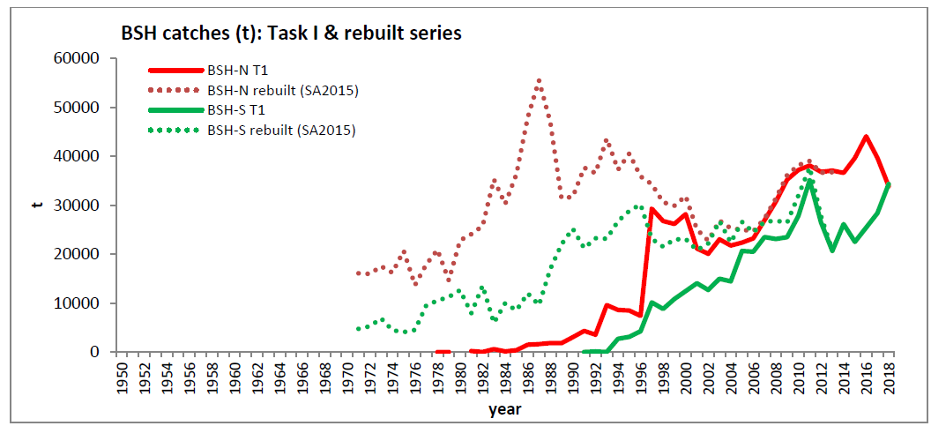
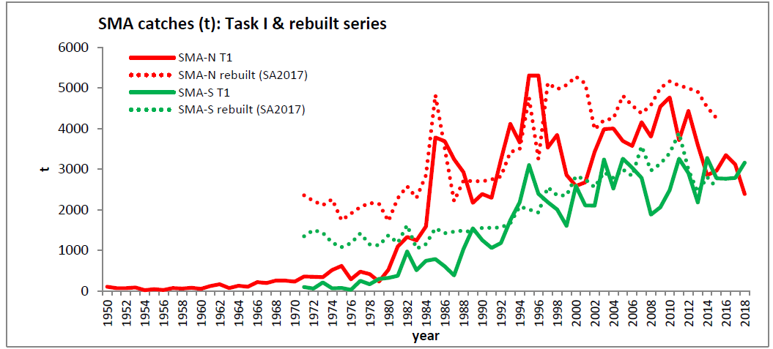
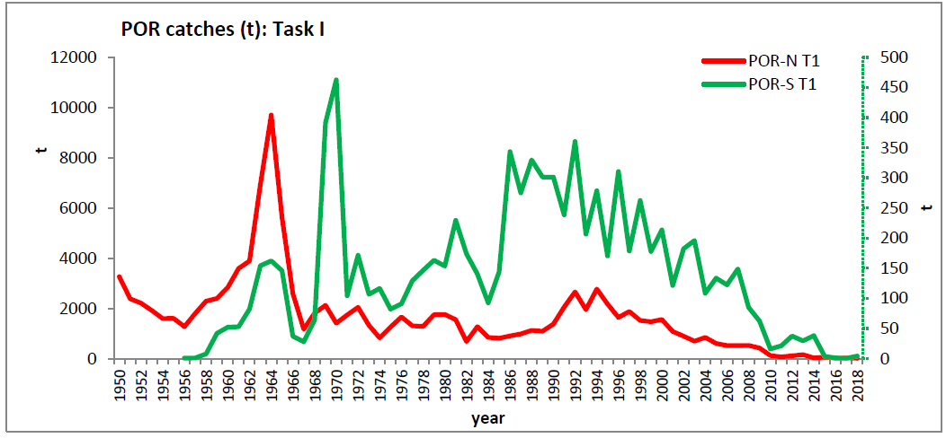
Sharks Fishery Indicators
Blue shark
General notes on shark statistics:
Global statistics on shark have improved;
… but are still insufficient to provide quantitative advice on stock status for most stocks (except BSH, SMA and POR) with sufficient precision to guide fishery management toward optimal harvest levels.
Shortfin mako
Porbeagle

Slide 57
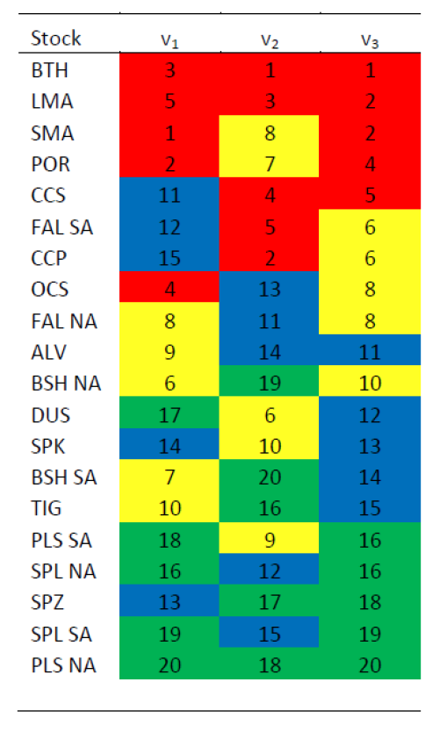
Sharks Stock Status
Ecological Risk Assessment (2012)
Vulnerability rank for 20 stocks of pelagic sharks and rays: A lower rank indicates higher risk. Stocks listed in decreasing risk order according to the sum of the three indices. Red highlight indicates risks scores 1-5; yellow, 6-10; blue, 11-15; and green, 16-20.
Main results:
Most vulnerable stocks: bigeye thresher, longfin and shortfin makos, porbeagle, and night sharks.
Lowest vulnerabilities: scalloped hammerheads, smooth hammerhead and pelagic stingray

Slide 58
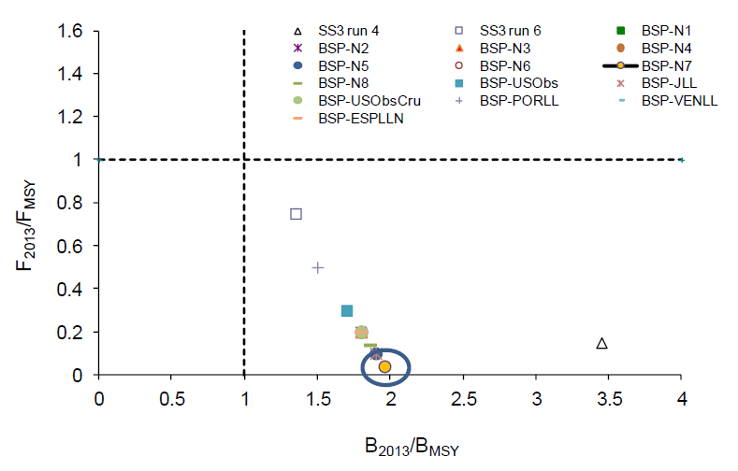
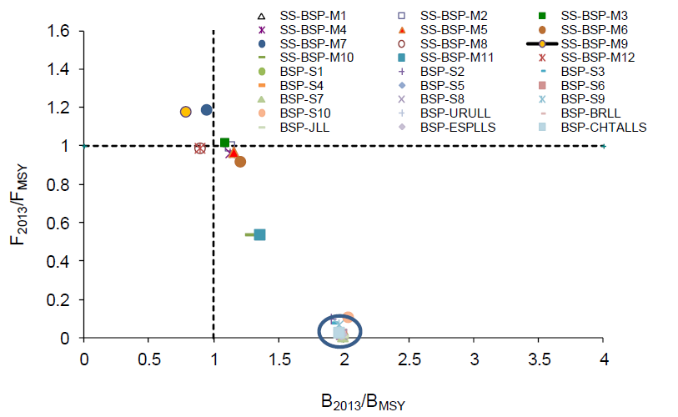
BSH Stock Status
Blue shark stock status, from production models and integrated analysis (SS3)
North Atlantic
South Atlantic
Last assessed in 2015
Last data (stock status) refers to 2013)
Notes:
The circles in the plots denotes common status for several BSP runs

Slide 59
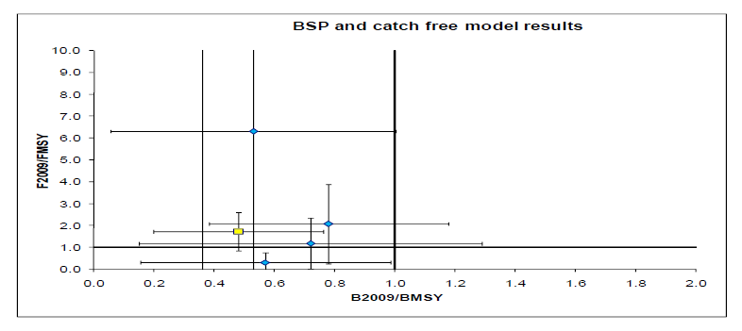
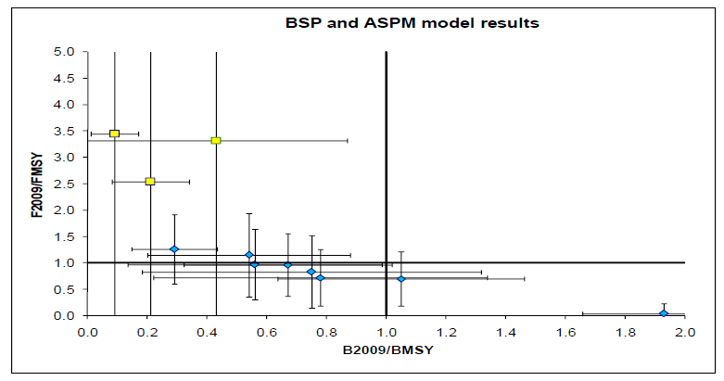
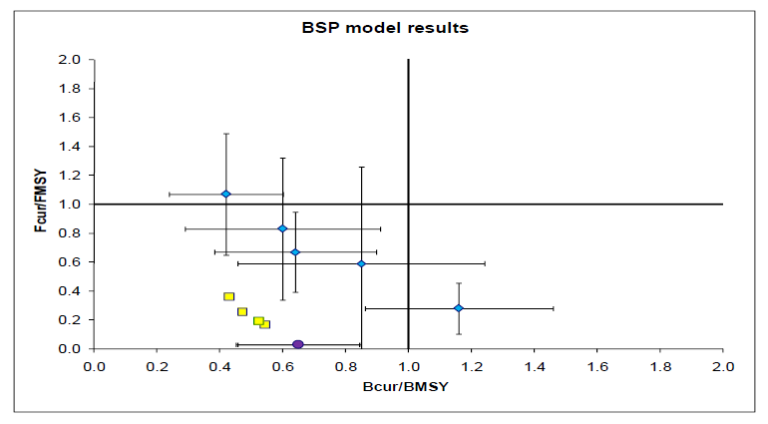
POR Stock Status
Southwest Atlantic
Porbeagle stock status, from production models and data-limited models
Last assessed in 2011
Stock status refers to 2009
Northeast Atlantic
Northwest Atlantic

Slide 60
Sharks Management recommendations
General recommendations for sharks
Precautionary management measures should be considered particularly for stocks where there is the greatest biological vulnerability and conservation concern, and for which there are very few data and/or great uncertainty in assessment results.
the Committee strongly urges CPCs to provide the corresponding statistics, including discards (dead and alive), of all ICCAT fisheries, including recreational and artisanal fisheries….
The Committee reiterates that the CPCs provide estimates of shark catches in both ICCAT and non-ICCAT fisheries for species that are oceanic, pelagic, and highly migratory within the ICCAT Convention area.
The magnitude of shark entanglements in FADs should be investigated. Methods for mitigating shark by-catch in fisheries also need to be investigated and applied.

Slide 61
BSH Management recommendations
Blue shark
South Atlantic stock
the Committee strongly recommends that the Commission considers a precautionary approach for this stock.
If the Commission chose to use the same approach taken for the North Atlantic stock, the average catch of the final five years used in the assessment model (28,923 t for 2009-2013) could be used as an upper limit
North Atlantic stock
uncertainty in the data inputs and model structural assumptions was high enough to prevent the Committee from reaching a consensus on a specific management recommendation.

Slide 62
POR Management recommendations
Porbeagle
The Commission work with countries catching porbeagle and relevant RFMOs to ensure recovery of North Atlantic porbeagle stocks (e.g. ICES, NAFO).
In particular, porbeagle fishing mortality should be kept at levels in line with scientific advice and with catches not exceeding the current level.
New targeted porbeagle fisheries should be prevented, porbeagles retrieved alive should be released following best handling practices to increase survivorship, and all catches should be reported.
Management measures and data collection should be harmonized as much as possible among all relevant RFMOs dealing with these stocks, and ICCAT should facilitate appropriate communication.

Slide 63
SHK Recommendations with financial implications
Provide funding for the SRDCP for Year 6 (€125,000) to complete work on South Atlantic shortfin mako age and growth, shortfin mako genetics, continue work on the reproductive biology of porbeagle and shortfin mako, and continue work on movement and habitat characterization of silky, oceanic whitetip, and hammerhead sharks through satellite tagging.
Recommend designing and implementing a study to compare the effects of circle versus J hooks on retention rates, catch rates, and at haulback mortality of sharks. The experimental design should account for the influence of leader material types (wire vs nylon) and consider possible regional and fleet operational differences.

Slide 64
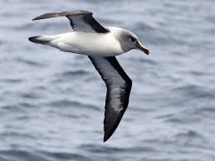

By-catch issues
Sub-committee on Ecosystems and By-catch
(By-catch and mitigation measures)

Slide 65
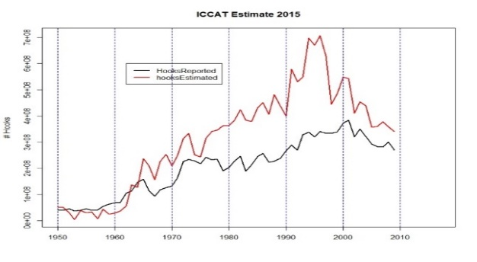
By-catch issues
Main work carried out in 2019
  Data - Revisions and updates of the data used in bycatch analyses:
    Further revision of ST-09 observer forms and ICCAT EFFDIS database
    Seabirds - Collaborative process of assessing the impact of longline fisheries on by-catch of seabirds
      Much done in a 2019 workshop, that is now close to being completed
    Sea-turtles - start a scientific collaboration similar to the process carried out for sea-birds
      A workshop is being planned for 2020 to advance this work.

Slide 66
By-catch issues
Recommendations with financial implications
  Requested financial assistance to support … a collaborative workshop to evaluate the impact of ICCAT fisheries on sea turtles. This is in support of an ongoing process that will continue over the coming years. [request of €10,000]

Slide 67
Thank You

Slide 68
Billfishes Species Group
BILLFISHES
BUM
WHM
SAI
+ 3 spearfishes species without stock assessments

Slide 69
SAI Management recommendations
Considerable uncertainty still remains in the assessments of both the eastern and western stocks…. there are concerns that reported catches, including dead discards, may be incomplete.
For both east and west Atlantic:
  the Committee has not new management recommendations.

Slide 70
BIL Responses to the Commission
19.3 Develop a new data collection initiative as part of the EPBR to overcome the data gap issues of those fisheries, in particular artisanal fisheries of developing CPCs. Rec. 18-04, paragraph 10.
The SCRS shall also develop a new data collection initiative as part of the ICCAT Enhanced Program for Billfish Research (EPBR) to overcome the data gap issues of those fisheries, in particular artisanal fisheries of developing CPCs, and shall recommend the initiative to the Commission for its approval in 2019.
Two studies have been completed on this issue. A first in 2015 on an inventory of strategic investments relative to artisanal fisheries in the West African region (Kebe, 2015), and a second in 2018 with a review of similar programs in the Caribbean and Central America region (Arocha, 2018).
These studies provided the general overview of the magnitude and importance of the artisanal fisheries, indicating that not only ICCAT, but multiple organizations and projects have dedicated substantial efforts and funds to artisanal fisheries in the Atlantic. However, the lack of coordination among organizations, a continued support, training of personal and common policies among countries are hampering these efforts.

Slide 71
BIL Responses to the Commission
The Committee recommends several initiatives to overcome the data gap issues of those fisheries, in particular artisanal fisheries of developing CPCs
Collaboration with the Western Central Atlantic Fishery Commission (WECAFC):
  … collaboration between ICCAT and WECAFC, aiming the submission of fisheries statistics of WECAFC members to the ICCAT Secretariat including artisanal fisheries for billfish species;
  … highlight the importance to continue to strengthen the coordination and collaboration of activities between ICCAT and WECAFC.
Other proposals aiming at improvement in data collection and reporting
  Proposal to hold regional workshops to bring together the CPC statistical correspondents, aiming to improve the statistics of small-scale fisheries;
  Recommend to initiate trial studies with local scientific institutions to develop applications (electronic phone e-forms) and portable databases to easily record fishing effort, catches, catch composition, photo-id of species, for remote port sampling of artisanal fisheries.

Slide 72
By-catch issues
Other recommendations (from the SC-ECO Report)
  Considering Rec. 13-11, the Sub-Committee once again recommends that the Commission take action to reduce sea turtle bycatch.
  Recent experimental and meta-data analyses presented to the Sub-Committee continue to indicate that large circle hooks are an effective measure in reducing sea turtle bycatch and could also increase post-release survival.
  The Sub- Committee acknowledges that while circle hooks are an effective sea turtle mitigation measure, they also have different impacts on both target and by-catch species and, therefore, circle hooks should not be considered a mitigation measure for all bycatch species.
  Taking into consideration the above scientific information, and that most sea turtle by-catch occurs on shallow longline sets, the Sub-Committee recommends the Commission to adopt the use of large circle hooks for shallow longline sets.

